Slide 1
Defending Against Man-in-the-Middle Attacks on AODV Routing
Andrew Fallgren
Aaron Pope
George Rush

Slide 2
What is AODV Routing?
Ad-hoc On Demand Distance Vector Routing (AODV)
This is the routing protocol used in ZigBee, a popular standard for wireless mesh networks.
A mesh network is a topology in which each node relays data for the network.

Slide 3
How does AODV work?
Original sender broadcasts Route Request (RREQ).
B
A

Slide 4
How does AODV work?
Intermediate nodes propagate RREQ.
B
A

Slide 5
How does AODV work?
Destination node sends Request Reply (RREP) back to sender for each RREQ.
B
A

Slide 6
How does AODV work?
Sender uses lowest hop-count route to communicate with destination.
B
A

Slide 7
Attack Model (Initial Conditions)
Of n deployed nodes, one or more are captured by an adversary.

Slide 8
Attack Model (Exploitation)
A captured node agrees to forward traffic on a route from Node A to Node B.
A
B

Slide 9
Attack Model (Exploitation)
The captured node drops all packets rather than forwarding them.
A
B

Slide 10


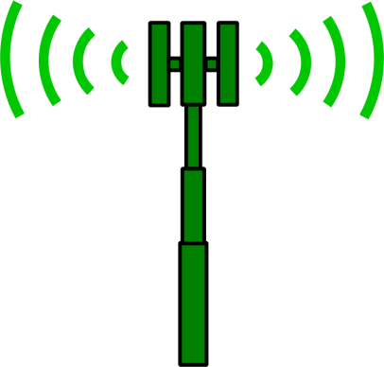

Attack Model (Results)
Data loss
Packets never reach their destination.
Energy loss
Nodes waste energy on radio communication.

Slide 11
Defensive Goals
Primary Objective
Ensure that packets reach their destination if it is possible to do so.
Secondary Objective
Minimize message complexity in order to reduce network transmissions.

Slide 12
Sources
Perkins, Charles E., and Elizabeth M. Royer. "Ad-hoc on-demand distance vector routing." Mobile Computing Systems and Applications, 1999. Proceedings. WMCSA'99. Second IEEE Workshop on. IEEE, 1999.
http://en.wikipedia.org/wiki/ZigBee
http://en.wikipedia.org/wiki/Mesh_networking
Images from openclipart.org

