Slide 1
Defending Against Man-in-the-Middle Attacks on AODV Routing
Andrew Fallgren
Aaron Pope
George Rush

Slide 2
What is AODV Routing?
Ad-hoc On Demand Distance Vector Routing (AODV)
This is the routing protocol used in ZigBee, a popular standard for wireless mesh networks.
A mesh network is a topology in which each node relays data for the network.

Slide 3
How does AODV work?

Slide 4
Attack Model (Initial Conditions)
Of n deployed nodes, one or more are captured by an adversary.

Slide 5
Attack Model (Exploitation)
A captured node agrees to forward traffic on a route from Node A to Node B.
A
B

Slide 6
Attack Model (Exploitation)
The captured node drops all packets rather than forwarding them.
A
B

Slide 7


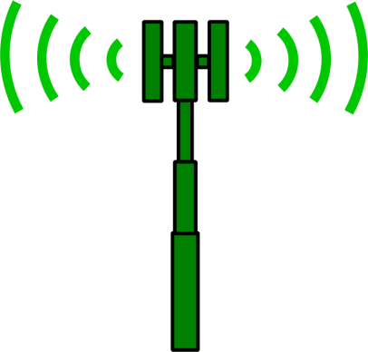

Attack Model (Results)
Data loss
Packets never reach their destination.
Energy loss
Nodes waste energy on radio communication.

Slide 8
Defensive Goals
Primary Objective
Ensure that packets reach their destination if it is possible to do so.
Secondary Objective
Minimize message complexity in order to reduce network transmissions.

Slide 9
Sources
Perkins, Charles E., and Elizabeth M. Royer. "Ad-hoc on-demand distance vector routing." Mobile Computing Systems and Applications, 1999. Proceedings. WMCSA'99. Second IEEE Workshop on. IEEE, 1999.
http://en.wikipedia.org/wiki/ZigBee
http://en.wikipedia.org/wiki/Mesh_networking
Images from openclipart.org

