Slide 1
Defending Against Man-in-the-Middle Attacks on AODV Routing
Andrew Fallgren
Aaron Pope
George Rush

Slide 2
What is AODV Routing?
Ad-hoc On Demand Distance Vector Routing (AODV)
This is the routing protocol used in ZigBee, a popular standard for wireless mesh networks.
A mesh network is a topology in which each node relays data for the network.

Slide 3
How does AODV work?
Original sender broadcasts Route Request (RREQ).
B
A

Slide 4
How does AODV work?
Intermediate nodes propagate RREQ.
B
A

Slide 5
How does AODV work?
Destination node sends Request Reply (RREP) back to sender for each RREQ.
B
A

Slide 6
How does AODV work?
Sender uses lowest hop-count route to communicate with destination.
B
A

Slide 7
Attack Model (Initial Conditions)
Of n deployed nodes, one or more are captured by an adversary.

Slide 8
Attack Model (Getting Selected)
A captured node spoofs the RREP in order to get selected as the shortest path.
I am Zero Hops from B
A
B

Slide 9
Attack Model (Getting Selected)
A pair of captured nodes create a fake tunnel to make it likely that they are selected as the shortest path.
Fake Connection
A
B

Slide 10
Attack Model (Exploitation)
The captured node drops all packets rather than forwarding them.
A
B

Slide 11


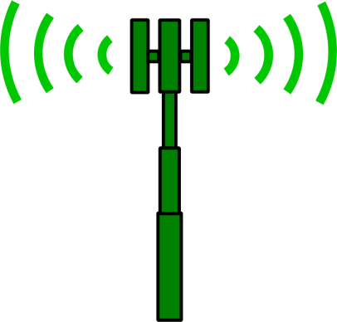

Attack Model (Results)
Data loss
Packets never reach their destination.
Energy loss
Nodes waste energy on radio communication.

Slide 12
Defensive Goals
Primary Objective
Ensure that packets reach their destination if it is possible to do so.
Secondary Objective
Minimize message complexity in order to reduce network transmissions.

Slide 13
Sources
Perkins, Charles E., and Elizabeth M. Royer. "Ad-hoc on-demand distance vector routing." Mobile Computing Systems and Applications, 1999. Proceedings. WMCSA'99. Second IEEE Workshop on. IEEE, 1999.
Tseng, Chin-Yang, et al. "A specification-based intrusion detection system for AODV." Proceedings of the 1st ACM workshop on Security of ad hoc and sensor networks. ACM, 2003.
http://en.wikipedia.org/wiki/ZigBee
http://en.wikipedia.org/wiki/Mesh_networking
Images from openclipart.org

