Slide 1

Angular Forms & Guards
Part2: Reactive Forms

Slide 2
Guards
A type of service used by the router to handle different navigation scenarios
Implements interfaces depending on what navigation scenario its guarding
3 possible outcomes from a guard:
If it returns true, the navigation process continues.
If it returns false, the navigation process stops and the user stays put.
If it returns a UrlTree, the current navigation cancels and a new navigation is initiated to the UrlTree returned.
During the guard check you can also trigger another navigation witch will begin after the current one is over

Slide 3
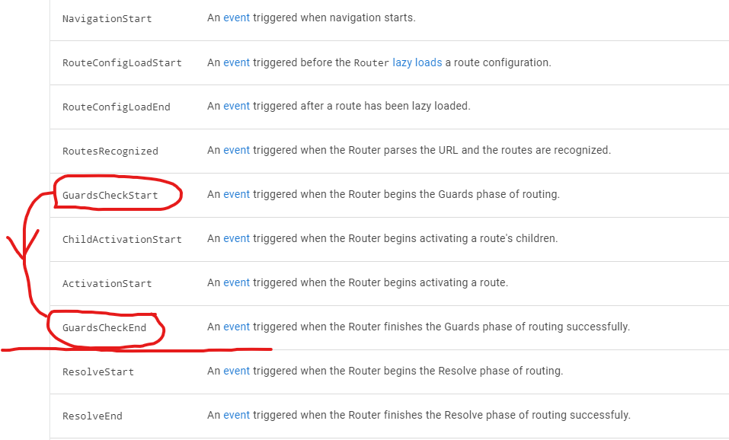

Slide 4
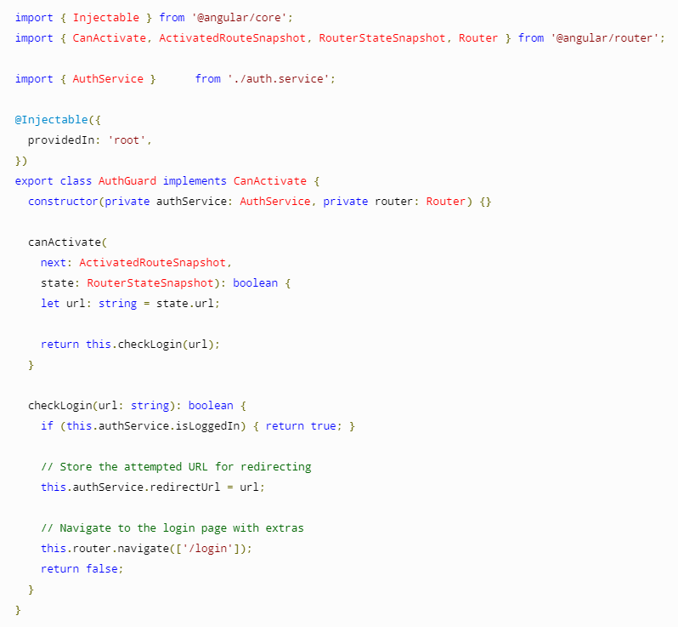
Can Activate
When we want to check something in regards to the destination of the navigation
Ex: is the user authorized to view that route?

Slide 5
Can Deactivate
When we want to check something in regards to the source of the navigation ( the point of departure )
Ex: When leaving a form, maybe we want to save the changes we did before we lose them
A little trickier to implement, we need some information from our component. Maybe even a input from our user.
We need to inject our component into the guard

Slide 6
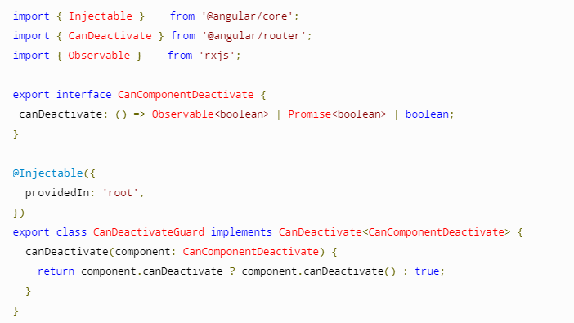
Abstract Implementation
We make an interface to expose the specific behavior for CanDeactivate from each component.
We have no knowledge of the internals of the component.
High Reusability

Slide 7
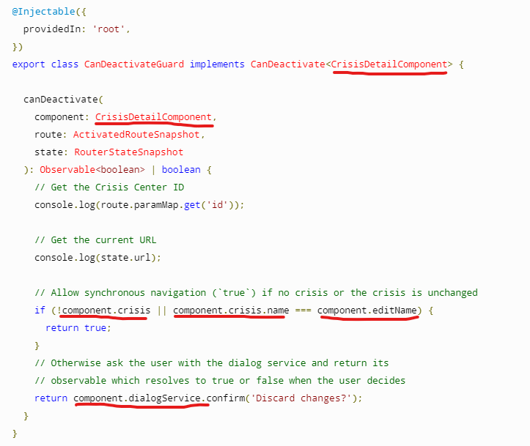
Specific Implementation
No need for a implementation
We have all the information available regarding our component
This guard can be used only by routes which use this component.
Low Reusability

Slide 8
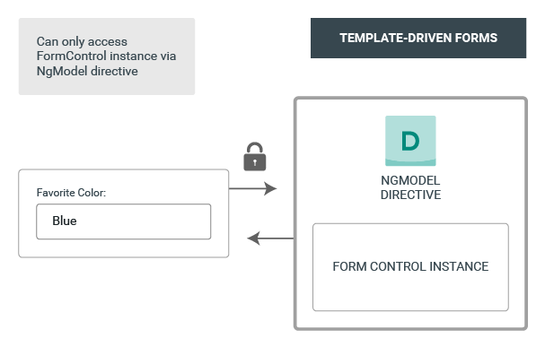
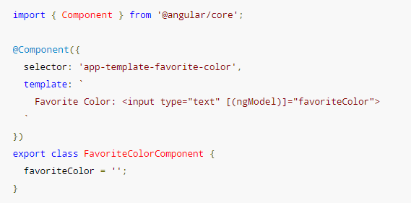
Template Driven

Slide 9
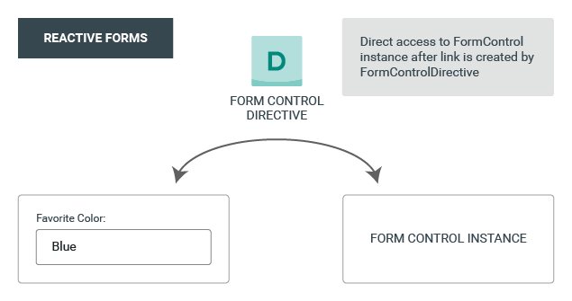
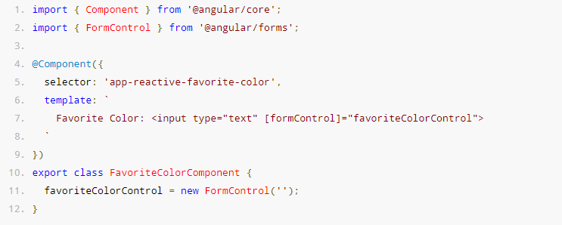
Reactive Forms

Slide 10
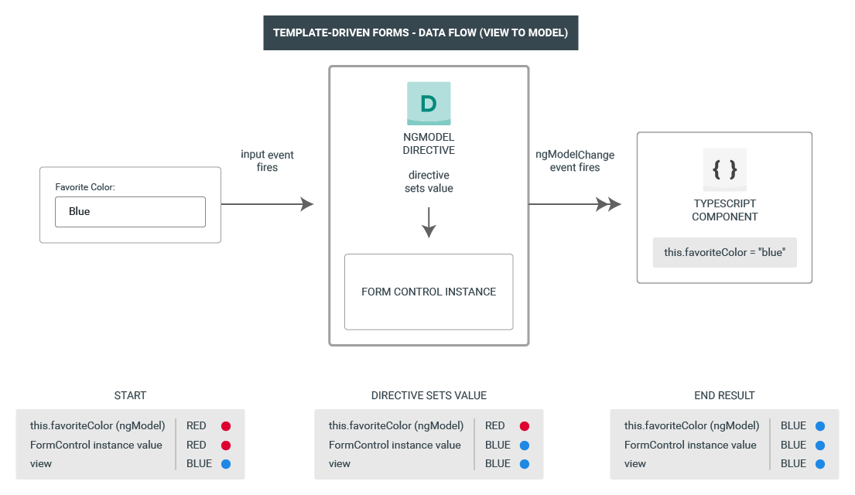

Slide 11
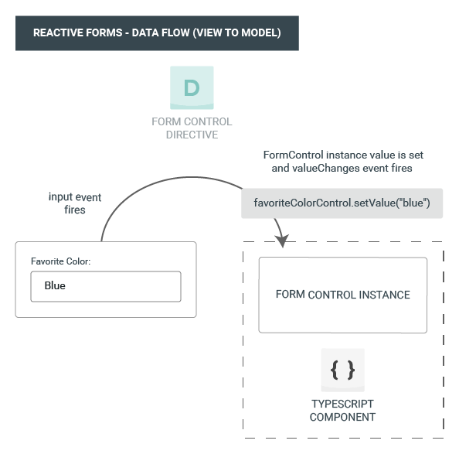

Slide 12
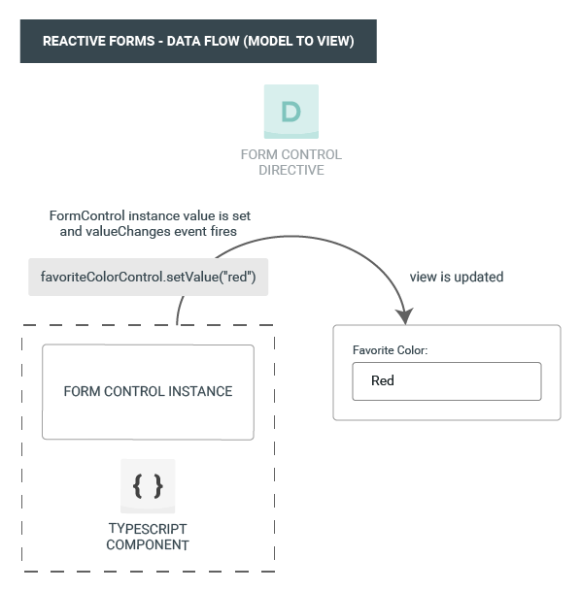

Slide 13
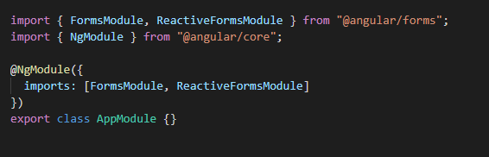
Where do I start?
Import the module

Slide 14
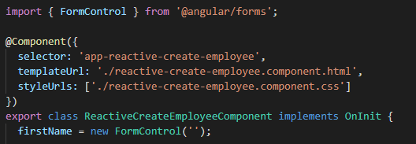
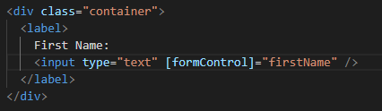
FormControl – basic building block
Apply to component
Apply to template

Slide 15

MASTERPIECE
We are done!!
Let's go home

Slide 16
FormControl – basic building block
Apply to component
Apply to template
Observations:
No Form Tags
Object one way binding
No model object

Slide 17
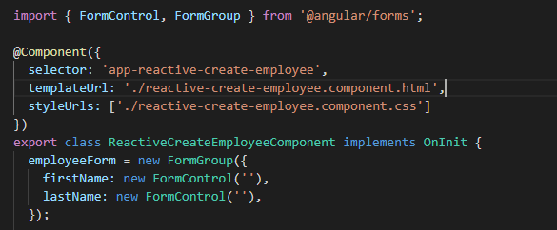
More than 1 input in a form?
FormGroup – Collecting FormControls and FormGroups
Apply to component

Slide 18
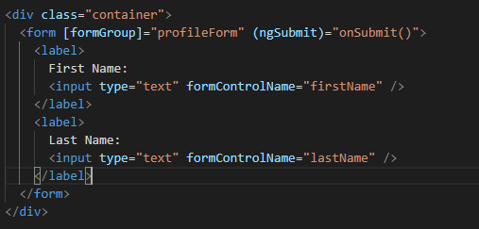

Apply to template:
Results are fabulous:
CSS anyone? :(

Slide 19
OBSERVATIONS:
Form is required
Binding only on form
No more binding on input
Using formControlName (Directive)

Slide 20
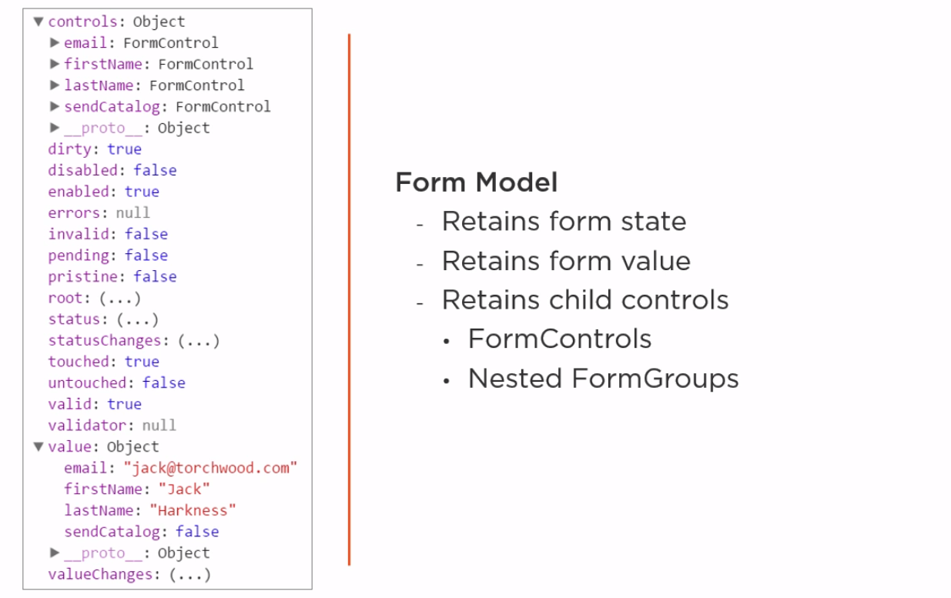
Under the hood...

Slide 21
Wait a sec! How do I control all of this???
Get data
.value
.valueChanges()
Set data
setValue() - imutable
patchValue() - partial imutable //not recommended
Internal structure
get()

Slide 22
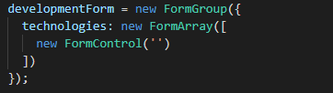
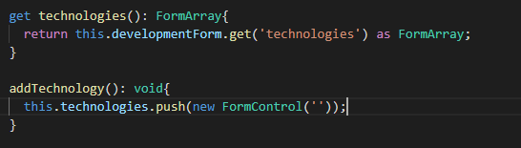
What about repeating sections?
FormArray – store formControls / FormGroups as an array
We need extra functions to help us:

Slide 23
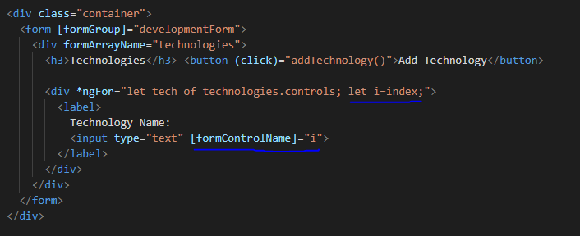
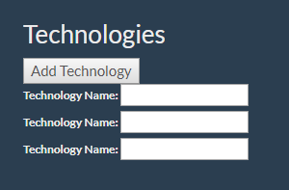
Binding to template is getting trickier:
Actual result:

Slide 24
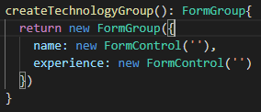
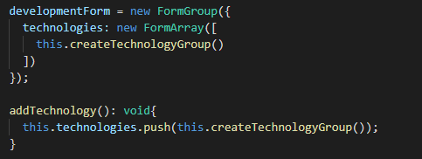
FormArray and FormGroup?
We need another function:
Update the form and existing functions:

Slide 25
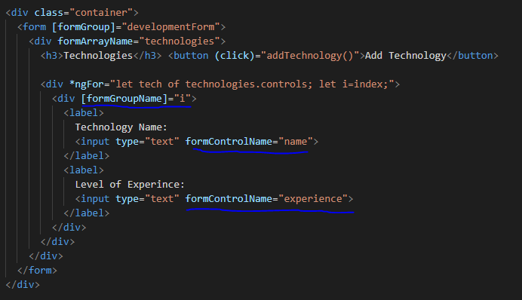
And the template

Slide 26
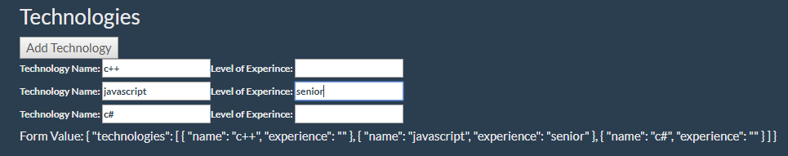
End Result

Slide 27

Too verbose?
FormBuilder – Service providing convenient methods for generating controls
Inject in constructor
FormControl -> control()
FormGroup -> group()
FormArray -> array()

Slide 28
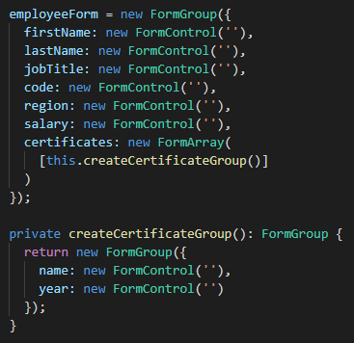
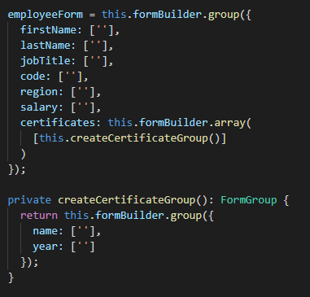
Transition
Before
After

Slide 29
Validation – first glance
Validators – set of validator functions:
Validators.required
Validators.min / Validators.max //for numbers
Validators.minLength / Validators.maxLength //for strings
Validators.pattern
Etc.

Slide 30

How to use?

Slide 31
