Slide 1
Angular Forms
(Part1: Template Driven)

Slide 2
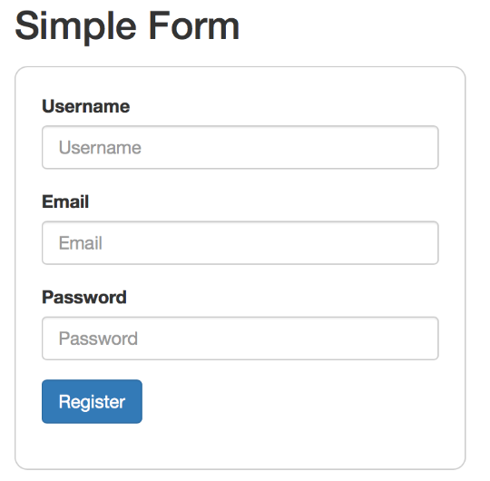
What is a Form ?
It is a template through which the user can send (write, update) data to the server

Slide 3
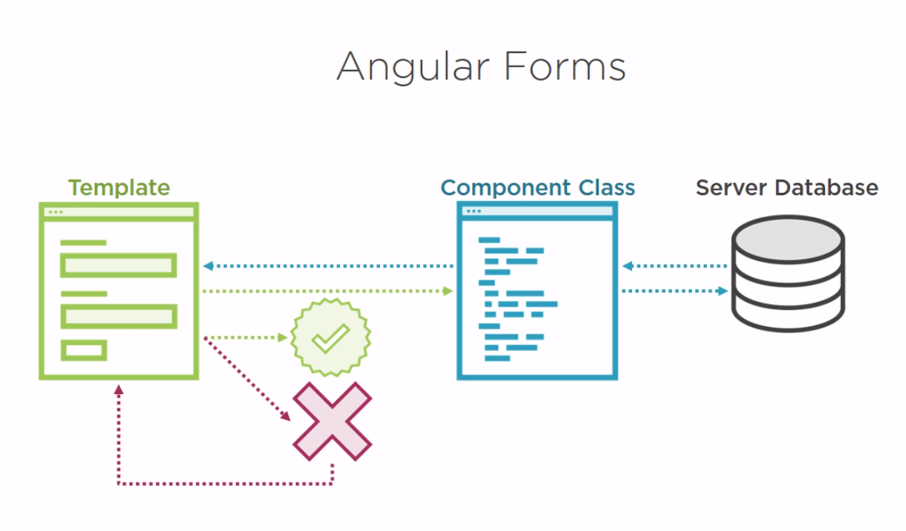

Slide 4
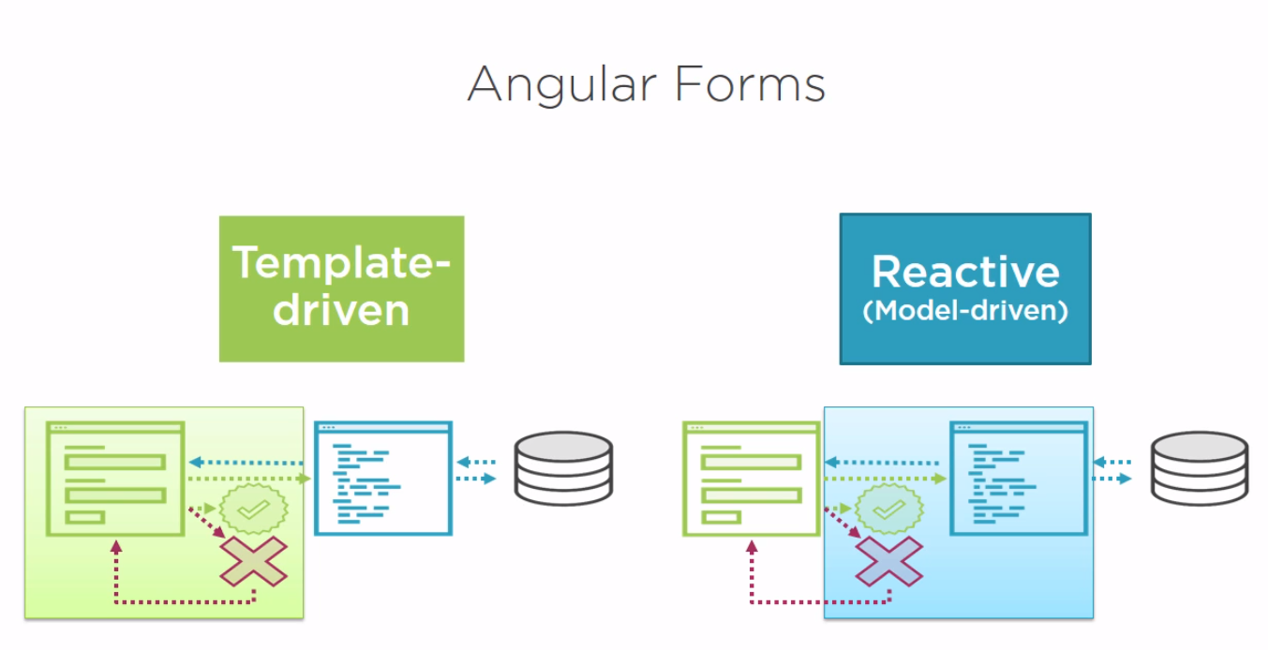

Slide 5
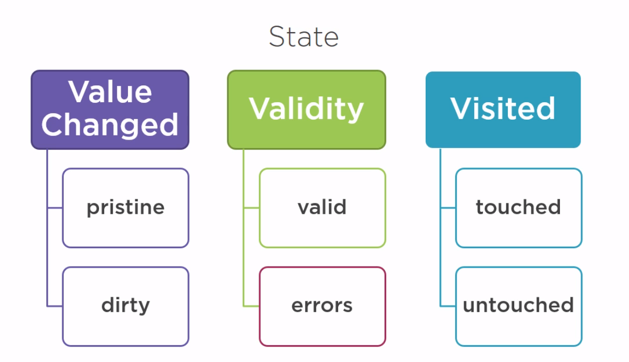

Slide 6
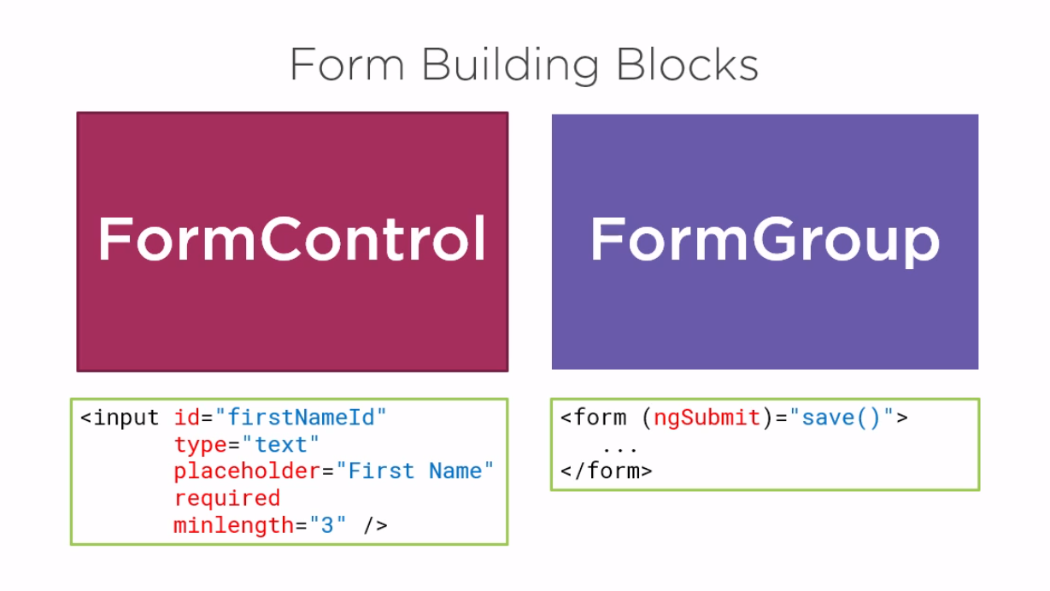

Slide 7
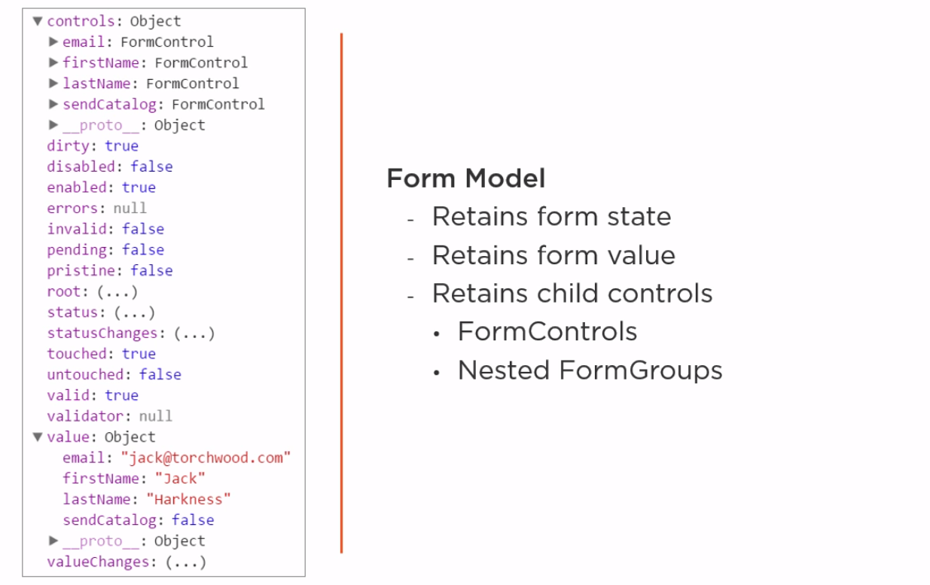
What define the build blocks(FormControl, FormGroup) ?

Slide 8
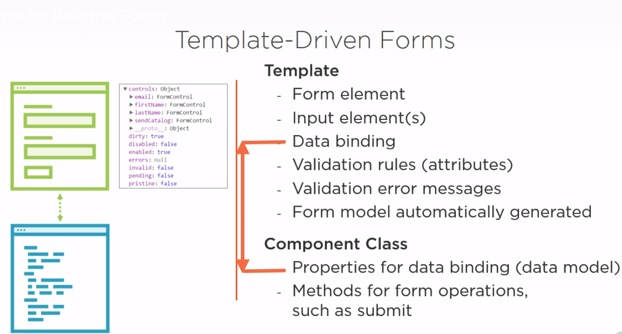

Slide 9
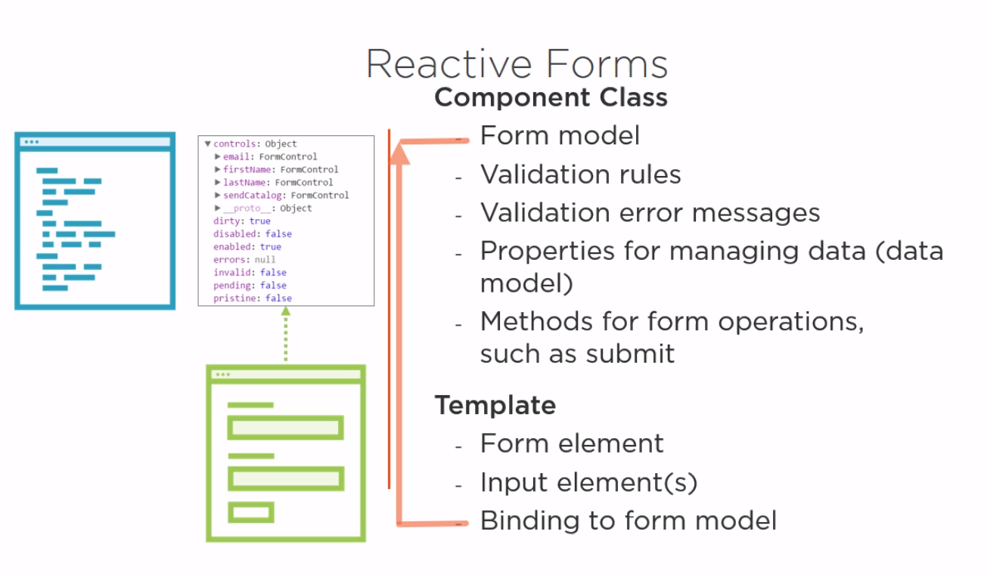

Slide 10
Who bind the FormControl and FormGroup to the form and its input elements ?

Slide 11
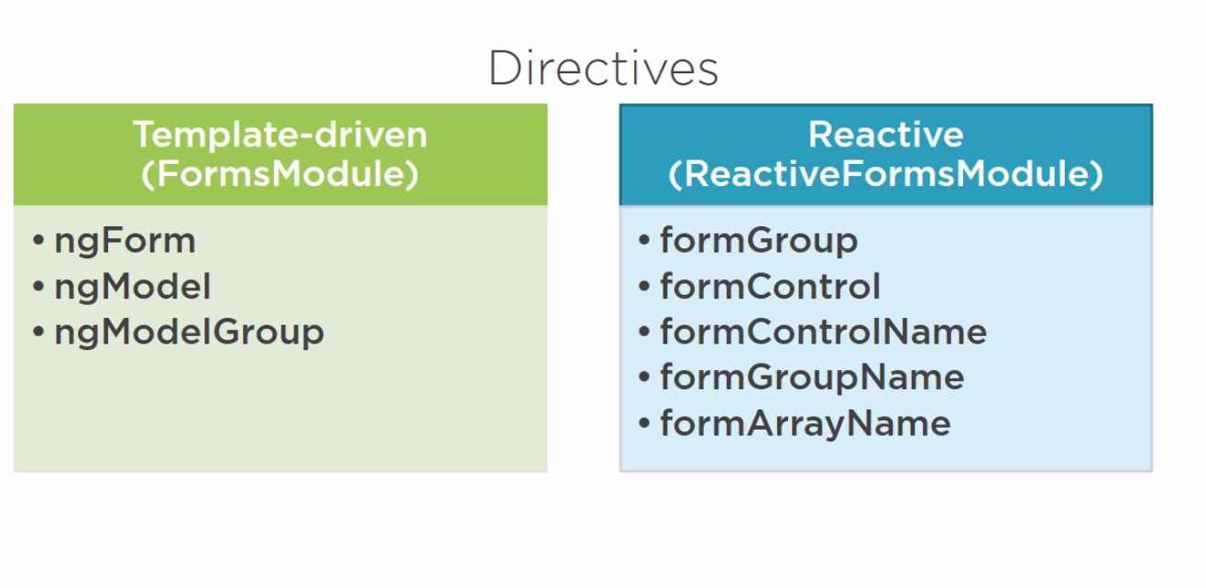

Slide 12
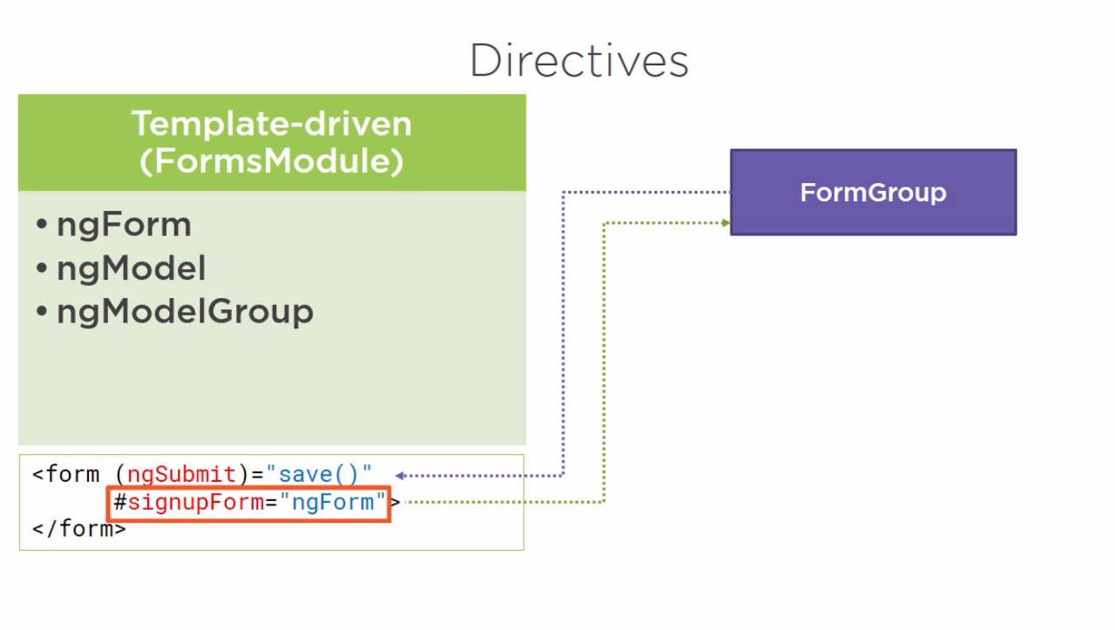

Slide 13
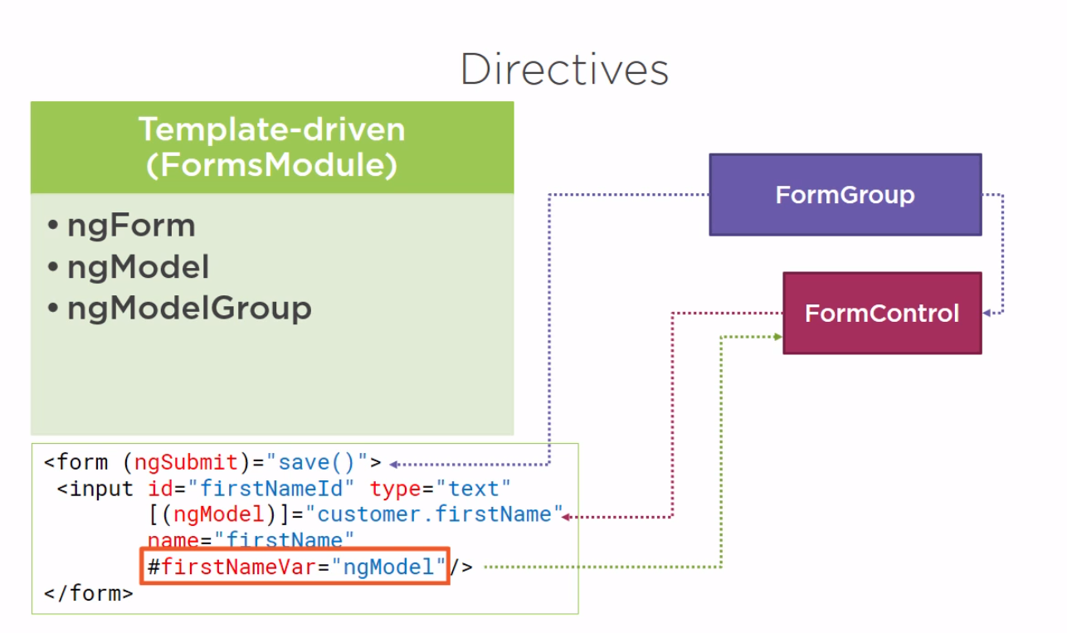

Slide 14
