Slide 1

Pipes, Directives, Resolvers, Interceptors
Curs 8

Slide 2
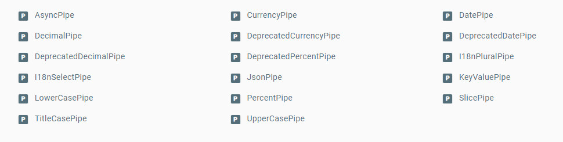
Pipes
Interpolation with a bit of style
Angular predefined pipes

Slide 3
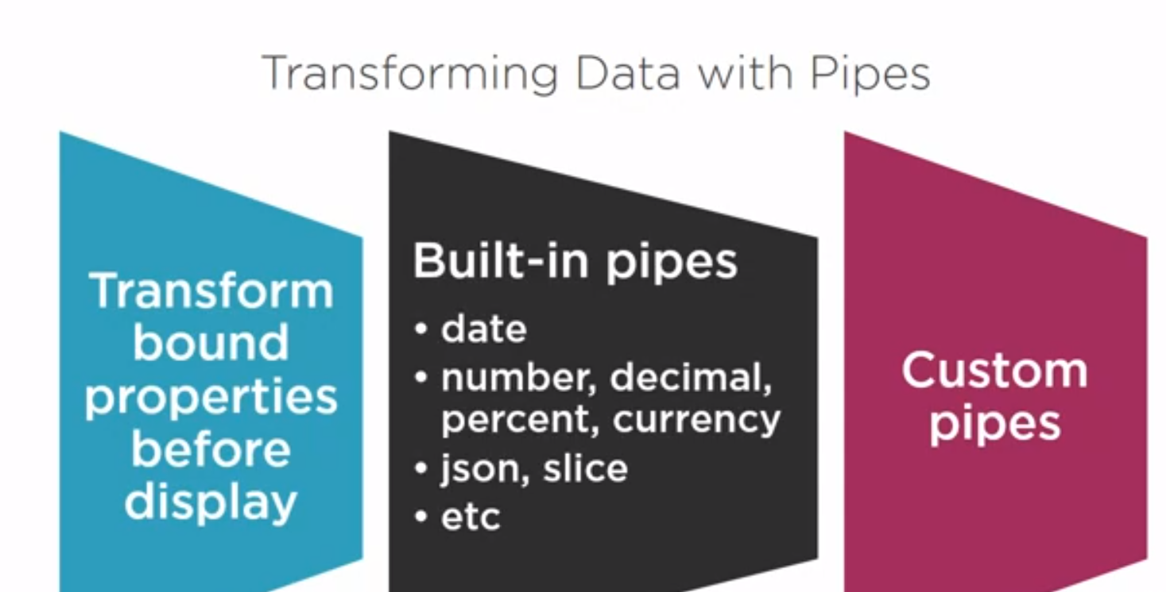

Slide 4
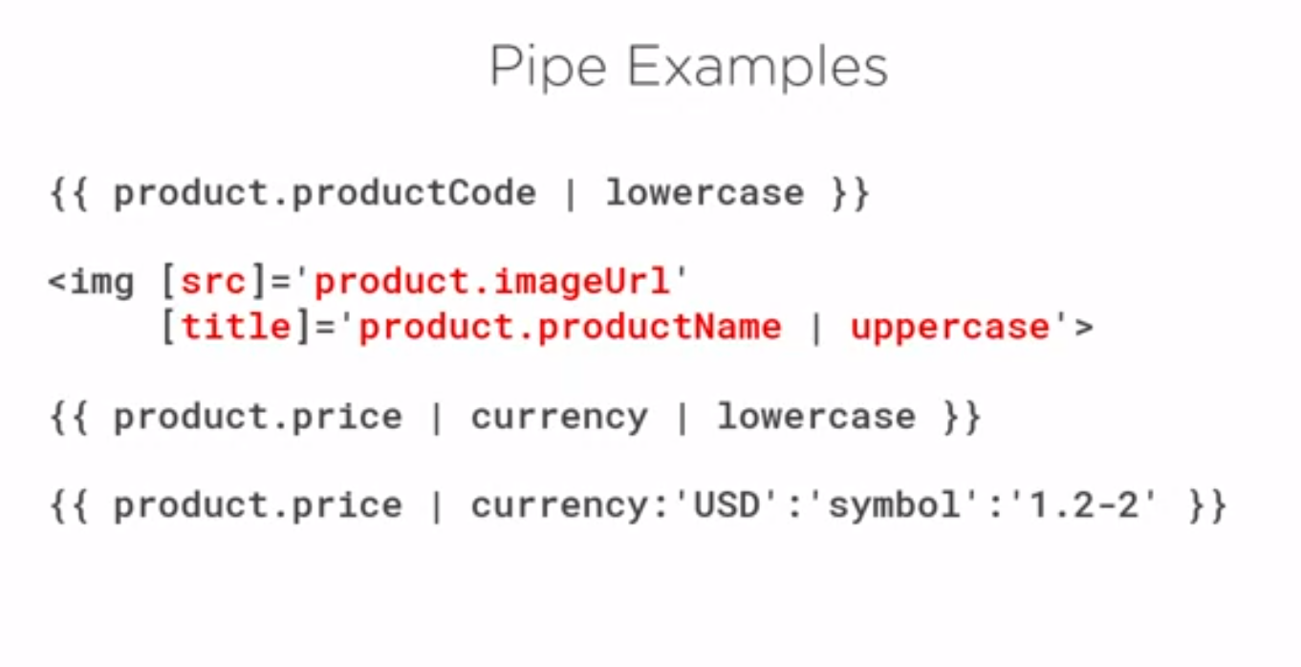

Slide 5
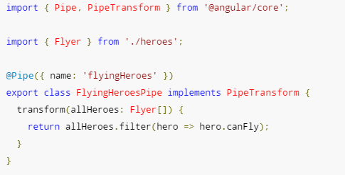
Pipe()
Implement PipeTransform

Slide 6
Attribute Directives
3 types of directives ( Components, Structural Directives, Attribute Directives )
Component without a template ( or css ).
Add custom logic to template ( maybe even validation rules? )
Directive() with its own provide.
The usuals: Inputs, Outputs, HostListener ( wait, what? )

Slide 7
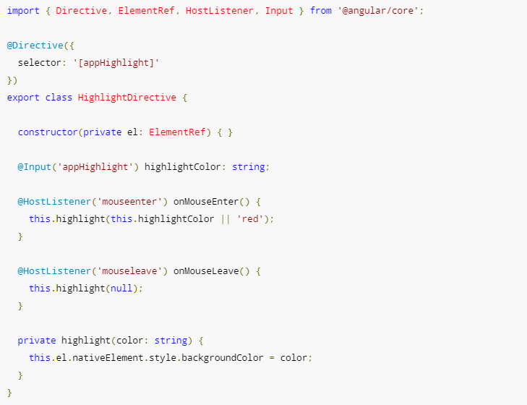

Slide 8
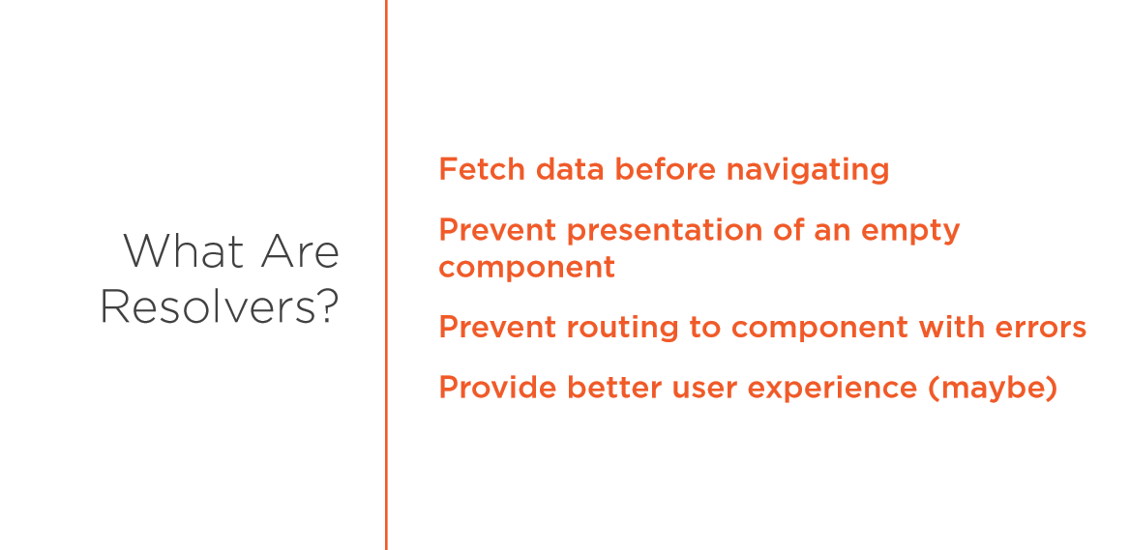

Slide 9
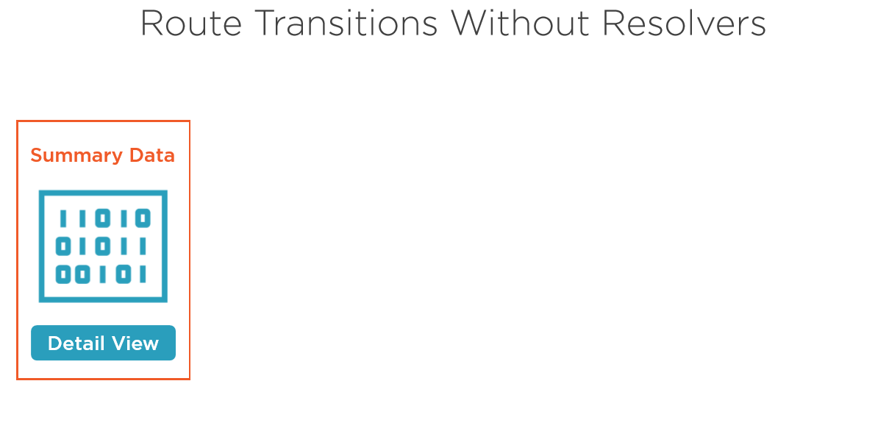

Slide 10
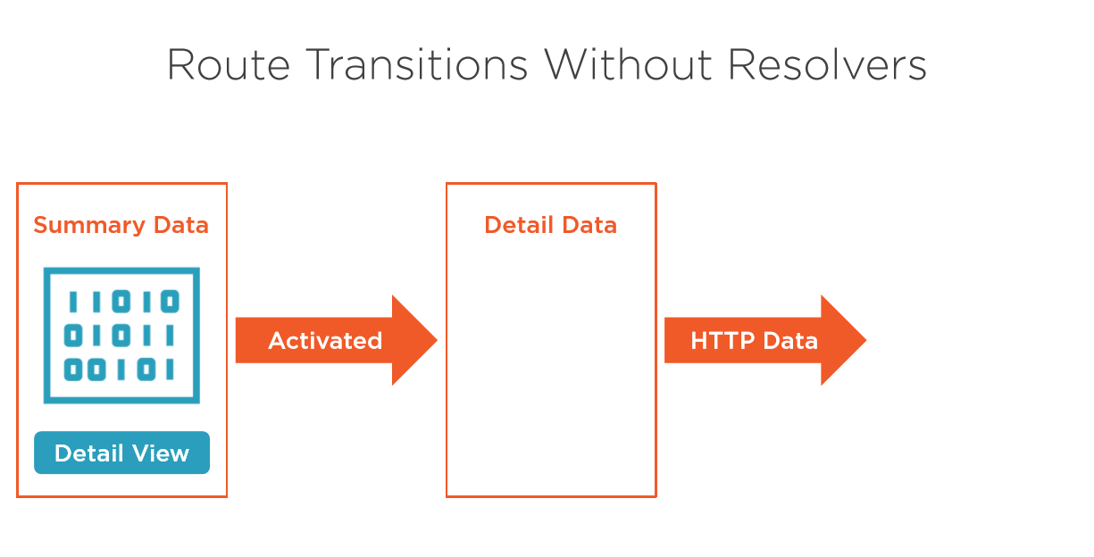

Slide 11
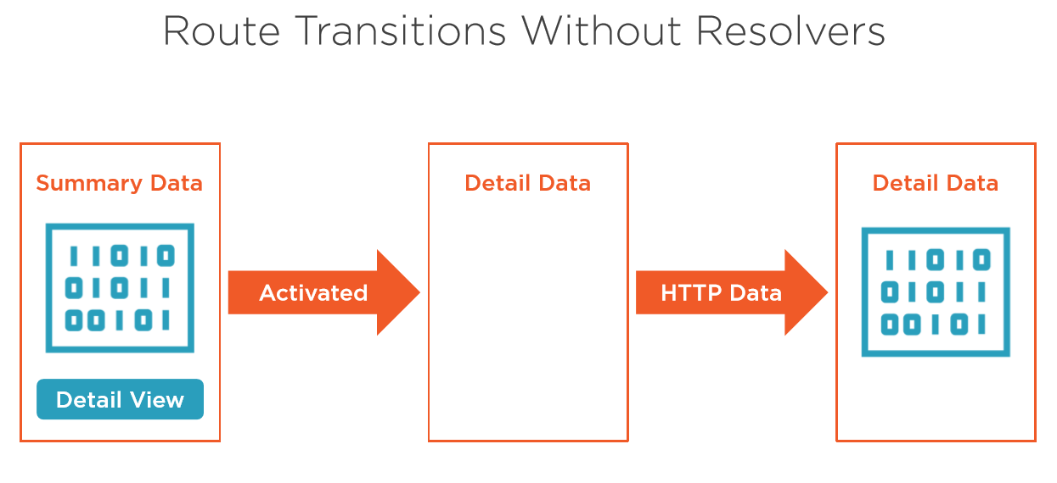

Slide 12
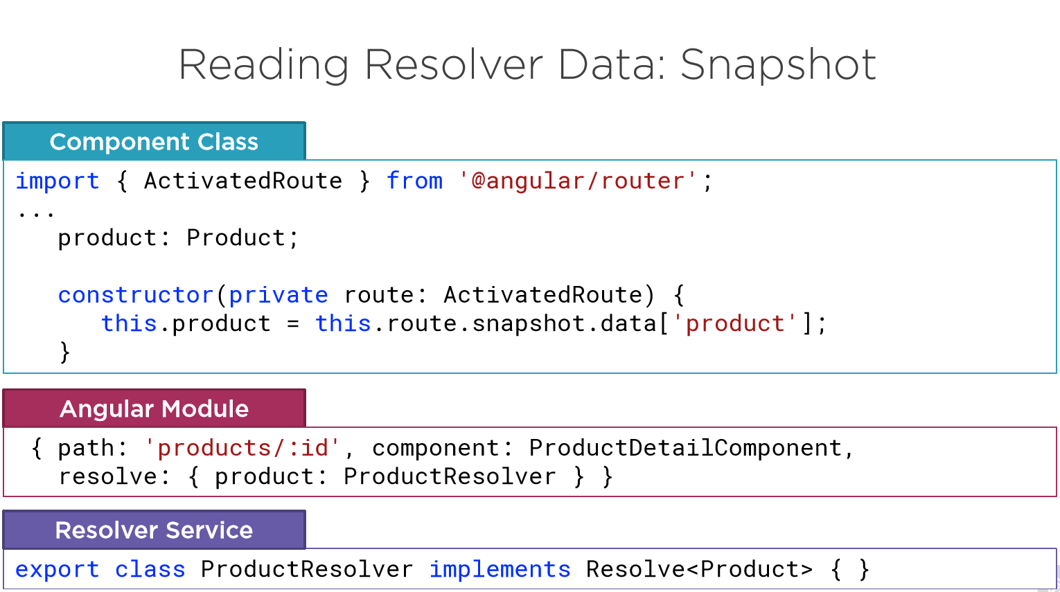

Slide 13
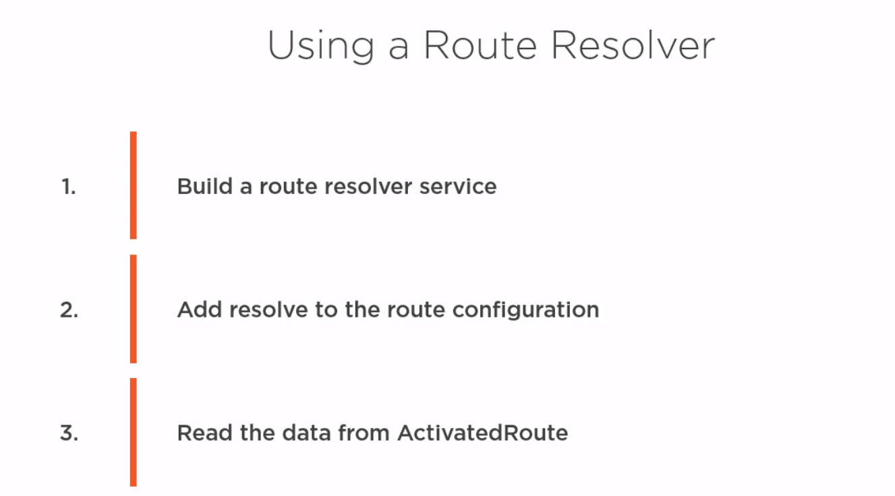
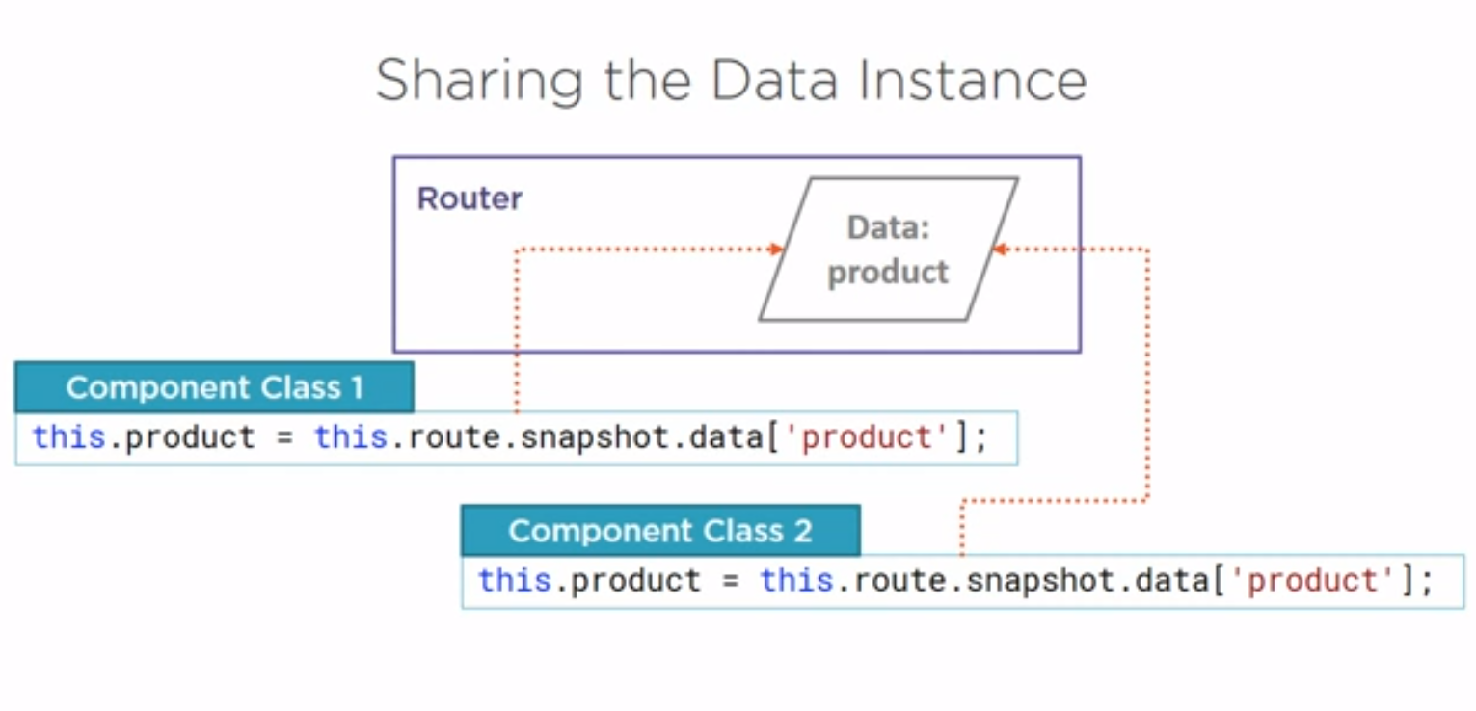
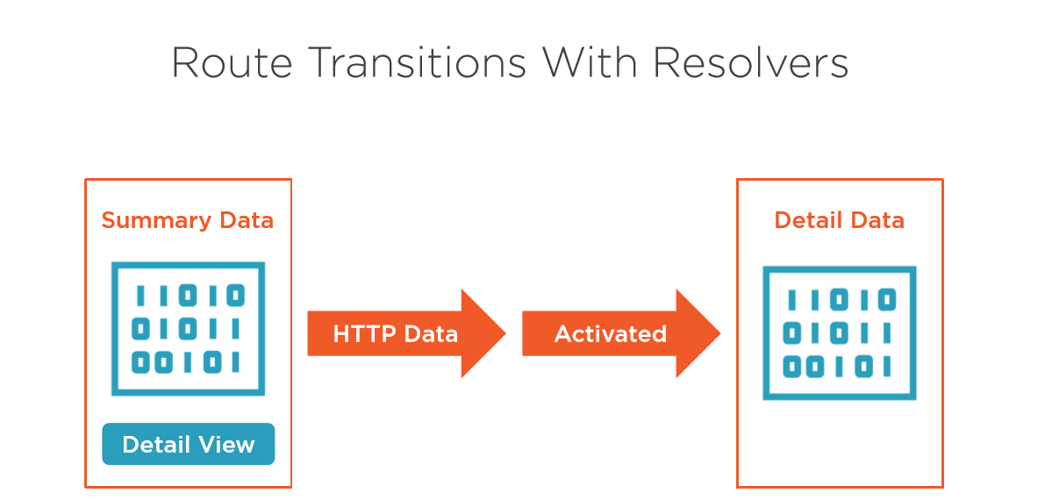

Slide 14
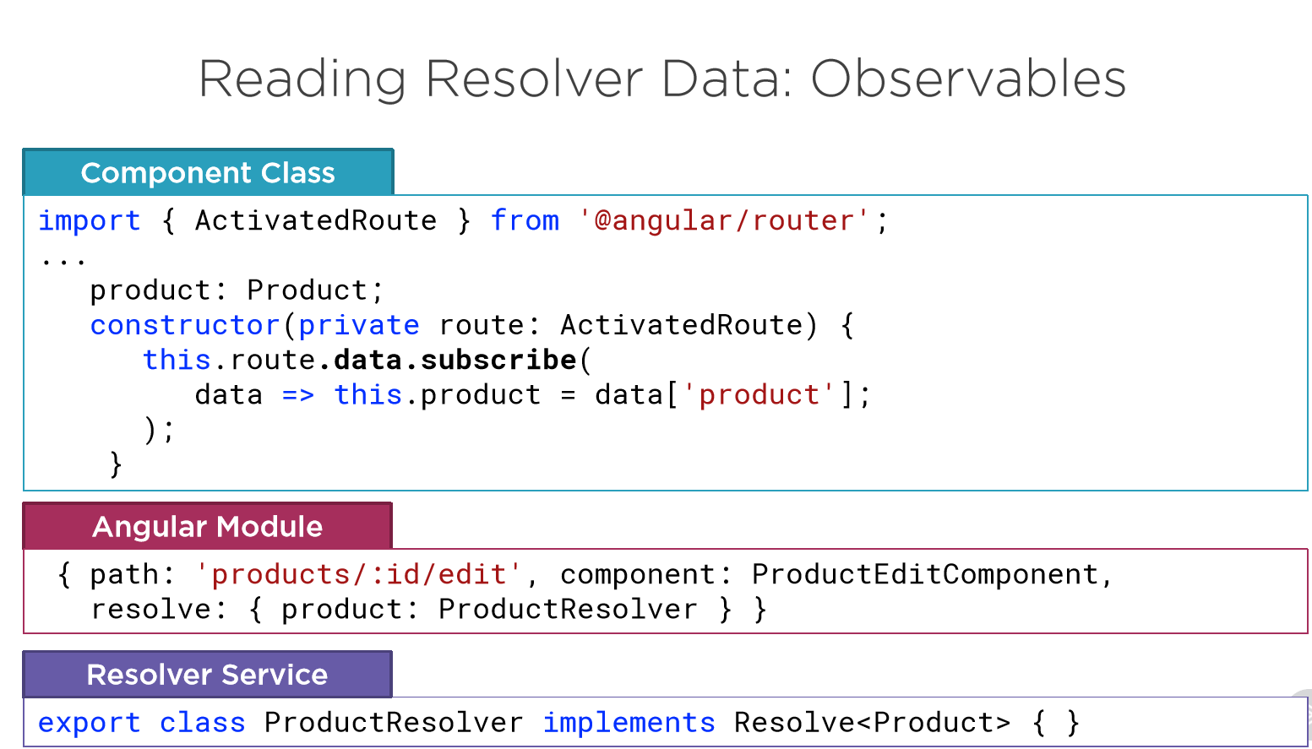

Slide 15
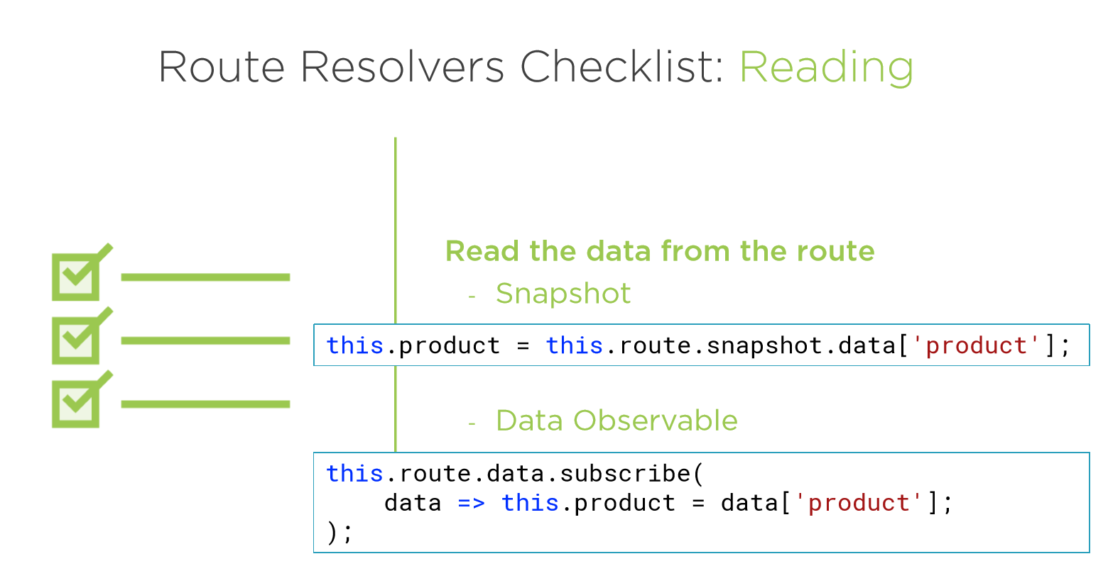
.. if the route never changes while on the page
..if the route could change while on the page (ex: edit/add page)

Slide 16
Interceptor
Angular SRI, he sees everything you send and receive
He can change requests and responses
Applied to all HttpModule calls
It's just a service, but only the HttpClient is using it
Has to implement HttpInterceptor
A more special provider

Slide 17
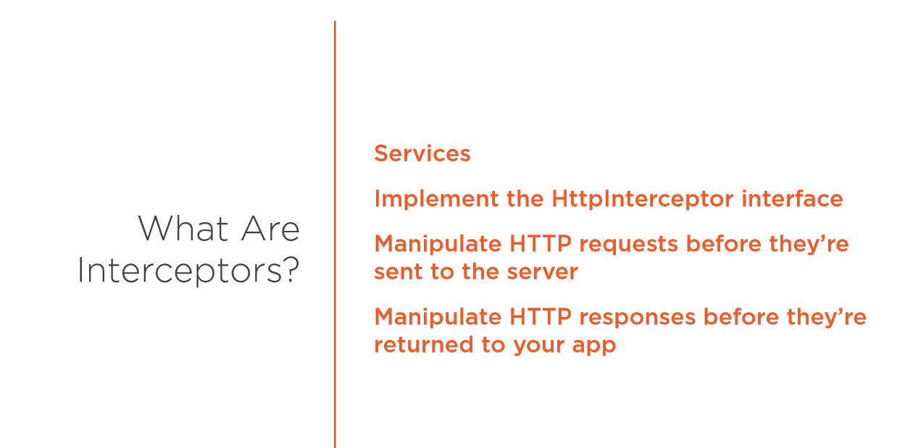

Slide 18
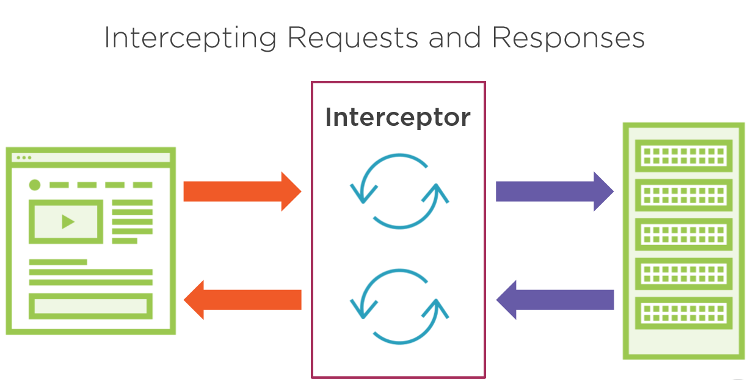

Slide 19
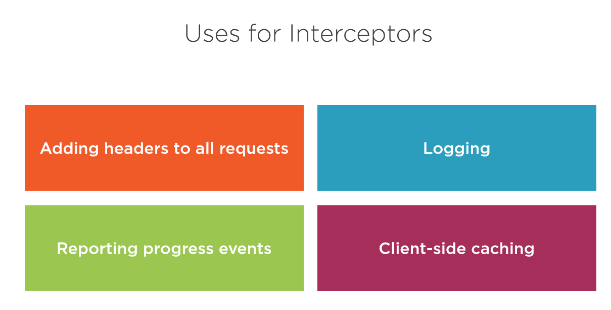

Slide 20
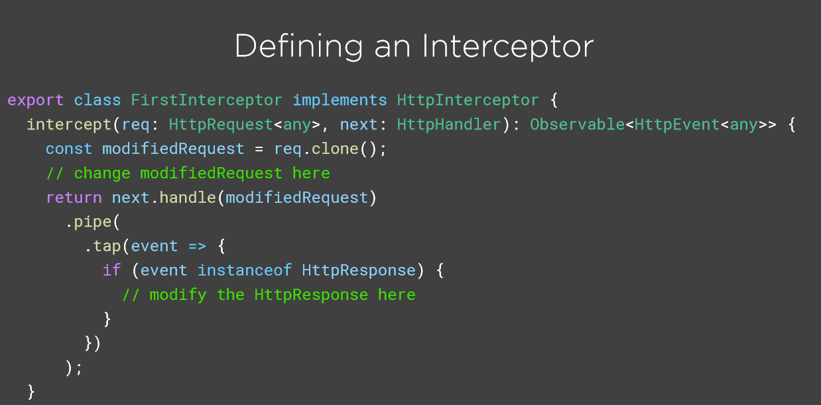

Slide 21
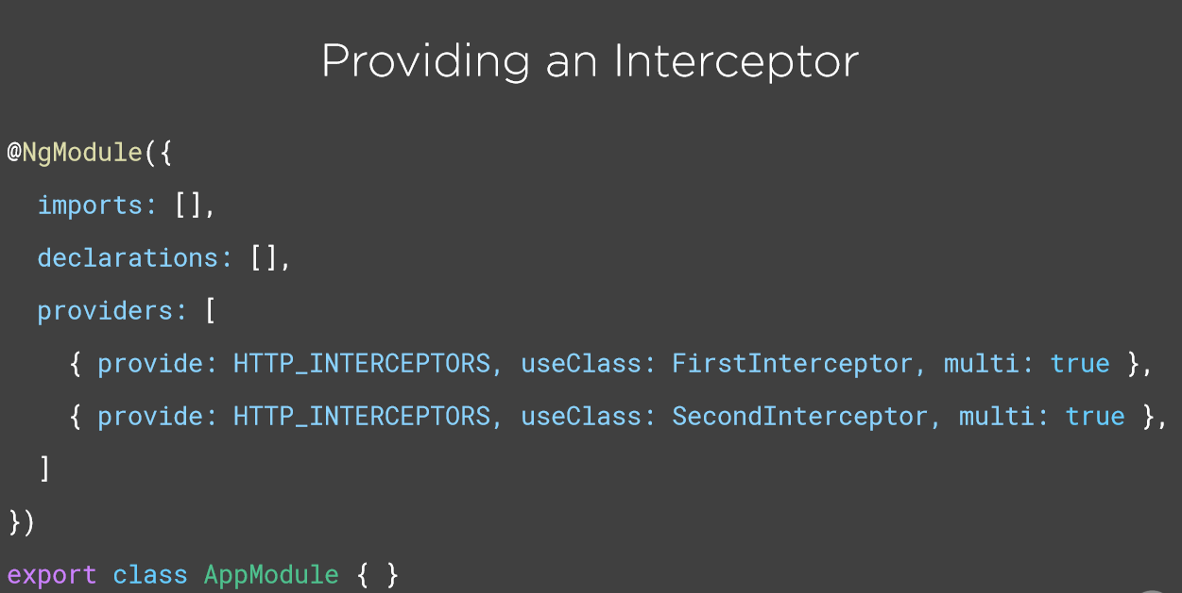

Slide 22
