Slide 1
Angular Modules
Curs 11

Slide 2
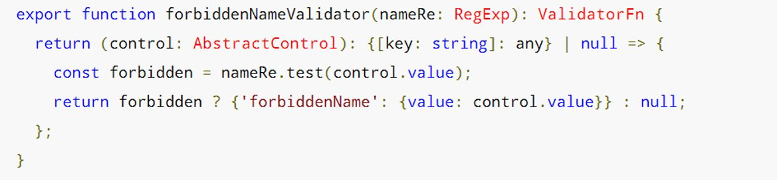
Custom Sync Validators
Clean function which returns another function

Slide 3
Custom Async Validators
Not a clean function anymore
Now we need a service.
Implement AsyncValidator
Careful with performance!!! UpdateOn : [change, submit, blur]
Executed after sync validators passed
Pending status, validation in progress

Slide 4
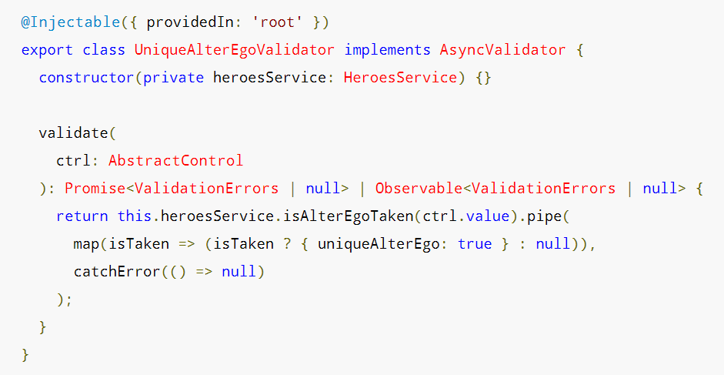

Slide 5
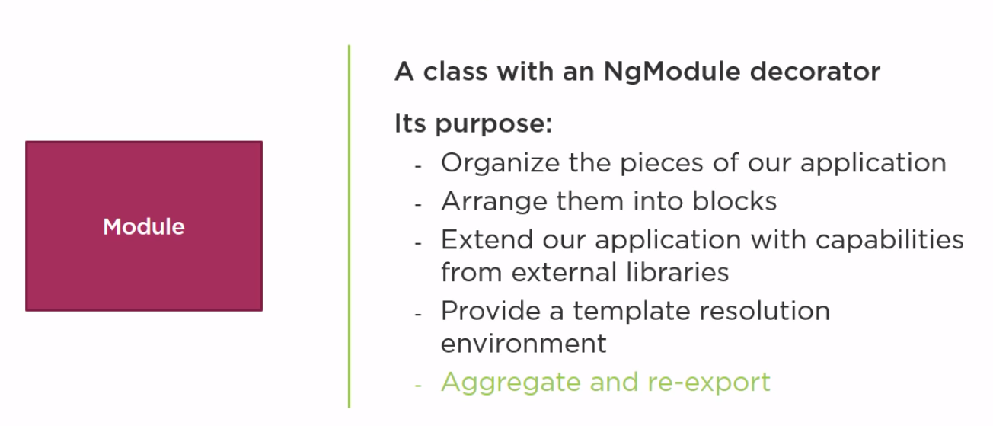
What is an Angular Module?

Slide 6
Angular Module
@angular module
Module
@angular module
Module
Imports
Module
Exports
Route module
3rd party module
Component,
Directive,
Pipe
3rd party module
Declares
Bootstraps
Service
Component,
Directive,
Pipe

Slide 7

AppComponent
CustomPipe
RouterModule
…
<tr *ngFor = ‘let employee of enmployees ‘>
<td>
<img *ngIf=’showImage’>
</td>
</tr>
...
…
<li> <a [routerLink]=”[‘/welcome]”>
Home </a> </li>
<li> <a [routerLink]=”[‘/employees]”>
Employee List</a> </li>
…
<router-outlet></router-outlet>
…
<input type = ‘text’
[(ngModel)] = ‘listFilter’ />
EmployeeList Component
CustomDirective
FormsModule
EmployeeDetail Component
OtherComponent
BrowserModule
Welcome Component

Slide 8
Template Resolution Environment
Module
Star Component
Forms Module
Module
EmployeeList Component
Star Component

Slide 9
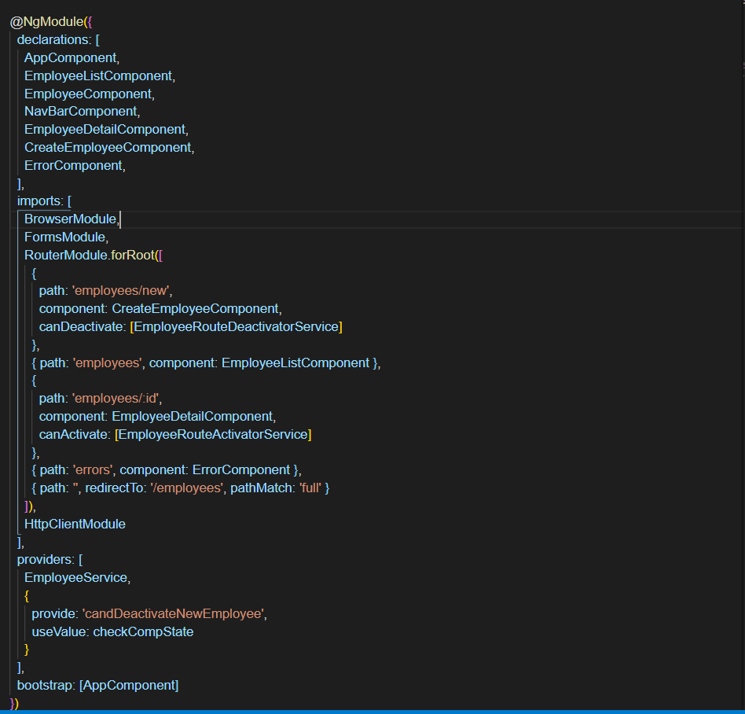

Slide 10
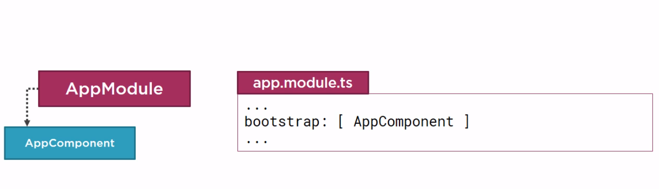
Bootstrap Array
………… Bootstrap

Slide 11
Bootstrap Array Truth
# 1 Every application must bootstrap at least one component, the root application component (AppComponent)
# 2 The bootstrap array should only be used in the root application module, AppModule

Slide 12
Declarations Array Truth
# 1 Every component, directive and pipe we create, must belong to one and only one Angular module
# 2 Only declare components, directives and pipes
# 3 Never re-declare components, directives, or pipes that belong to another module
# 4 All declared components, directives or pipes are private by default

Slide 13
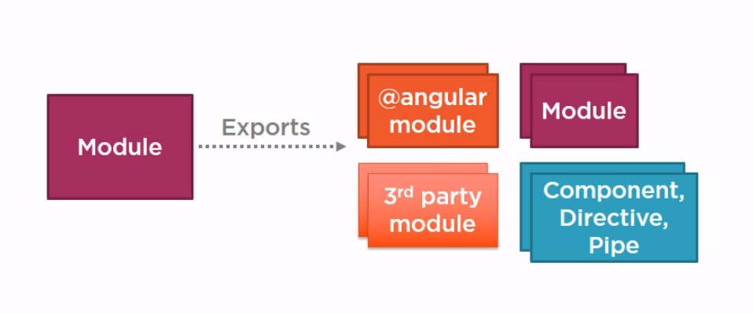
Exports Array

Slide 14
Exports Array Truth
# 1 Exports any component, directive or pipe if other components needed
# 2 Re-export modules to re-export their components, ...
# 3 We can re-export something without importing it first
# 4 Never export a service

Slide 15
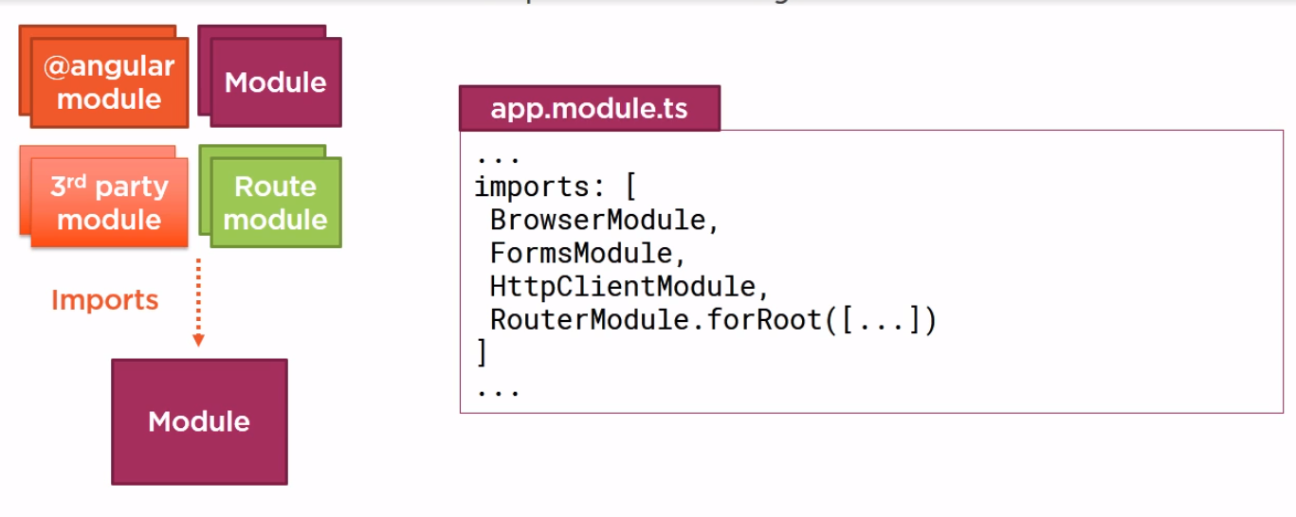
Imports Array

Slide 16
Imports Array Truth
# 1 Importing a module makes available any exported components, directives and pipes from that module
# 2 Only import what this module needs
# 3 Importing a module does NOT provide access to its imported modules

Slide 17
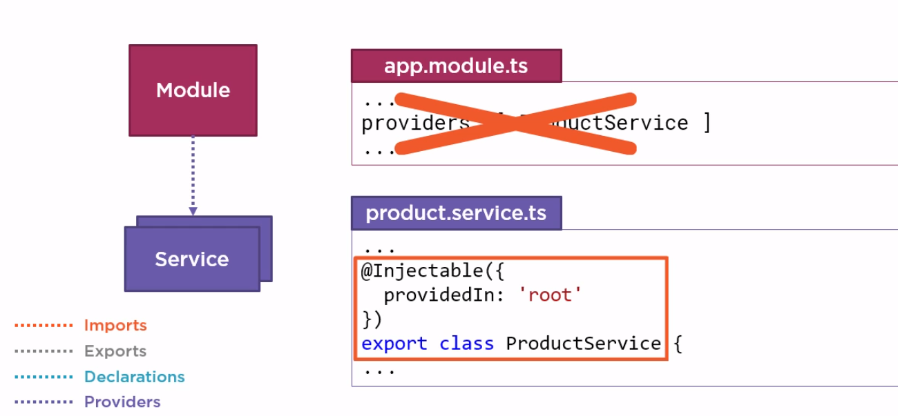
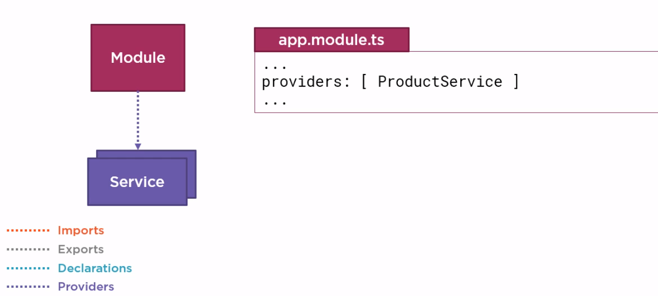
Providers Array

Slide 18
Providers Array Truth
# 1 Any service provider added to the providers array is registered at the root of the application
If you want to be sure that a particular service is encapsulated and only accessible within a specific component or set of components, add the service to the providers array of an appropriate component instead of an Angular module !

Slide 19
Providers Array Truth
# 2 Don’t add services to the providers array of a shared module
Consider building a CoreModule for services and importing it once in the AppModule

Slide 20
Feature Modules
CommonModule
BrowserModule
FormsModule
FormsModule
HttpClientModule
RouterModule
RouterModule
AppModule
AppModule
ProductModule
AppComponent
NavComponent
AppComponent
EmployeeList Component
Welcome Component
EmployeeList Component
EmployeeDetail Component
EmployeeDetail Component
…… Imports
…… Exports
…… Declarations
…… Providers
…… Bootstrap
UserComponent
UserComponent
...Component
...Component

Slide 21
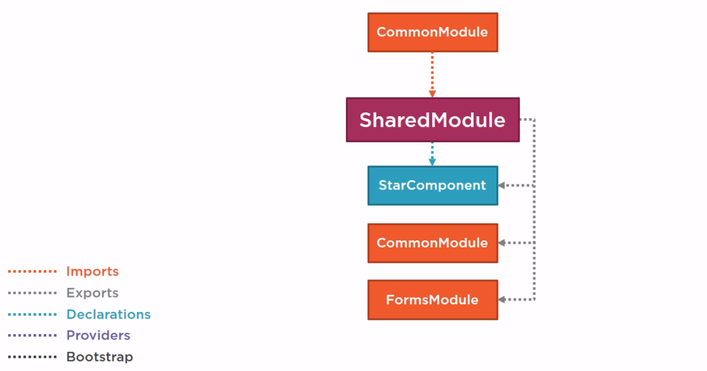
Defining a Shared Module
Employees Module

Slide 22

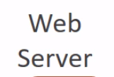
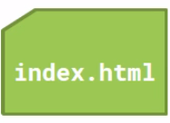
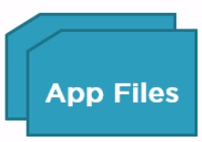

Lazy Loading
URL Request (www.mysite.com)
Response

Slide 23
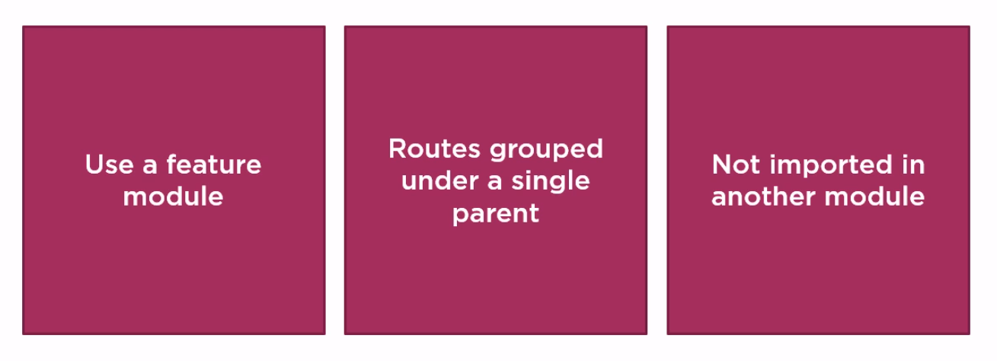
Preparing for Lazy Loading

Slide 24
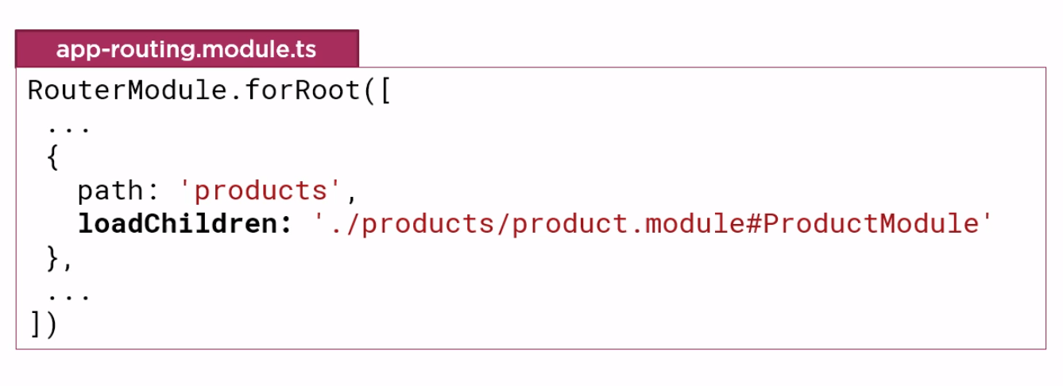
Lazy Loading

Slide 25
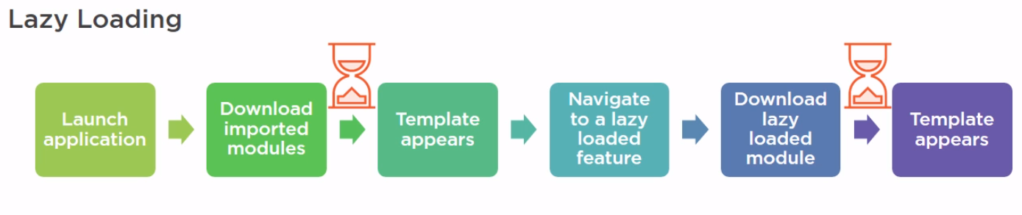
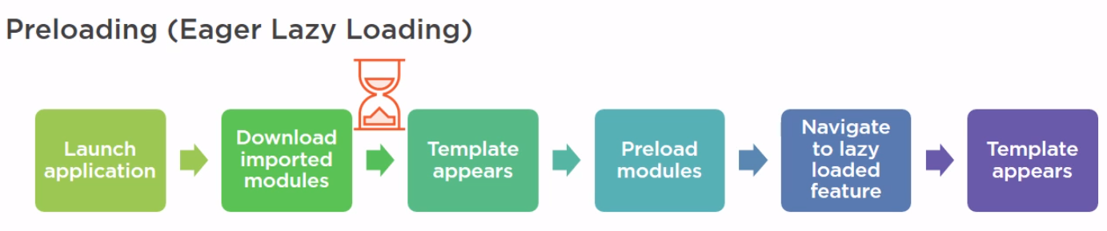
Preloading Feature Modules

Slide 26
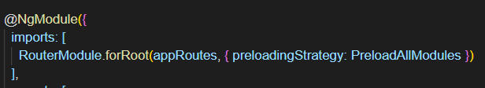
Preload Strategies
No preloading (by default)
Preload all
Custom :
Build a preloading strategy service
Set the routing option

Slide 27
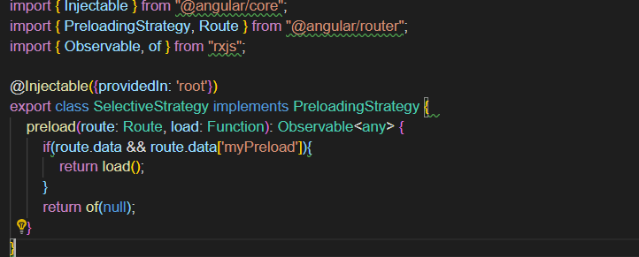
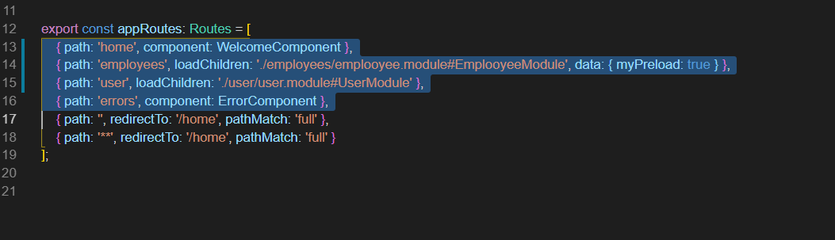
Custom Preloading Strategy (Lazy L.)

