Slide 1

Validators, Directives, Interceptor, Resolver, Pipes

Slide 2
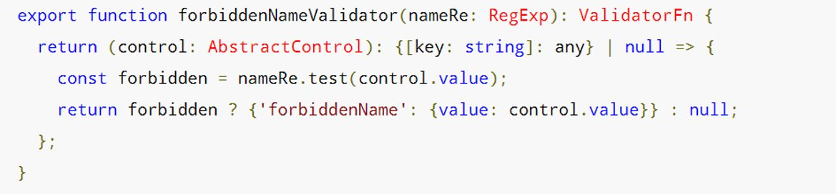
Custom Sync Validators
Clean function which returns another function

Slide 3
Custom Async Validators
Not a clean function anymore
Now we need a service.
Implement AsyncValidator
Careful with performance!!! UpdateOn : [change, submit, blur]
Executed after sync validators passed
Pending status, validation in progress

Slide 4
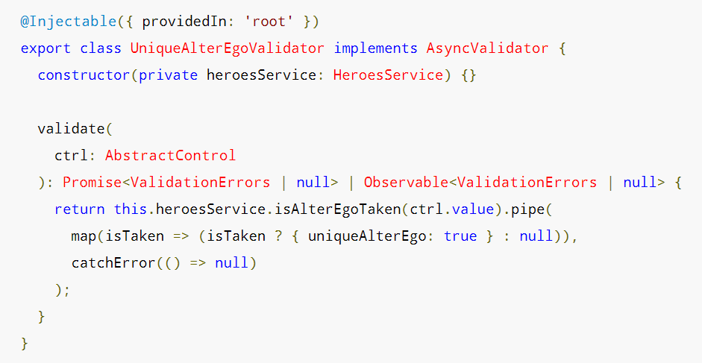

Slide 5
Attribute Directives
3 types of directives ( Components, Structural Directives, Attribute Directives )
Component without a template ( or css ).
Add custom logic to template ( maybe even validation rules? )
Directive() with its own provide.
The usuals: Inputs, Outputs, HostListener ( wait, what? )

Slide 6
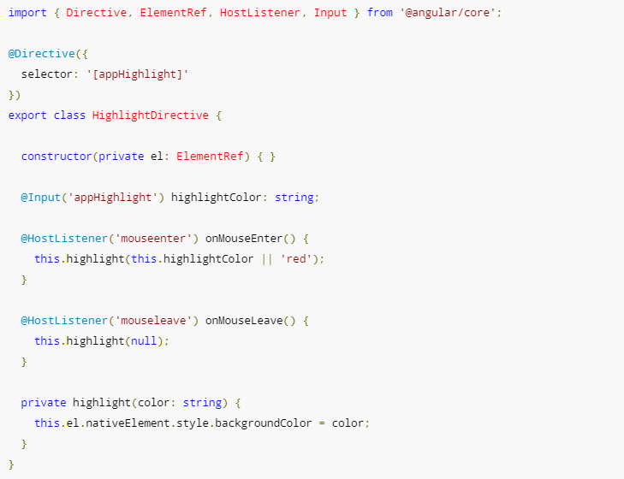

Slide 7
Interceptor
Angular SRI, he sees everything you send and receive
He can change requests and responses
Applied to all HttpModule calls
It's just a service, but only the HttpClient is using it
Has to implement HttpInterceptor
A more special provider

Slide 8
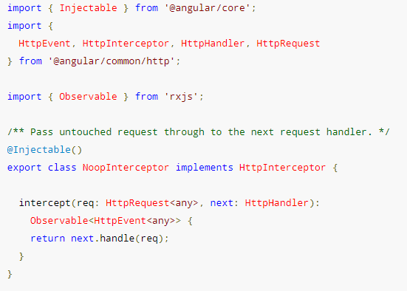


Slide 9
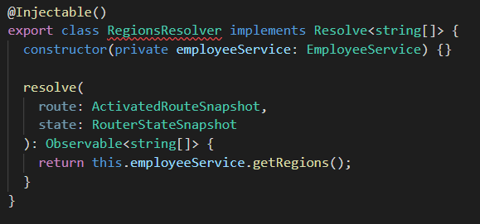
Resolvers
We need data before page load, we use a resolver
It's just a service, but only the Router is using it
Retrieve data from ActivatedRoute

Slide 10
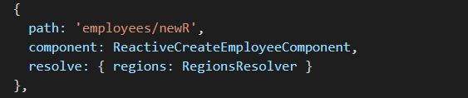
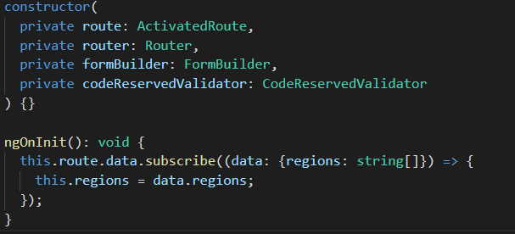

Slide 11
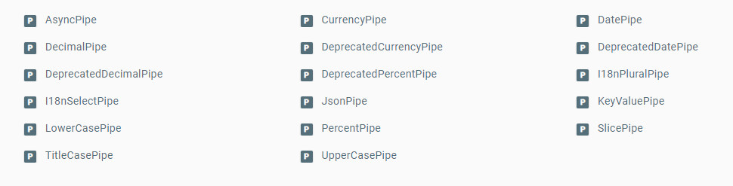
Pipes
Interpolation with a bit of style
Angular predefined pipes

Slide 12
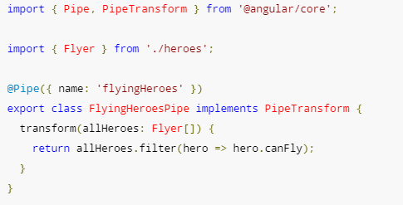
Pipe()
Implement PipeTransform

