Slide 1
RxJs Observables in Angular

Slide 2
Evolution of Asynchronous
JavaScript
Callbacks
Promises
Generators / yield
Async/await

Slide 3
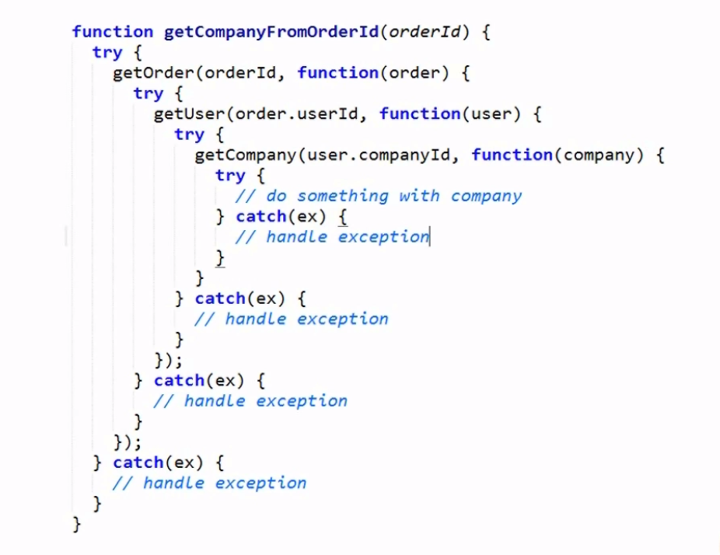
Calback function

Slide 4
Promises
What is a Promise?
“A promise is an object that may produce a single value some time in the future”
“A promise is a special kind of javascript object which contains another object”
A promise may be in one of 3 possible states: fulfilled, rejected, or pending.
Ex:
const wait = time => new Promise((resolve) => setTimeout(resolve, time));
wait(3000).then(() => console.log('Hello!')); // 'Hello!'

Slide 5
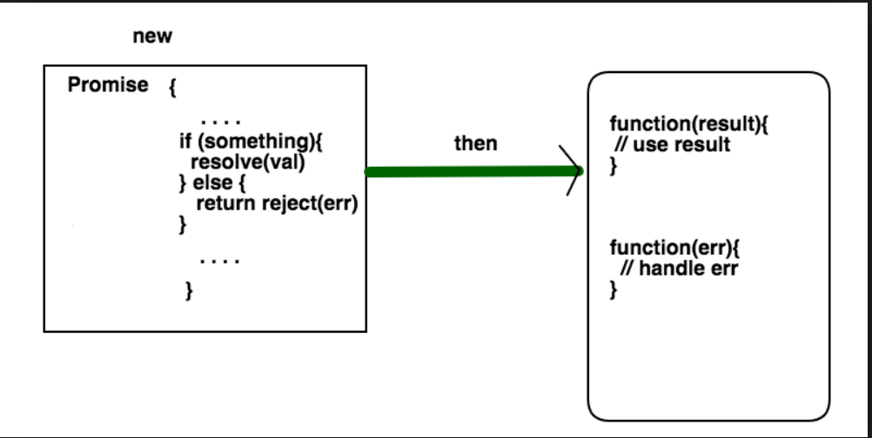
Promise

Slide 6
Generators/yield
Introduced in ES6
“Wouldn't it be nice, that when you execute your function, you could pause it at any point, calculate something else, do other things, and then return to it, even with some value and continue?”
function* foo () {
var index = 0;
while (index < 2) {
yield index++;
}
}
var bar = foo();
console.log(bar.next()); // { value: 0, done: false }
console.log(bar.next()); // { value: 1, done: false }
console.log(bar.next()); // { value: undefined, done: true }

Slide 7
Async/await
Introduced in ES7
Under the hood async functions using Promises → return a Promise

Slide 8
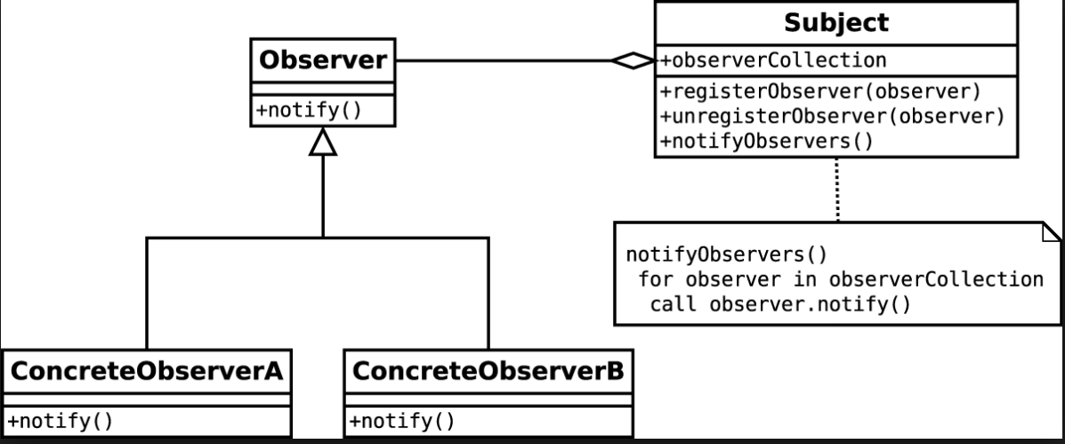
Observable Patern

Slide 9
What is RXJS ?
“Reactive Extensions for JavaScript (RXJS) is a reactive streams library for buildng ansynchronous applications with observable sequences”
RxJS can be used both in the browser or in the server-side using Node.js
Basically RxJS helps you observe the events that happen in a stream and react to them accordingly.

Slide 10
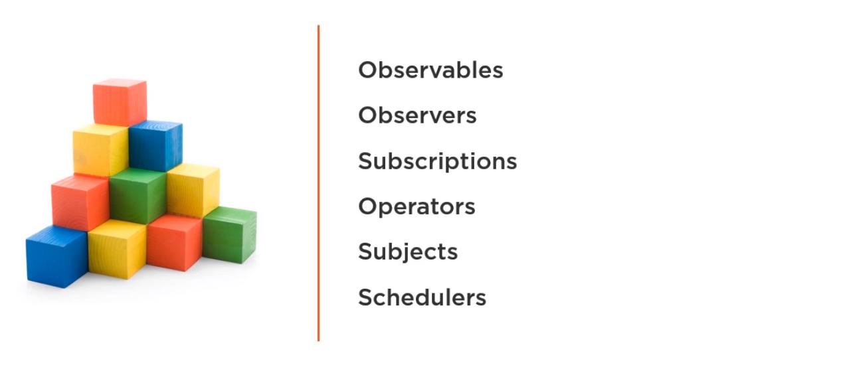
RxJs Building Blocks

Slide 11
Observable
“A representation of any set of values over any amount of time”
https://rxjs-dev.firebaseapp.com/api/index/Observable
Observable:
Next()
Error()
Complete()

Slide 12
Observers

