Slide 1
RxJs (II)

Slide 2
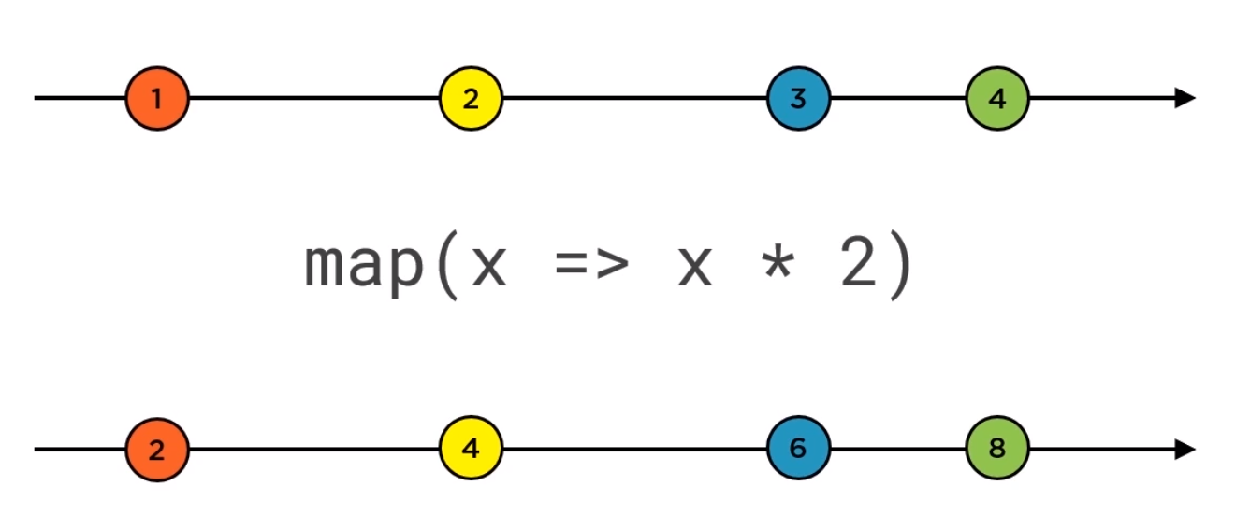
Diagram

Slide 3
Categories of Operators
TRANSFORMATION Ex: map, groupBy, pluck, reduce, ..
FILTERING Ex: filter, first, take, skip, debounceTime, ..
COMBINATION Ex: concat, merge, race, ..
UTILITY Ex: do/tap, finalize, let, repeat, ..
CONDITIONAL Ex: every, iif
AGGREGATE EX: min, max, ..
MULTICASTING Ex: multicast, refCount, publish, share ..
Others
Ref: https://www.learnrxjs.io/operators/

Slide 4
Custom Operators
Function myOperator(config1, config2) {
Return function(source$) {
Return new Observable$;
}
}

Slide 5
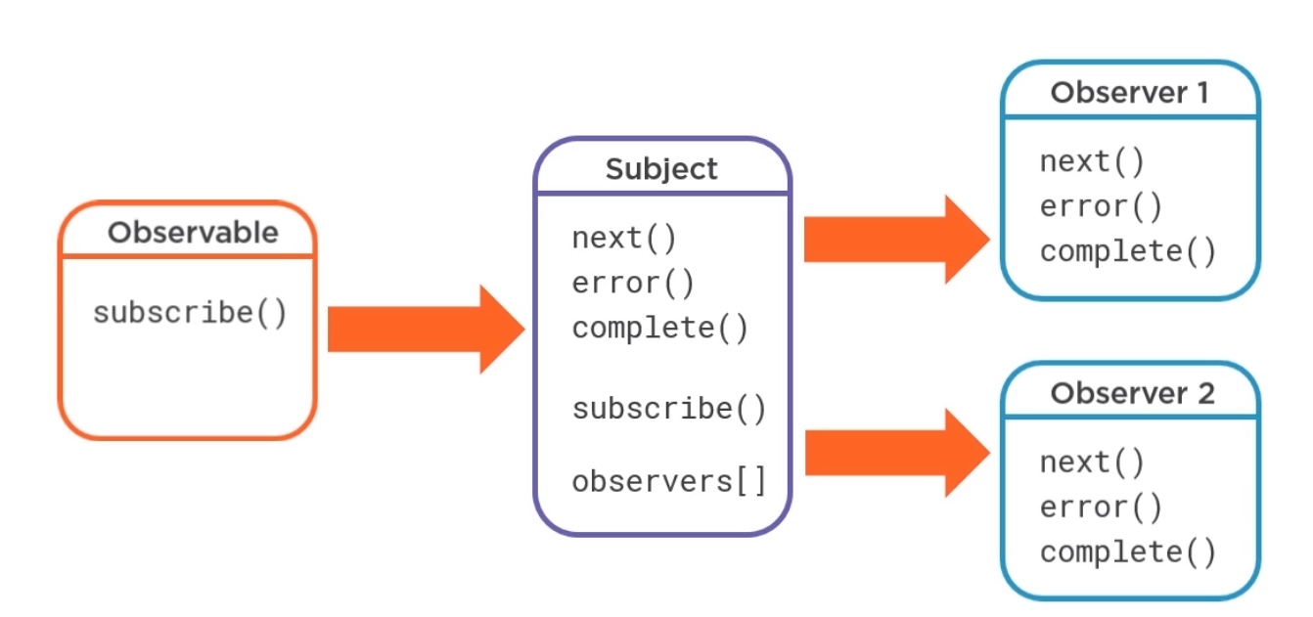
What are Subjects

Slide 6
Observable vs BehaviourSubject/Subject
Observable | BehaviourSubject/subject
It’s just a function, no state | Has state, Stores data in memory
Rates only Observable (data producer alone) | Same code run only once for all observers
Usage: Simple Observable with only one Observer | Usage: Store data and modify frequently Multiple observers listen to data Proxy between Observable and Observer

