Slide 1
Angular
Curs 3

Slide 2
In this session:
Two-way binding between components
Angular Component Lifecycle Hooks

Slide 3
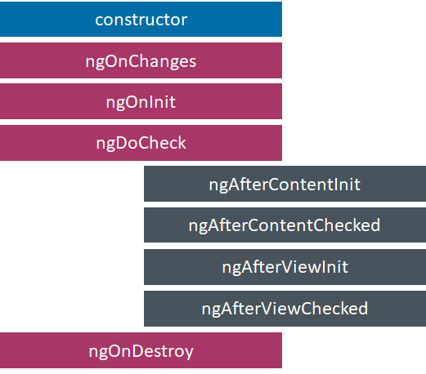
Angular Component Lifecycle Hooks

Slide 4
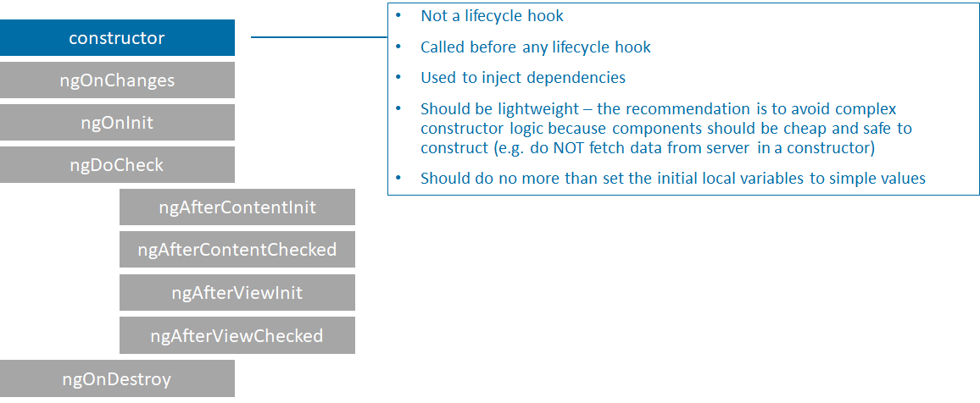
Constructor

Slide 5
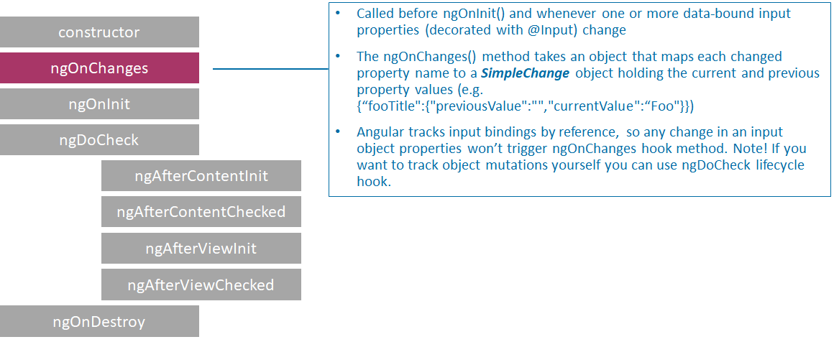
NgOnChanges

Slide 6
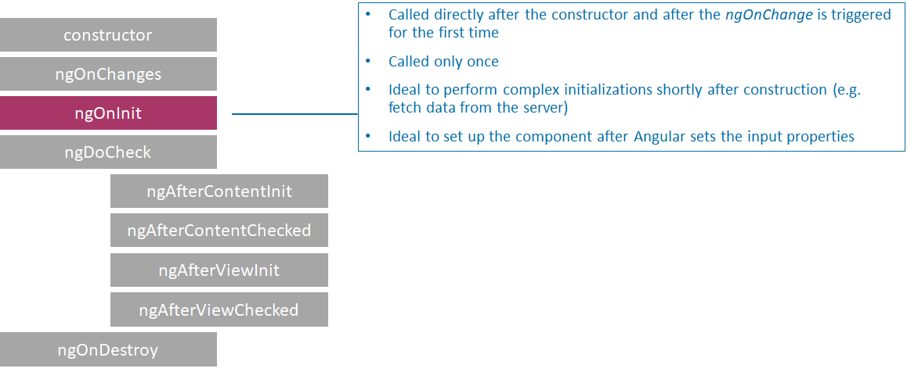
ngOnInit

Slide 7
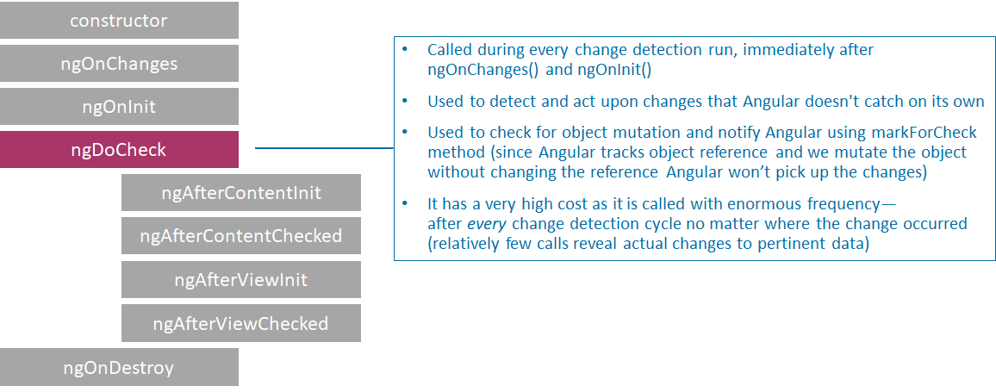
ngDoCheck

Slide 8
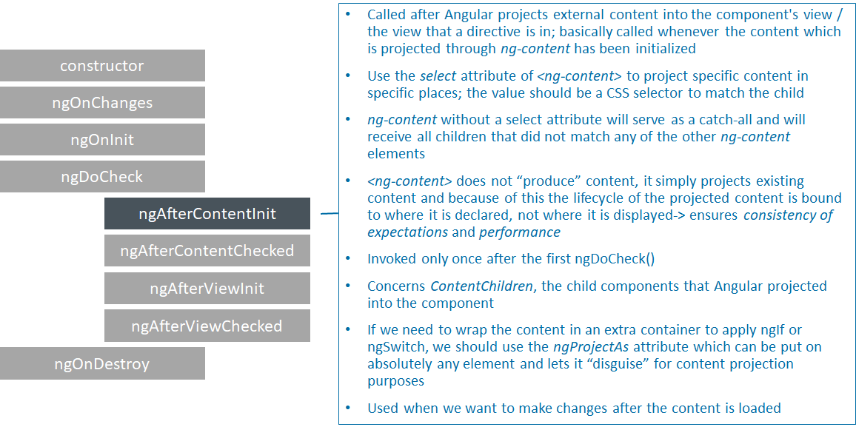
ngAfterContentInit

Slide 9
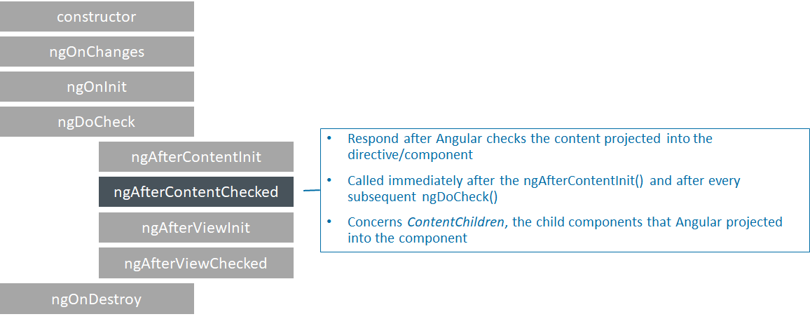
ngAfterContentChecked

Slide 10
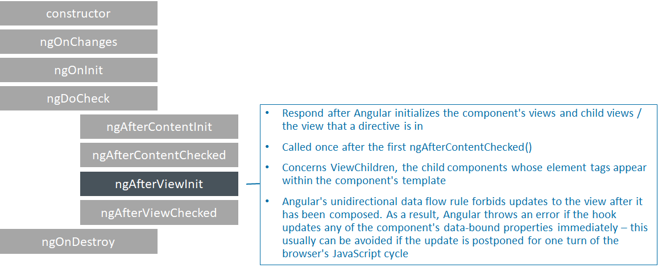
ngAfterViewInit

Slide 11
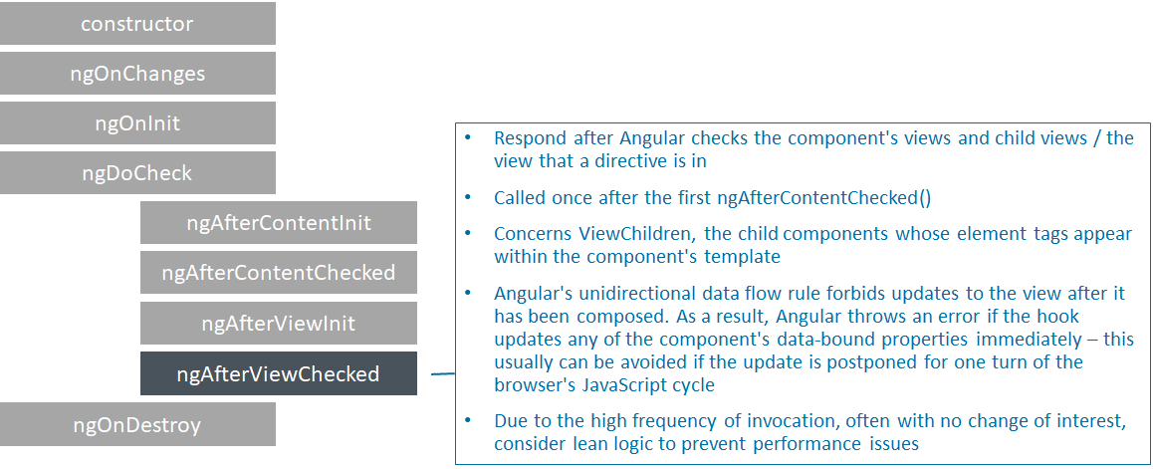
ngAfterViewChecked

Slide 12
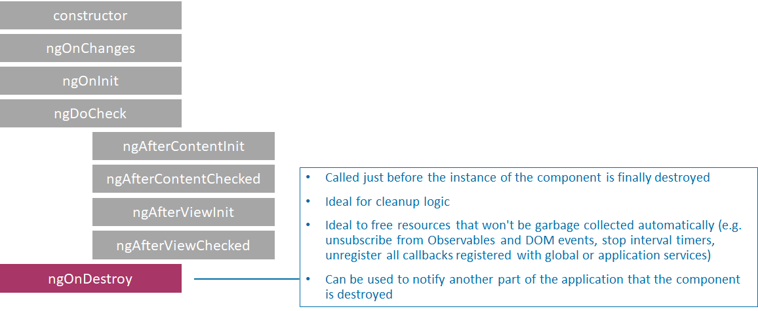
ngOnDestroy

Slide 13
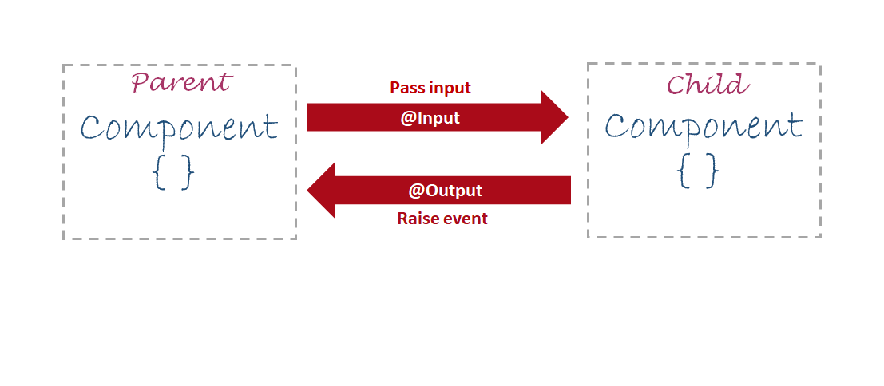
Parent - child communication

Slide 14
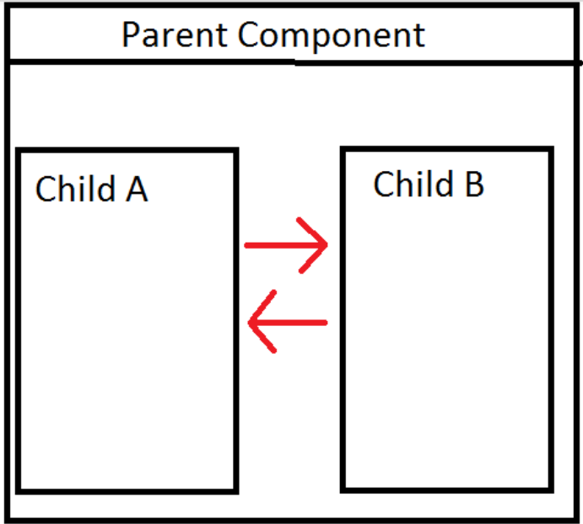
Two-way Binding Between Components

Slide 15
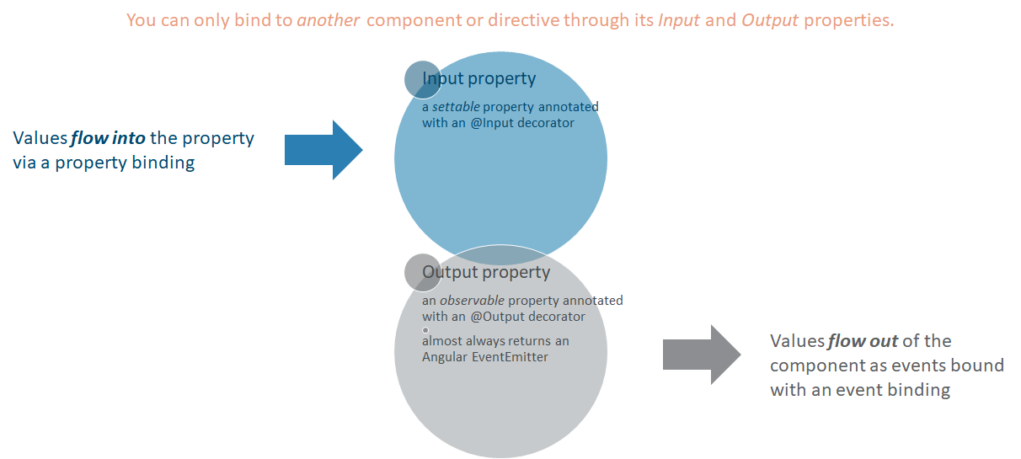
Input & Output properties

Slide 16

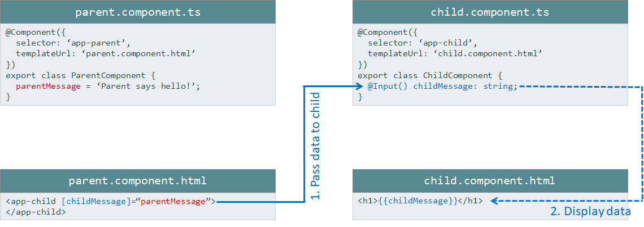

Slide 17
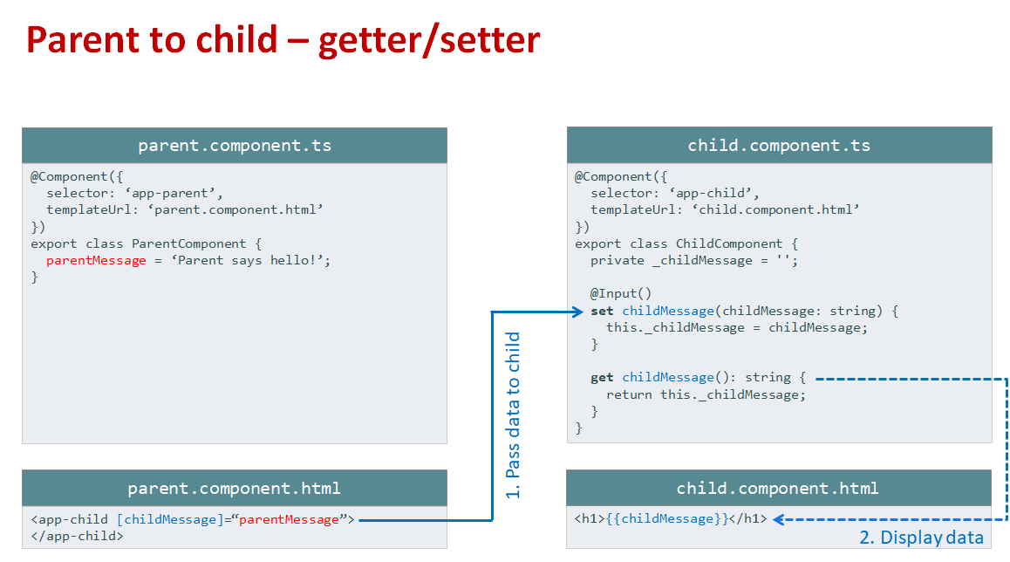

Slide 18
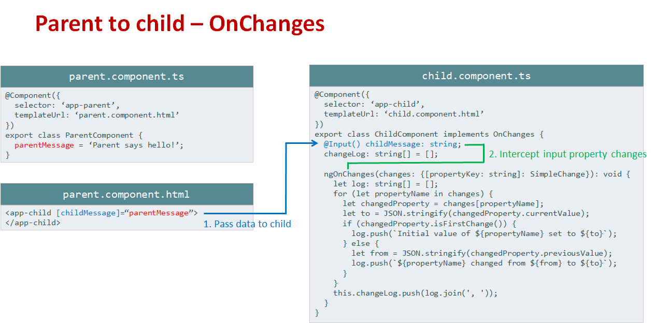

Slide 19
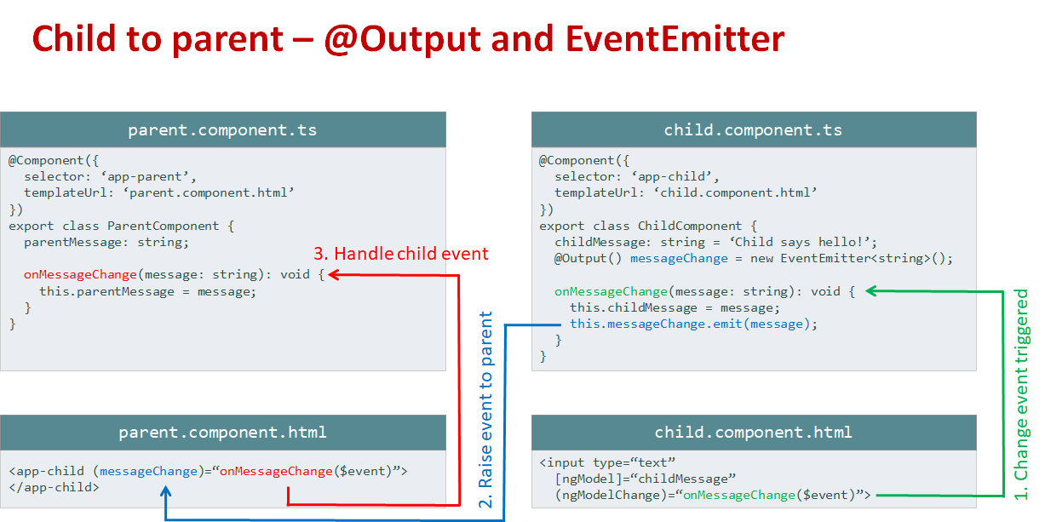

Slide 20
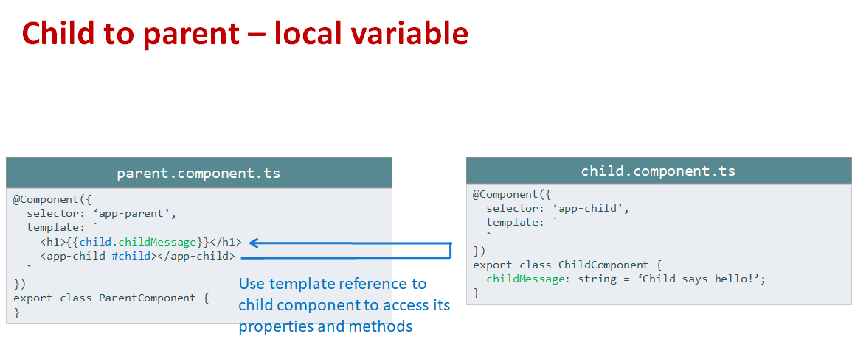

Slide 21
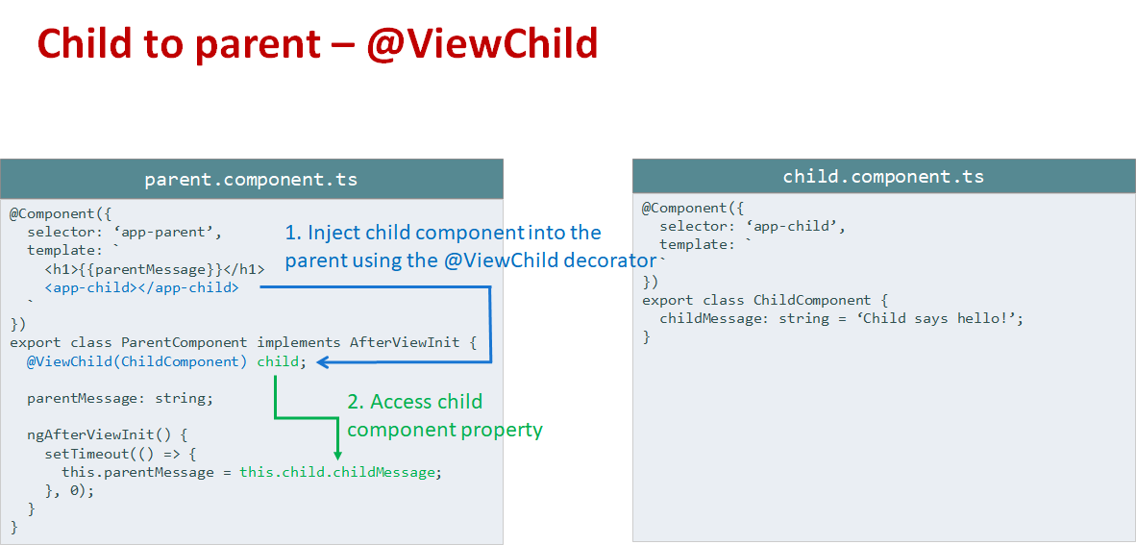

Slide 22
