Slide 1

Angular Forms
Part2: Reactive Forms

Slide 2
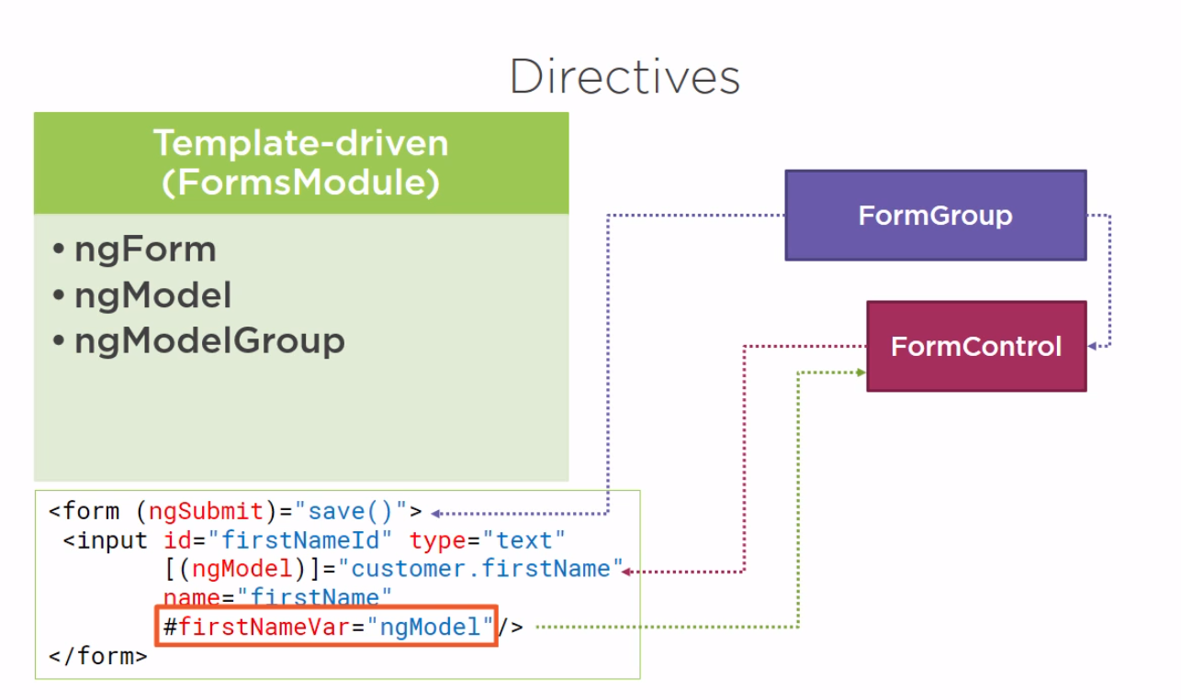

Slide 3
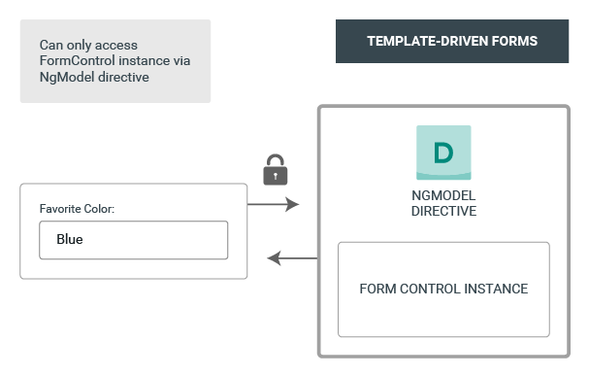
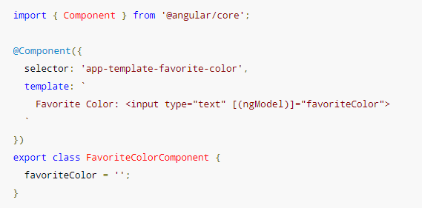
Template Driven

Slide 4
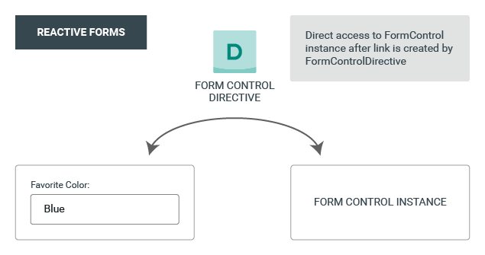
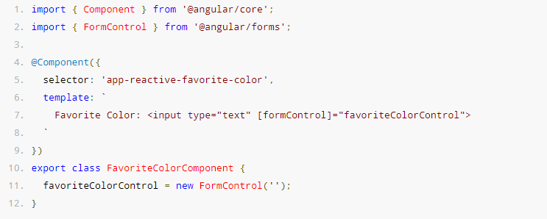
Reactive Forms

Slide 5
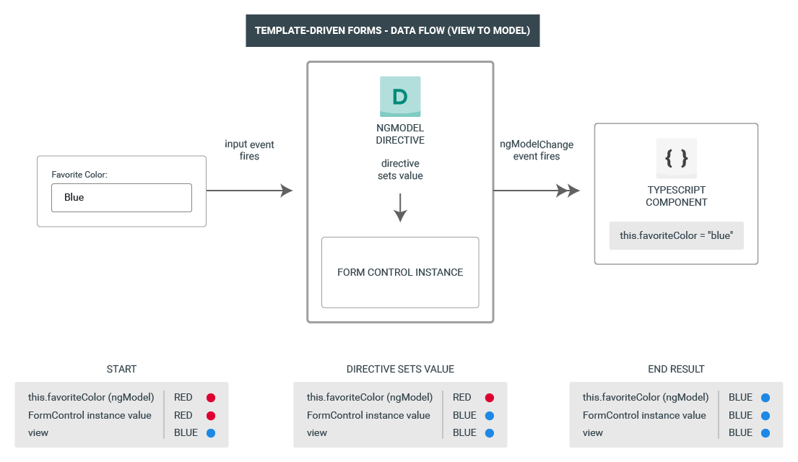

Slide 6
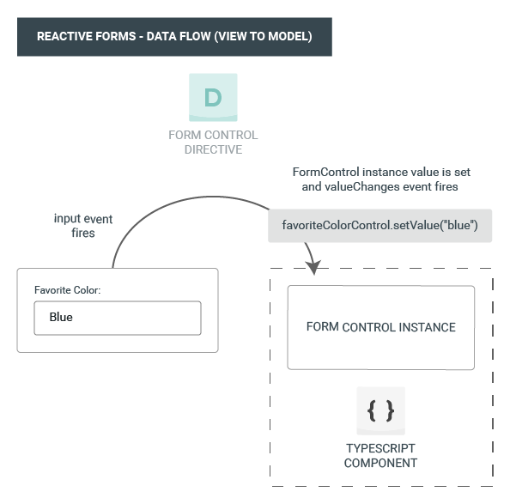

Slide 7
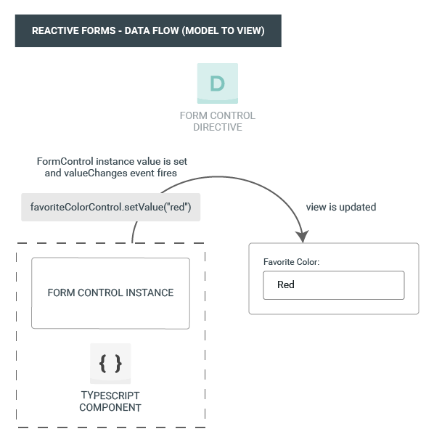

Slide 8
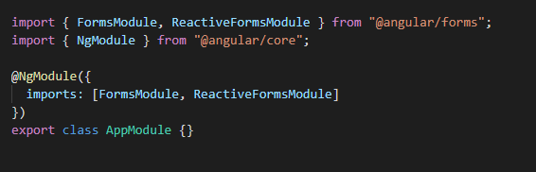
Where do I start?
Import the module

Slide 9
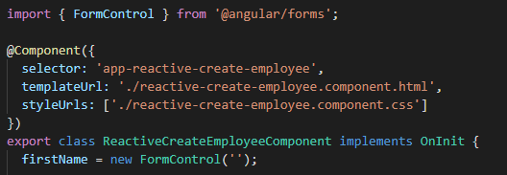
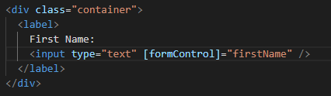
FormControl – basic building block
Apply to component
Apply to template

Slide 10

MASTERPIECE
We are done!!
Let's go home

Slide 11
FormControl – basic building block
Apply to component
Apply to template
Observations:
No Form Tags
Object one way binding
No model object

Slide 12
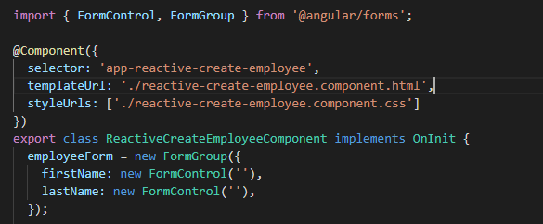
More than 1 input in a form?
FormGroup – Collecting FormControls and FormGroups
Apply to component

Slide 13
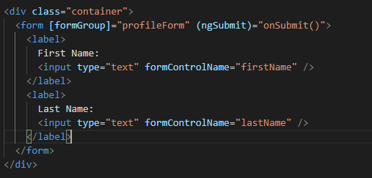

Apply to template:
Results are fabulous:
CSS anyone? :(

Slide 14
OBSERVATIONS:
Form is required
Binding only on form
No more binding on input
Using formControlName (Directive)

Slide 15
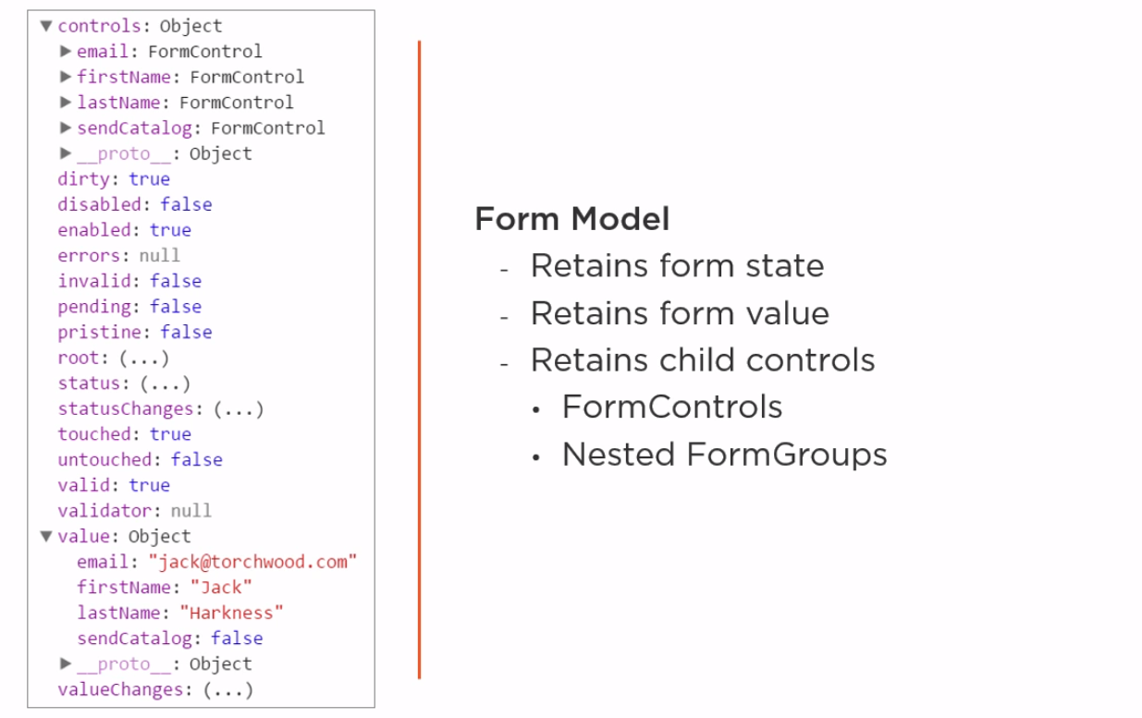
Under the hood...

Slide 16
Wait a sec! How do I control all of this???
Get data
.value
.valueChanges()
Set data
setValue() - imutable
patchValue() - partial imutable //not recommended
Internal structure
get()

Slide 17
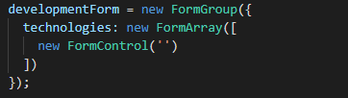
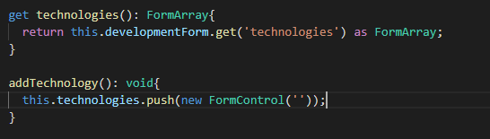
What about repeating sections?
FormArray – store formControls / FormGroups as an array
We need extra functions to help us:

Slide 18
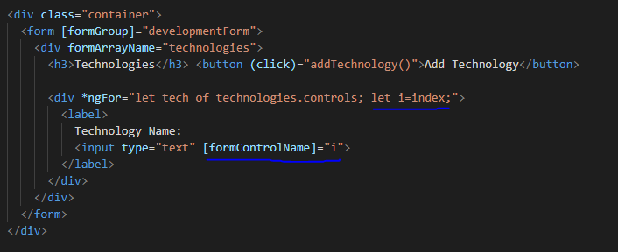
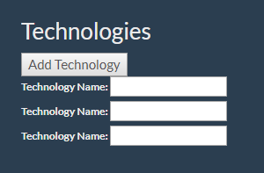
Binding to template is getting trickier:
Actual result:

Slide 19
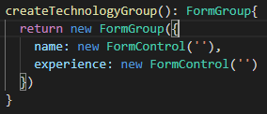
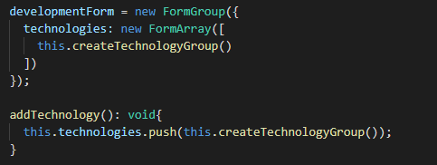
FormArray and FormGroup?
We need another function:
Update the form and existing functions:

Slide 20
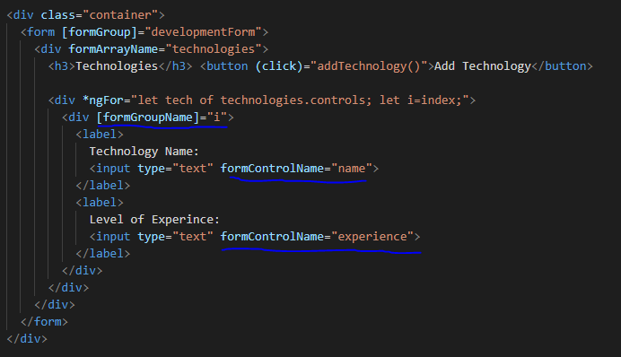
And the template

Slide 21
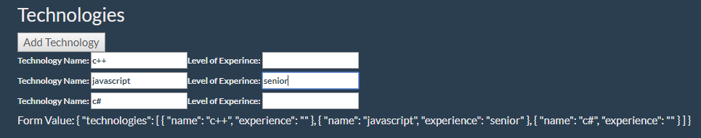
End Result

Slide 22

Too verbose?
FormBuilder – Service providing convenient methods for generating controls
Inject in constructor
FormControl -> control()
FormGroup -> group()
FormArray -> array()

Slide 23
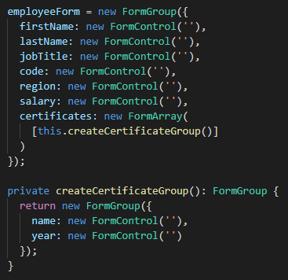
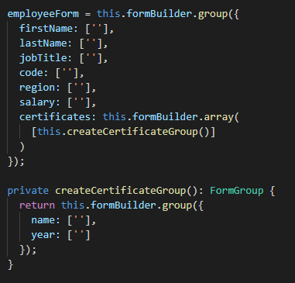
Transition
Before
After

Slide 24
Validation – first glance
Validators – set of validator functions:
Validators.required
Validators.min / Validators.max //for numbers
Validators.minLength / Validators.maxLength //for strings
Validators.pattern
Etc.

Slide 25

How to use?

Slide 26
