Slide 1

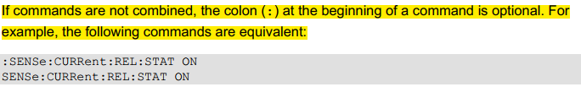
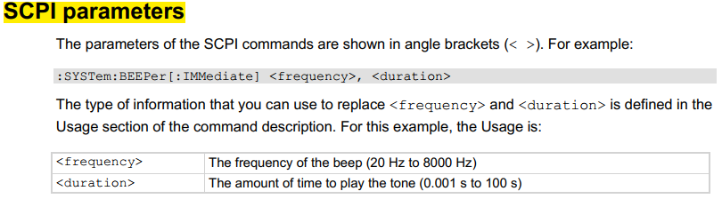
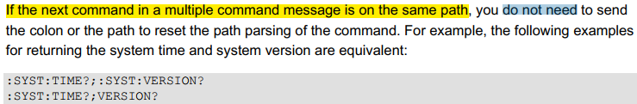
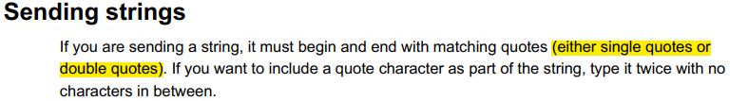
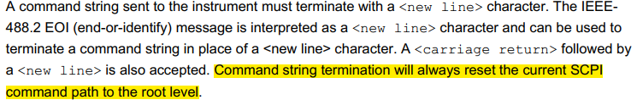
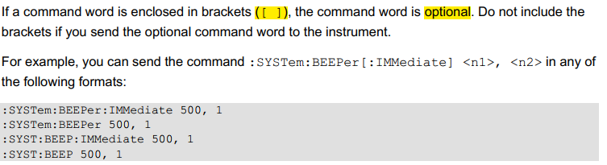
SCPI COMMANDS IN A NUT SHELL

Slide 2
Step | Description
1 | Install IviSharedComponents64_261.exe
2 | Install KeithleyDMM6500-x64.msi
SCPI and TSP are available for DMM6500
Plan | Description
1 | SCPI commands for voltage measurement
2 | SCPI commands for impedance measurement
3 | SCPI commands for current measurement
4 | SCPI commands for trigger

Slide 3
DMM
COMPUTER
SCANNER MODULE
OSC
PS

Slide 4
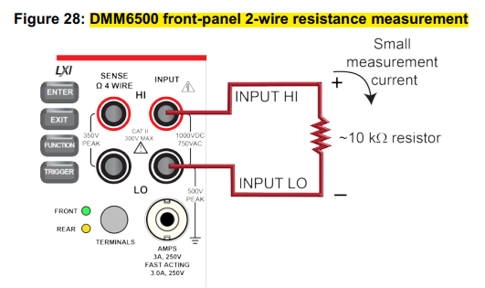
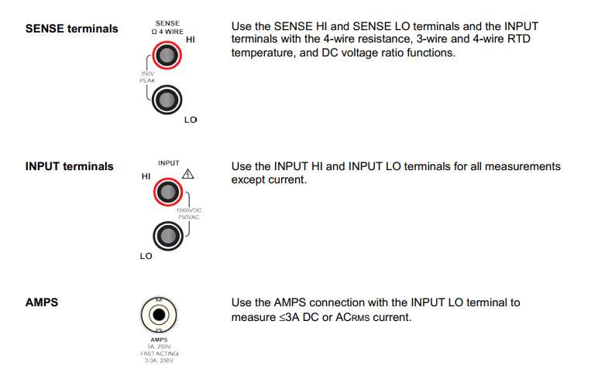
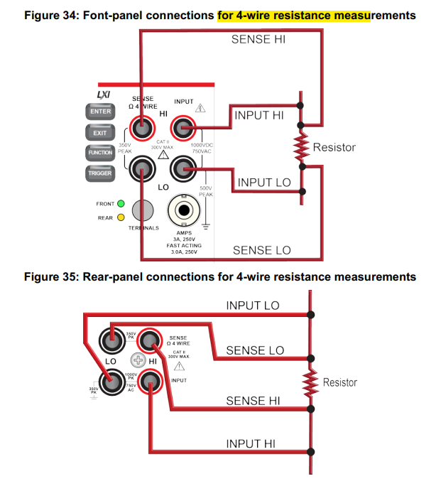
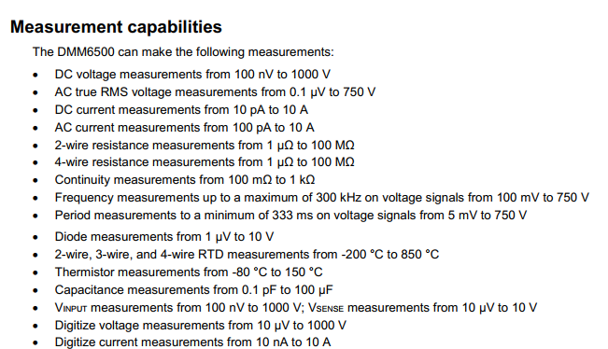
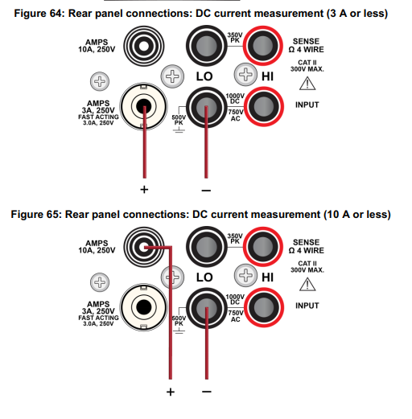
GENERAL INFORMATION

Slide 5
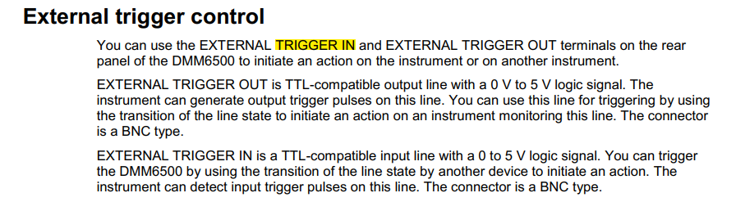
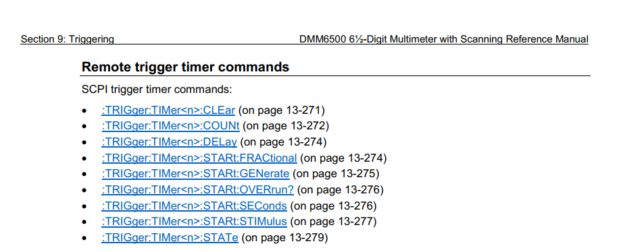
GENERAL INFORMATION

Slide 6
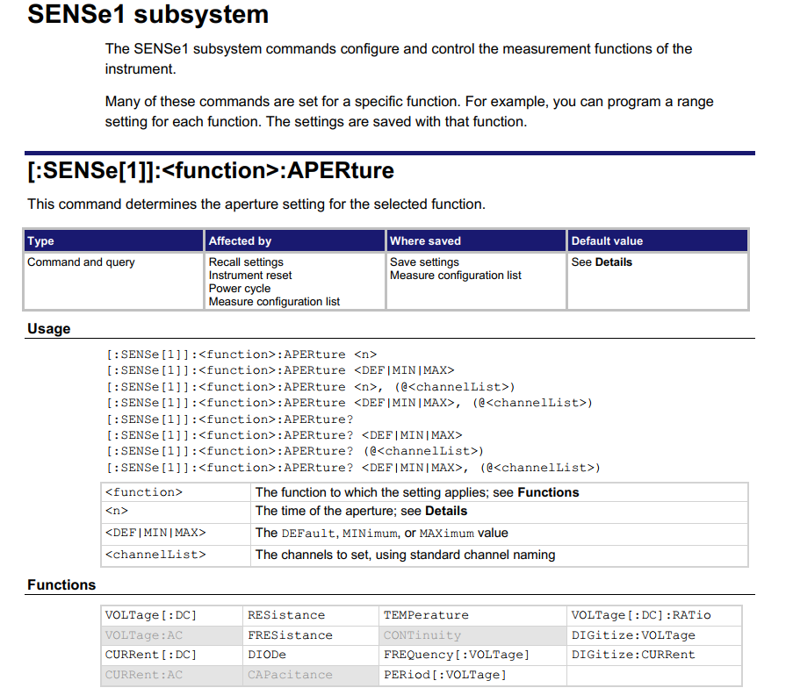
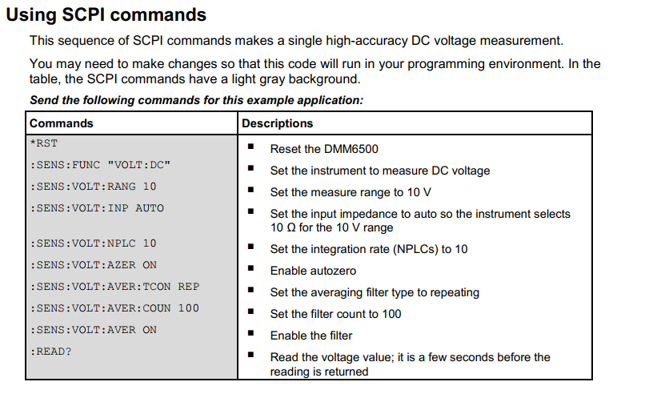
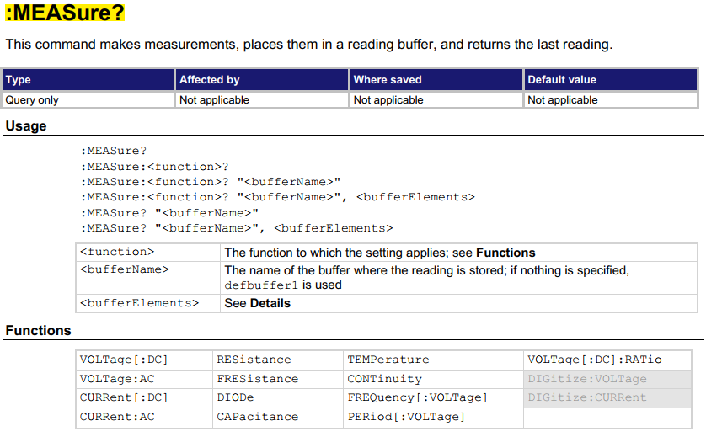
VOLTAGE MEASUREMENT

Slide 7
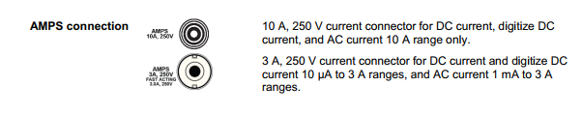
CURRENT MEASUREMENT

Slide 8
RESISTANCE MEASUREMENT

Slide 9
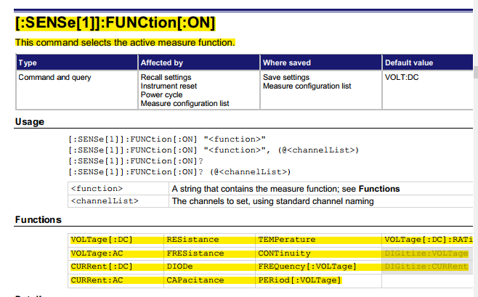
CONFIGURATION
SENSE:
FUNC
VOLT:DC
VOLT:AC
CURR:DC
CURR:AC
RES
FourwireRESistor
DIOD
CAP
TEMP
CONT
FREQ
PER

Slide 10
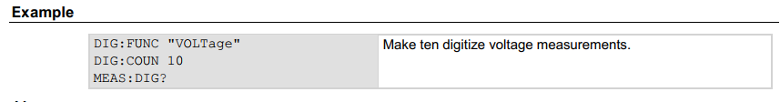
CONFIGURATION
SENSE:
DIGitize:
COUNt
FUNCtion
VOLT:
CURR:
<int>
“CURRent”
“VOLTage”
SRATe
<int>

Slide 11
MEAS: SUBSYSTEM
MEAS:
DIGitize:
COUNt
FUNCtion
<int>
“CURRent”
“VOLTage”

Slide 12
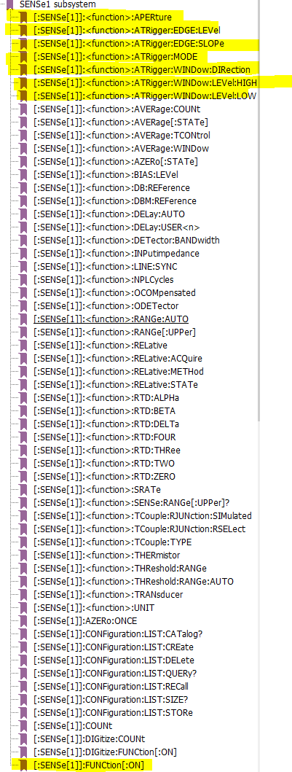
SENSE
APER:
INP:
ATR:
AVER:
DEL:

Slide 13
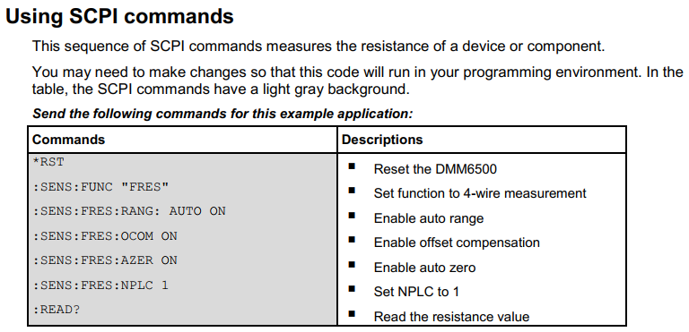
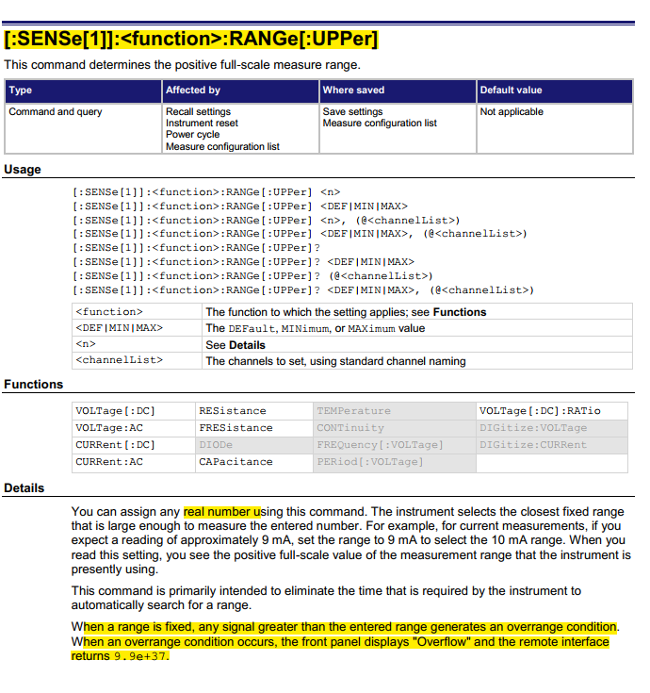
CURRENT MEASUREMENT

Slide 14
IMPEDANCE MEASUREMENT

Slide 15
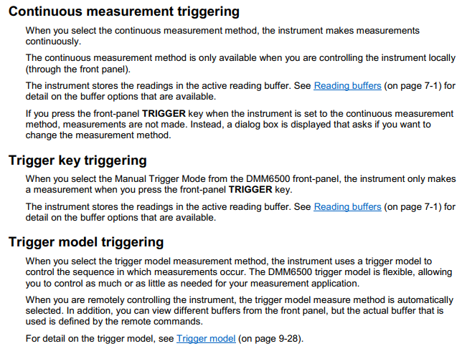
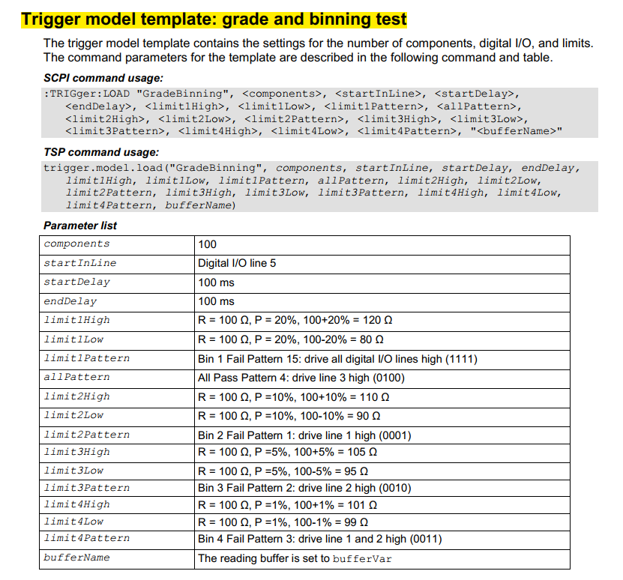
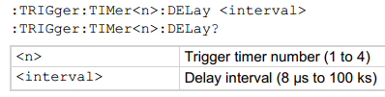
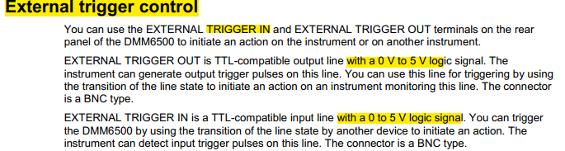
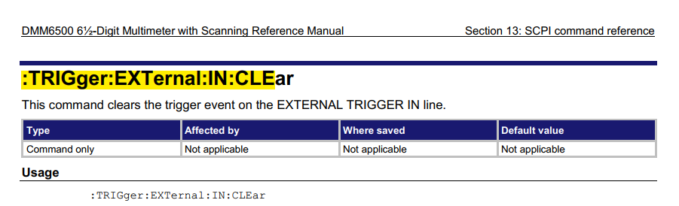
TRIGGER

Slide 16
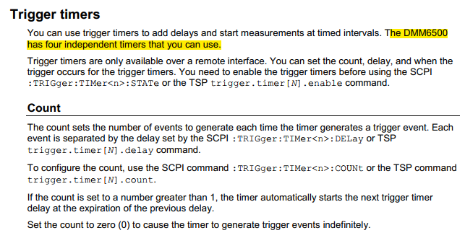
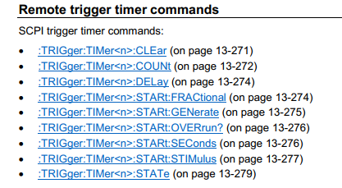
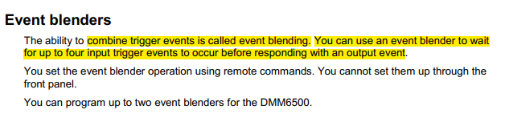
TRIGGER TIMER

Slide 17
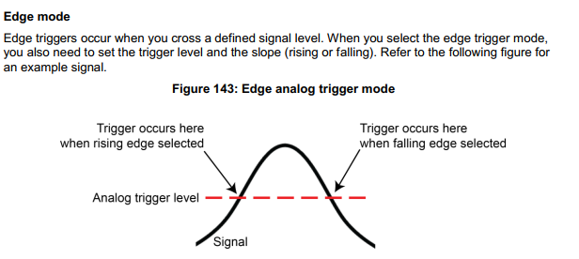
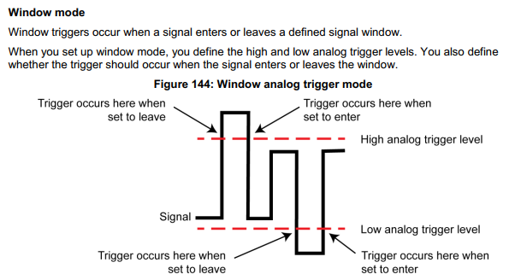
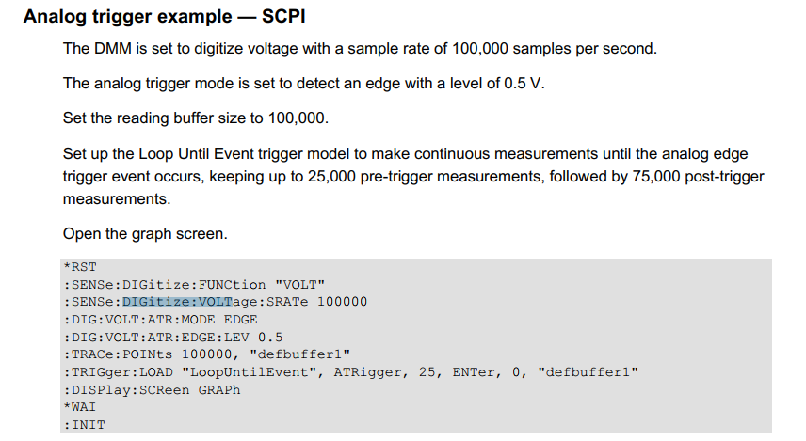
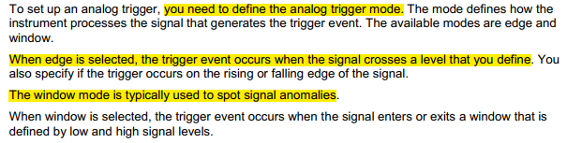
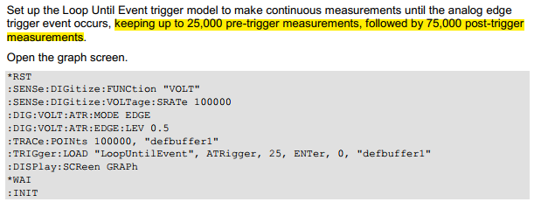
ANALOG TRIGGER

Slide 18
ANALOG TRIGGER

Slide 19
TRIGGER
TRIG:
ABOR:
INIT:
EXTernal:
PAUSe
RESume
STATe?
TIM<1:4>er:
IN:
OUT:
CLEar
COUNt <integer>
DELay <second>
STAT:(?)
1e-5 = 10us
EDGE:
CLEar
OVERrun
LOGic:
ON
OFF
FALLing
RISing
EITHer
POSitive
NEGative

Slide 20
TRIGGER (Cont.)
TRIG:
CONTinuous:
AUTO
RESTart
OFF

Slide 21

ANALOG TRIGGER

Slide 22
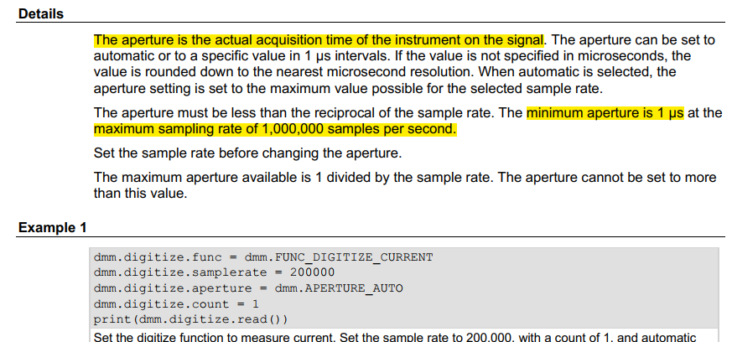
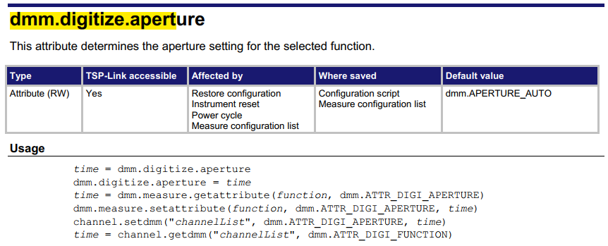
BUFFER
DCV
Max no. of samples: 100000
First index: 1
Sampling period: ~ 201.45 ms
Digi V
Max no. of samples: 100000
First index: 1
Sampling period: 1us

Slide 23
PYTHON STRUTURE
SCPI_TEMPLATE
SenseSubFncTemplate
AC
DC
RES
FRES
DIOD
TEMP
FREQ
PER
DIG
VOLT
CURR

