Slide 1





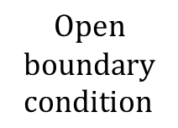



$$0.2032 m$$
$$Open$$
$$boundary \\ condition$$
$$0.0254 m$$
$$0.0254 m$$
$$0.0508 m$$
$$0.00635 m$$
$$Web$$
$$Open$$
$$boundary \\ condition$$
$$0.0254 m$$
$$Gap height: 0.794 mm$$

