Slide 1
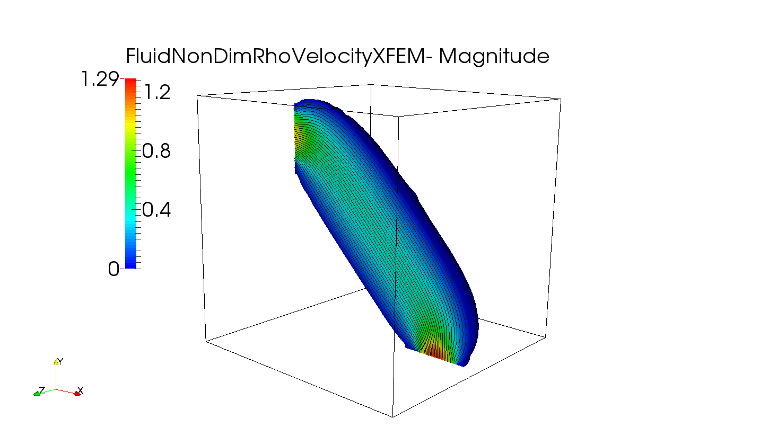


$$0.0$$
$$1.25$$

