Slide 1
Forest Fire Burn Area Prediction: Regression Problem
CSE 6740 Project
Grace Driskill

Slide 2
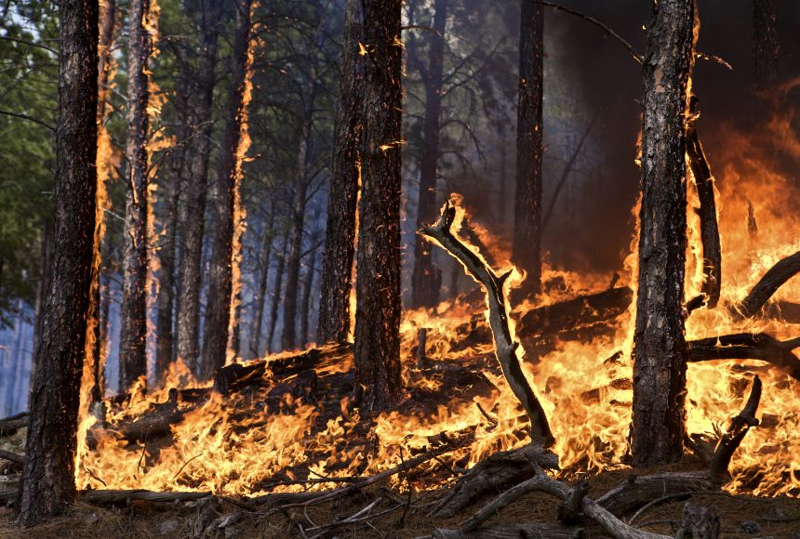
Forest Fires
Some forest fires are naturally occurring and beneficial to environment
Huge, uncontrolled fires can be a danger to humans, and cause ecological damage
Need automatic solutions for detecting wildfires
Source: (Wildfires: How They Form, and Why They’re so Dangerous, 2023)

Slide 3
Dataset
UCI Machine Learning Repository taken from Cortez & Morais, 2007
Forest in Portugal
12 input features
Geographic data, temporal data, meteorological data
517 samples
Output to predict is the burned area
Source: (UCI Machine Learning Repository, 2008)
(Cortez & Morais, 2007)

Slide 4
Approach Overview
3 regression algorithms:
Linear Regression
Support Vector Regression (SVR)
Artificial Neural Network (ANN)
Compare performance:
Mean squared error (MSE)
Generalization

Slide 5
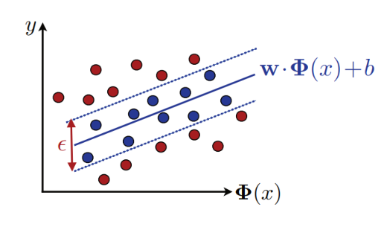
Support Vector Regression (SVR)
Fits a ε-width tube
Points inside tube have zero-loss
ε-insensitive loss
Source: (Mohri et al., 2018)
(Smola & Schölkopf, 2004)

Slide 6
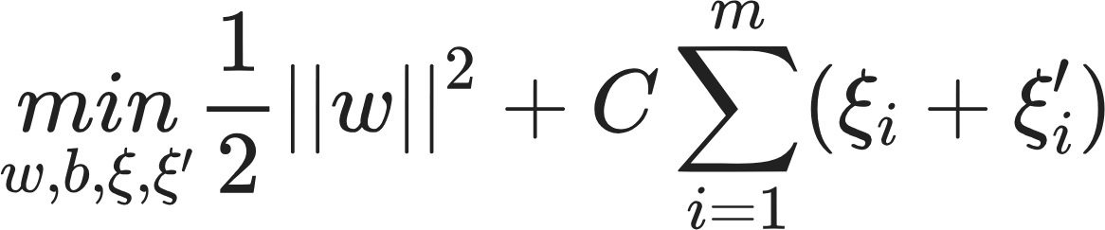
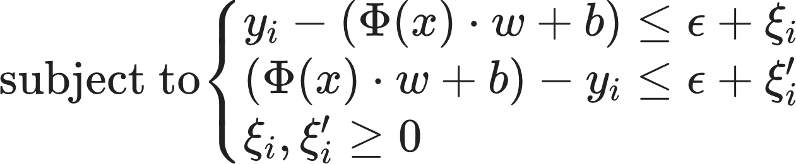
Support Vector Regression (SVR)
Hypothesis class:
feature mapping Φ(x) corresponds to a PDS kernel K,
k(x, x') = <Φ(x), Φ(x')>
Objective function:
Source: (Mohri et al., 2018)
(Smola & Schölkopf, 2004)

Slide 7
Artificial Neural Network (ANN)
Used a fully connected feedforward network
One hidden layer and sigmoid activation function
Universal Approximation Theorem
one hidden layer and a sigmoidal function can approximate continuous functions with arbitrary precision
if no constraints are placed on the number of nodes or the size of the weights
Source: (Cybenko, 1989)
Notes:
This is theorical result, and the constraints on number of nodes obviously is not infinfoite, however
First: What it is
Second: I chose to use this universal approximation theorem to narrow my focus and base my project in theory.
I decided to use a NN architecture that match the one describe in this theorem

Slide 8
Implementation Details
Pre-processing:
Log transformation on target data
Suggested by paper, help positively skewed data
Normalized all data to [0,1]
Used scikit-learn for linear regression, SVR, metrics, cross validation
Used PyTorch for NN
Tuned hyperparameters with a grid search cross validation
First coarse search, then a more granular search using result

Slide 9
Results
 | RMSE test | RMSE train | MSE difference
Linear Regression | 0.210 | 0.193 | 0.017
SVR - Linear | 0.213 | 0.197 | 0.016
SVR - Polynomial | 0.211 | 0.196 | 0.015
SVR - RBF | 0.211 | 0.196 | 0.015
SVR - Sigmoid | 0.211 | 0.197 | 0.014
ANN | 0.213 | 0.193 | 0.020

Slide 10
Results
Linear regression had best test error
 | RMSE test | RMSE train | MSE difference
Linear Regression | 0.210 | 0.193 | 0.017
SVR - Linear | 0.213 | 0.197 | 0.016
SVR - Polynomial | 0.211 | 0.196 | 0.015
SVR - RBF | 0.211 | 0.196 | 0.015
SVR - Sigmoid | 0.211 | 0.197 | 0.014
ANN | 0.213 | 0.193 | 0.020

Slide 11
Results
Linear regression had best test error
 | RMSE test | RMSE train | MSE difference
Linear Regression | 0.210 | 0.193 | 0.017
SVR - Linear | 0.213 | 0.197 | 0.016
SVR - Polynomial | 0.211 | 0.196 | 0.015
SVR - RBF | 0.211 | 0.196 | 0.015
SVR - Sigmoid | 0.211 | 0.197 | 0.014
ANN | 0.213 | 0.193 | 0.020
ANN had best training error

Slide 12
Results
Linear regression had best test error
 | RMSE test | RMSE train | MSE difference
Linear Regression | 0.210 | 0.193 | 0.017
SVR - Linear | 0.213 | 0.197 | 0.016
SVR - Polynomial | 0.211 | 0.196 | 0.015
SVR - RBF | 0.211 | 0.196 | 0.015
SVR - Sigmoid | 0.211 | 0.197 | 0.014
ANN | 0.213 | 0.193 | 0.020
ANN had best training error
ANN generalized the worst

Slide 13
Results
Linear regression had best test error
 | RMSE test | RMSE train | RMSE difference
Linear Regression | 0.210 | 0.193 | 0.017
SVR - Linear | 0.213 | 0.197 | 0.016
SVR - Polynomial | 0.211 | 0.196 | 0.015
SVR - RBF | 0.211 | 0.196 | 0.015
SVR - Sigmoid | 0.211 | 0.197 | 0.014
ANN | 0.213 | 0.193 | 0.020
]
SVR overall generalized the best
ANN had best training error
ANN generalized the worst

Slide 14
Linear Model Performed Best
Data naturally had linear relationship?
R² for linear regression was 0.034950124385348835 - not very good
Coefficient of determination = proportion of variance in dependent variable explained by the model
Notes:
"More technically, R2 is a measure of goodness of fit. It is the proportion of variance in the dependent variable that is explained by the model." https://www.scribbr.com/statistics/coefficient-of-determination/

Slide 15
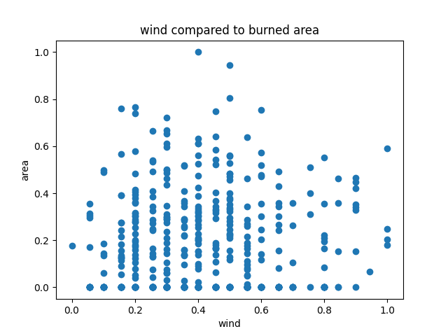
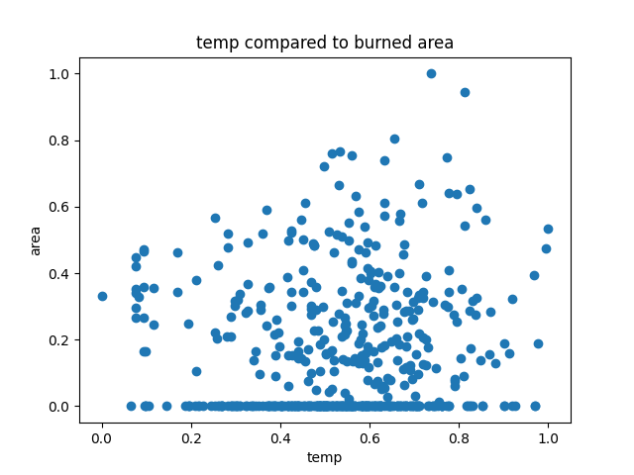
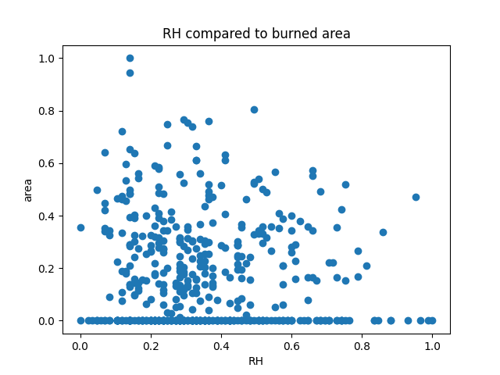
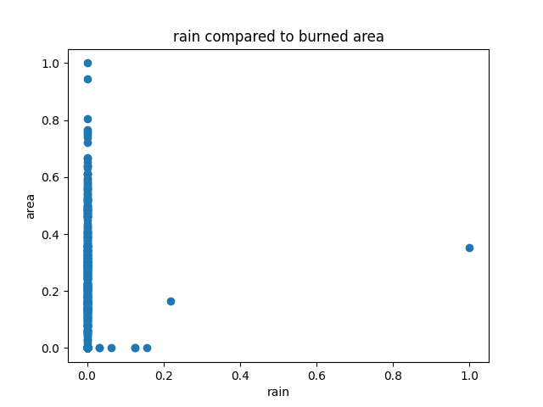
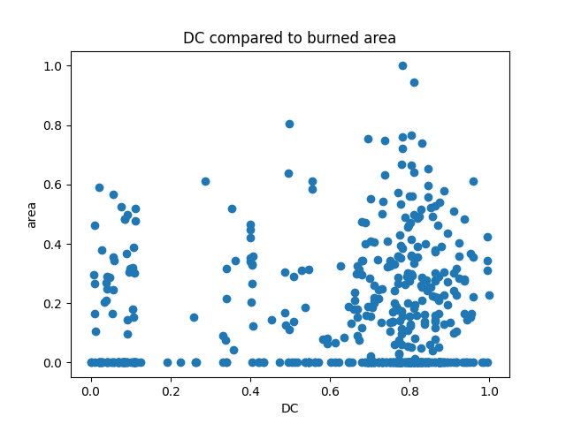
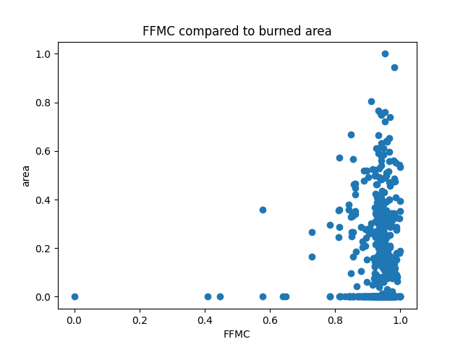
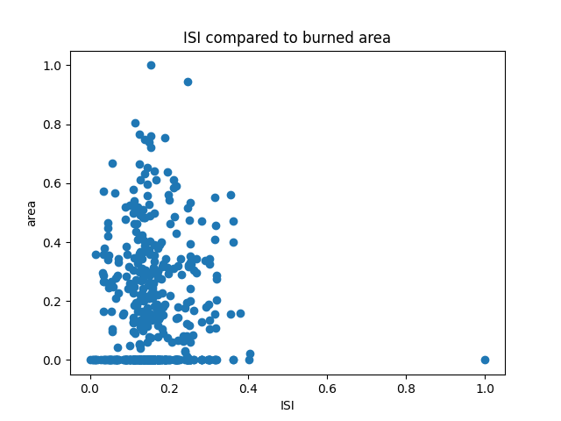
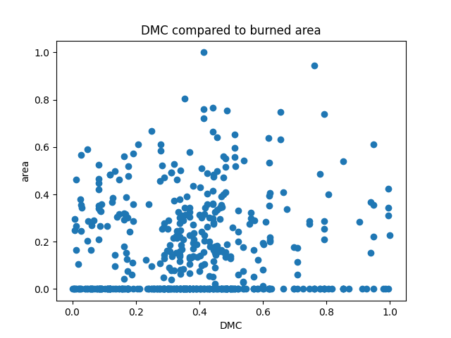
Linear?
Notes:
Graphs for the comparing the individual features to area burned

Slide 16
Linear Model Performed Best?
All models test RMSE were within 0.003 or 1.4%
Difficult regression task
Room for improvement for SVR and ANN:
More hyperparameter tuning
Deep NN

Slide 17
NN Overfitting
NN can be prone to overfitting because of the model's complexity
Not a large data set (517 samples, 12 features)
Regularization can help prevent overfitting ex. Weight decay
Notes:
Explanation for why the ANN had the largest difference between training and test RMSE
& why the ANN had the lowest training error
I did not do any regularization with the NN
This is another way to improve NN

Slide 18
SVR Stability-Based Bound
Assuming that K(x,x) ≤ r² for all x ∊ X and that L_{ε}(epsilon insensitive loss used in SVR) is bounded by M ≥ 0. For any
𝛿 > 0 the following holds with probability ≥ 𝛿
SVR is β-stable with β ≤ r²/mλ
Explanation for the good generalization seen with SVR
Source: (Mohri et al., 2018)

Slide 19
References
Cortez, P., & Morais, A. (2007). A Data Mining Approach to Predict Forest Fires using Meteorological Data.
Cybenko, G. (1989). Approximation by superpositions of a sigmoidal function. Mathematics of Control, Signals, and Systems, 2(4), 303–314. https://doi.org/10.1007/bf02551274
Mohri, M., Rostamizadeh, A., & Talwalkar, A. (2018). Foundations of machine learning. The Mit Press.
Smola, A. J., & Schölkopf, B. (2004). A tutorial on support vector regression. Statistics and Computing, 14(3), 199–222. https://doi.org/10.1023/b:stco.0000035301.49549.88
UCI Machine Learning Repository. (2008, February 28). Archive.ics.uci.edu. https://archive.ics.uci.edu/dataset/162/forest+fires
Wildfires: How They Form, and Why They’re So Dangerous. (2023, October 19). Education.nationalgeographic.org; National Geographic Society. https://education.nationalgeographic.org/resource/wildfires-how-they-form-and-why-theyre-so-dangerous/

Slide 20
Thank you! Questions?

