Slide 1
Αναλογικές μετρήσεις Python/Atmega
Σύνδεση και επικοινωνία εντός ATMega16a με αισθητήρα LM35 και αποστολή των δεδομένων μέσω UART

Slide 2
Required Hardware
ATMega16a
LM35
UART compatible device(FT232)
USBASP v2.0
Breadboard

Slide 3
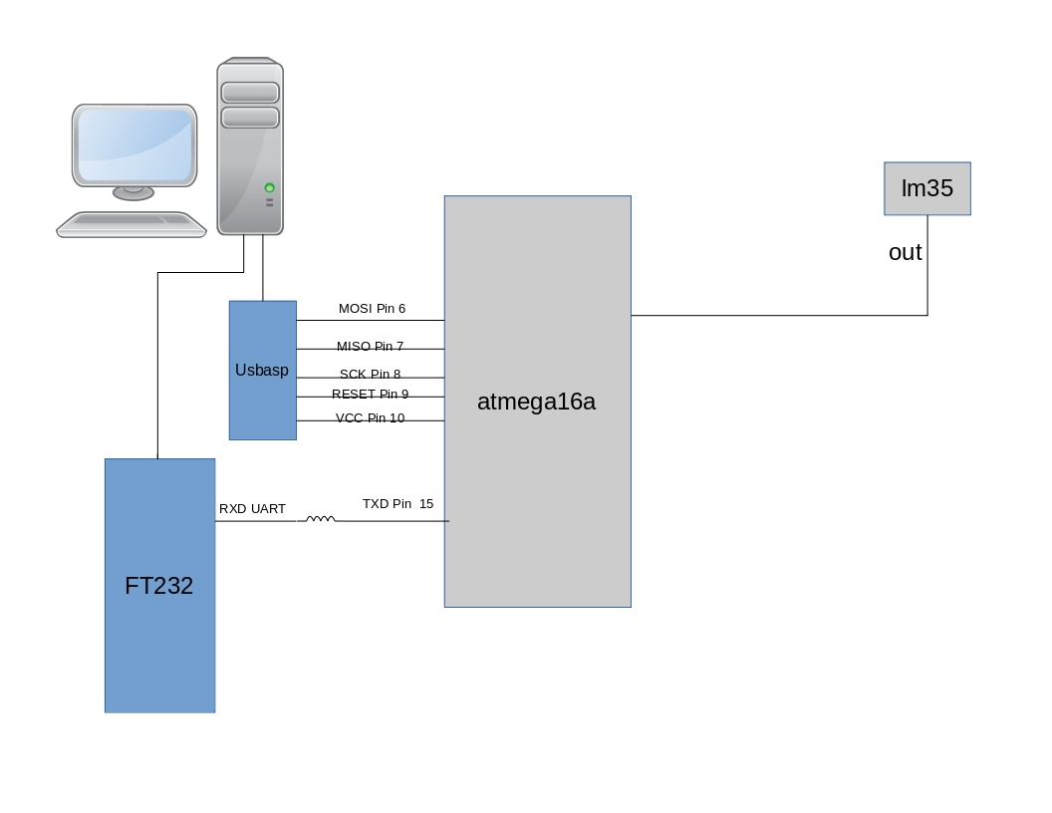
Electric Circuit Diagram

Slide 4
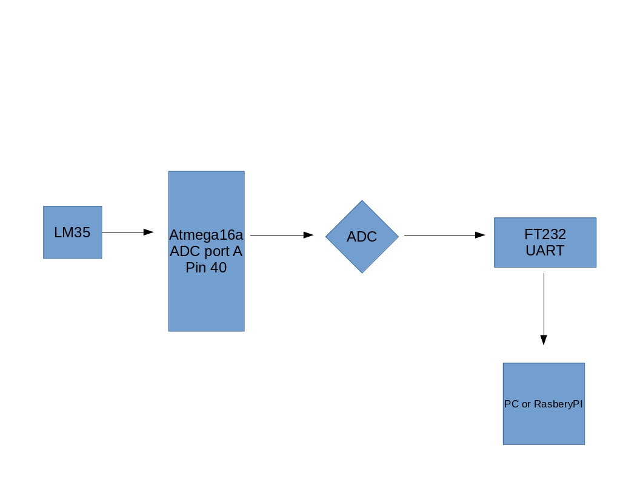
Flow Chart of Data

Slide 5
ATMega Code Flow
ADC Init with commands DDRA,ADCSRA,ADMUX
USART Init with commands ,UCSRC,UCSRB,UCSRB,UBRRH
Infinite while loop with ADC read convertion of the analog value to Digital and convertion of the digital value to Celsius with the function (Celsius = (Value * 4.88))/10
Transmit via USART the converted value to connected PC with the use of a FTDI 232

Slide 6
Software Requirements
Python 3.5
Python library Serial
Python Library Matplotlib
Python Library drawnow

Slide 7
Python Code
Open serial port /dev/ttyUSB0 with baudrate 1200.
Keep 2 list. One for temperature and one for average temperature
In a try block we create a new file and in a while block we read the values from UART. We convert the values from string to float and we keep them in the temperature list
We write the value with interpolation strings to the file
……..

Slide 8
We append the values to the temperature list
We setup matplotlib plot
We calculate the average temperature and we append the value to the average list
If the length of the two lists is bigger that 50 we remove(pop) the first element of the list. This is necessary for keeping the render of the plot at maximun 50 steps

Slide 9
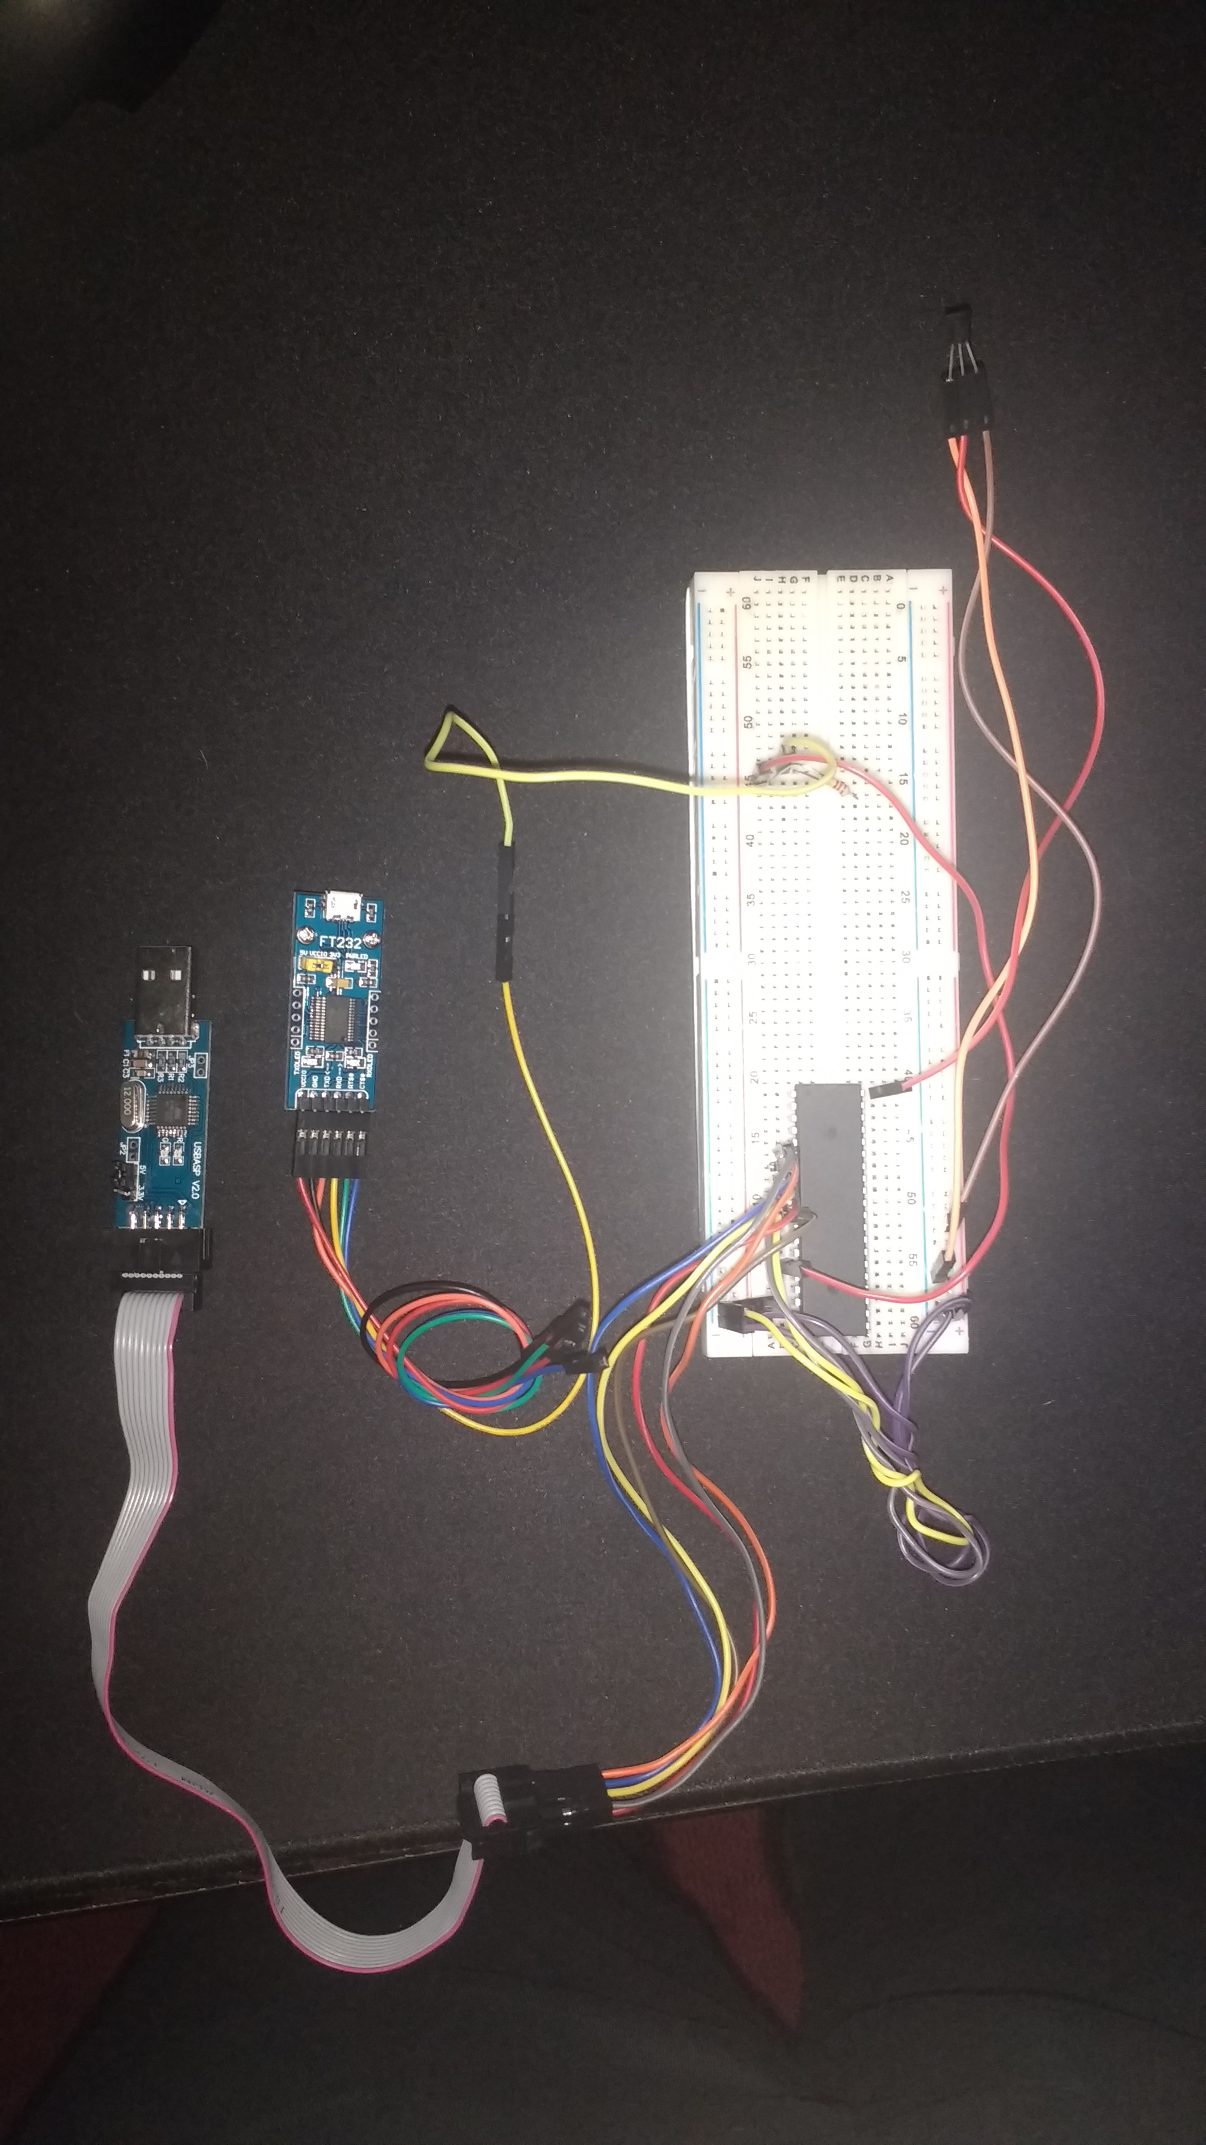
The Hardware

Slide 10
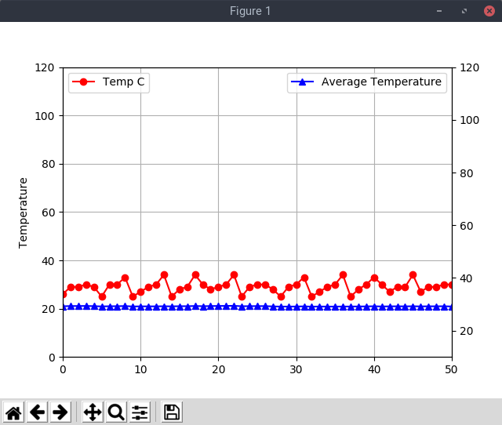
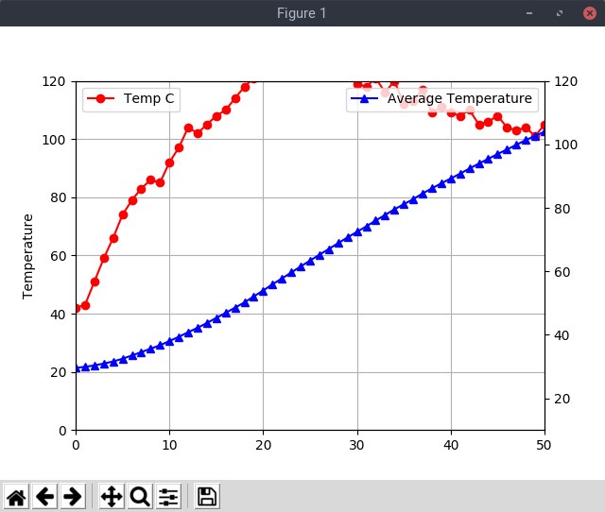
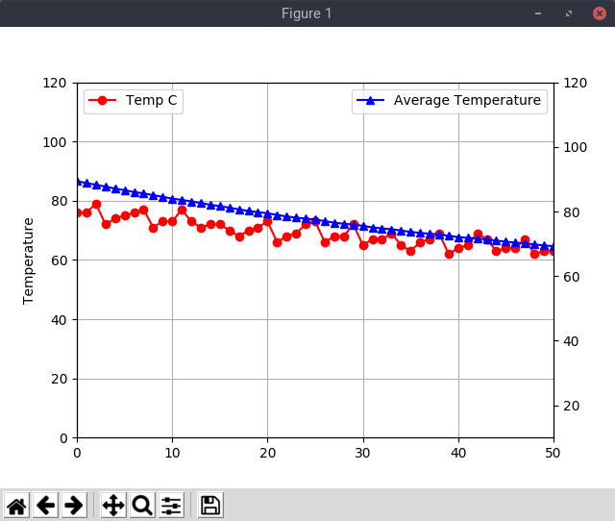
The Result(real time)

Slide 11
GitHub
Everything is on Github at:
https://github.com/gdroumpalis/Megaman.git

