Slide 1
Αναλογικές μετρήσεις Python/Atmega
Connecting and communicating ATMega16a with LM35 sensor and render live data via UART

Slide 2
Required Hardware
ATMega16a
LM35
UART compatible device(FT232)
USBASP v2.0
Breadboard

Slide 3
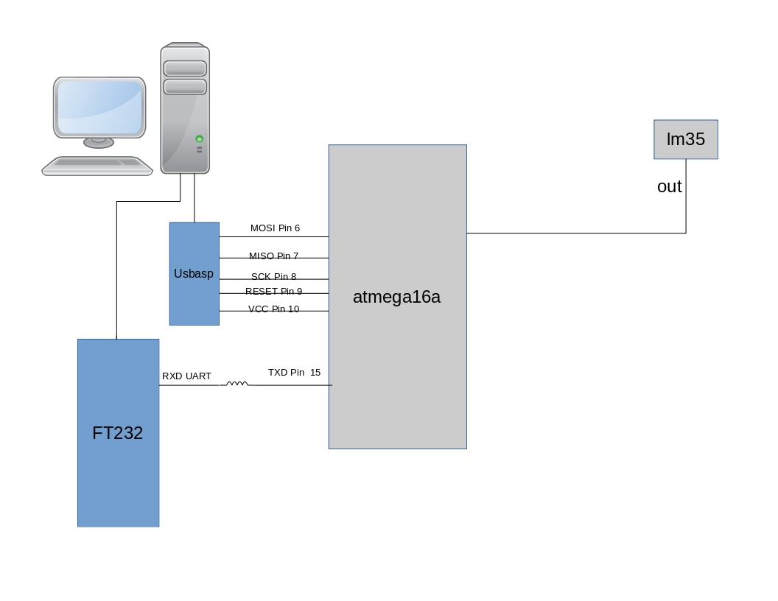
Electric Circuit Diagram

Slide 4
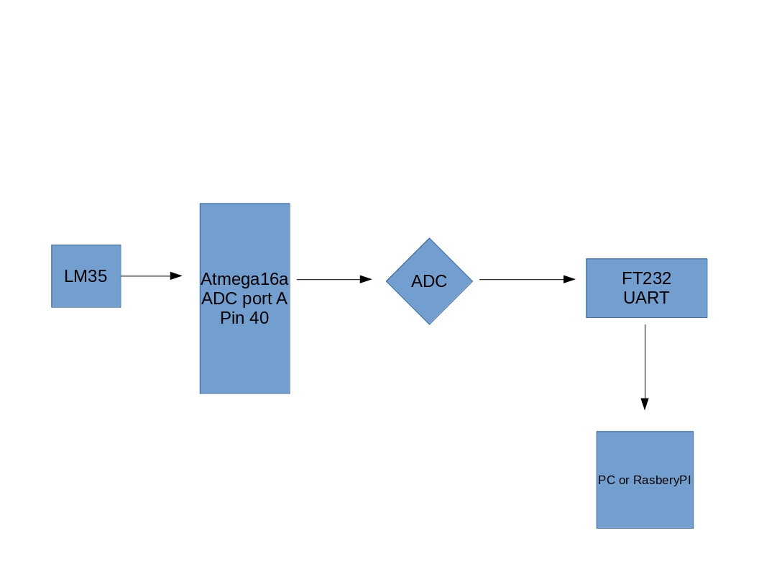
Flow Chart of Data

Slide 5
ATMega Code Flow
ADC Init with commands DDRA,ADCSRA,ADMUX
USART Init with commands ,UCSRC,UCSRB,UCSRB,UBRRH
Infinite while loop with ADC read convertion of the analog value to Digital and convertion of the digital value to Celsius with the function (Celsius = (Value * 4.88))/10
Transmit via USART the converted value to connected PC with the use of a FTDI 232

Slide 6
Software Requirements
Python 3.5
Python library Serial
Python Library Pyqtgraph
Python Library Numpy

Slide 7
Python Code
Open serial port /dev/ttyUSB0 with baudrate 1200.
Keep 2 list. One for temperature and one for average temperature
In a try block we create a new file and in a while block we read the values from UART. We convert the values from string to float and we keep them in the temperature list
We write the value with interpolation strings to the file
……..

Slide 8
We sift both the average and temperature array by 1
We append the values to the temperature numpy.array
We setup pyqtgraph plot
We calculate the average temperature and we append the value to the average numpy array

Slide 9
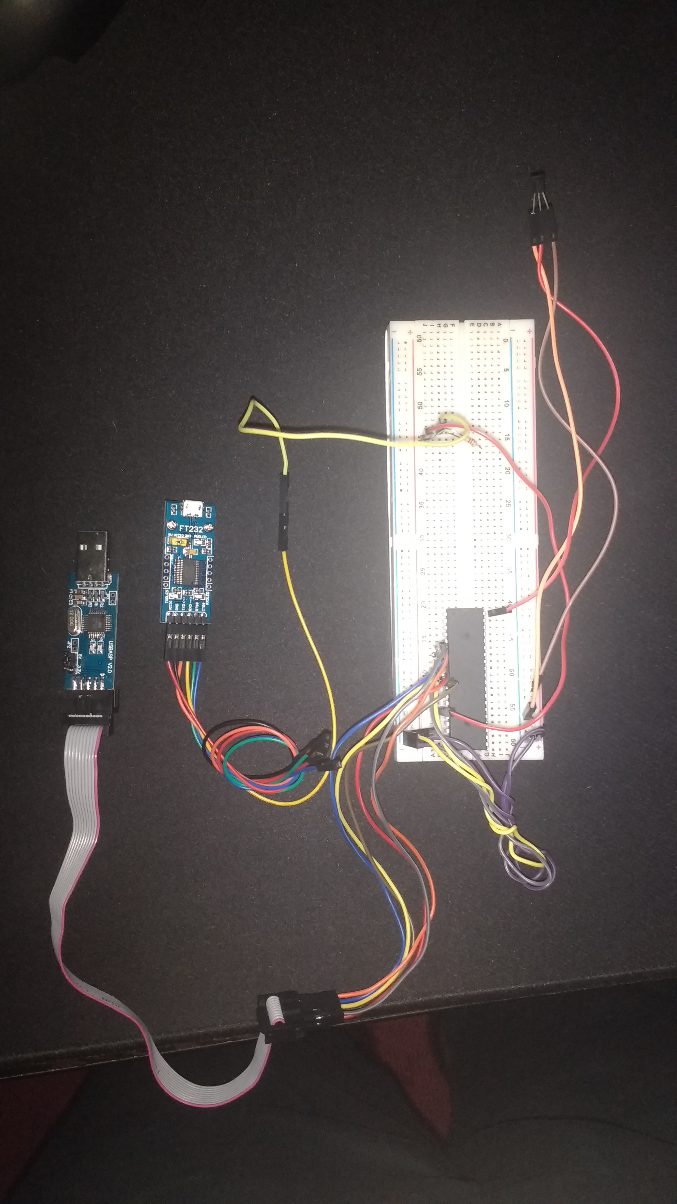
The Hardware

Slide 10
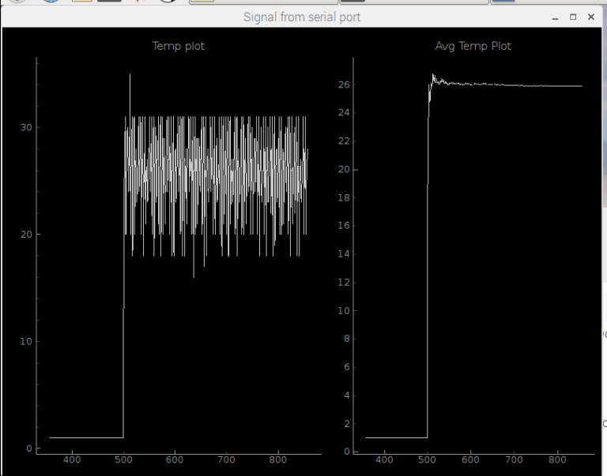
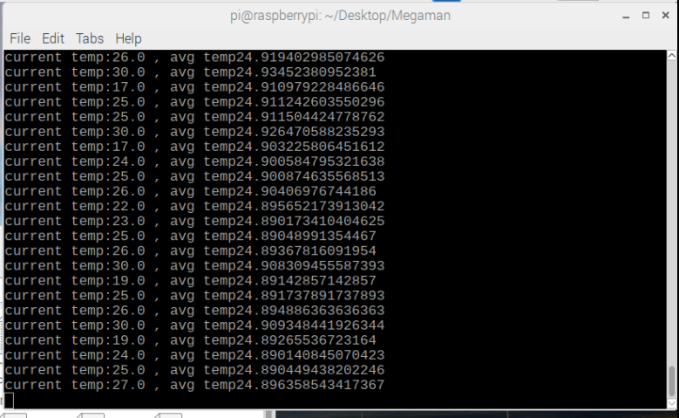
The Result(real time)

Slide 11
GitHub
Everything is on Github at:
https://github.com/gdroumpalis/Megaman.git

