Slide 1
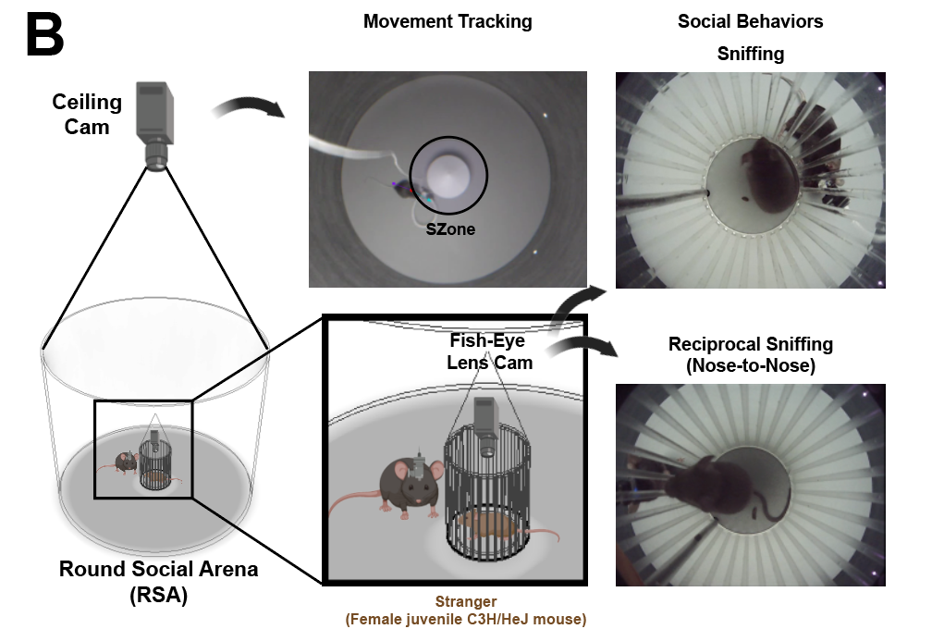
Round Social Arena (RSA)
Sunwhi Kim

Slide 2
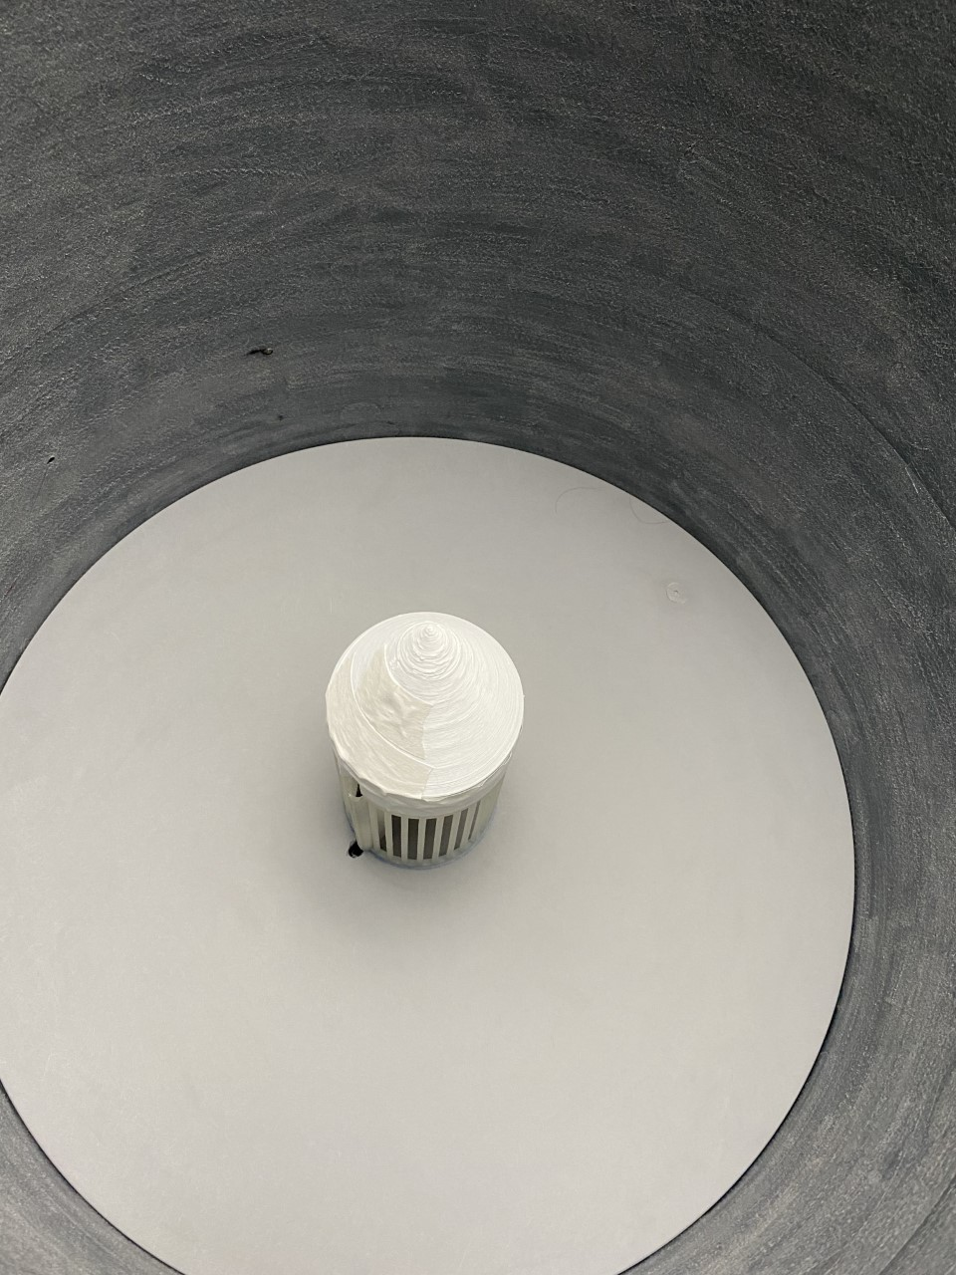
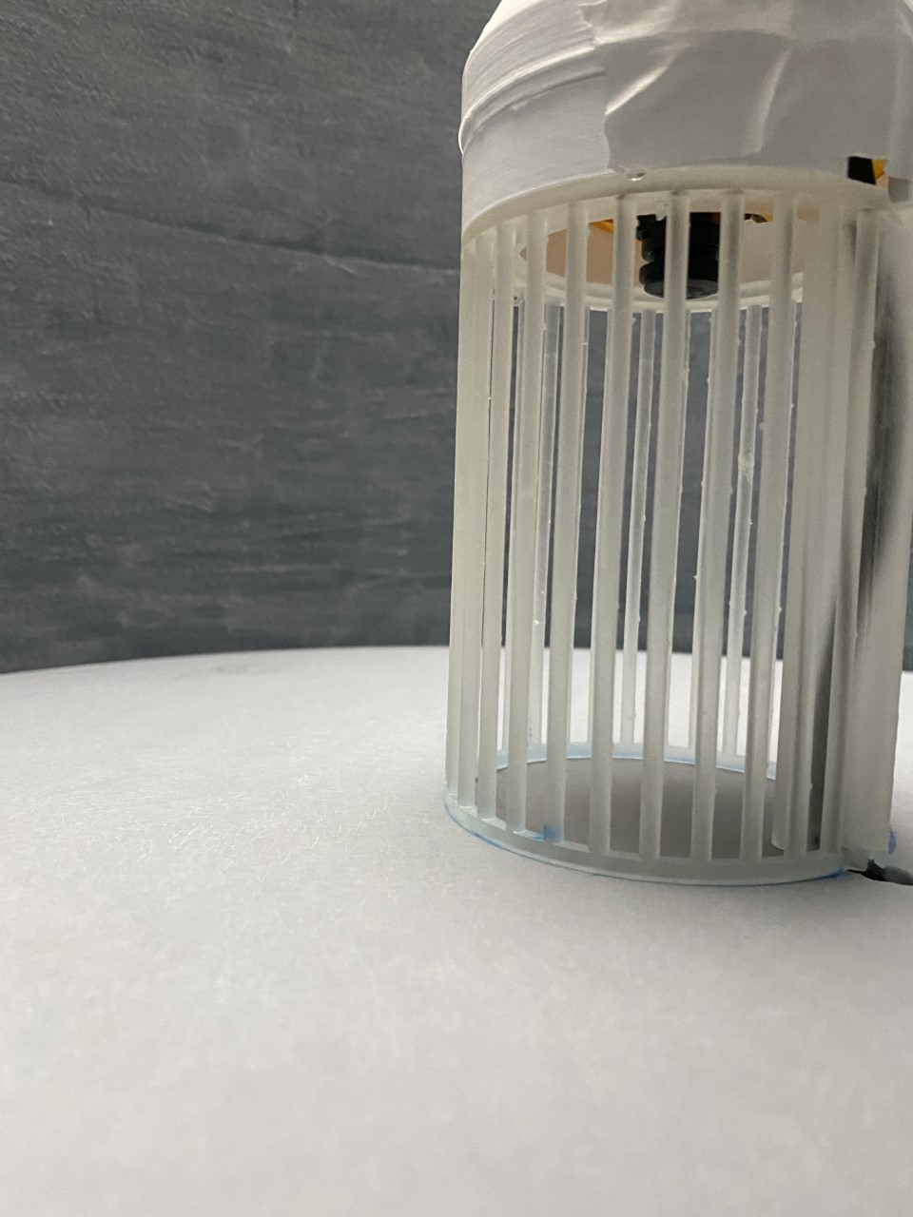

Slide 3
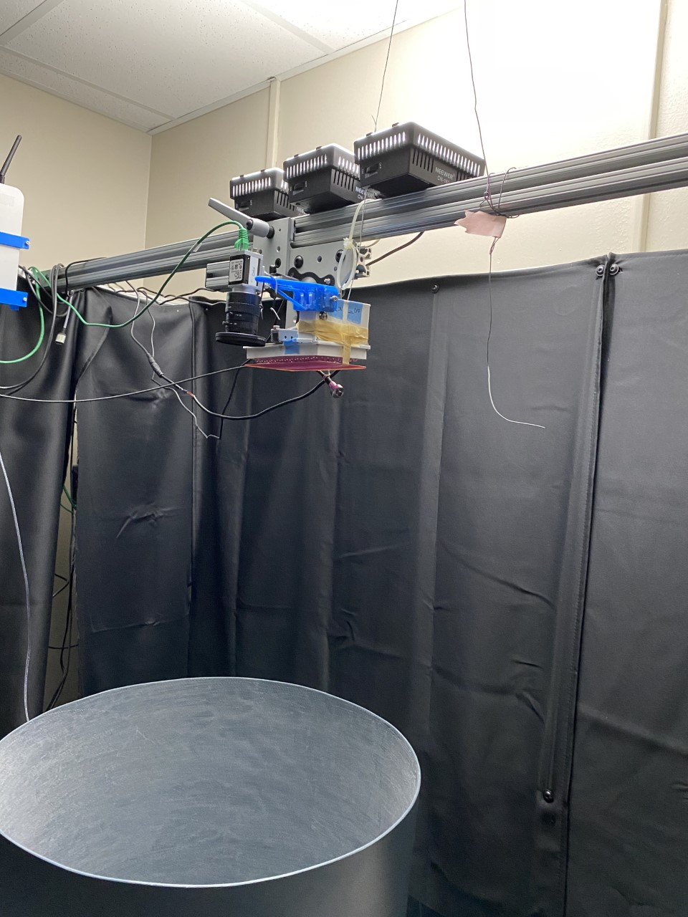

Slide 4
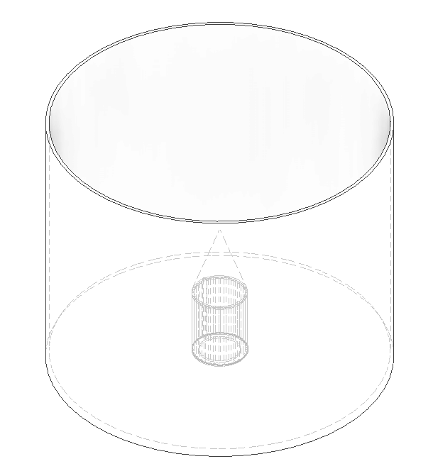
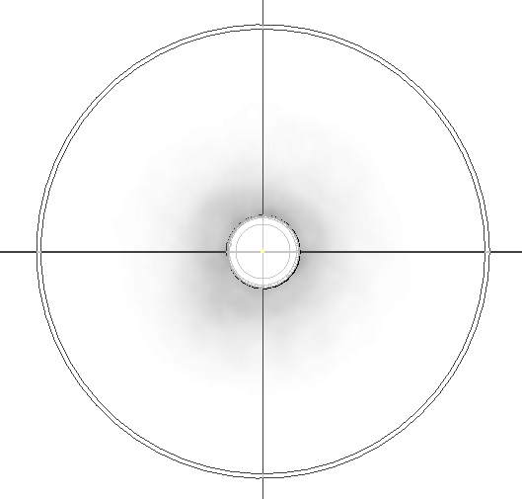
ID: 490mm
OD: 500mm

Slide 5
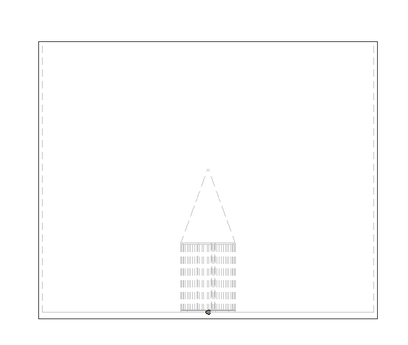
H: 450mm
T: 10mm

Slide 6
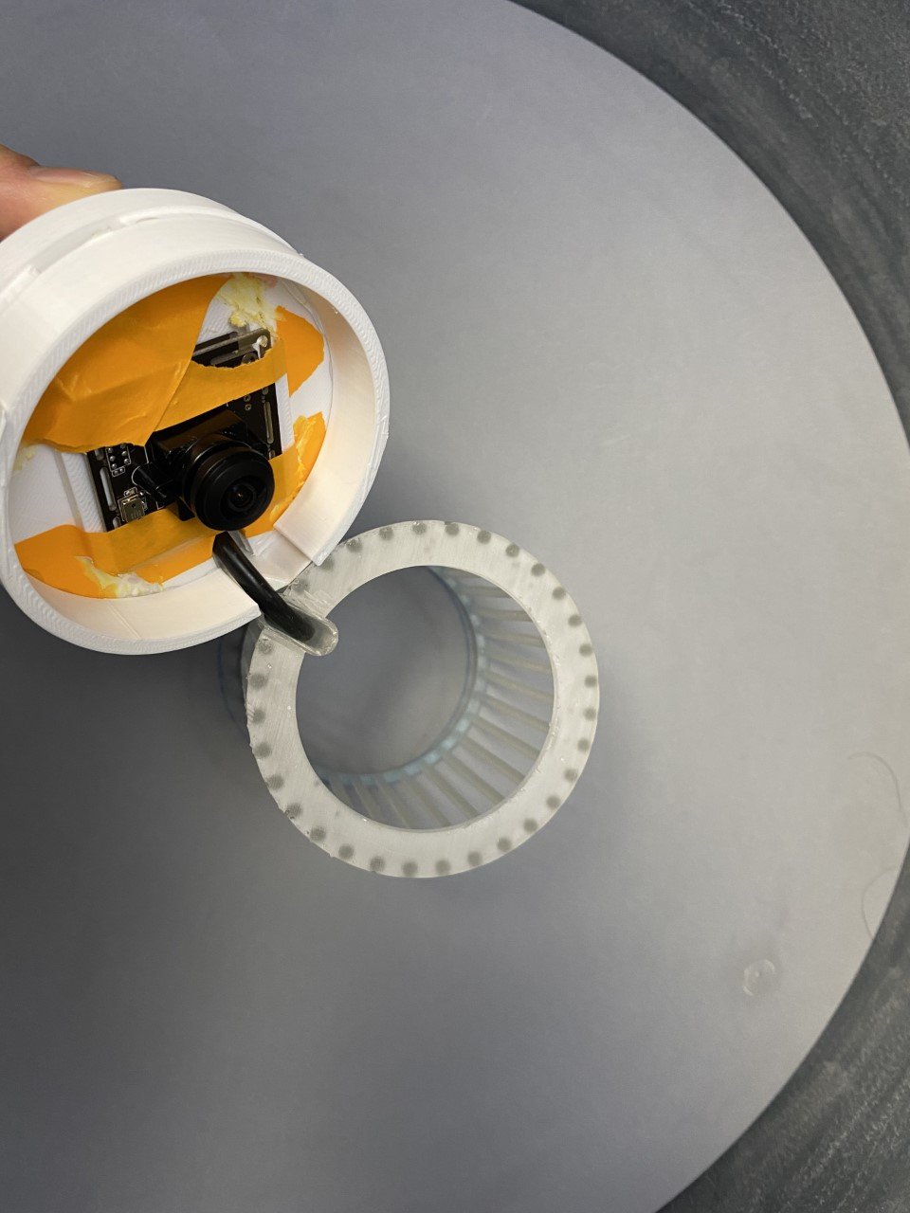
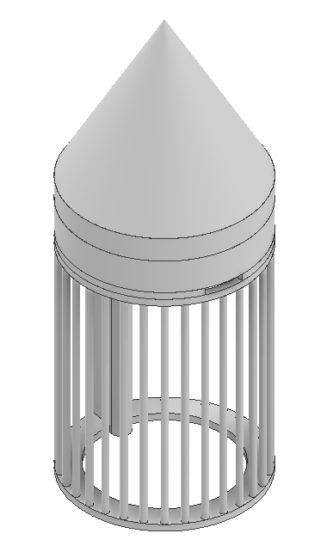
3D printed parts
Cone
Spacer
Camera holder
Translucent Cage

Slide 7
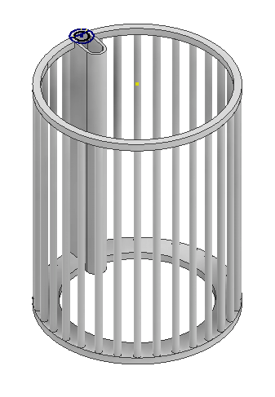
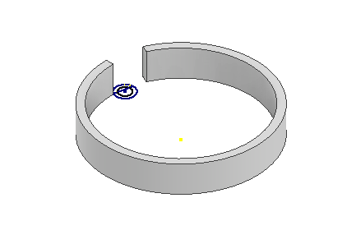
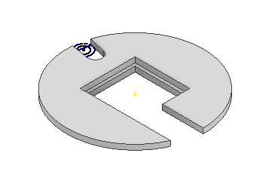
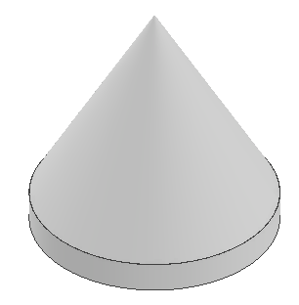
Camera cable hole
CameraHolder.stl
Recommend printing with plain ABS printer
Spacer.stl
Recommend printing with plain ABS printer
TranslucentCage.stl
Recommend printing with Form2 or Form3 with transparent resin
Cone.stl
Recommend printing with plain ABS printer

Slide 8
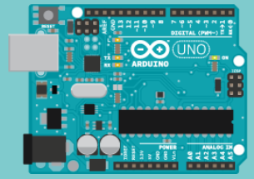
Wiring Schematics
Ceiling Cam
Connected to
Behavior Tracking System
TTL signal from Behavior Tracking System
Arduino
Fish-Eye Lens
Webcam
Infrared
LED
PC
USB
Extension

Slide 9
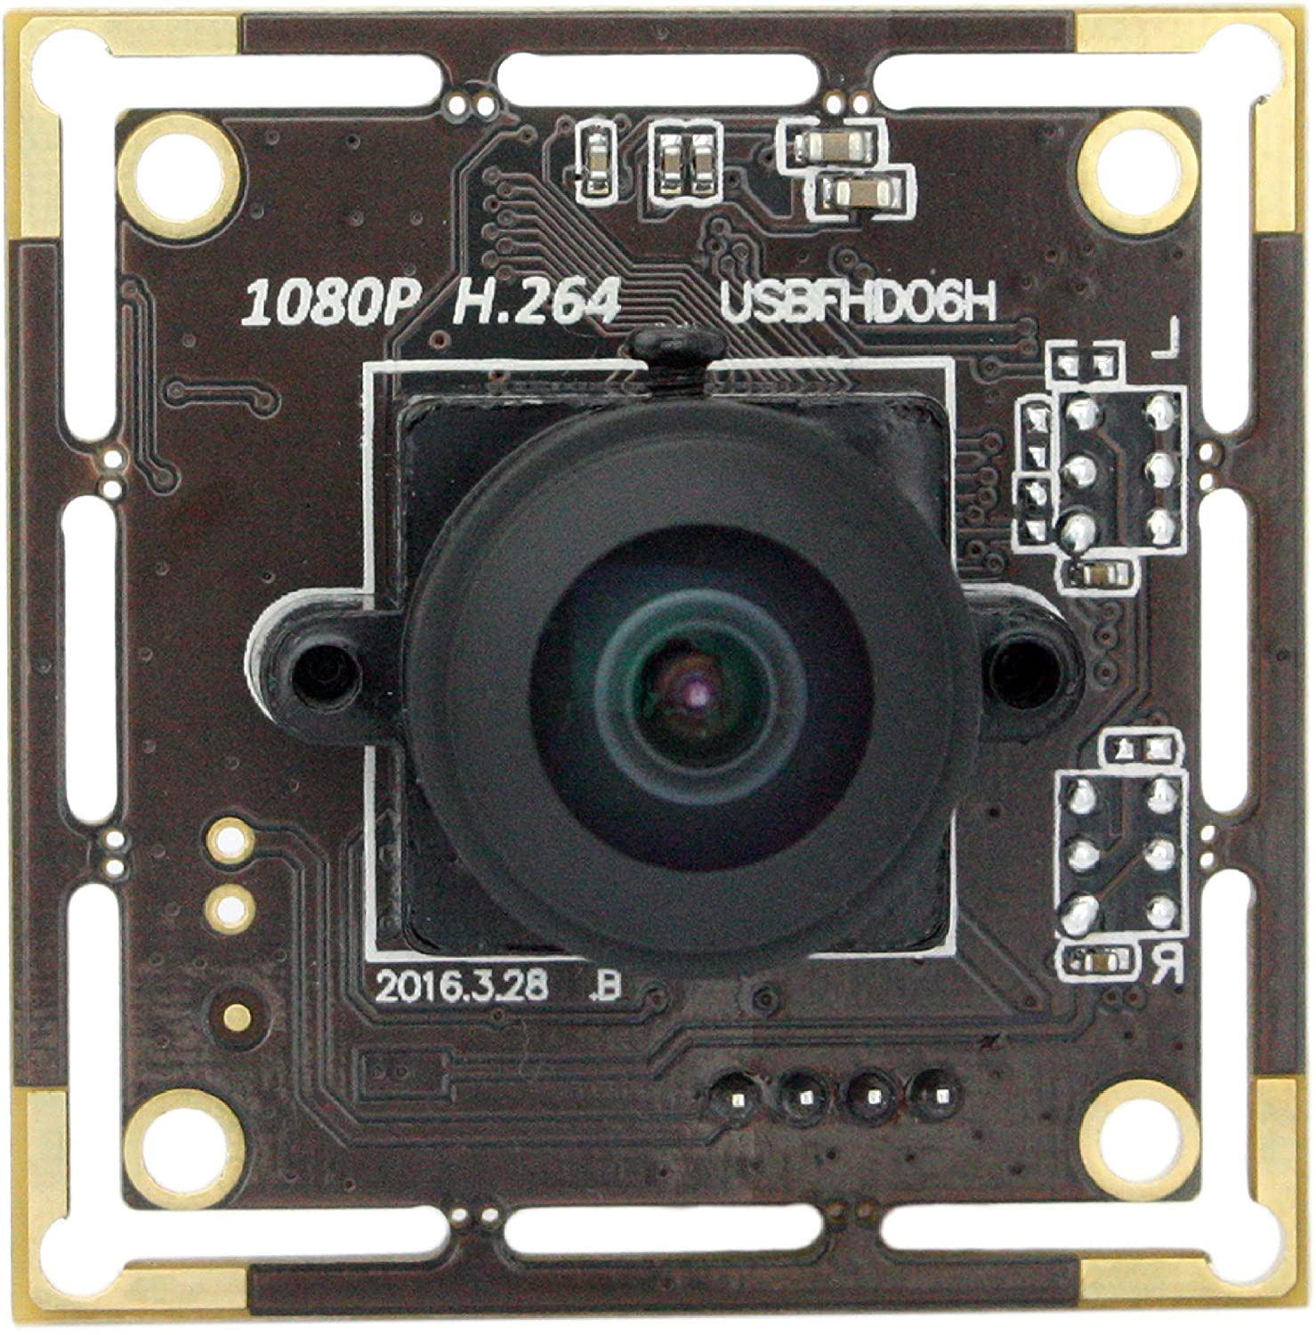
Fisheye lens webcam
https://www.amazon.com/SVPRO-Illumination-Camera-Module-Fisheye/dp/B07C1N624T
SVPRO Fisheye Lens 180 Degree USB Camera Module HD 1080P, Sony IMX322 USB Camera Board with Microphone, 0.01Lux Low Light Web Security Cam H.264 Video Output

