Slide 1
MOLSSI Workshop 2018: Anaconda Junyper Notebooks OpenMM/MDTraj Git and Git Hub
25 July 2018
Garrett Santis

Slide 2

MolSSI- The Molecular Sciences Software Institute
Group of scientists with software engineering backgrounds
Create software tools for computational sciences
Focus on the innovation of software, standards, and practices for scientists to use for their research

Slide 3
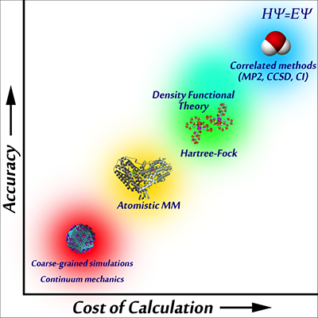
Molecular Mechanics

Slide 4
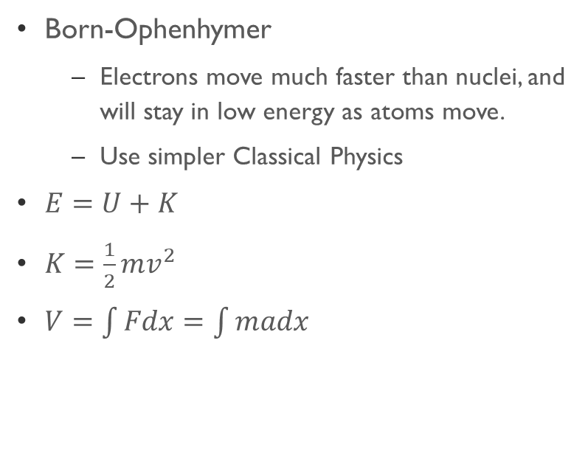
Molecular Mechanics
What it is…
Major Takeaways…
Born-Ophenhymer
Electrons move much faster than nuclei, and will stay in low energy as atoms move.
Use simpler Classical Physics
$E=U+K$
$K=\frac{1}{2}mv^{2}$
$V=\int{Fdx}=\int{madx}$
Bonds are classified through classical spring potentials and parameterized periodic functions
Molecules interact through electrostatic and Lenard-Jones potentials

Slide 5
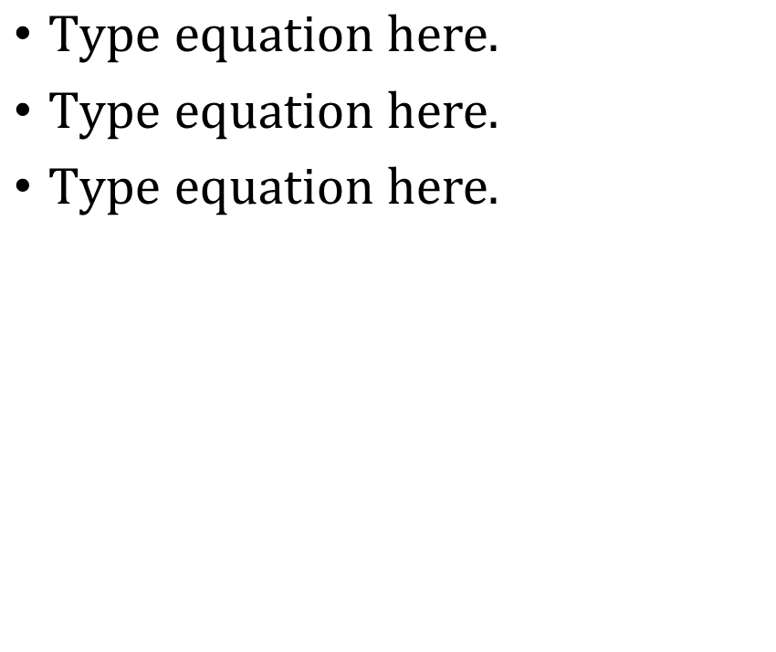
Molecular Mechanics
Bond Potential
Angle Potential
Torsion Potential
Electrostatic Potential
VanDer Waals Potential

Slide 6
Molecular Dynamics
What it is…
Important things to take away…
Take an input, change it based on forces, repeat.
You need…
Atomic Properties(where, how heavy, charges etc.)
Connectivity (bonds and such)
Force Field
Integrator (How these will change as simulation runs)
Constants (Isothermal/Isobaric systems)
Specified Timestep and Length
Chemistry cannot be conducted. Bonds can be neither broken or made.
Again, bonding cannot change.
Timesteps are about 1 fs (1x10-15 sec)
Runs go for ns-ms of molecular time

Slide 7
Molecular dynamics
Important things to take away…
Chemistry cannot be conducted. Bonds can be neither broken or made.
Again, bonding cannot change.
Timesteps are about 1 fs (1x10⁻¹⁵ sec)
Runs go for ns-ms of molecular time

Slide 8
Anaconda
Python setup for multiple uses
You can run scripts (call python <scripy_name>.py)
You can open Jupyter notebooks (call jupyter notebook)
You can run interactive python (call ipython)
All of these can be run through anaconda prompt (windows) or terminal (mac)
Oher programs, such as Git can run through anaconda prompt.

Slide 9
Use openMM and MDTraj in anaconda
Download packages
conda install openmm -c omnia
conda install mdtraj -c omnia
conda config --add channels conda-forge
conda install nglview -c bioconda
jupyter-nbextension install widgetsnbextension --py --sys-prefix
jupyter-nbextension enable –-py –-sys-prefix widgetsnbextension
jupyter-nbxtension enable nglview –-py –-sys-prefix

Slide 10
OpenMM
What Is it?
Benefits
Molecular mechanics and forcefield calculator able to do molecular dynamics under python and C++ languages.
Freeware that has many incorporated files for easy use
Implemented through python script
Flexible for customizable input files for force fields and topology
Constantly being updated by both scientists and software engineers through GitHub
Can now be implemented on GPUs, which are much faster.

Slide 11
OpenMM
Creats small function app for many specific purposes throughout OpenMM
Imports main program
From simtk.openmm import app
Import simtk.openmm as mm
From simtk import unit
From sys import stdout
Import time as time
Pdb=mm.PDBFile(‘<file.pdb>’)
Forcefield=mm.ForceField(‘<file>.xml’)
Imports units for good converstions
Creats a thingy for printing output to screen
Time is a tool you can put on the wall
Reads PDB file for topology
Reads force field for MM analysis

Slide 12
OpenMM
Creates and edits forcefield.
Allows for edits such as constraining H vibrations (can run at 2 fs now!!!!)
Specify the Integrator, such as Langevin Integrator, VVVR Integrator, BAOAB Integrator, Generalized hybrid Monte Carlo. Also where you can make your system isothermal or isobaric
system=<forcefield>.
createSystem(…)
Integrator=mm.<TypeOfIntegrator>
(<constraint>)
Simulation=app.Sumulation(<pdb>.topology , system, integrator)
Simulation.context.setPositions
(<pdb>.positions)
Creates Simulation using stuff before
Sets environment for simulation to start!

Slide 13
OpenMM

Slide 14
OpenMM
Find Local minima as a starting point
Simulation.minimizeEnergy()
Simulation.context.setVelocitiesToTemperature
(<#>*unit.kelvin)
Simulation.reports.append(app.StateDataReporter
(stdout,<stuff>)
Simulation.step(<#>)
Simulation.reporters.clear()
Simulatoin.reporters.append(app.DCDReporter
(<file.dcd>,<#>)
Simulation.reporters.append(app.StateDataReporter
(stdout,<stuff>)
Simulation.step(<#>)
Add Kinetic Energy to reach Temp
Reads out equilibriation
Loops simulation through # steps
Clear reporter for number of steps
Reads output to a DCD file
Reads out reports to screen
Loops through simulation for # steps

Slide 15
MDTraj
What is it
Benefits
Another package free for python made to read .dcd and analize data.
Can look at population density for enegies across parameters
Can look at parameters over time to see how molecule changes
Very Plastic in that you pick what you output and how you output it.

Slide 16
MDTraj
Imports MDTraj, the important part
Numpy for data management
Import mdtraj as md
Import numpy as np
Import matplotlib.pyplot as plt
Import statsmodels.api as sm
Import nglview as ngl
Import math as math
kB=8.31446/1000
Temp=298.15
Traj=md.load(‘<file>.dcd’, top=‘<File>.pdb’)
For plotting
To smooth plot
This allows for visualization and movies!!!
Can’t make pie without math
Values for Statistical Thermodynamics
Loads output and topology for analysis

Slide 17
MDTraj-Visualize
Visualize= ngl.show_mdtraj(traj)
Visualize

Slide 18
MDTraj-Energetic Studies
Indicies=[]
Obj=md.compute_<type>(traj,
[indices])*<unit_convert>
Objc,bine,other=plt.hsit(obj)
Objc[objc==0]=0.1
Pmf=-kB*Temp*np.log(objc)
Pmf=pmf-np.min(pmf)
Binc=(bine[1:]+bine[:-1])/2
Pmfs=sm.nonparametric.lowess
(pmf,binc,frac=0.05)

Slide 19
GitHub and Git
Repository
Place to store files, and back them up
Share documents for collaboration
Merge versions for program design
OpenMM and MDTraj are maintained communally through GitHub.

Slide 20
Thank You MolSSI for putting the Workshop together

Slide 21
Welcome to The Extra section with Links and More detailed instructions

