Slide 1
MOLSSI Workshop 2018: Anaconda Junyper Notebooks OpenMM/MDTraj Git and Git Hub
25 July 2018
Garrett Santis

Slide 2

MolSSI- The Molecular Sciences Software Institute
Group of scientists with software engineering backgrounds
Create software tools for computational sciences
Focus on the innovation of software, standards, and practices for scientists to use for their research

Slide 3
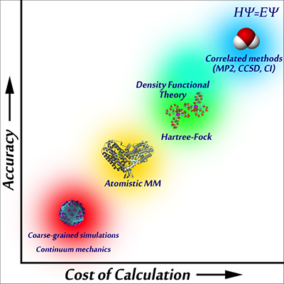
Molecular Mechanics

Slide 4
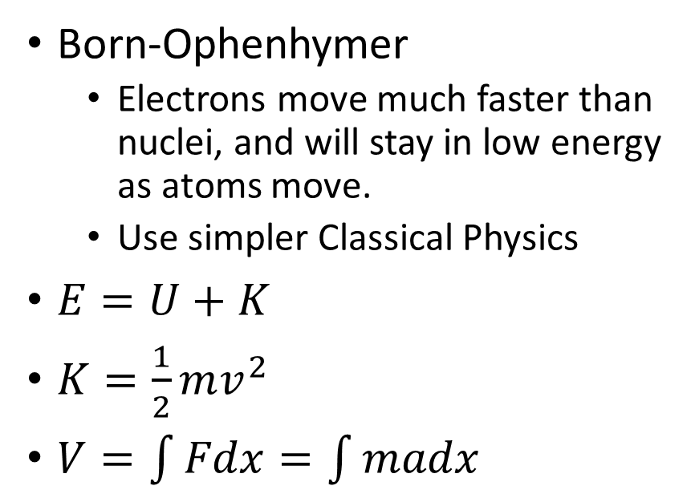
Molecular Mechanics
What it is…
Major Takeaways…
Born-Ophenhymer
Electrons move much faster than nuclei, and will stay in low energy as atoms move.
Use simpler Classical Physics
$E=U+K$
$K=\frac{1}{2}mv^{2}$
$V=\int{Fdx}=\int{madx}$
Bonds are classified through classical spring potentials and parameterized periodic functions

Slide 5
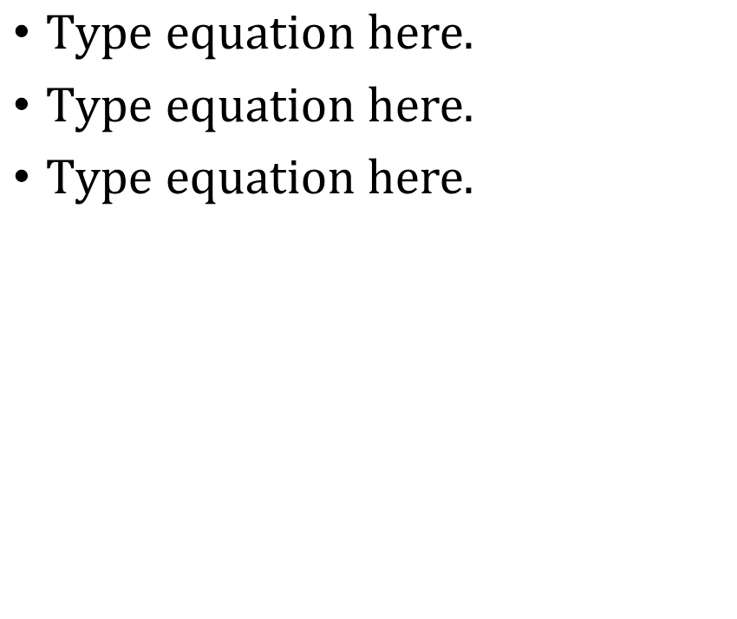
Molecular Mechanics
Bond Potential
Angle Potential
Torsion Potential
Electrostatic Potential
VanDer Waals Potential

Slide 6
Molecular Dynamics
What it is…
Important things to take away…
Take an input, change it based on forces, repeat.
You need…
Atomic Properties(where, how heavy, charges etc.)
Connectivity (bonds and such)
Force Field
Integrator (How these will change as simulation runs)
Constants (Isothermal/Isobaric systems)
Specified Timestep and Length
Chemistry cannot be conducted. Bonds can be neither broken or made.
Again, bonding cannot change.
Timesteps are about 1 fs (1x10-15 sec)
Runs go for ns-ms of molecular time

Slide 7
Molecular dynamics
Important things to take away…
Chemistry cannot be conducted. Bonds can be neither broken or made.
Again, bonding cannot change.
Timesteps are about 1 fs (1x10⁻¹⁵ sec)
Runs go for ns-ms of molecular time

Slide 8
Anaconda
Python setup for multiple uses
You can run scripts (call python <scripy_name>.py)
You can open Jupyter notebooks (call jupyter notebook)
You can run interactive python (call ipython)
All of these can be run through anaconda prompt (windows) or terminal (mac)
Oher programs, such as Git can run through anaconda prompt.

Slide 9
OpenMM

Slide 10
MDTraj

Slide 11
GitHub and Git

