Slide 1
MOLSSI Workshop 2018: Anaconda Junyper Notebooks OpenMM/MDTraj Git and Git Hub
25 July 2018
Garrett Santis

Slide 2

MolSSI- The Molecular Sciences Software Institute
Group of scientists with software engineering backgrounds
Create software tools for computational sciences
Focus on the innovation of software, standards, and practices for scientists to use for their research

Slide 3
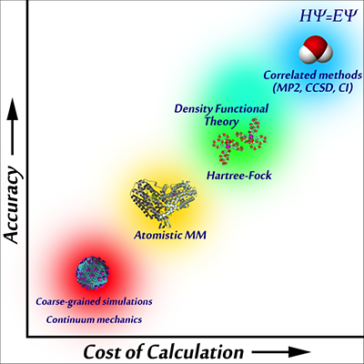
Molecular Mechanics

Slide 4
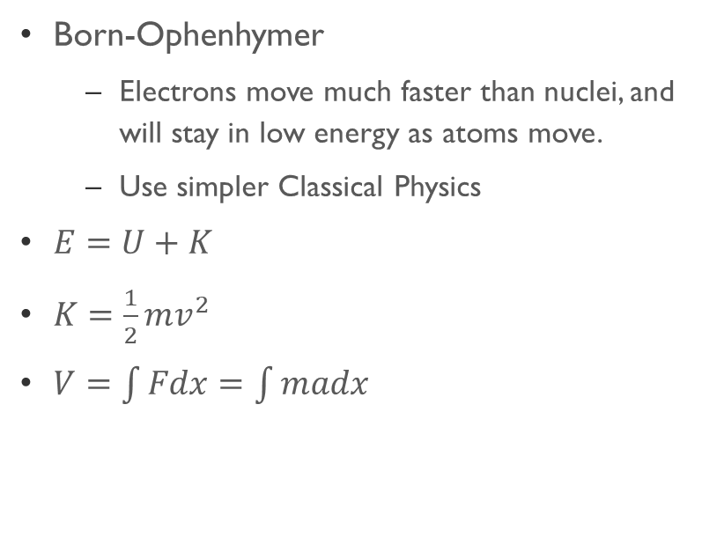
Molecular Mechanics
What it is…
Major Takeaways…
Born-Ophenhymer
Electrons move much faster than nuclei, and will stay in low energy as atoms move.
Use simpler Classical Physics
$E=U+K$
$K=\frac{1}{2}mv^{2}$
$V=\int{Fdx}=\int{madx}$
Bonds are classified through classical spring potentials and parameterized periodic functions
Molecules interact through electrostatic and Lenard-Jones potentials

Slide 5
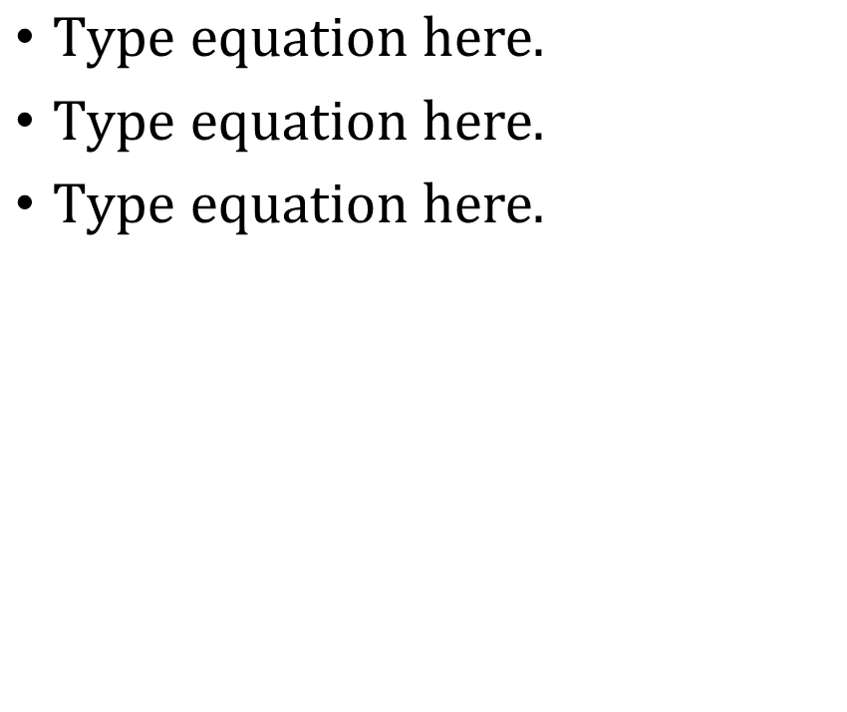
Molecular Mechanics
Bond Potential
Angle Potential
Torsion Potential
Electrostatic Potential
VanDer Waals Potential

Slide 6
Molecular Dynamics
What it is…
Important things to take away…
Take an input, change it based on forces, repeat.
You need…
Atomic Properties(where, how heavy, charges etc.)
Connectivity (bonds and such)
Force Field
Integrator (How these will change as simulation runs)
Constants (Isothermal/Isobaric systems)
Specified Timestep and Length
Chemistry cannot be conducted. Bonds can be neither broken or made.
Again, bonding cannot change.
Timesteps are about 1 fs (1x10-15 sec)
Runs go for ns-ms of molecular time

Slide 7
Molecular dynamics
Important things to take away…
Chemistry cannot be conducted. Bonds can be neither broken or made.
Again, bonding cannot change.
Timesteps are about 1 fs (1x10⁻¹⁵ sec)
Runs go for ns-ms of molecular time

Slide 8
Anaconda
Python setup for multiple uses
You can run scripts (call python <scripy_name>.py)
You can open Jupyter notebooks (call jupyter notebook)
You can run interactive python (call ipython)
All of these can be run through anaconda prompt (windows) or terminal (mac)
Oher programs, such as Git can run through anaconda prompt.

Slide 9
Use openMM and MDTraj in anaconda
Download packages
conda install openmm -c omnia
conda install mdtraj -c omnia
conda config --add channels conda-forge
conda install nglview -c bioconda
jupyter-nbextension install widgetsnbextension --py --sys-prefix
jupyter-nbextension enable –-py –-sys-prefix widgetsnbextension
jupyter-nbxtension enable nglview –-py –-sys-prefix

Slide 10
OpenMM
Molecular mechanics and forcefield calculator able to do molecular dynamics under python and C++ languages.
Freeware that has many incorporated files for easy use
Integrators
Langevin Integrator
VVVR Integrator
BAOAB Integrator
Generalized hybrid Monte Carlo
Force Fields
Charmm and Amber Force Fields

Slide 11
OpenMM
From simtk.openmm import app
Import simtk.openmm as mm
From simtk import unit
From sys import stdout
Import time as time
Pdb=mm.PDBFile(‘<file.pdb>’)
Forcefield=mm.ForceField(‘<file>.xml’)

Slide 12
OpenMM
system=<forcefield>.createSystem(…)
Integrator=mm.<TypeOfIntegrator>(<constraint>)
Simulation=app.Sumulation(<pdb>.topology, system, integrator)
Simulation.context.setPositions(<pdb>.positions
Simulation.minimizeEnergy()
Simulation.context.setVelocitiesToTemperature(<#>*unit,kelvin)
Simulation.reports.append(app.StateDataReporter(stdout,<stuff>)
Simulation.step(<#>

Slide 13
OpenMM
Simulation.reporters.clear()
Simulatoin.reporters.append(app.DCDReporter(<file.dcd>,<#>)
Simulation.reporters.append(app.StateDataReporter(stdout,<stuff>)
Simulation.step(<#>)
Your simulation has been completed and data read into a dcd file for MDTraj to analyses

Slide 14
MDTraj
What is it
Another package free for python made to read .dcd and analize data.
Can look at population density for enegies across parameters
Can look at parameters over time to see how molecule changes

Slide 15
MDTraj
Import mdtraj as md
Import numpy as np
Improt matplotlib.pyplot as plt
Import statsmodels.api as sm
Import nglview as ngl
Import math as math
kB=8.31446/1000
Temp=298.15
Traj=md.load(‘<file>.dcd’, top=‘<File>.pdb’)

Slide 16
MDTraj-Visualize
Visualize= ngl.show_mdtraj(traj)
Visualize

Slide 17
MDTraj-Energetic Studies
Indicies=[]
Obj=md.compute_<type>(traj,
[indices])*<unit_convert>
Objc,bine,other=plt.hsit(obj)
Objc[objc==0]=0.1
Pmf=-kB*Temp*np.log(objc)
Pmf=pmf-np.min(pmf)
Binc=(bine[1:]+bine[:-1])/2
Pmfs=sm.nonparametric.lowess
(pmf,binc,frac=0.05)

Slide 18
GitHub and Git
Repository
Place to store files, and back them up
Share documents for collaboration
Merge versions for program design
OpenMM and MDTraj are maintained communally through GitHub.

