Slide 1

Angular
Web Development Workshop - Day 3
- GDSC CVR
- Anirudh Varma & Shubh A Chudasama

Slide 2
What is Angular?
Angular is a development platform, built on TypeScript. As a platform, Angular includes:
A component-based framework for building scalable web applications
A collection of well-integrated libraries that cover a wide variety of features, including routing, forms management, client-server communication, and more
A suite of developer tools to help you develop, build, test, and update your code

Slide 3
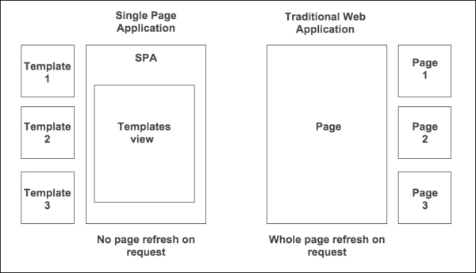
SPA (Single-page application)
An SPA (Single-page application) is a web app implementation that loads only a single web document, and then updates the body content of that single document via JavaScript APIs.

Slide 4
Why use Angular?
Create dynamic frontend apps & Uls
Full featured framework (router, http, etc)
Integrated TypeScript (optional)
RxJS - efficient, asynchronous programming
Test-friendly
Popular in enterprise business
Supported by Google

Slide 5
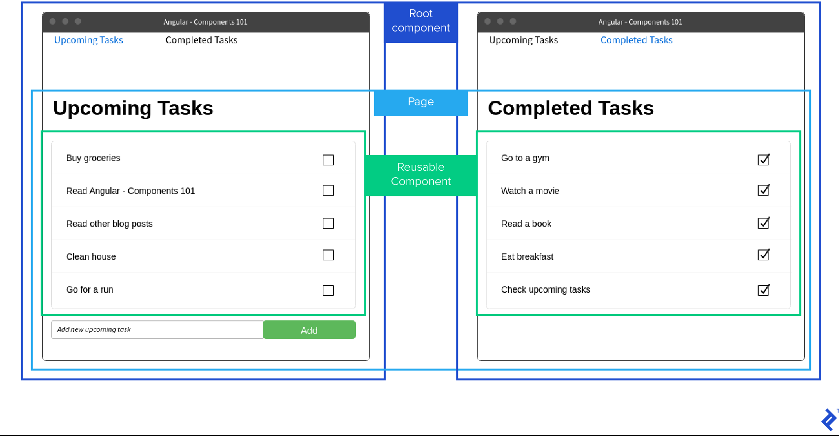

Slide 6
Setting up Angular
Prerequisites: NodeJS, Code Editor (Visual Studio Code)
Install the Angular CLI
You use the Angular CLI to create projects, generate application and library code, and perform a variety of ongoing development tasks such as testing, bundling, and deployment.
npm install -g @angular/cli
To create an angular app: ng new <app-name>
To run the application:
cd app-name
ng serve --open
App opens in http://localhost:4200/

Slide 7
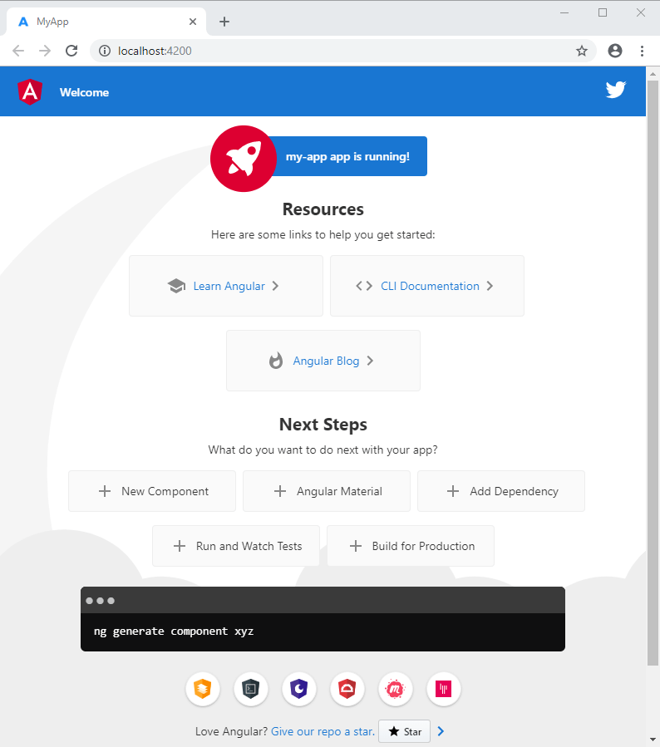

Slide 8
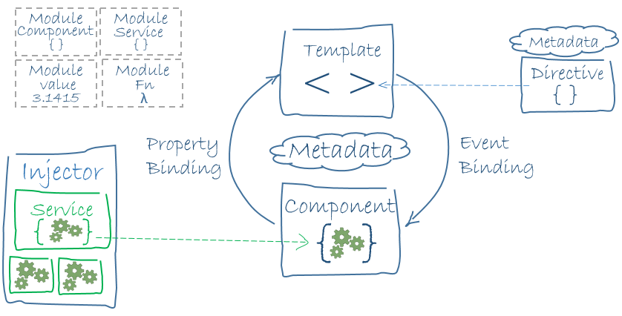
Angular Architecture
Angular features:
Components
Templates
Directives
Dependency injection

Slide 9
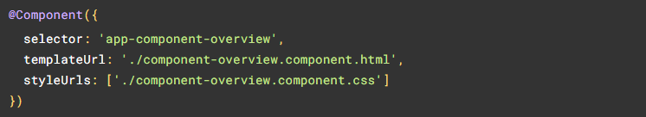
Angular Components
Components are the main building block for Angular applications. Each component consists of:
An HTML template that declares what renders on the page
A TypeScript class that defines behavior
A CSS selector that defines how the component is used in a template
Optionally, CSS styles applied to the template

Slide 10
Creating an Angular Component
From a terminal window, navigate to the directory containing your application.
Run the ng generate component <component-name> command, where <component-name> is the name of your new component.
By default, this command creates the following:
A directory named after the component
A component file, <component-name>.component.ts
A template file, <component-name>.component.html
A CSS file, <component-name>.component.css
A testing specification file, <component-name>.component.spec.ts

Slide 11
Template
Templates: In Angular, a template is a chunk of HTML. Use special syntax within a template to build on many of Angular’s features.
Template features:
Interpolation
Property binding
Event binding
Class & Style binding

Slide 12


Interpolation
Interpolation refers to embedding expressions into marked up text. By default, interpolation uses the double curly braces {{ and }} as delimiters.
To illustrate how interpolation works, consider an Angular component that contains a currentCustomer variable:
Use interpolation to display the value of this variable in the corresponding component template:
Angular replaces currentCustomer with the string value of the corresponding component property. In this case, the value is Maria.

Slide 13


Property binding
Property binding in Angular helps you set values for properties of HTML elements or directives. Use property binding to do things such as toggle button features, set paths programmatically, and share values between components.
To bind to an element's property, enclose it in square brackets, [], which identifies the property as a target property.
A target property is the DOM property to which you want to assign a value.

Slide 14

Event binding
Event binding lets you listen for and respond to user actions such as keystrokes, mouse movements, clicks, and touches.
To bind to an event you use the Angular event binding syntax. This syntax consists of a target event name within parentheses to the left of an equal sign, and a quoted template statement to the right.
The event binding listens for the button's click events and calls the component's onSave() method whenever a click occurs.

Slide 15
Class & Style binding
Use class and style bindings to add and remove CSS class names from an element's class attribute and to set styles dynamically.
To create a single class binding, use [class.sale]="onSale"
Angular adds the class when the bound expression, onSale is truthy, and it removes the class when the expression is falsy—with the exception of undefined
To bind to multiple classes, use [class]="classExpression"

Slide 16
Directives
Directives are classes that add additional behavior to elements in your Angular applications. Use Angular’s built-in directives to manage forms, lists, styles, and what users see.
Components: Used with a template. This type of directive is the most common directive type.
Attribute directives: Change the appearance or behavior of an element, component, or another directive.
Structural directives: Change the DOM layout by adding and removing DOM elements.

Slide 17
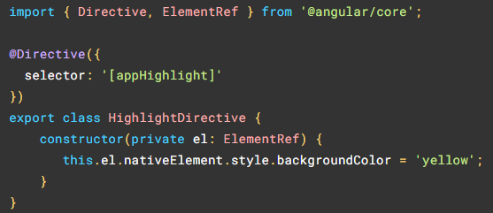
Attribute directives
Change the appearance or behavior of DOM elements and Angular components with attribute directives.

Slide 18

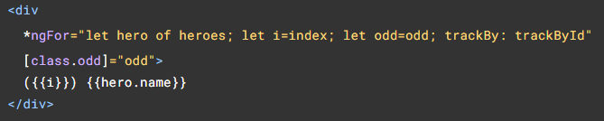
Structural directives
Structural directives are directives which change the DOM layout by adding and removing DOM elements. Angular provides a set of built-in structural directives (such as NgIf, NgForOf, NgSwitch and others) which are commonly used in all Angular projects

Slide 19

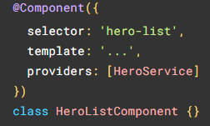
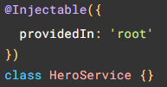
Dependency Injection
Dependency injection, or DI, is one of the fundamental concepts in Angular. DI is wired into the Angular framework and allows classes with Angular decorators, such as Components, Directives, Pipes, and Injectables, to configure dependencies that they need.

Slide 20
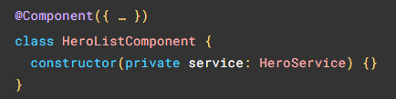
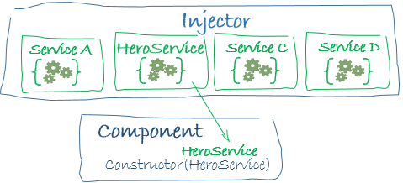

Slide 21


