Slide 1
Typescript

Slide 2
Table of Contents
What is Typescript
Info of Javascript
Why there was an need for Typescript
Installation in our machine
Datatypes
Variables – let,var,const
(string,number,Boolean) = Primitive types
Arrays
Type Assignments(Explicit and implicit)
Type Inference
Union
Object types
Control statements(if-else,switch)
Loops(for , for-in , for-of , while)
Functions
Arrow functions
Decorators

Slide 3

What is Typescript
Powerful Addition to JavaScript.
Developed By Microsoft.
Supported by Technologies like Angular,vuejs,Reactjs etc
Typescript is an free and open high-level programming language developed by Microsoft.It is a strict syntactical superset of javascript.

Slide 4
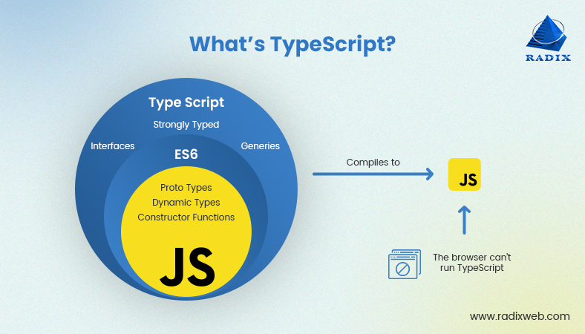
TypeScript may be used to develop JavaScript applications for both client-side and server-side execution.
The reason to use TypeScript is that it catches errors at compile-time, so that you can fix it before you run code.

Slide 5
Why Typescript ?
1.Strong Type Checking
2.Compile-Time Error Checks
3.Object Oriented

Slide 6
DataTypes in Typescript
String
String is another primitive data type that is used to store text data. String values are surrounded by single quotation marks or double quotation marks.
Ex : let student_name:string = “Vineeth”
Some of the string methods are :
str.length() str.slice(start,end) str.substring(start,end) str.substr(start,lengthrequired) toUpperCase() toLowerCase()
replace(old,new)
replaceAll(old,new)
s.concat(new_string)

Slide 7
Boolean
Boolean values are supported by both JavaScript and TypeScript and stored as true/false values.
Ex : let sresult : boolean = true
Number
TypeScript supports number data type. All numbers are stored as floating point numbers. These numbers can be Decimal (base 10), Hexadecimal (base 16) or Octal (base 8).
Ex : let num :number = 500

Slide 8
Any (Known as the Super type of all DataTypes)
> Built-in Types (number,string,Boolean,void null)
> User definedTypes(Array,Enums,Interfaces,Classes,tuples)
Operators
Arithmetic operators
Logical operators
Relational operators
Bitwise operators
Assignment operators
Ternary/conditional operator
String operator
Type Operator

Slide 9
Variables
Declaring an Variable and Assigning values
let or var or const <variable_name> : <Type of variable>
Ex : let language : string = “Typescript”
Comments :
//this is single line comment
/* This is a Multi-line comment */
Typescript is case-sensititve

Slide 10
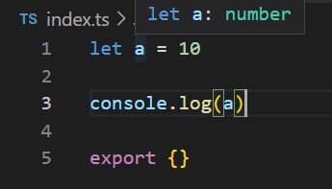
Type Assignments
Assigning types to the variable will be done in 2 ways
1.Explicit Assignment(Here we will explicitly mention its type)
Ex : let a : number = 50
2.Implicit Assignment [Type Inference]
(Here in this kind he typescript will automatically detect its type)
Ex : let a = 50;

Slide 11
Control statements
If-else :
syntax : if(condition)
{
//statements
}
else
{
//statements
}

Slide 12
Control statements
If-else :
Syntax :
if(condition)
{
//statements
}
else
{
//statements
}
Switch :
Syntax :
switch(expression) { case x: // code block break; case y: // code block break; default: // code block }

Slide 13
For-loop
for (initialization; condition; increment)
{
code to be executed
}
Ex : for(var i=0;i<10;i++){
console.log(“Hello”)
}
While
While(condition)
{
//statements
}
Ex : while(condition)
{
console.log(“hello”)
}

Slide 14
do-while loop
Syntax:
do
{
//statements
}while(condition)
Ex:
var x = 5;
do
{ console.log(“Hello”)
x++
}
while(x<5)
for-in loop
Syntax :
for(var i in Array)
{
console.log(i)
}
Ex : let arr = [10,20]
for(var i in arr)
{
console.log(i)
}

Slide 15
Arrays
An array is a user-defined data type. An array is a homogeneous collection of similar types of elements that have a contiguous memory location and which can store multiple values of different data types.
The array follows Index based storage i.e)the first element of an array is stored at index 0 or at index ‘i’ and the remaining elements are stored at the location ‘i+1’.
Syntax : let <array_name> : <type>[ ] = [val1,val2,val3…….]
Example : let marks : number[ ] = [158,356,965,425,321] // 1-d Array
Example : let studata = [ [10,56],[89,56],[25,68] ] // 2-d Array

Slide 16
Array Methods :
<array_name>.push(value) // adds an value at last position of array
<array_name>.pop() //deletes last index element
<array_name>.length // finds length of array
<array_name1>.concat(<array_name2>) //combining 2 arrays

Slide 17
Union
TypeScript allows us to use more than one data type for a variable or a function parameter. This is called union type.
Ex : let locationA : string | number = 150 // no error
locationA = “Typescript” // no error
locationA = true // throws an error
let arr : number[] | string[] = [10,”ten”,20,”twenty] //no errors

Slide 18
Objects in Typescript
Objects, in TypeScript, are the most important data type and form the building blocks for Typescript. These objects are quite different from Typescript’s primitive data types (Number, String, Boolean, null, undefined, and symbol) in the sense that these primitive data types all store a single value each (depending on their types).
Syntax : {key1:value1,key2:value2}
Ex : {name:”Saiteja”, marks:156} //this is an object
Arrays of objects : We will create an array with objects as its members.
EX : let arr = [ { name : “S1” , marks : 158 } , { name : “S2” , marks : 589} ]

Slide 19
Functions
A TypeScript function is a block of code designed to perform a particular task.
A TypeScript function is executed when "something" invokes it (calls it).
Syntax : function name(parameter1 :type, parameter2 : type) :return
{ // code to be executed }
Ex : function printName(name:string) : void
{
console.log(name);
}

Slide 20
Arrow functions
ES6 version of TypeScript provides an arrow function which is the shorthand syntax for defining the anonymous function, i.e., for function expressions. It omits the function keyword.
Syntax :
let function_name = (parameter:type,parameter:type……) => {
console.log();
}
Ex : let printHello = (a : string) => {
console.log(“string passed is “ + a)
}

Slide 21
Decorators in Typescript
A Decorator is a special kind of declaration that can be applied to classes, methods, accessor, property, or parameter. Decorators are simply functions that are prefixed @expression symbol, where expression must evaluate to a function that will be called at runtime with information about the decorated declaration.
TypeScript Decorators serves the purpose of adding both annotations and metadata to the existing code in a declarative way.
To enable experimental support for decorators, we must enable the experimentalDecorators compiler option either on the command line or in our tsconfig.json:

Slide 22
Thanks!

