Slide 1

Test Drive
306 Project One Presentation

Slide 2
Team Members and Roles
Testing Manager & Team Leader – Wesley Yep
- Organises the development & management of unit and acceptable tests.
- Leader of team Test Drive.
Project Manager – Nikhil Prasad
- Manages the development of the project plan.
Documentation Manager – Elliot Whiley
- Manages the Wiki for the project on GitHub.
Presentation & User Manual Manager – Paul Joo
- Manages the development of the user manual and presentations.
Interface Manager – Chang Kon Han
- Manages the development of the user interface & workflow.
Integration Manager – Lennon Chen
- Manages the integration of code from multiple parts of the project.
Code Manager – Guyver Fu
- Ensures the code adheres to coding standards and follows a cohesive style.
Requirements & Innovation Manager – John Law
- Ensures the project fulfils the requirements & manages the innovation within the project.

Slide 3
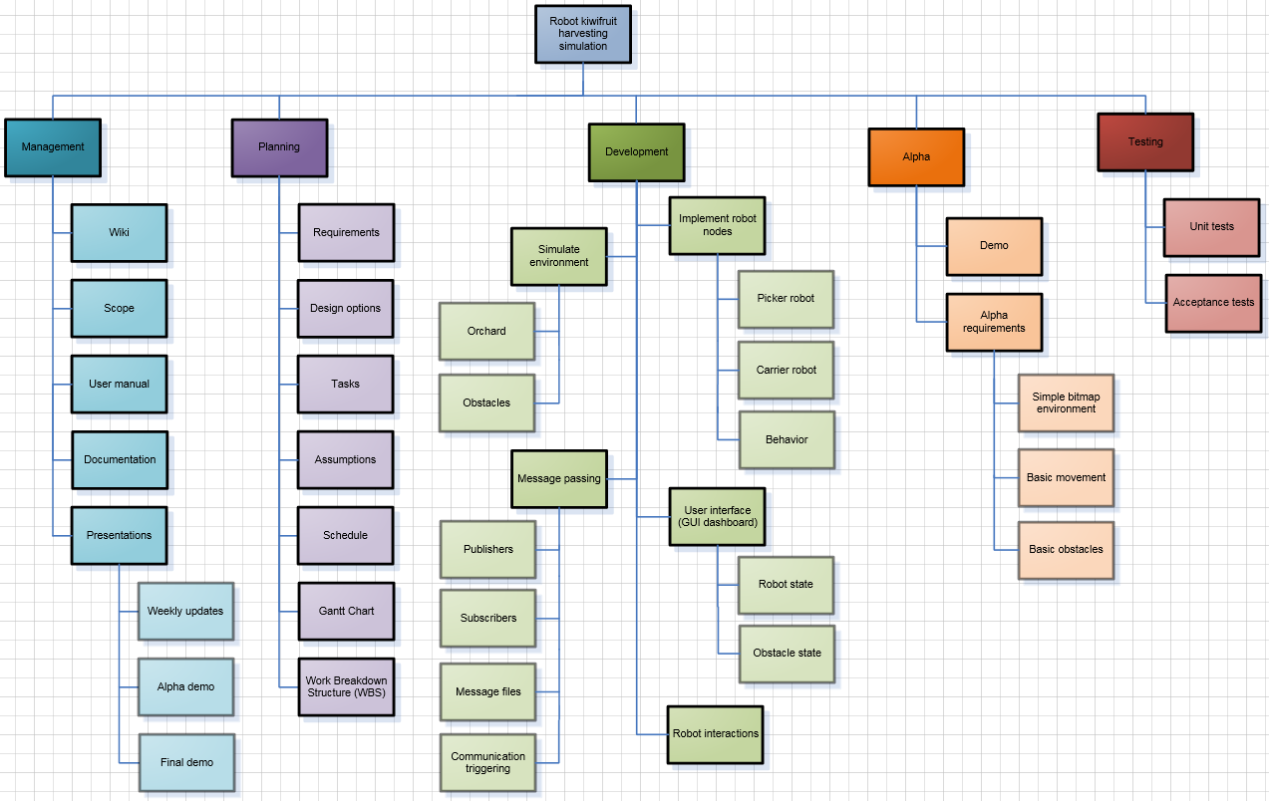
Work Breakdown Structure (WBS)

Slide 4
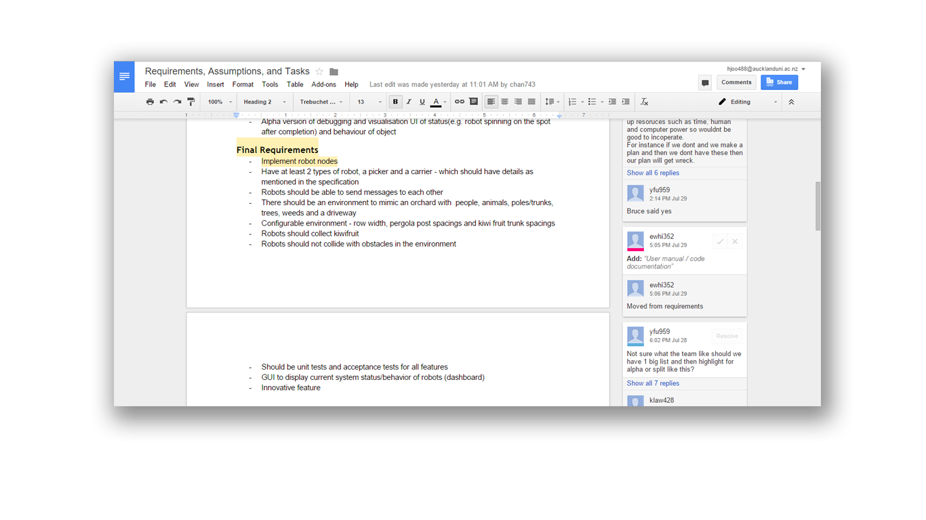
Project Planning

Slide 5
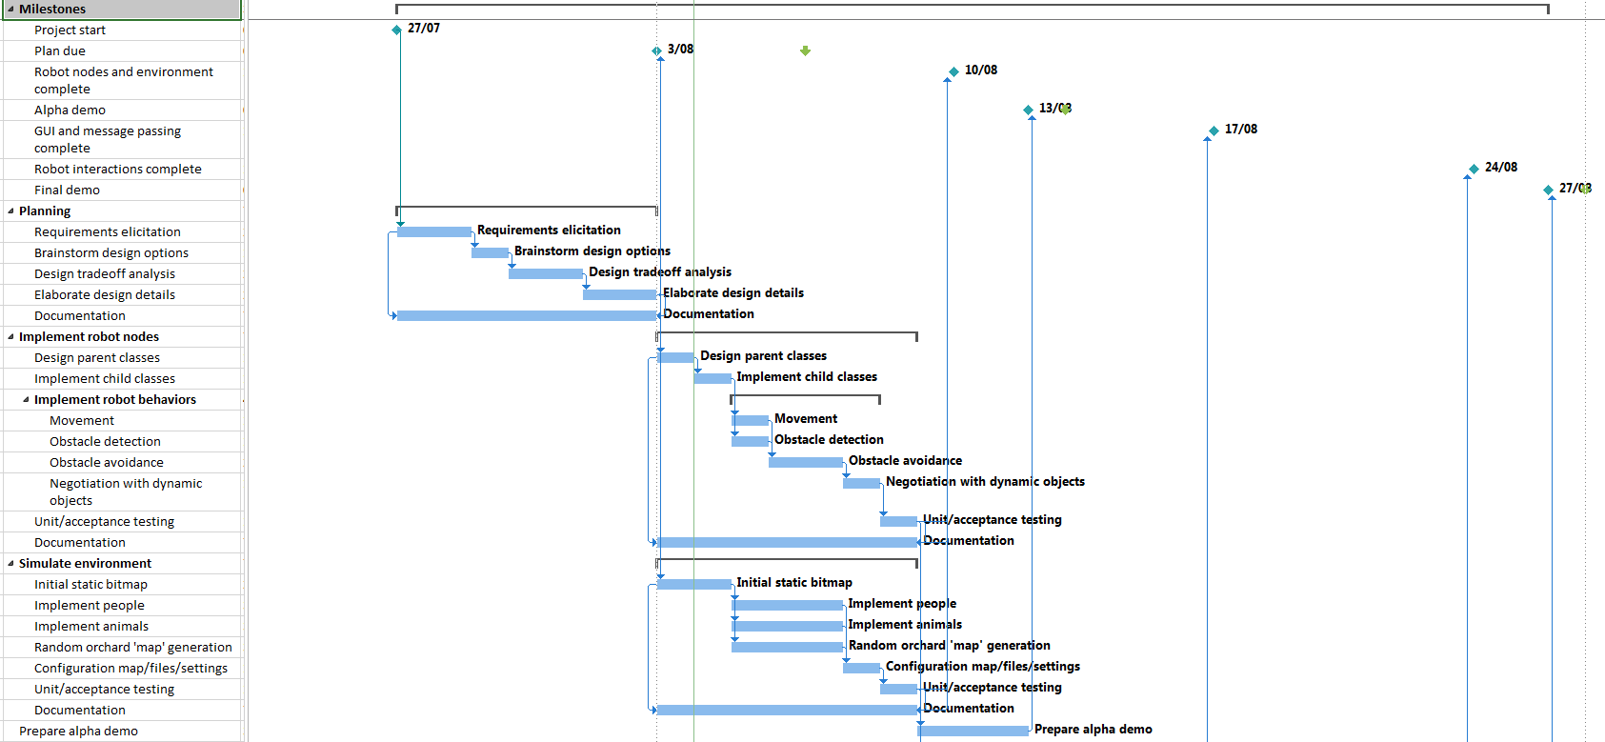
Gantt Chart

Slide 6
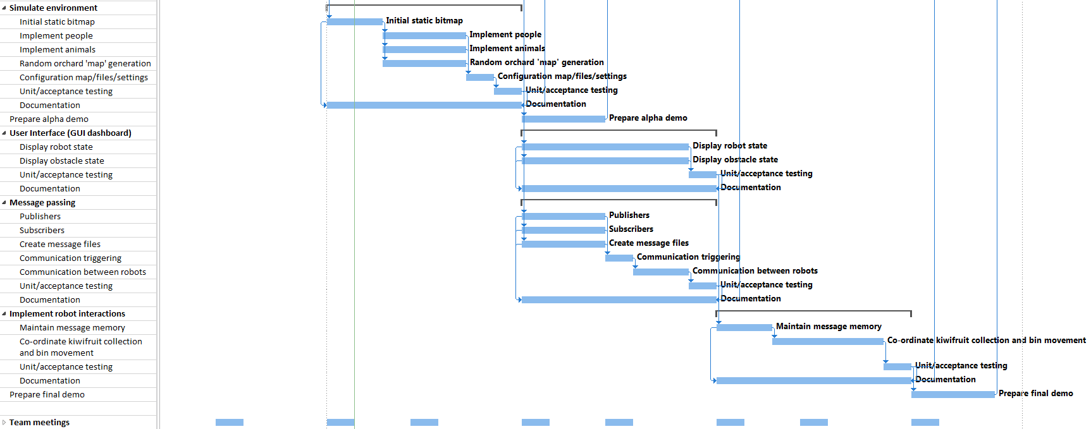
Gantt Chart

