Slide 1
Test Drive
306 Project One Presentation

Slide 2
Delegation of Tasks
Implementation of agreed Software Design
John Law, Nikhil Prasad, Guyver Fu
Implementation of Picker & Carrier Robot functions
Nikhil Prasad, Guyver Fu
Detection of obstacles in the environment
Chang Kon Han, Lennon Chan
Visualisation of Success & Errors for Debugging & Project Plan
Elliot Whiley, Paul Joo
Implementation of the behaviour of Environment Objects
John Law
Gui Design and Model Design of World File
Wesley Yep

Slide 3
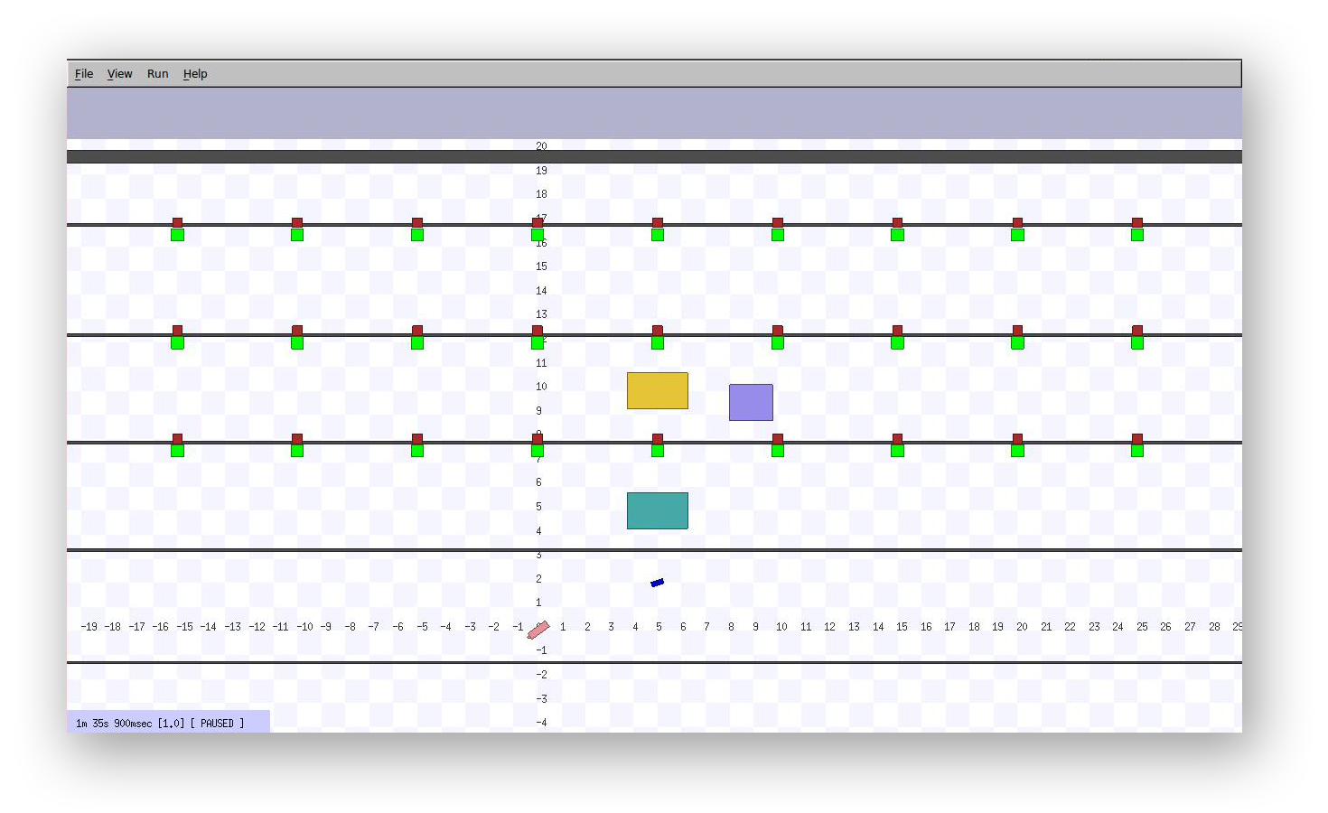
Results Thus Far

Slide 4
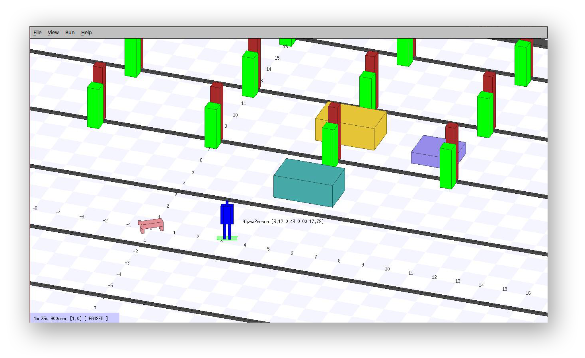
Results Thus Far

Slide 5
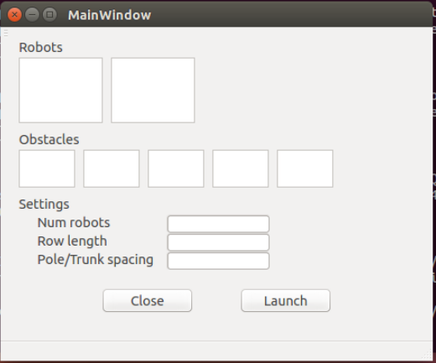
GUI

