Slide 1
Test Drive
Project One Presentation

Slide 2
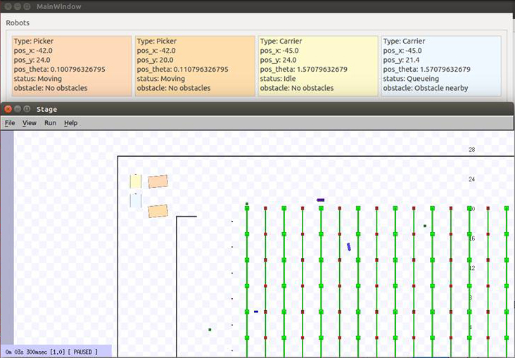
Progress
Refining of Robot Behaviour
Nikhil Prasad & Guyver Fu

Slide 3
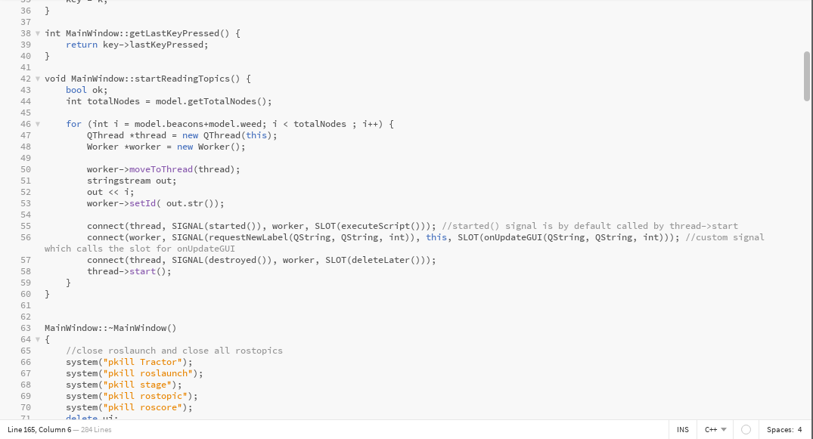
Progress
Code Refinement & Refactor
Wesley Yep & Lennon Chan

Slide 4
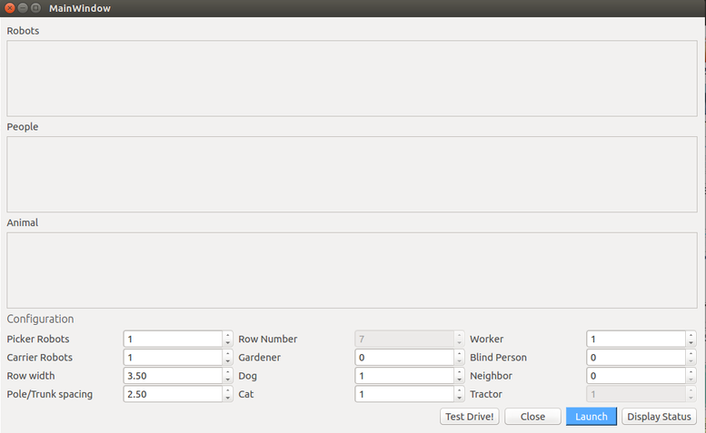
Progress
New World Components
Elliot Whiley, John Law, Lennon Chan, Chang Kon Han
& Paul Joo

Slide 5

Progress
Documentation & User Manual
Team Test Drive

