Slide 1
Test Drive
306 Project One Presentation

Slide 2
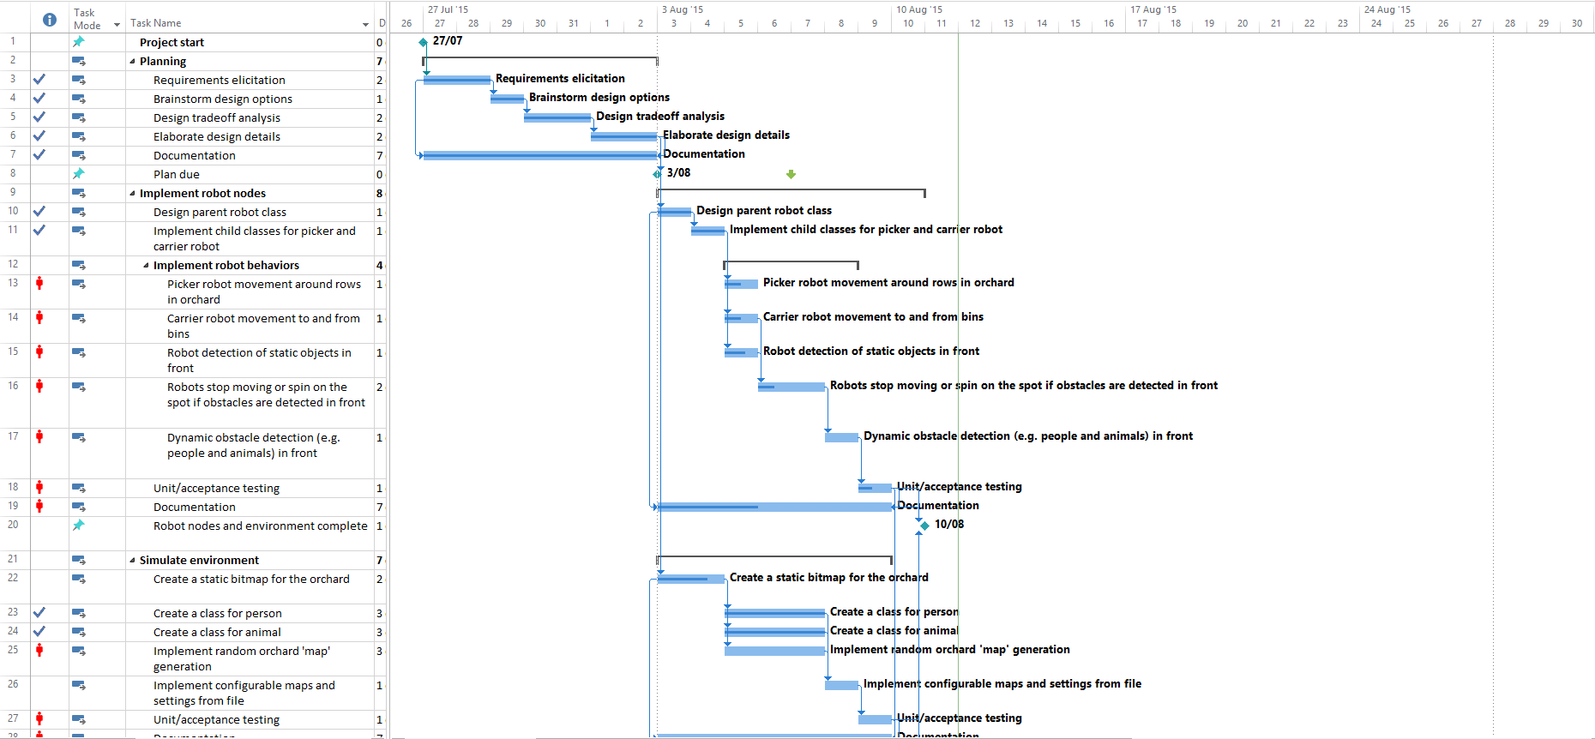
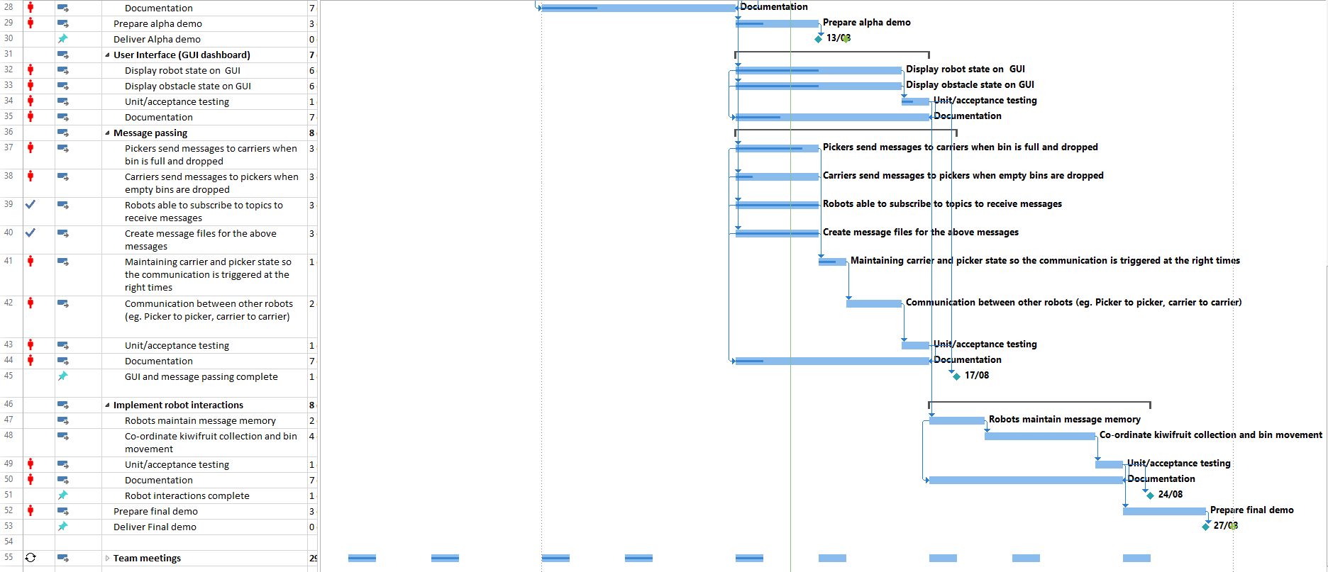

Slide 3
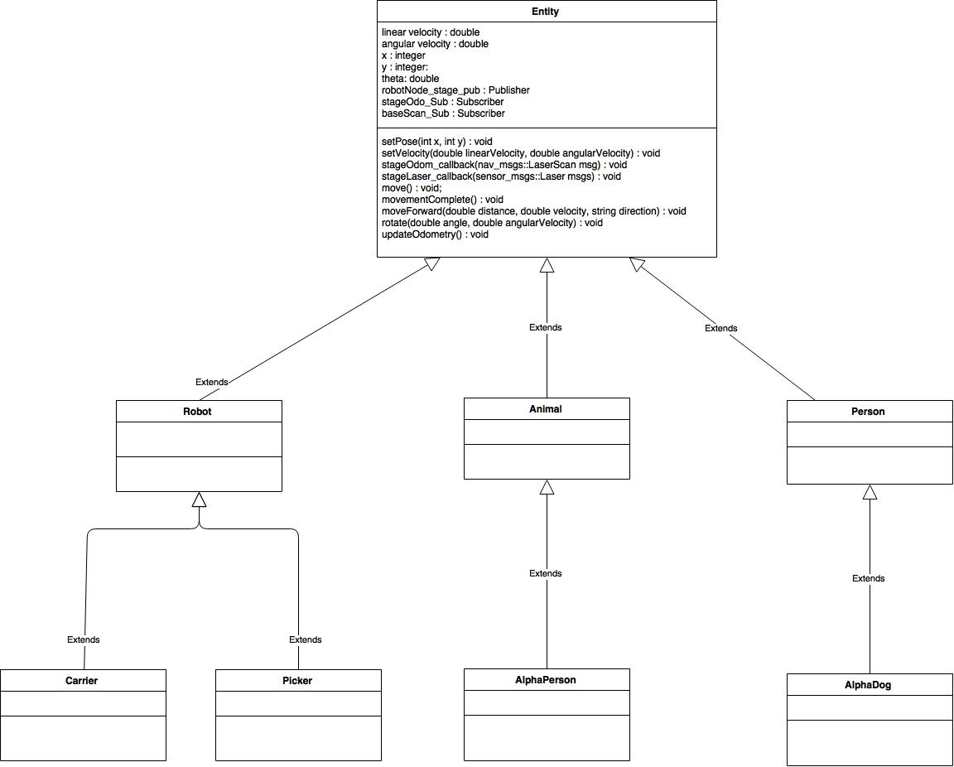
UML Class Diagram

Slide 4
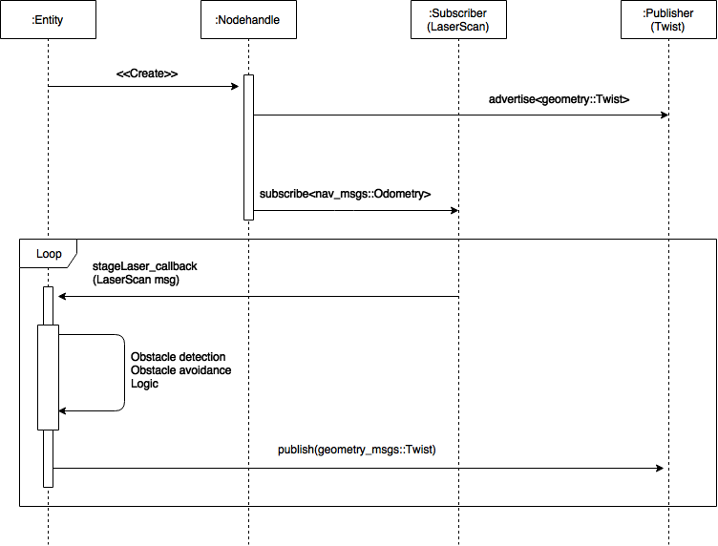
Sequence Diagram

Slide 5
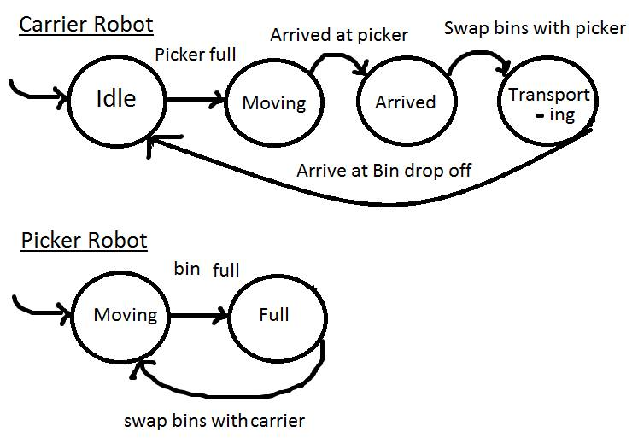
Robot Status Modelling

Slide 6
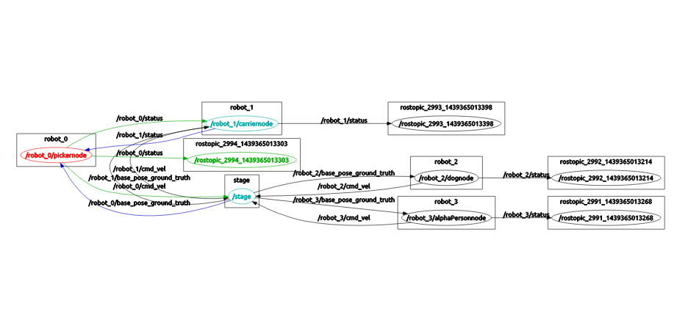
RQT Graph

Slide 7
Unit Tests
catkin_make run_tests

Slide 8
Demo Time
Launch scripts/ GUI design (Wesley)
GUI receiving messages (Paul)
GUI showing statuses (Elliot)
Picker robot behaviour (Gyver)
Carrier robot behaviour (Nikhil)
Dog and person behaviour (John)
Laser sensors for robots
Using laser sensor information (Chang Kon)

