Slide 1
Test Drive
Project One Presentation

Slide 2
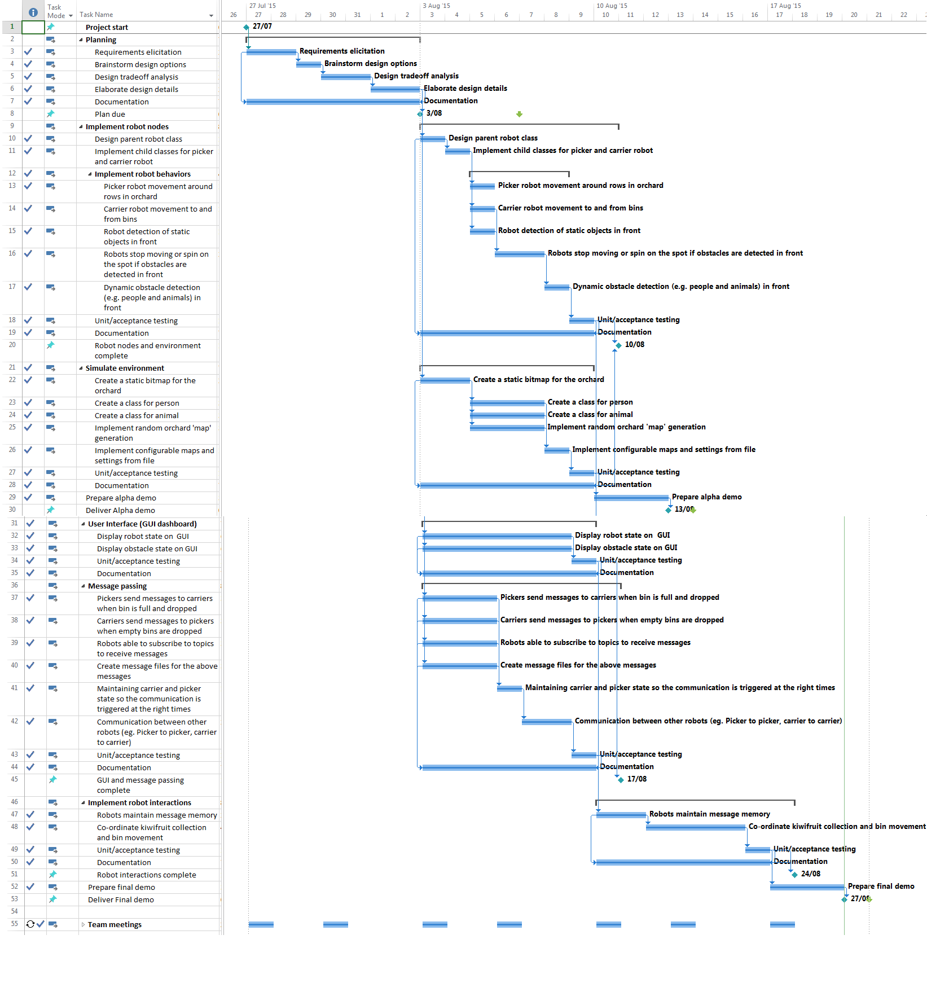

Slide 3
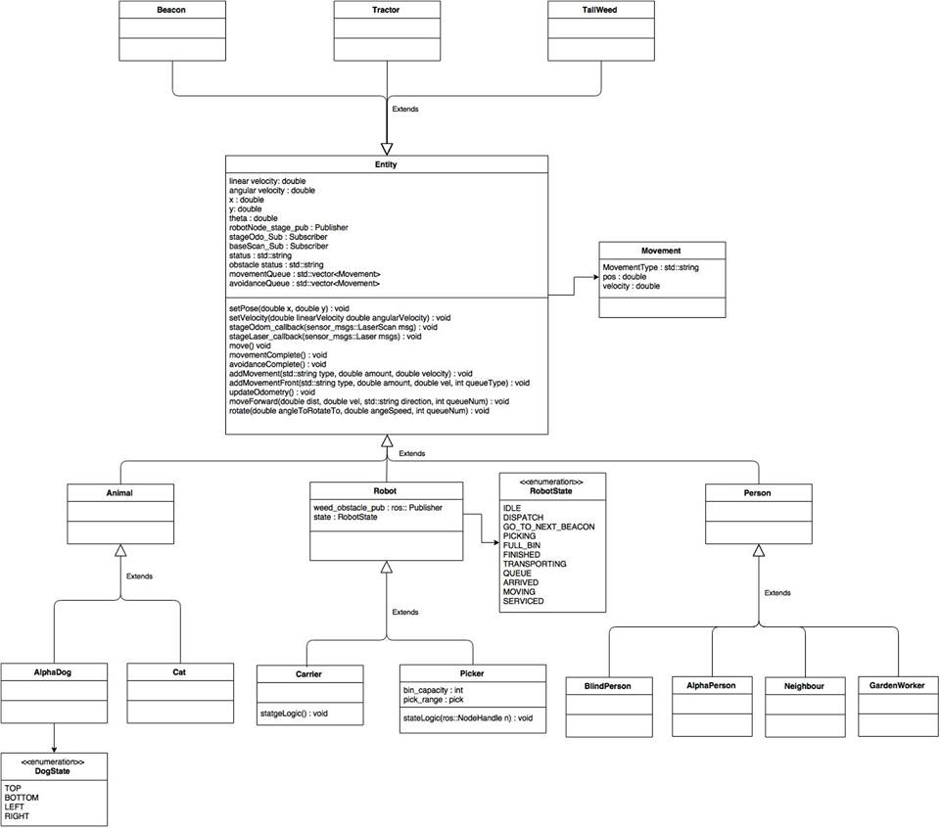
UML Class Diagram

Slide 4
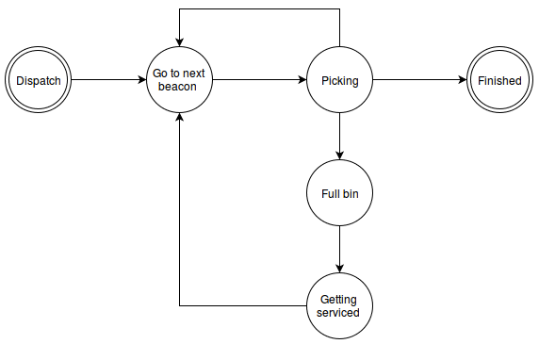
Picker Finite-State-Machine

Slide 5
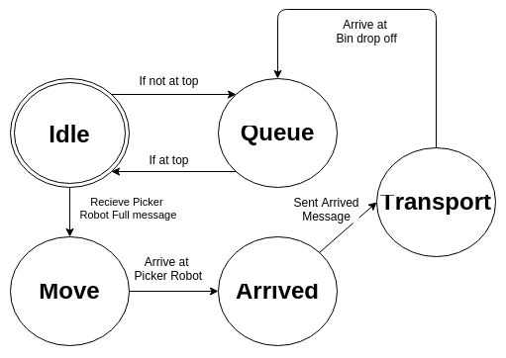
Carrier Finite-State-Machine

Slide 6
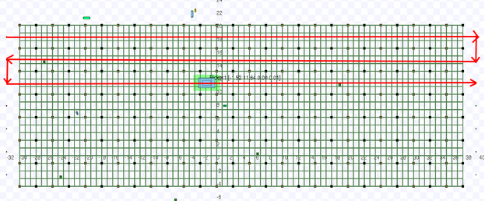
Beacon System

Slide 7
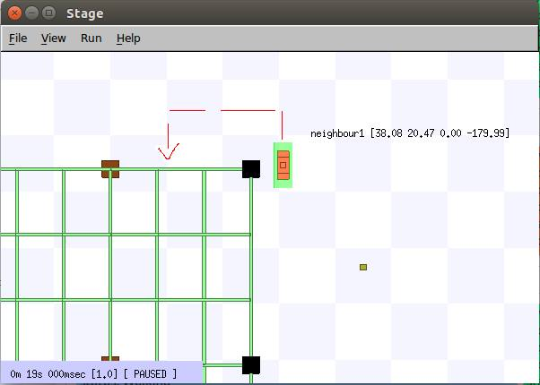
Obstacle Avoidance

Slide 8
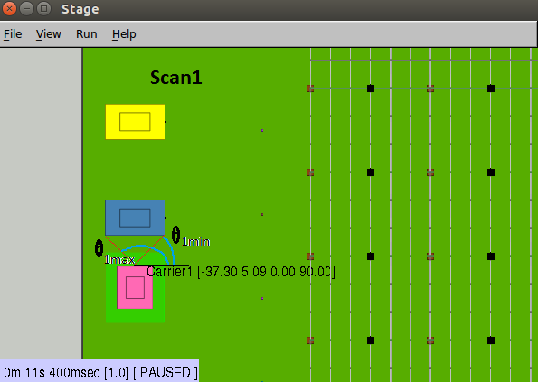
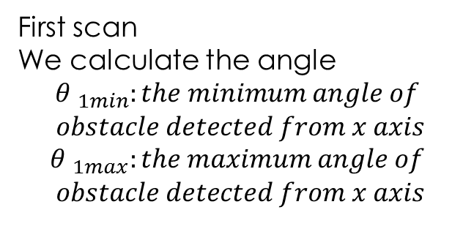
Obstacle Avoidance
First scan
We calculate the angle
$${θ }_{1min}:the minimum angle of$$
$$obstacle detected from x axis$$
$${θ }_{1max}:the maximum angle of$$
$$obstacle detected from x axis$$

Slide 9
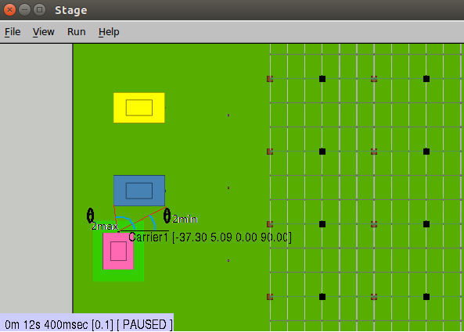
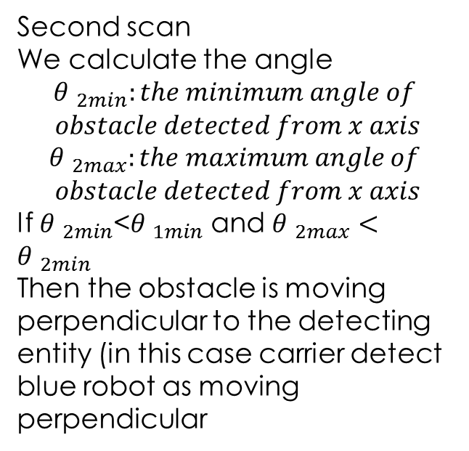
Obstacle Avoidance
Second scan
We calculate the angle
$${θ }_{2min}:the minimum angle of$$
$$obstacle detected from x axis$$
$${θ }_{2max}:the maximum angle of$$
$$obstacle detected from x axis$$
If ${θ }_{2min}$<${θ }_{1min}$ and ${θ }_{2max}<{θ }_{2min}$
Then the obstacle is moving perpendicular to the detecting entity (in this case carrier detect blue robot as moving perpendicular

Slide 10
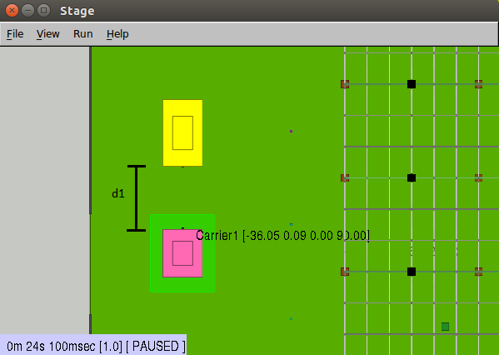
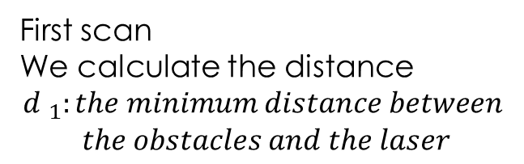
Obstacle Avoidance
First scan
We calculate the distance
$${d }_{1}:the minimum distance between$$
$$the obstacles and the laser$$

Slide 11
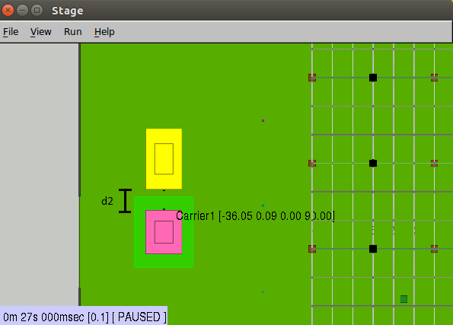

Obstacle Avoidance
second scan
We calculate the distance
$${d }_{2}:the minimum distance between$$
$$the obstacles and the laser$$
If ${d }_{2}$<${d }_{1}$ then the obstacle is moving face on with the detecting entity.
If ${d }_{2}$=${d }_{1}$ then the obstacle stationary
(in this case carrier detect yellow robot as moving perpendicular

Slide 12
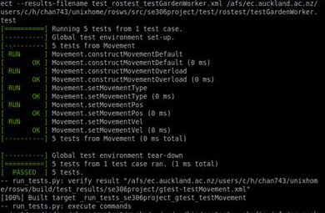
Unit Tests

Slide 13
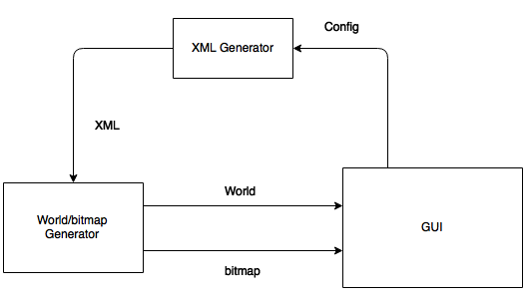
Generator

Slide 14
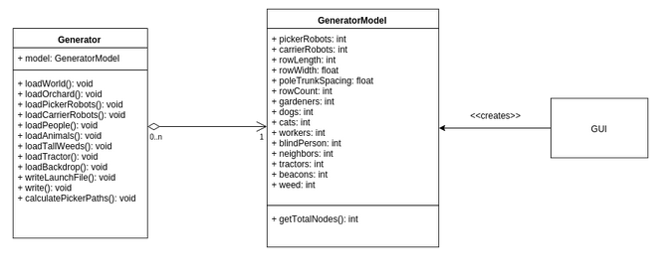
Generator

Slide 15
Demo
GUI Design & Configurability – Chang Kon
GUI Spinner Limits – Elliot
Colour Panels & World Design – Paul
Picker Division – Nikhil
Carrier Queue – John
Obstacle Avoidance - Guyver
Cat Behaviour & Design – Elliot
Neighbour Behaviour & Design – Lennon
Gardener Behaviour & Design – Chang
Dog, Worker Behaviour & Design – John
Blind Person Design & Behaviour – Wesley
Innovation - Wesley

