Slide 1
Team UGSOFT
Project TWO Plan Presentation

Slide 2
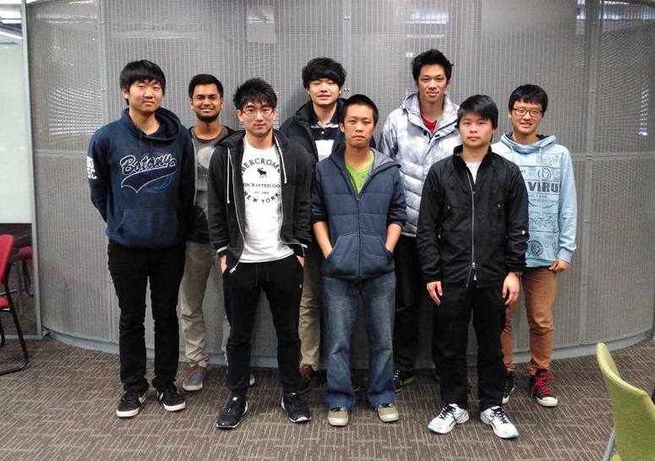
The Team
Absent: Jared Young

Slide 3
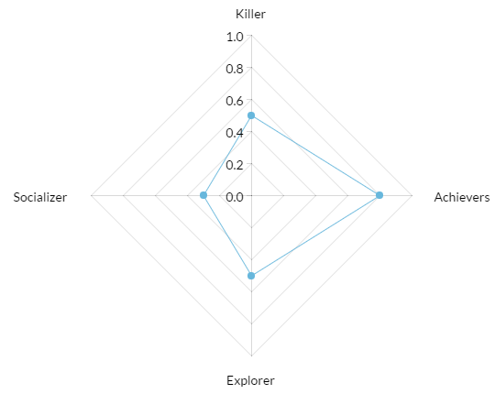
Game Concept
Santa simulator
The player is a Santa who tries to deliver presents to children without being detected. The Santa will need to figure out how to navigate around the house and deliver the presents while avoiding obstacles so he doesn’t make noise and not seen by anyone .
Genre
Type: Simulation
Genre: Stealth
Target audience
High School(12-18), any gender

Slide 4
Goal and sub goals
Overall goal:
Deliver correct presents without arising suspicion
Sub-goals:
Get a good high score
Collect/eat cookies (bonus points)

Slide 5
Central Character (Santa)
Delivers present to certain location in household without raising suspicion
Skills and Functionality
Unlockable/equips: Slippers, candy cane and tools
Actions
Free movement (movement in any direction)
Slow walking
Faster movement
Crouch
Stick to wall

Slide 6
Other Characters
Human
Entity which can move (random or patrol) or be stationary. Can get suspicious if it thinks Santa is nearby
Sleep walkers
Patrols area and doesn’t get suspicious unless disturbed
Animals
Entities which also get suspicious. More easily suspicious because of acute senses
Elf
Gives Santa additional information about present details

Slide 7
Game World
House which is the stage/game world in the game
Rooms within each house
House lights. Light of different intensity depending on player location
Randomly generated static elements
Obstacles: e.g. Creaky floorboards
Cookies and keys
Santa spawn location
Randomly selected present drop off location e.g. Christmas tree

Slide 8

Score system
Scoring is based on these criterions:
Suspicion level, the lower the better
Time taken to deliver the present
Number of cookies collected

Slide 9
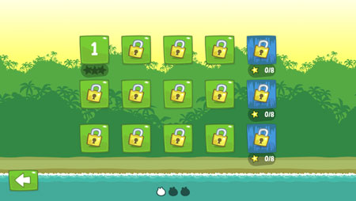
Level generation mechanic
Fixed room and start location
Locked door for some room
Random NPC spawn with fixed patrolling movement and random cookie spawn
As the level progress
More obstacle
More NPC
Bigger house

Slide 10
Tools and Technology
Windows 7 or higher for operating system of developing environment
Unity 5.2.0f3 for game development
Microsoft visual studio for coding IDE
Deploying onto android
Azure web API
GitHub
Google doc / spreadsheet for plan and documentation draft

Slide 11
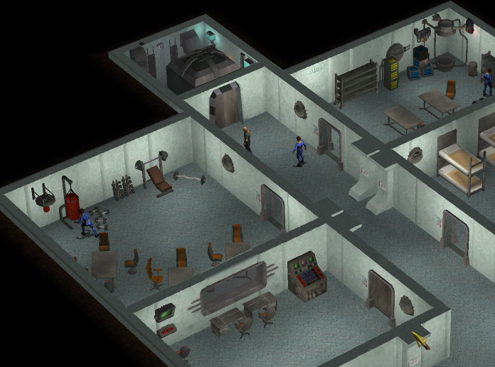
Design Features
Game to be implemented in 2.5D
Fixed level generation
Game sound, to be triggered upon certain events.
High score screen

Slide 12
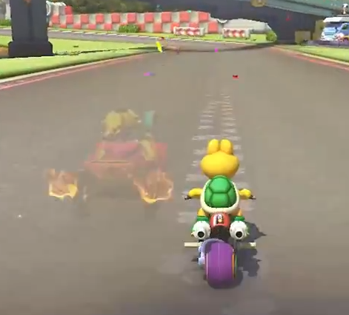
Advanced Features
One versus One time trial match.
Play through a level at the same time as your opponent to see who can complete it in the quickest time.
As you are playing, a “ghost” of your opponent’s avatar will be visible which will show what they are doing in real time.

