Slide 1
Team UGSOFT
Project Two Prototype Presentation

Slide 2
Check List
Features | Planned? (Y/N) | Achieved? (Y/N/P) | Reason
One completely playable level. | Y | Y | First level has been completed, more levels to implement in future
Characters design and functionality (e.g. central character and/or enemies etc.) | Y | P | Other AI people characters have been implemented, still need to add in animals and improve line of sight
Game world layout (e.g. with obstacles and path options) | Y | P | First level game world is completed, more levels to implement in future
A scoring system (point/time) | Y | Y | Implemented based on time, suspicion bar, and cookies collected
A player life system where lives can be lost/gained/maxed out (e.g. 3 lives max) | Y | Y | Suspicion bar implemented, the game is over once it reaches full
An achievement system (e.g. rewards unlocked based on player performance.) | Y | P | Planed to have a place holder page actual database not implemented.
A welcome screen (e.g. select a game, return to welcome screen and ability to start again.) | Y | Y | Welcome screen and level screen implemented as planned

Slide 3
Check List
Features | Planned? (Y/N) | Achieved? (Y/N/P) | Reason
An exit screen (e.g. to congratulate player if finished all designed levels or to alert player to indicate game over.) | Y | P | Have success and failure screen implemented, user can go to next level or back to home. Need to add more.
Pre-designed, different levels of complexity | Y | Y | First level difficulty is preset by level designers.
A clear game objective and level objectives (e.g. to get to the end of the level or get 100 points etc.) | Y | Y | Clear goal of delivering present to Christmas tree is implemented.
Some aspects of RNG (e.g. random item generation, enemy attacks, level generation.) | Y | Y | Cookie randomly generates at set locations
Playtesting of all above features within team. | Y | Y | Play testing at each iteration was planned and achieved
Playtesting of all above features by at least one other team. | Y | Y | Cross testing with Team RGB as planned

Slide 4
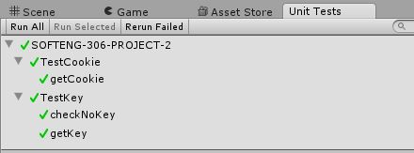
Testing
Unit Test:
Use unity test tool for unit test
Use Unity built in play to test the GUI and mechanics of objects in the game world
Integration testing on android phones

Slide 5
Demo Time

