Slide 1



cmdb_oracle_database
View in Power BI
Last data refresh:
26/10/2018 17:28:09 GMT Standard Time
Downloaded at:
26/10/2018 17:30:41 GMT Standard Time

Slide 2
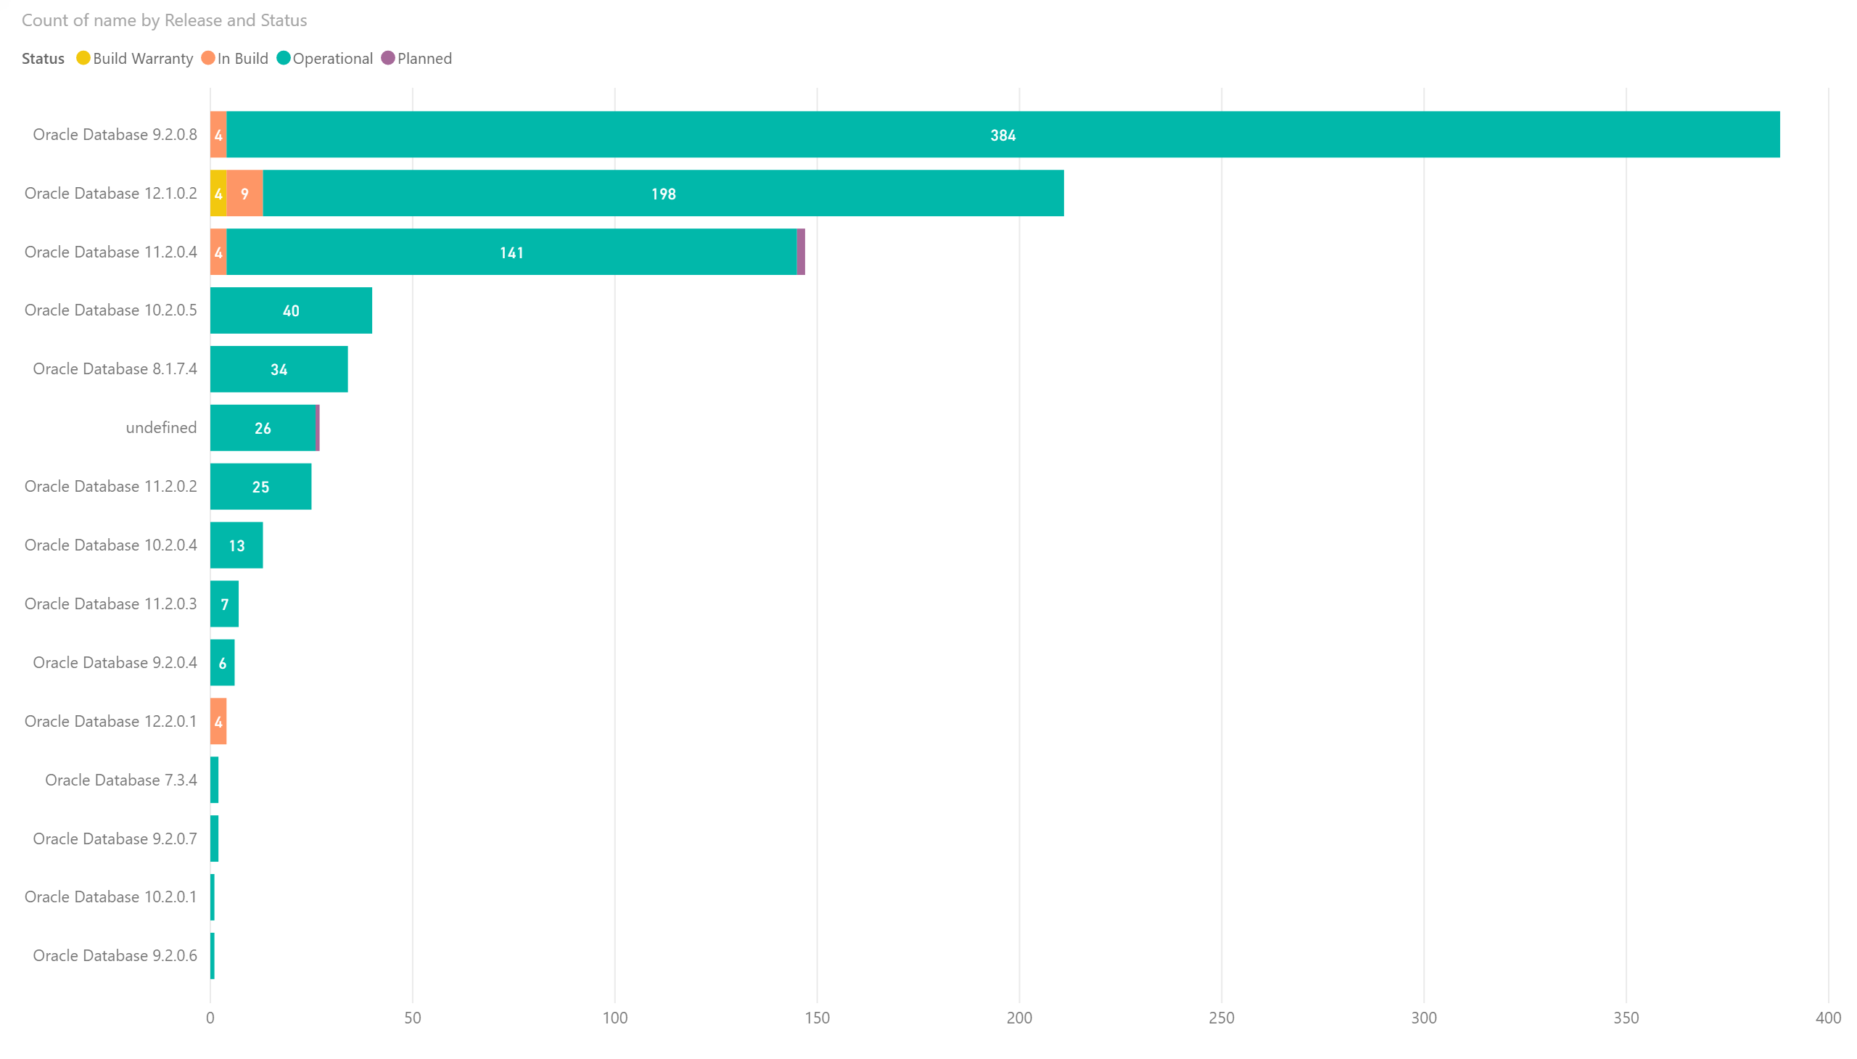

Slide 3
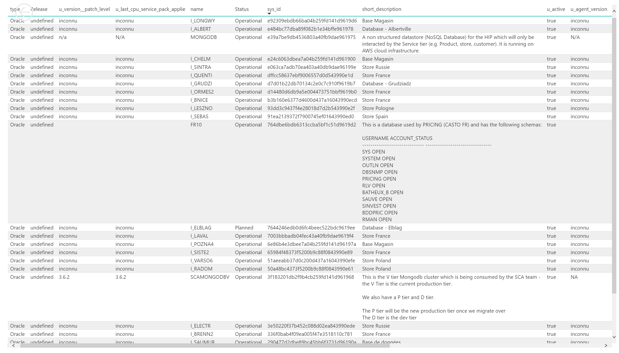

Slide 4
