Slide 1
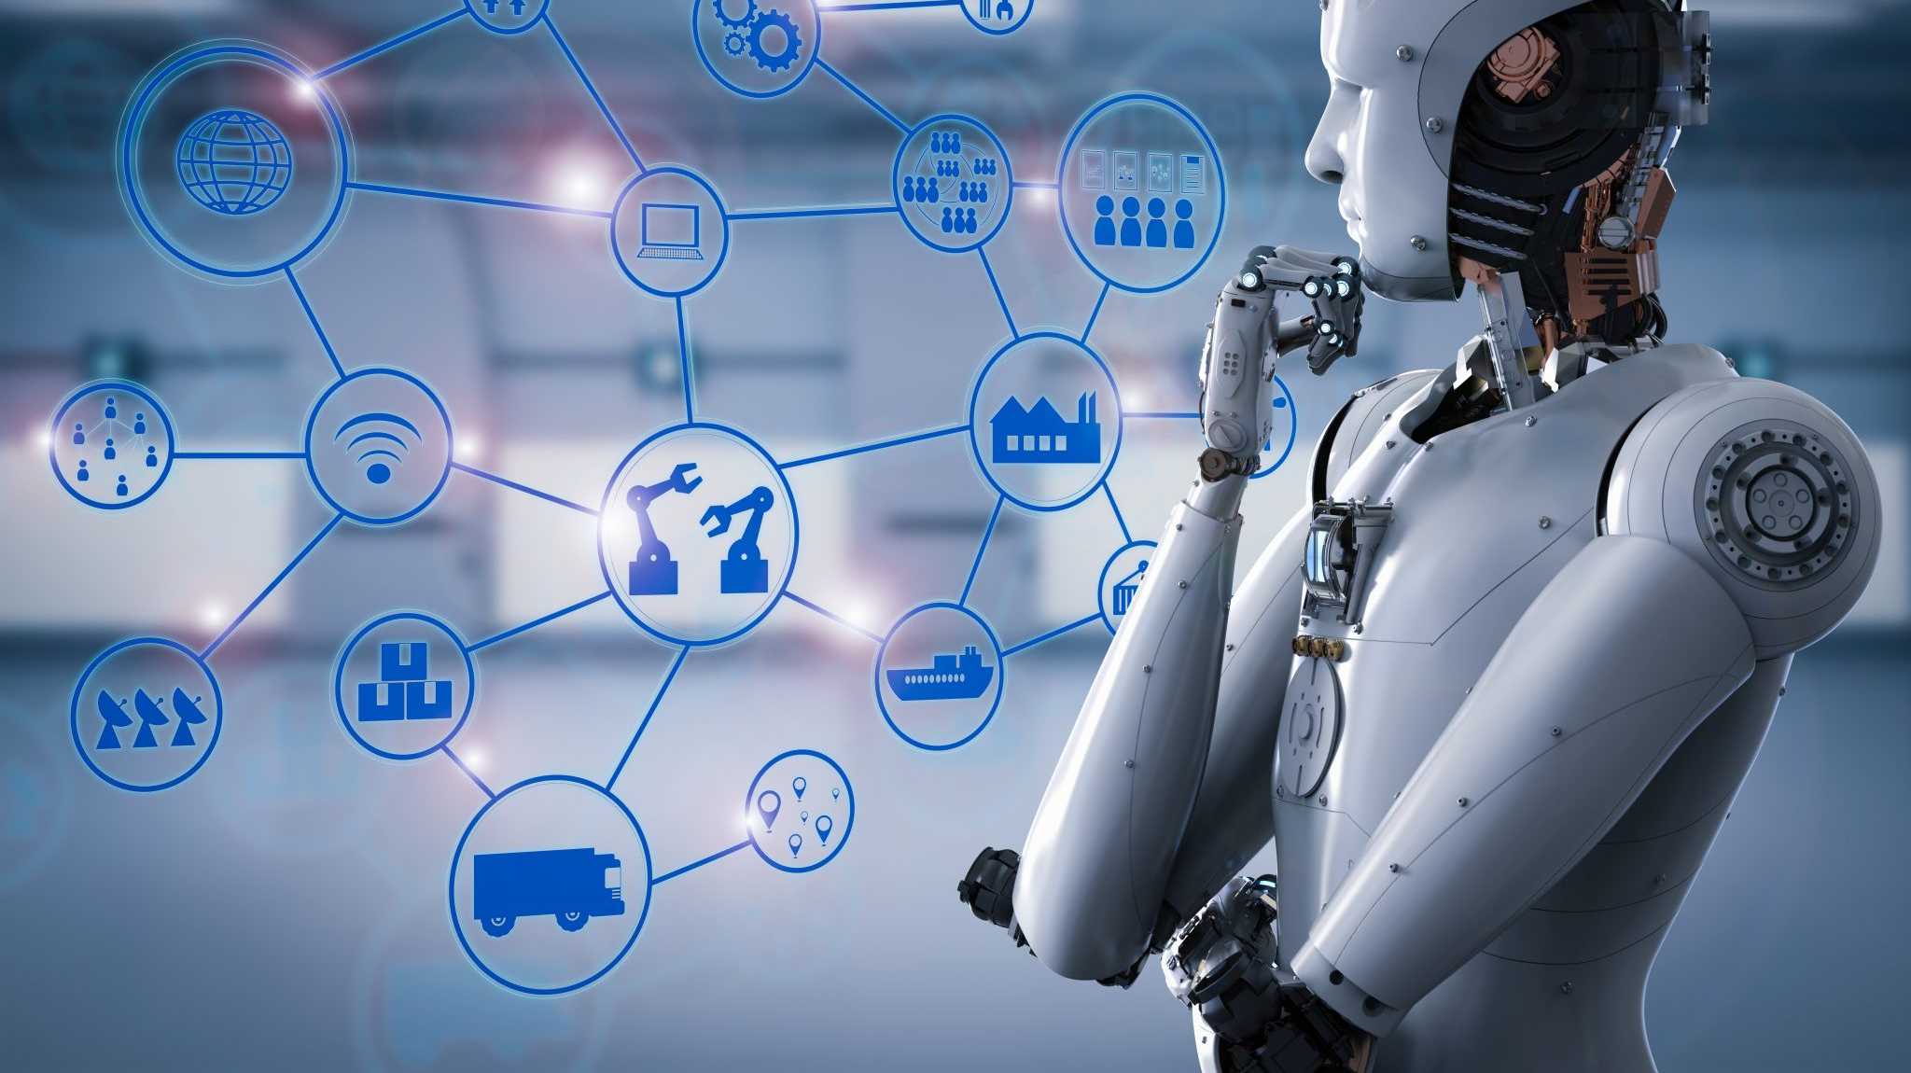
RPA
Robotic Process Automation

Slide 2
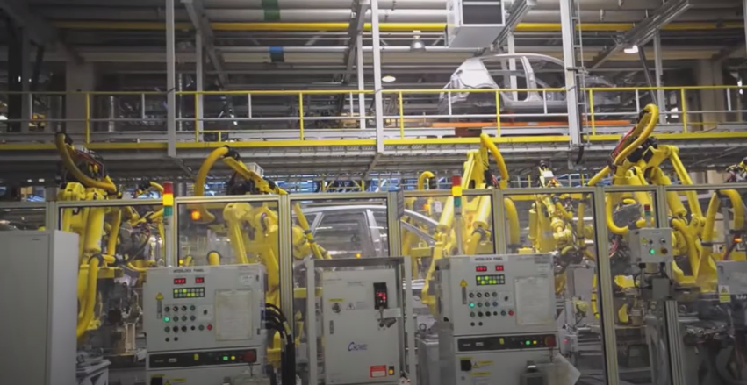
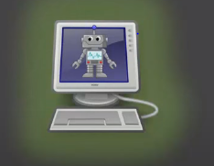
Types of Robot
Physical Robot
Software Robot

Slide 3

Robotic Process Automation is the technology that allows anyone today to configure computer software, or a “robot” to emulate and integrate the actions of a human interacting within digital systems to execute a business process. RPA robots utilize the user interface to capture data and manipulate applications just like humans do. They interpret, trigger responses and communicate with other systems in order to perform on a vast variety of repetitive tasks. Only substantially better: an RPA software robot never sleeps and makes zero mistakes.
What is Robotic Process Automation?

Slide 4
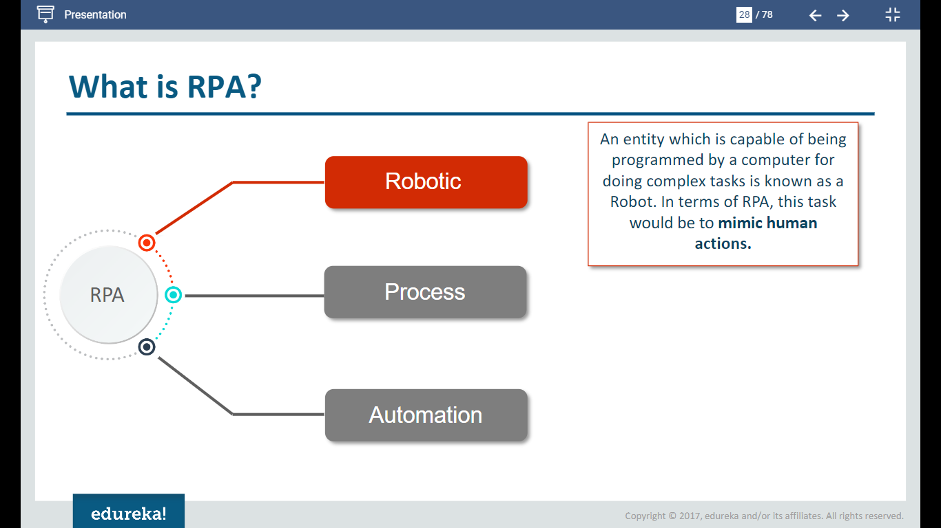

Slide 5
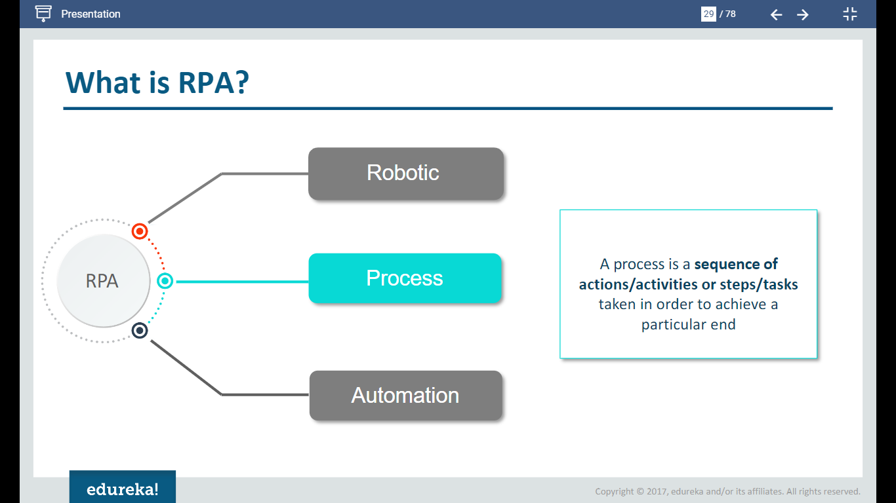

Slide 6
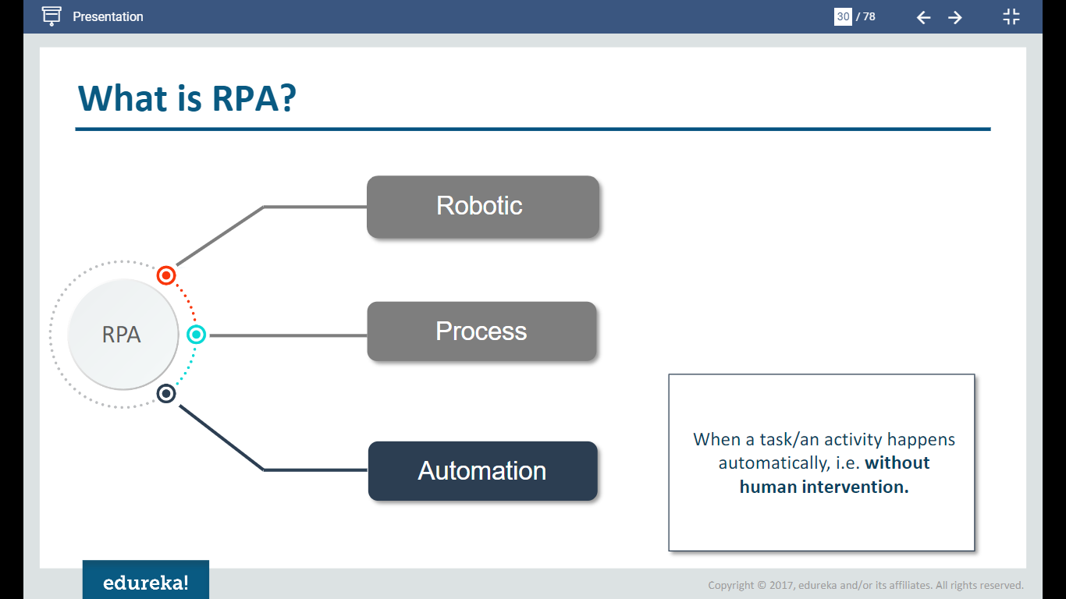

Slide 7
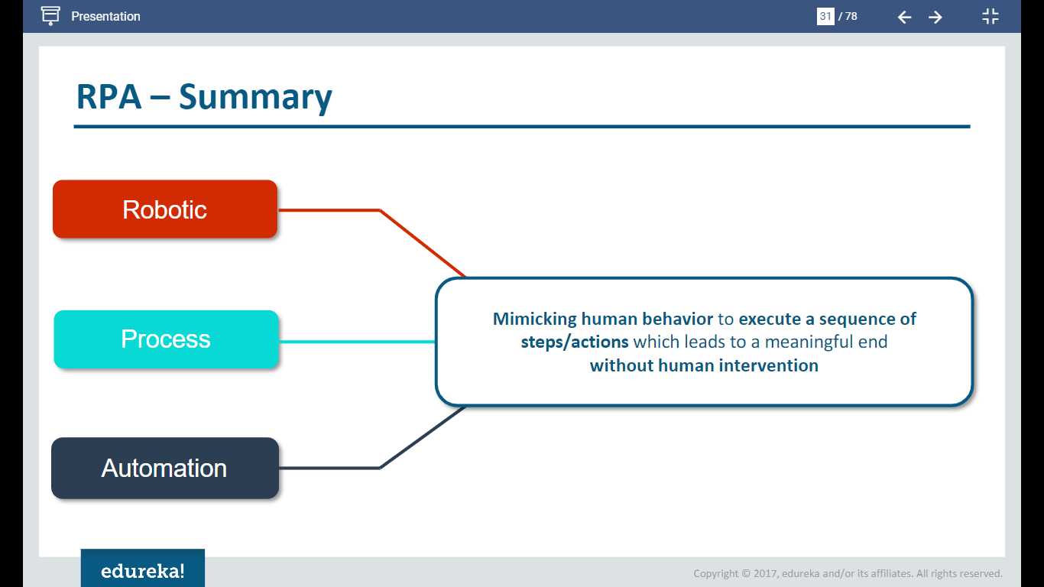

Slide 8

Why RPA is needed
RPA offers enhanced services to processes with the high probability of human errors, thereby increasing accuracy. Robots are reliable, and consistent and don't complain when expected to work tirelessly. They reduce the cases of re-work and enhance quality
RPA tools play an important role in modern companies because they can automate manual or repetitive human tasks, freeing workers to focus on more important work. One of the hottest emerging technologies in recent years has been robotic process automation
It helps to ensure that outputs are complete, correct, and consistent between tasks and between human workers. It helps to ensure that tasks can be completed more quickly because the robotic process automation tool can find and retrieve any necessary data in the background.

Slide 9
What is the benefit of RPA?
Accuracy & Quality. RPA offers improved services to processes that have a high probability of human error, thereby increasing accuracy. Robots are reliable, and consistent and do not whine when expected to work tirelessly. They also reduce the cases of re-works and improve the output quality, drastically.

Slide 10
1. Cost Effective
It has been estimated that using robotics cuts operational costs by as much as 25-50%. Robots can operate 24/7 and take no vacation when compared to humans, who work 8/5 and have a pre-fixed number of annual leaves each year. Having robots take over some of the manually intensive work from humans could result in visible gains for the business. Automation can help you recover the cost within a short time span and from then on, it is all only about gains!
2. Accuracy & Quality
RPA offers improved services to processes that have a high probability of human error, thereby increasing accuracy. Robots are reliable, and consistent and do not whine when expected to work tirelessly. They also reduce the cases of re-works and improve the output quality, drastically. The best part here is that robots follow all rules to the dot, thereby producing 100% accuracy in the process results and let’s not forget what adds more sweetness to this deal – the fast implementation of this technology. RPA optimizes capabilities that multiply the organizational capacity.
3. Consistency
Robotics is a safe, non-invasive technology that doesn’t interfere with the inherent systems and provides perfect consistency in performing the activities across the board, each time and every time.
4. Improved Analytics
Having access to error free, accurate data from various sources would improve the quality of analytics in the process. This leads to better decision making and overall, to the betterment of the process execution.
5. Increased Employee Productivity
RPA ultimately facilitates humans and robots to do just what they excel at. As RPA frees the employees from their mundane tasks, they can focus more on client and customer interaction, relationship management and other such activities where humans naturally excel at. Having satisfied clients and customers only mean better business.
6. Increased Customer Satisfaction
Delivering better quality of work with high accuracy and improved customer/client interaction leads to increased customer and client satisfaction. This only adds to the goodwill of the business.
7. Faster
As bots are handling the execution here, a larger amount of work can be done in a relatively much shorter period. A faster delivery, coupled with accuracy becomes the norm with automation.
8. Reconciliation from Multiple Systems
RPA makes the tallying of data and information from multiple systems possible which generate information that helps with the integration of processes.
9. Versatility
RPA is applicable across industries and has the ability to perform a wide range of tasks. Any process that is rule based and can be defined and is repeatable makes an ideal automation candidate.
10. Better IT Support and Management
RPA improves the operational quality of the service desk and monitors the network. This enables companies to handle short term spikes without having to recruit extra staff or train them.

Slide 11
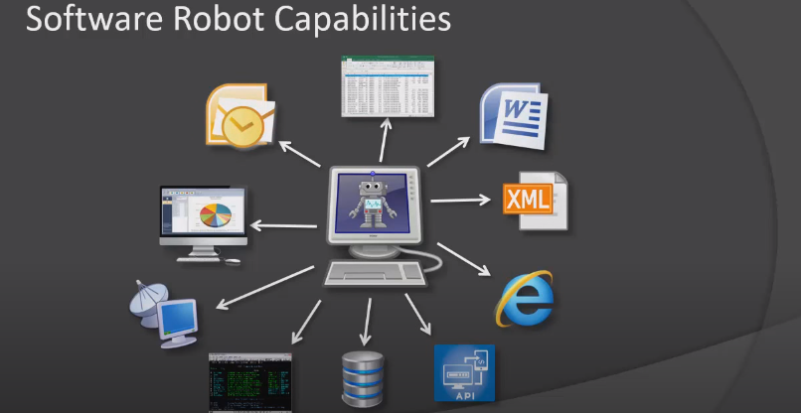

Slide 12

How does RPA work?

Slide 13
Robotic process automation (RPA) is the use of computer software ‘robots’ to handle repetitive, rule-based digital tasks such as filling in the same information in multiple places, reentering data, or copying and pasting. It enables organizations to give more and more of the mundane admin work over to machines that can handle it well and in full compliance.
This enables an organization to achieve cost efficiencies by streamlining processes and enhancing accuracy. As importantly, it enables humans to focus on work that requires judgement, creativity and interpersonal skills rather than on routine processes. You can read our previous blog post for more info on what RPA is; this time, we delve into how RPA works.

Slide 14
How does RPA work with your existing systems?
RPA works by accessing information from your existing IT systems. There are numerous ways that RPA tools can integrate with your applications. One option is through connections to databases and enterprise web services in the backend. Another is through front end or desktop connections that take multiple forms.
Which way is best? It depends on your enterprise and the needs that the solution will address. With backend connectivity, your automation accesses systems and services under the control of a process automation server. This is most commonly used for unattended automation, where your software robots carry out back-office tasks such as processing insurance claims at scale and with minimal to no employee intervention.
Front-end RPA integrations
On the front end, there are several ways your automation can connect with desktop applications (such as SAP, PeopleSoft, and Salesforce CRM as examples) and other resources to get the job done. A front-end automation can read and write data as well as capture events straight from the user interface of the target application, in a similar way to a human operator.
Humans look at the screen, recognize the elements by what they look like and how they’re labeled and interact accordingly. But how does attended RPA work? By recognizing each element by its properties and technology family, and checking out its structure and hierarchy. Exactly where that element sits on the screen doesn’t really matter.
Another way of connecting to desktop elements is via controlled user interface connectivity. Its power can be enabled by hidden fields and controls created by the application owner, carrying information that’s not visible to the human eye. Such information might be an account number, for example.
Other tools in your process automation solution may provide additional capabilities. Some NICE automation tools, for example, include surface connectivity capabilities. What that means is the ability to pull in information from images, PDFs, and remote applications.

Slide 15

AI-powered RPA – how it works
This is a term for advanced automation that leverages artificial intelligence (AI) and related technologies such as Optical Character Recognition, Text Analytics, and Machine Learning. Where attended and unattended RPA excel with processes that leverage information from structured databases, cognitive automation can also tap into unstructured data sources like scanned documents, emails and letters. Cognitive automation uses Optical Character Recognition (or OCR) , chatbots and Machine Learning technologies, to support the automation of more complex business processes. With machine learning, the automation process has the ability to learn, expand capabilities, and continually improve certain aspects of its functionality on its own. In the foreseeable future, you’ll be able to use AI to independently map, identify, and automate processes. AI is also able to train robots to handle exceptions, by learning from the ways that human employees handle exceptions in attended automation processes.

Slide 16
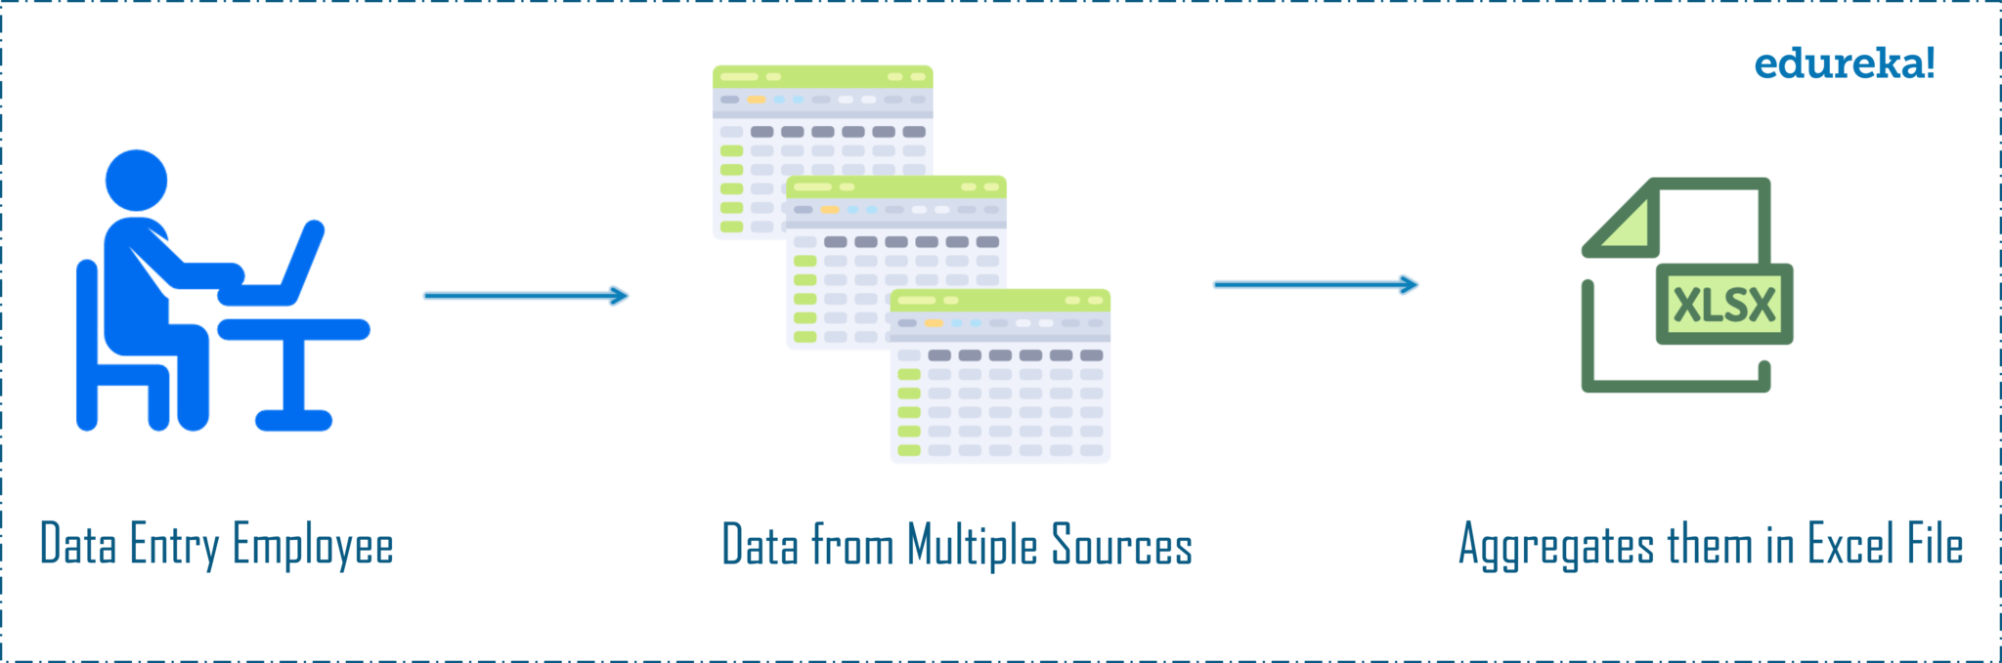
What is Automation?
Consider a scenario where a person’s sole job is to collect data from multiple sources and then aggregate them in an Excel file. Refer to the below image. Now, do you think this person should do this job on a daily basis or instead automate this task to use his talents in a better way? Obviously, the second option sounds better.
So, a person can just automate this task of collecting data from various sources and aggregating them into a single file by using Robotic Process Automation. If I have to define Automation for you, then Automation is the technique of reducing human effort and improve the performance simultaneously. To automate tasks, we need RPA Tools to do so, and one of such tools is UiPath.

Slide 17
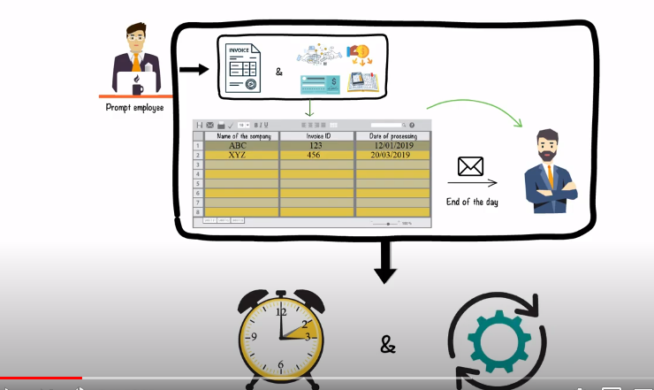

Slide 18
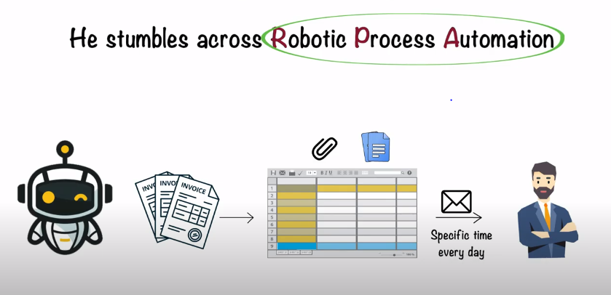

Slide 19
10 RPA Automation Examples
Moving Files from Source Folder to Destination Folder
Web Automation
Email Automation
Excel Automation
PDF Automation
Transferring Data from one system to another
Call center operations
Payroll Processing
Forms Processing
Client profile updates
Generating Premium renewals
Claims Processing
Credit card applications

Slide 20
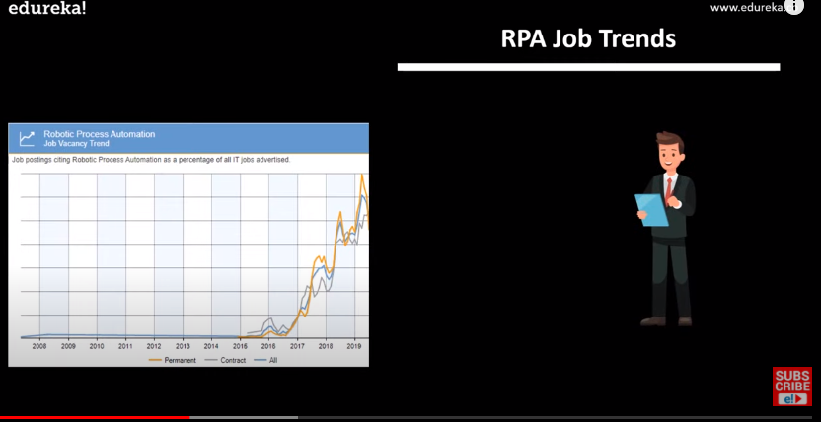

Slide 21
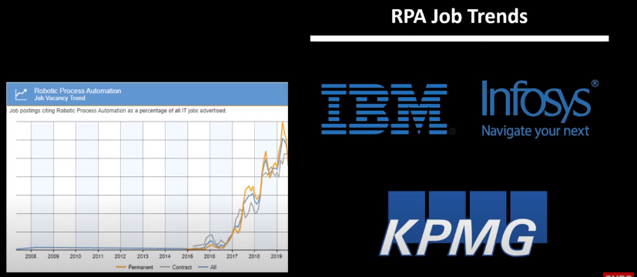

Slide 22
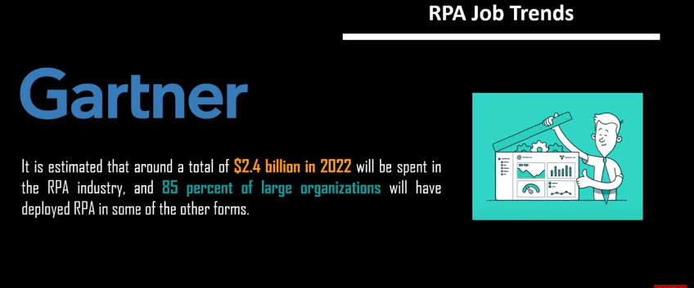

Slide 23
RPA Developer Job Trends
Location | Number of Jobs
United States | 5520
United Kingdom | 512
India | 3439
The following table illustrates the number of jobs in different locations around the Globe.

Slide 24
RPA Developer Salary
The salary can vary on the following parameters:
Positions-Based
Roles-Based
Company-Based
Geographically

Slide 25
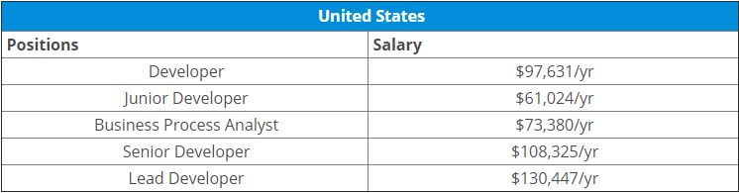
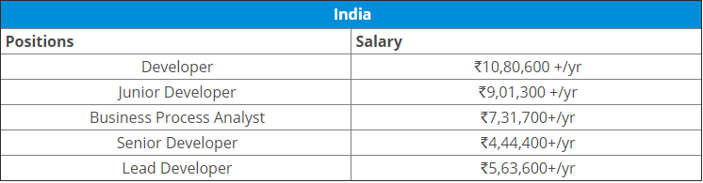
RPA Developer Salary Trends: Positions Based
According to Indeed.com, below are stats depicting the average RPA Developer salary for the US and India for various positions in the market.

Slide 26
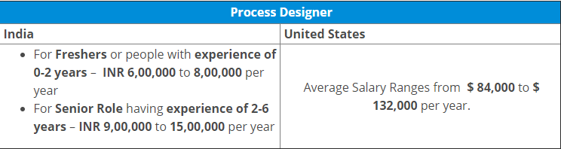
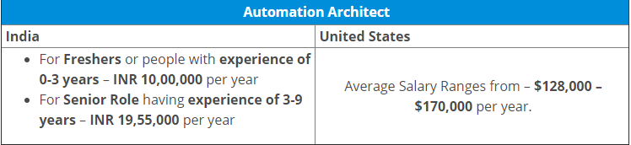
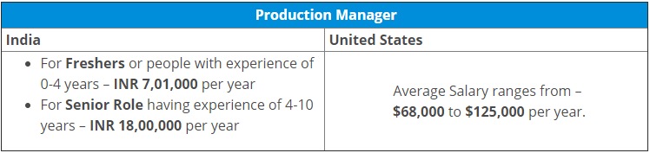
RPA Developer Salary: Roles-Based: RPA Developer has mainly three roles in the industry: Process Designer, Automation Architect, and Production Manager. So let me discuss the tentative salaries you will get based on these roles.

Slide 27
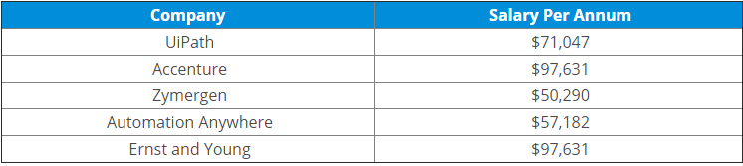

RPA Developer Salary: Company-Based
I am listing down the salary offered to an RPA Developer by major companies who are actively hiring for the same.
RPA Developer Salary: Geographically

Slide 28
