Slide 1



AutoSense
Analytics
A data collection company utilizing vehicle mounted sensors

Slide 2
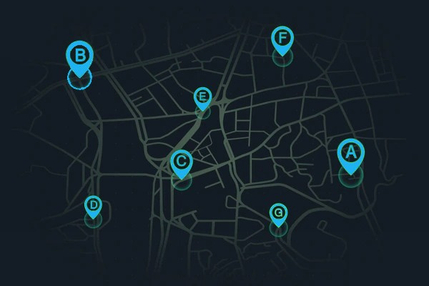
PROBLEM
STATEMENT
01
Lack of available data
Inflexible data collection
02
03
Data fragmentation

Slide 3




OUR SOLUTION
Vehicle Mounted Sensors
Deploy sensors on vehicles to collect real-time data across various routes
Data Sharing Partnerships
Adoption of IoT Technology
Centralized Data Integration Platforms

Slide 4

UNIQUENESS
Vehicle Utilization
Enhanced Features
Data Analysis
Public transportation vehicles: established routes frequently
Private transportation vehicles (taxis): wide range of routes
Commercial Fleets: specific hours
Low-cost and high-speed hardware
Plug and play h/w
Edge-AI
Application specific hardware design
Customized data analysis per project
Friendly and readable data presentation
Covering a wide spectrum of applications

Slide 5







CURRENTLY WORKING
NAM
Group
Image Collection for 3D reconstruction
Signal RSSI Mapping
WiFi Access-Point Mapping
Measuring:
Detecting:
Collecting:
4G/5G
LoRa
Zigbee
NB-IoT
Approximate detection of access point location, in campus
Images from 3 cameras looking in different angles
WiFi RSSI
Providing:
Providing:
Providing:
Detection of dead signal spots
Recommendation of new access points placement
Creation of signal coverage heatmap
Comparison of network service providers
A map of the campus WiFi access points locations
Images formatted for 3D-reconstruction of the desired area
Information from the images collected, using EdgeAI
A heatmap of the campus WiFi signal
Recommendations for access-points reallocation

Slide 6










HARDWARE SELECTION
Raspberry Pi 4 B+ 8GB
Raspberry Pi HATs
selected depending on each business needs
Extra Hardware
Battery or
12V Car Lighter Power adapter
3D printed
Vehicle Mount
Case
GPS Antenna
RPi Camera
RPi AI HAT+

Slide 7
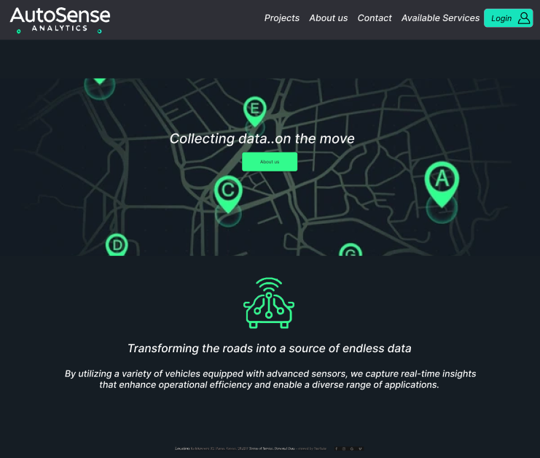

WEBSITE DRAFT

Slide 8
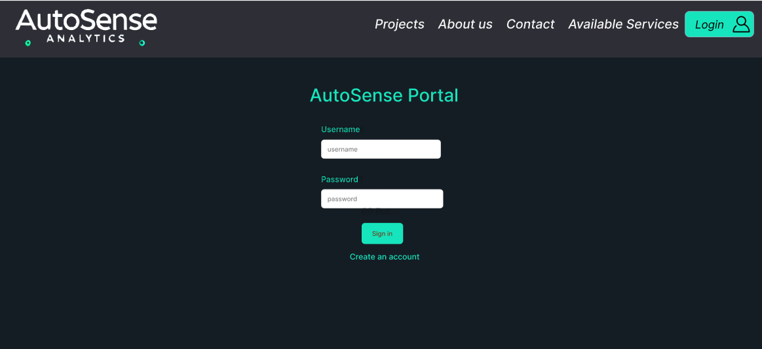
Authorized User Login
Login necessary in order to view the project updates

Slide 9
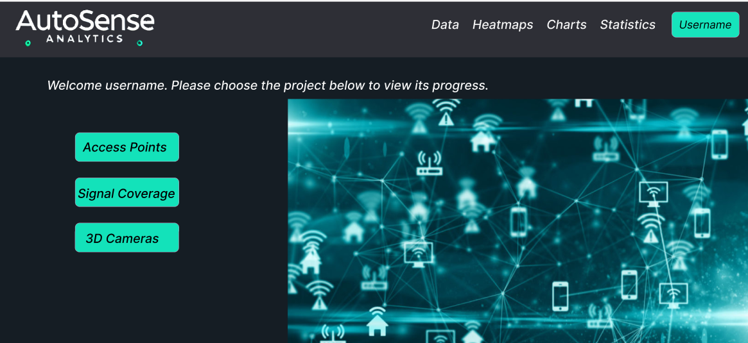
For each connected user the list of the projects they are associated with, will be displayed.

Slide 10
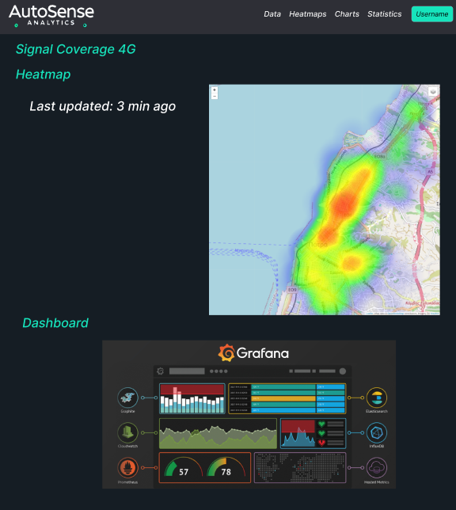
For every project:
Customized Dashboard, depending on the users needs
Heatmaps
Graphana charts

Slide 11




OUR TEAM
Eleni Sakellariou Matsi
Georgios
Stergiopoulos
Student @ ECE Upatras
Student @ ECE Upatras
Specialization
Communications
Specialization
Computer Engineering
+30 6987095462
+30 6931152410
up1084047@ac.upatras.gr
gstergiopoulos@ac.upatras.gr

Slide 12

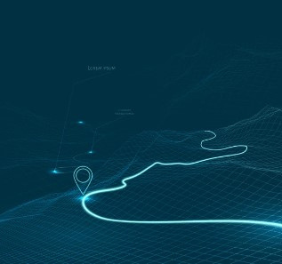
AutoSense
Analytics
Thank's For Watching
Connect with us.
+30-2610-995-386
contact@autosense.com

