Slide 1



AutoSense
Analytics
A data collection company utilizing vehicle mounted sensors

Slide 2
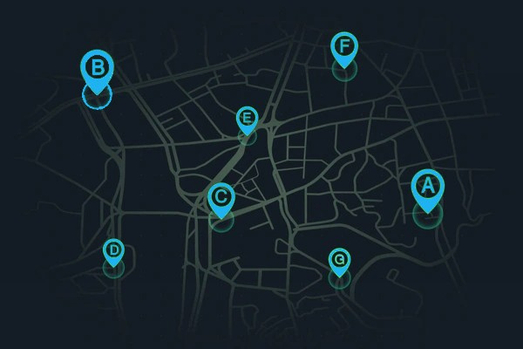
PROBLEM
STATEMENT
1
Lack of available data for Urban Infrastructure, needed for deployment and maintenance decisions
2
Network blind spots, weak signal strength, incorrectly positioned antennas
Not enough data for road quality and roughness, unsafe roads in need of maintenance
3
4
Limitations of stationary sensors, non unified data, limited spatial insight

Slide 3




OUR SOLUTION
Vehicle Mounted Sensors
Deploy sensors on vehicles to collect real-time mobile data across various routes
Data Sharing Partnerships and on-demand data collection
A Business to Business Company Model
Adoption of IoT Technologies providing us with continuous and automated data
Centralized Data Integration Platform offering unified and complete data presentation

Slide 4






Access Points
Access Points
More than 170 for EduRoam
3 LoRa
27 for Patras WiFi
80 LoRa
Signal RSSI Mapping
WiFi Access-Point Mapping
Measuring:
Detecting:
4G/5G
LoRa
NB-IoT
and others
Approximate detection of access point location, in campus
WiFi RSSI
Providing:
Providing:
Detection of dead signal spots
Recommendation of new access points placement
Creation of signal coverage heatmap
Comparison of network service providers
A map of the campus WiFi access points locations
A heatmap of the campus WiFi signal
Recommendations for access-points reallocation

Slide 5


MORE PROJECTS
NAM
Group
Road Roughness
Image Collection for 3D reconstruction
Detecting:
Collecting:
Road roughness using an IMU
Images from 3 cameras looking in different angles
Providing:
Providing:
Improving road maintenance scheduling
Images formatted for 3D-reconstruction of the desired area
Information from the images collected, using AI
Suggesting routes for micro mobility vehicles
Urban infrastructure suggestions

Slide 6

UNIQUENESS
Vehicle Utilization
Enhanced Features
Data Analysis
Public transportation vehicles:
established routes frequently
Private transportation vehicles (taxis):
wide range of routes
City management vehicles:
specific hours
Low-cost hardware
Plug and play h/w
Application specific hardware selection
Customized data analysis per project
Use of AI/ ML
Friendly and readable data presentation
Covering a wide spectrum of applications

Slide 7











HARDWARE SELECTION
Raspberry Pi 4 B+ 8GB
Raspberry Pi HATs
selected depending on each business needs
Extra Hardware
Battery or
12V Car Lighter Power adapter
3D printed
Vehicle Mount
Case
GPS Antenna
RPi Camera
RPi AI HAT+
IMU

Slide 8
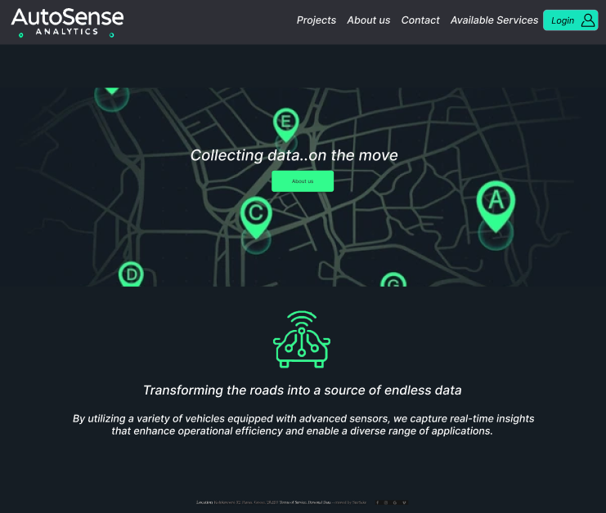

WEBSITE DRAFT

Slide 9
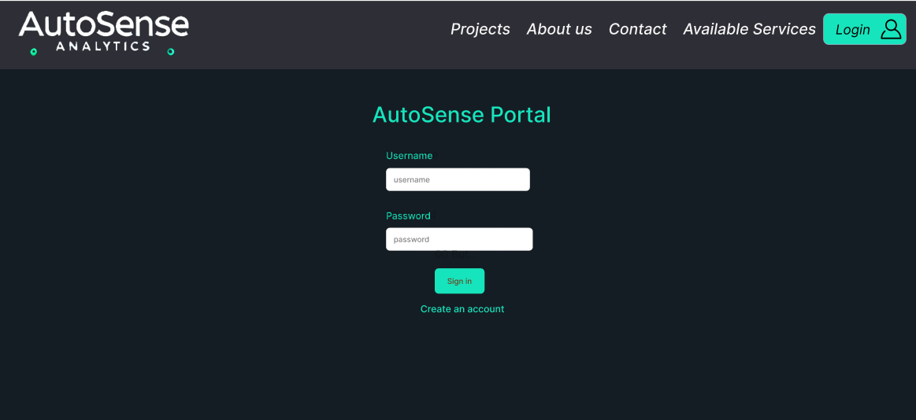
Authorized User Login
Login necessary in order to view the project updates

Slide 10
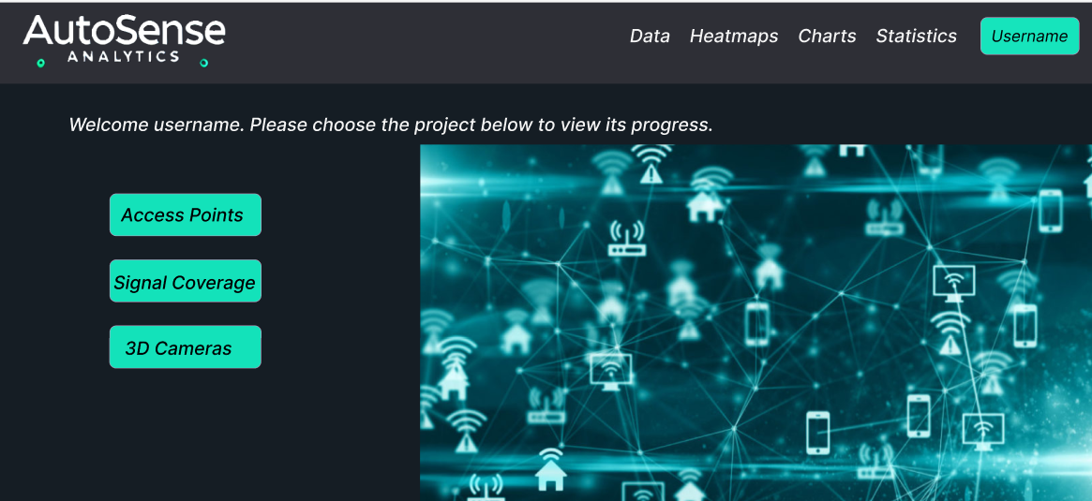
For each connected user the list of the projects they are associated with, will be displayed.

Slide 11
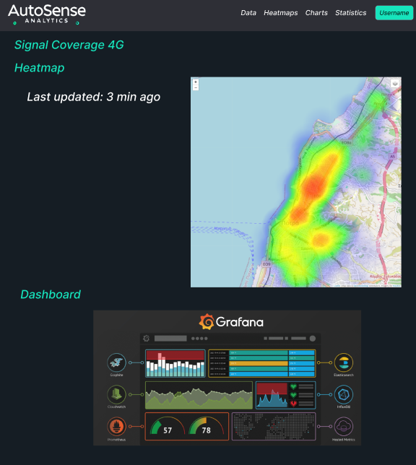
For every project:
Customized Dashboard, depending on the users needs
Heatmaps
Graphana charts

Slide 12




OUR TEAM
Eleni Sakellariou Matsi
Georgios
Stergiopoulos
Student @ ECE Upatras
Student @ ECE Upatras
Specialization
Communications
Specialization
Computer Engineering
+30 6987095462
+30 6931152410
up1084047@ac.upatras.gr
gstergiopoulos@ac.upatras.gr

Slide 13

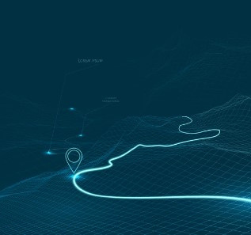
AutoSense
Analytics
Thank's For Watching
Connect with us.
+30-2610-995-386
contact@autosense.com

