Slide 1
Shell scripts
Gino Trombetti and Danielle Ascoli

Slide 2

What is a shell script?
SHELL – program that takes commands and outputs them to OS
Command line interpreter
SCRIPT – collection of commands stored in a file
Shell acts on commands within the script

Slide 3

Why?
AUTOMATION
Simplify repetitive tasks
PRACTICAL USES
Data backup
Computer maintenance
Create basic applications
Process user input

Slide 4
Our script
PURPOSE
To automate the creation of a local website on Apache server
USED
Zsh - Shell
Apache – Server
Virtual Box
Ubuntu
Mac OSX

Slide 5
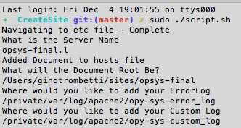
What it does

Slide 6

WID Cont’d

Slide 7
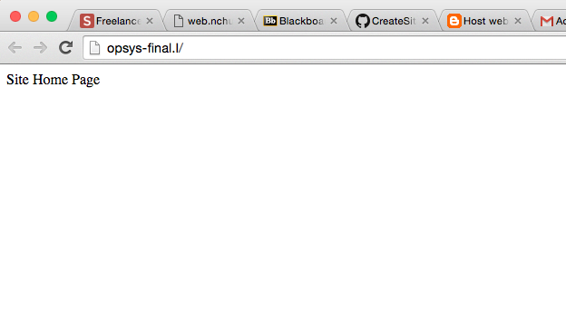
WID Cont’d

Slide 8

WID CONT’d

Slide 9

WID Final

Slide 10
conclusion
ISSUES
Dual booting Linux
Virtual Box
Learning website creation
QUESTIONS?

