Slide 1
wantMAW
WDI6 - project1
Dale
An application linking multilinguists with companies that need translating work.
Simple
Overview of candidates and positions
Fast

Slide 2
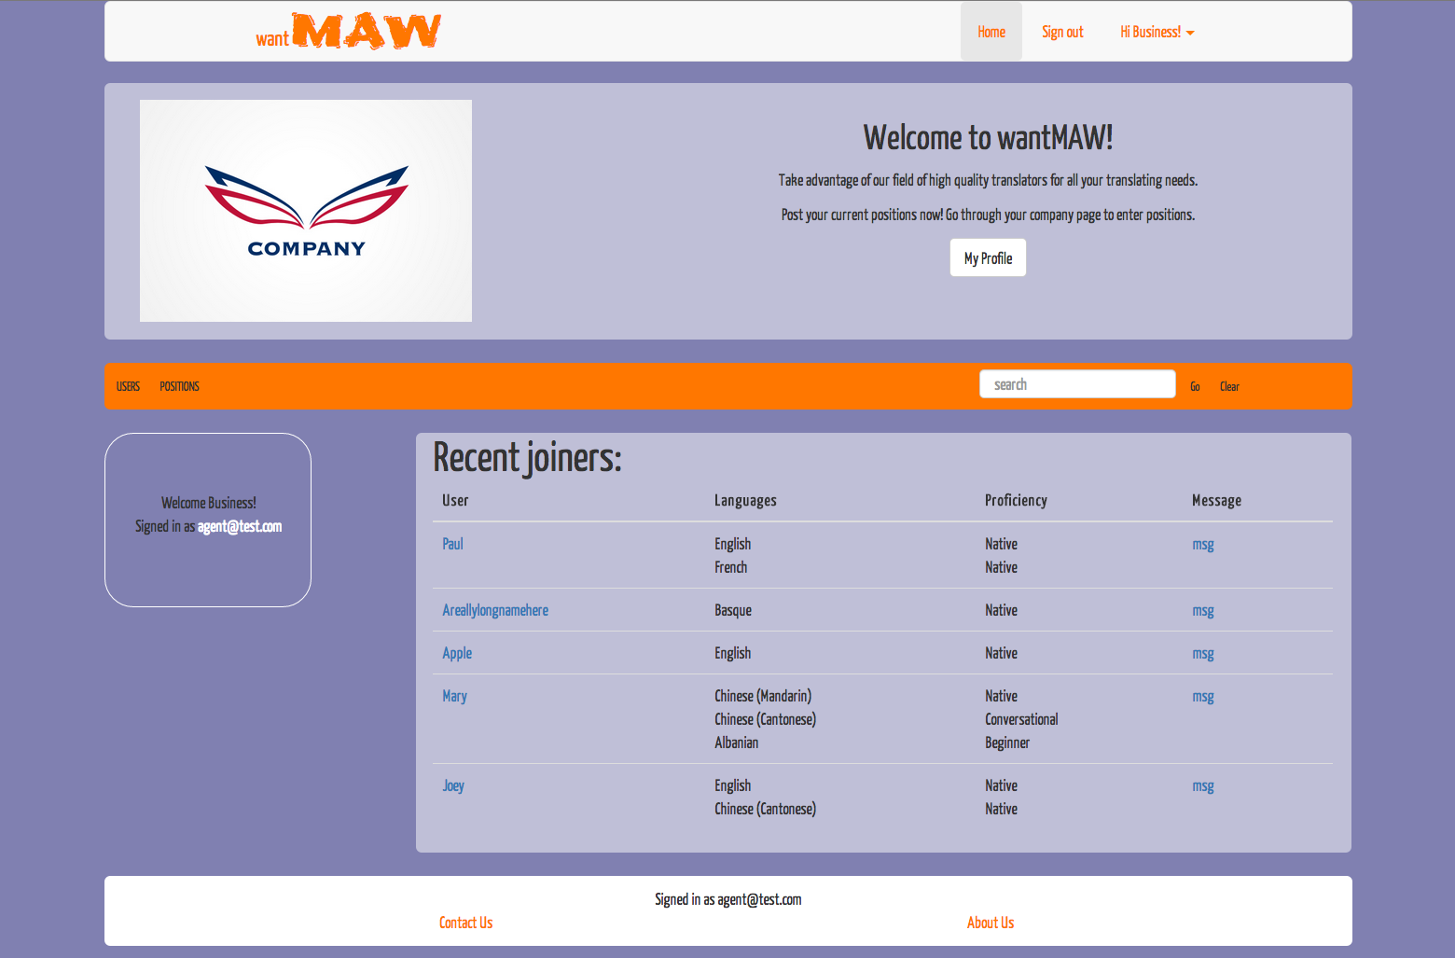
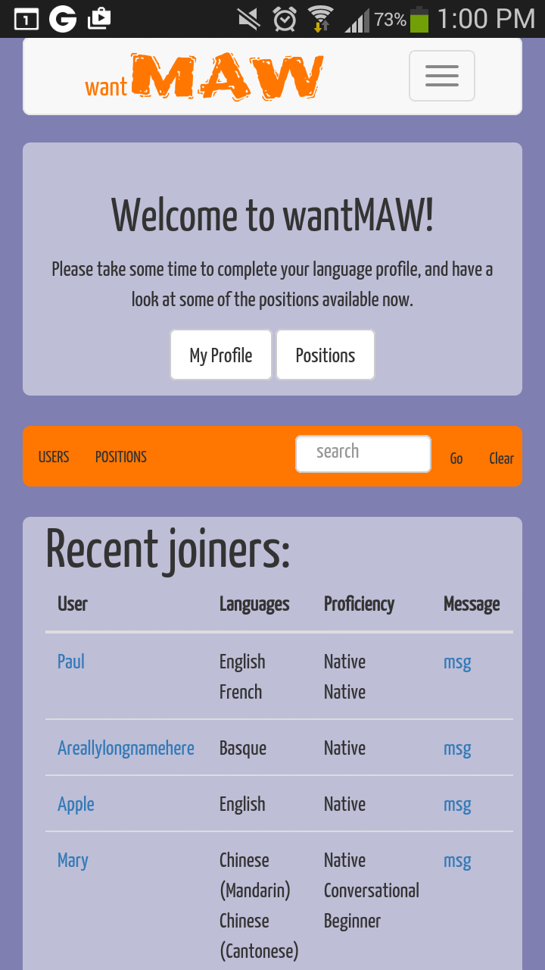
wantMAW

Slide 3
Technologies
Languages
  html/css, javascript, ruby
Libraries
  rails, gems
  bootstrap, jquery
Other
  git (version control)
  heroku, AWS

Slide 4
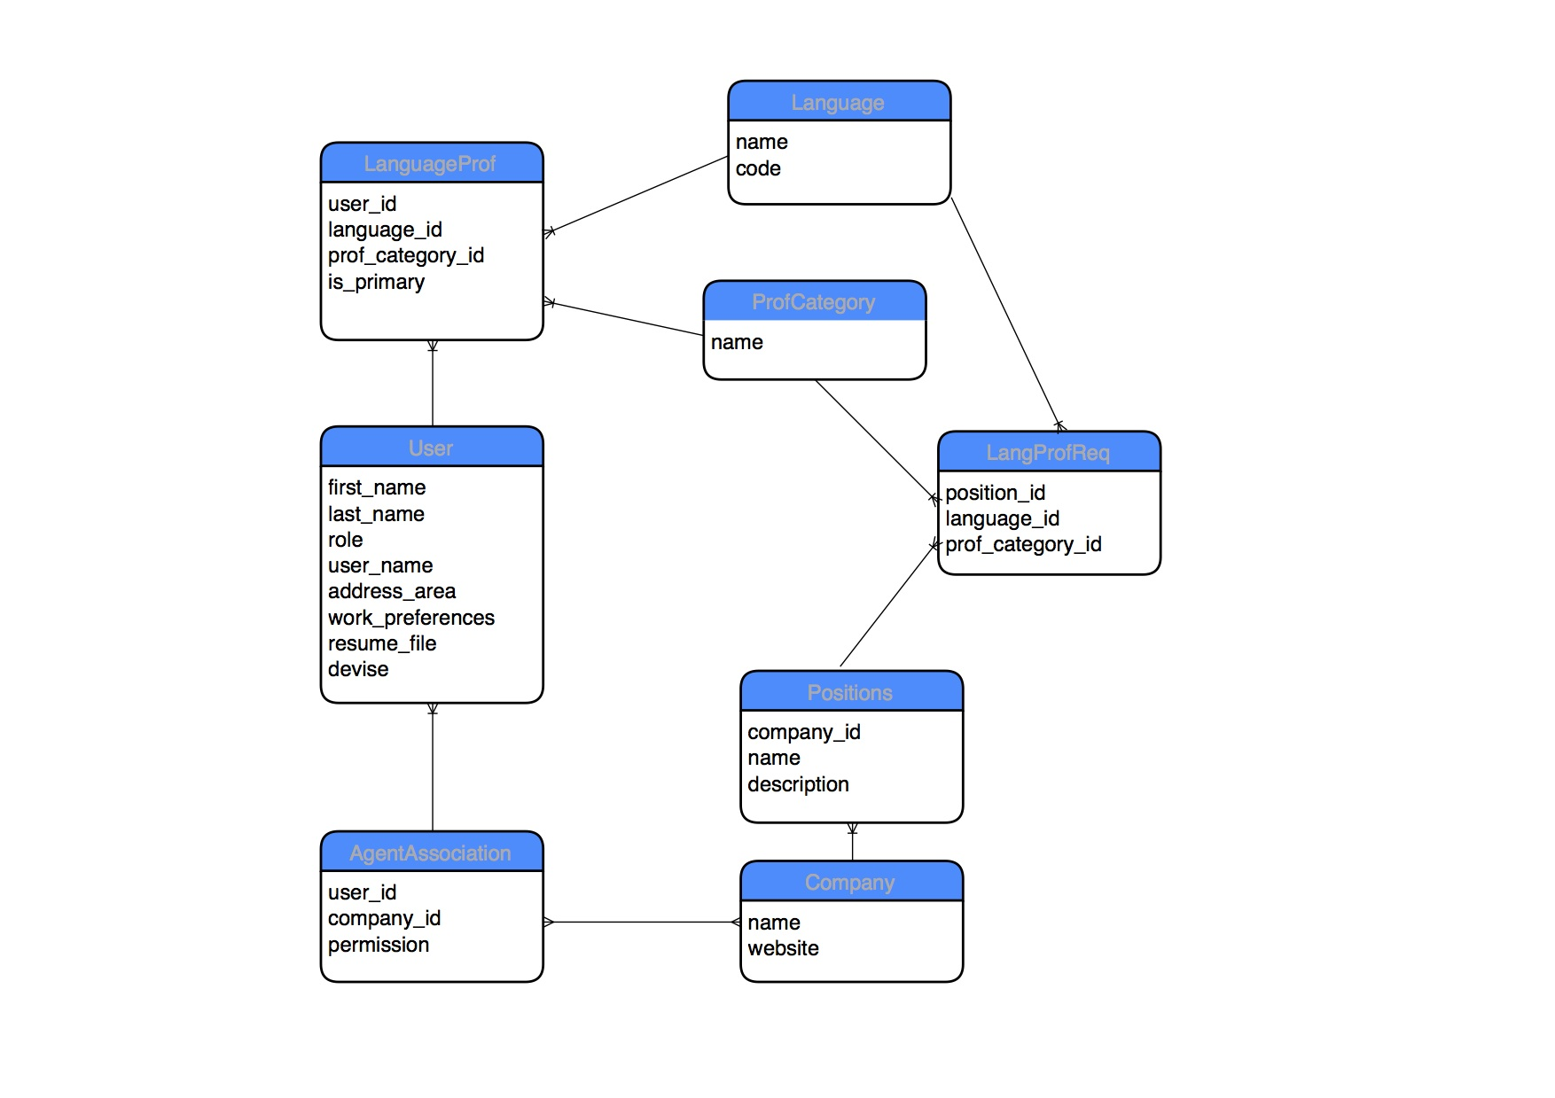
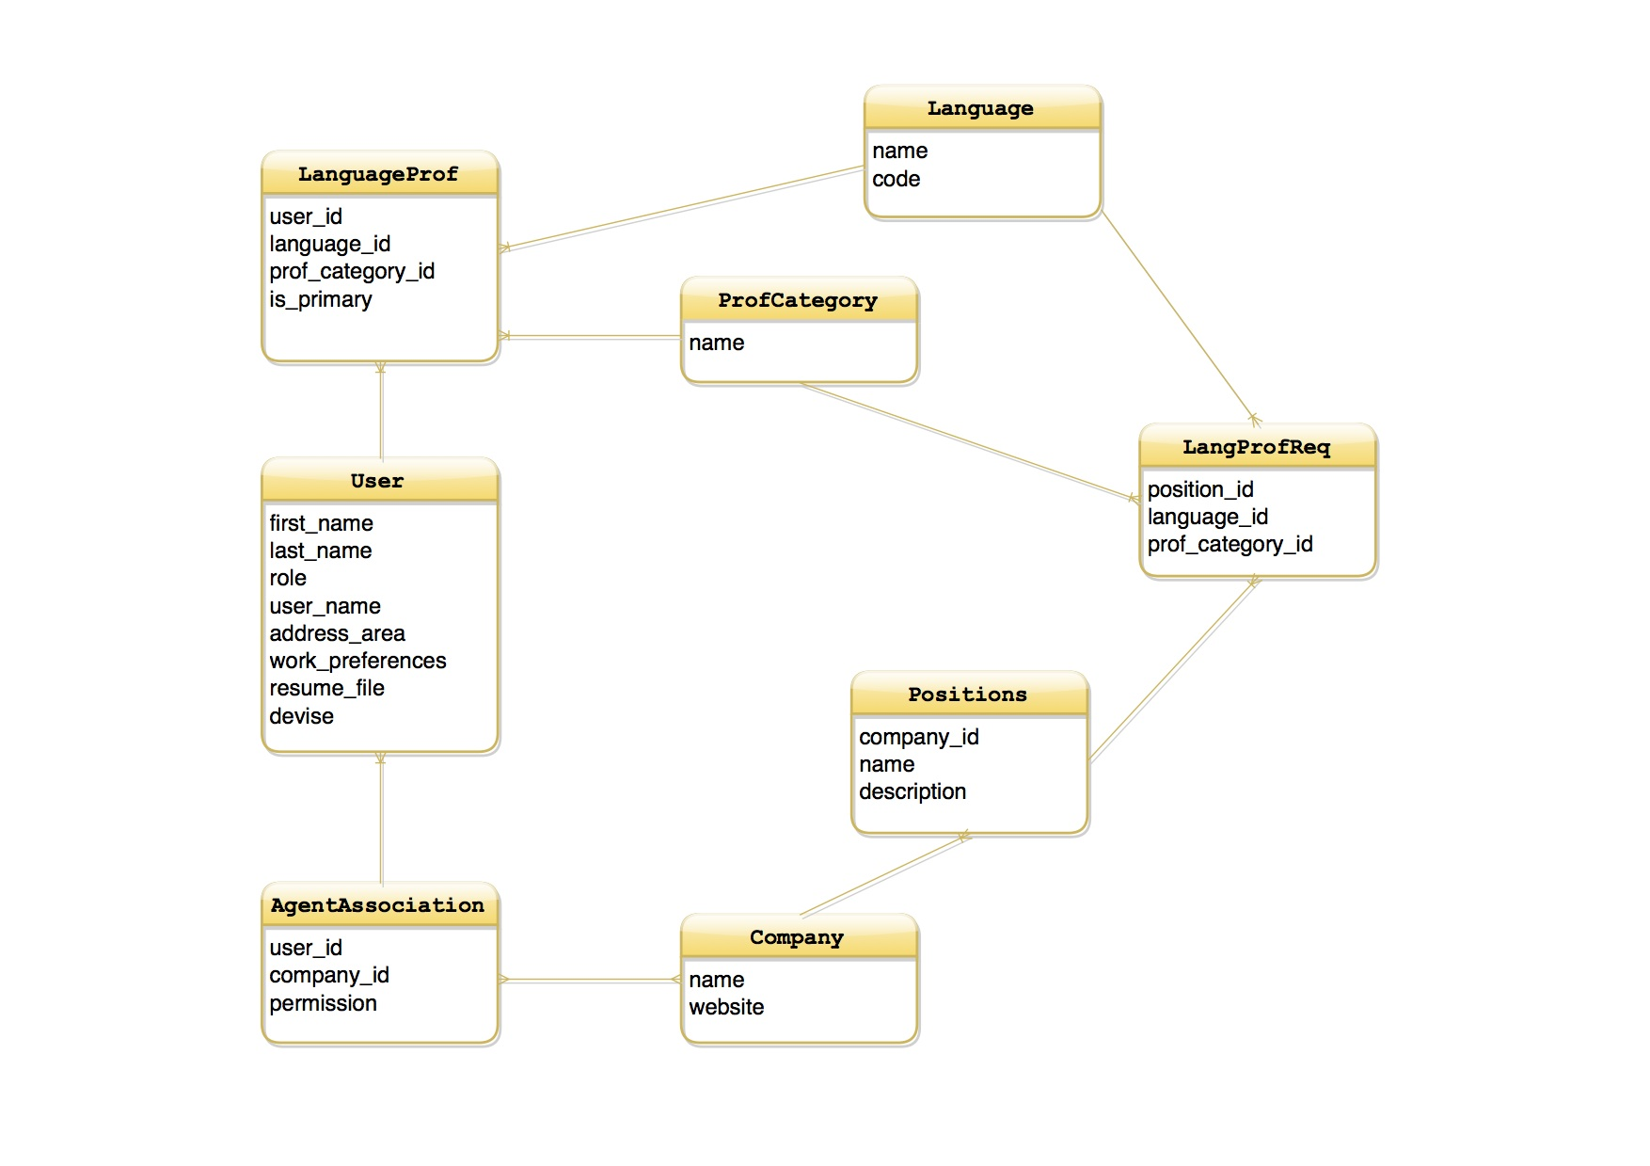

Slide 5
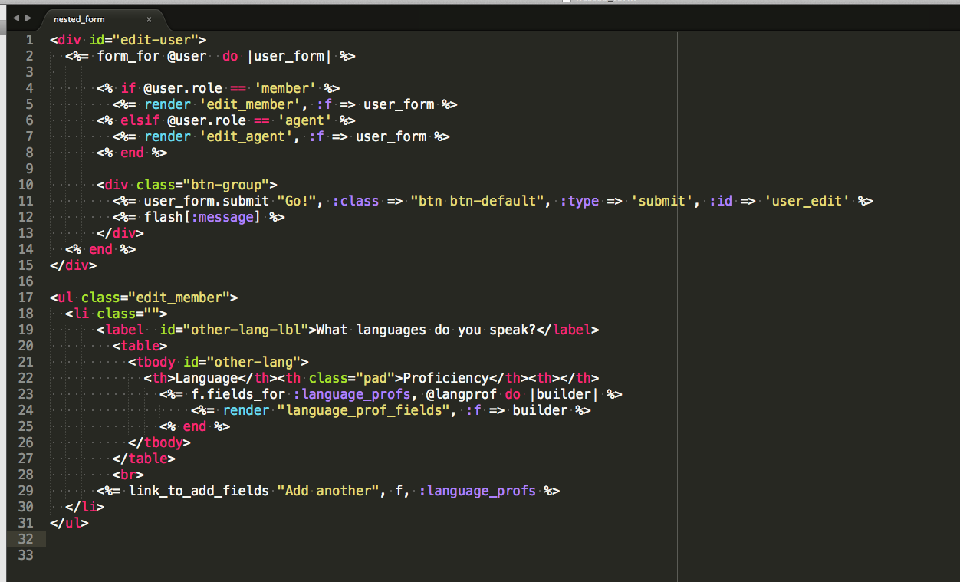
Technical Challenges
Updating multiple tables through one record
  used accepts_nested_attributes_for in the model

Slide 6
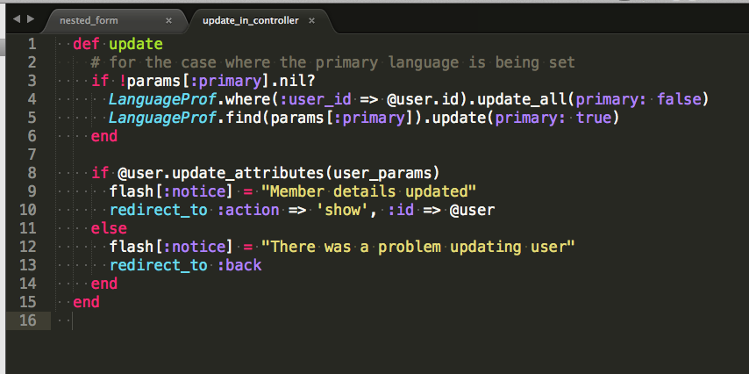
Technical Challenges
Indicating which language is 'primary'
  boolean field 'primary' in user
  updated in user_controller

Slide 7
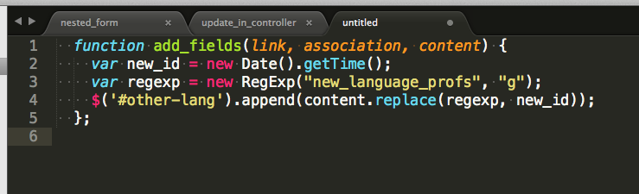
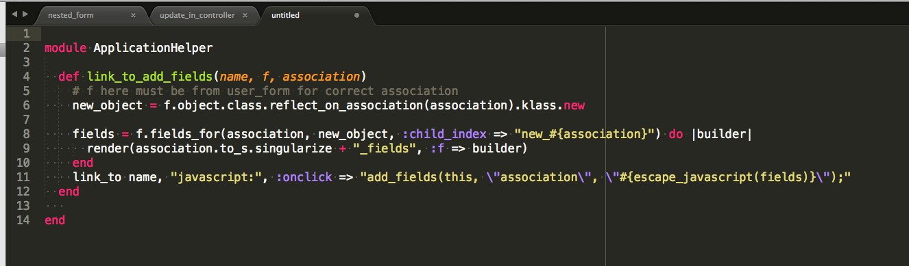
Technical Challenges
Dealing with dynamically created elements
  Create ids with js and replace when updated

Slide 8
Mistakes were made
nested_forms
  not clean, confuses the relationships
primary language
  user field, gems
project scope
  needed early focus on important features

Slide 9
