Slide 1
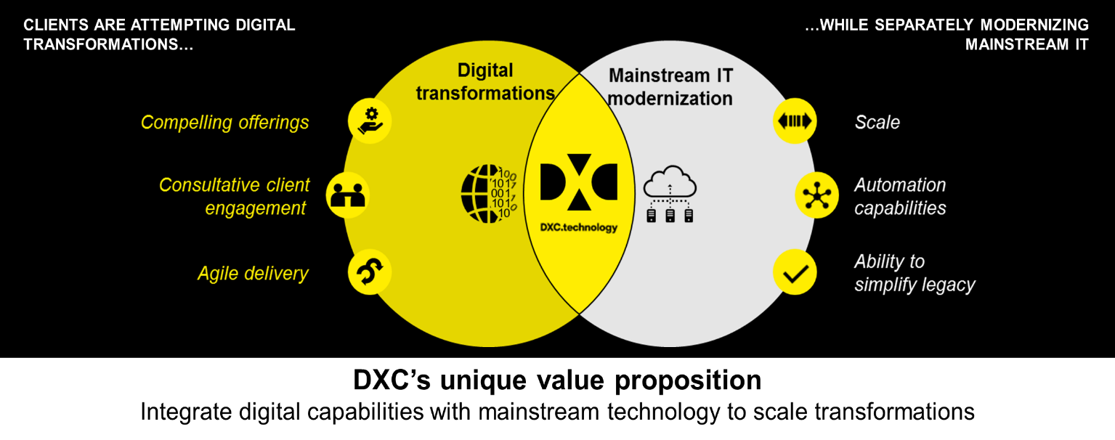
Charter
Purpose: The DTC’s aim to change the client conversation to Digital ,featuring DXC’s unique value proposition to integrate digital capabilities with mainstream technology to scale transformations.
Notes:
Need to answer…what is a roadmap? Need an example.

Slide 2

DTC plans to achieve this purpose by
Offering an immersive digital transformation experience for clients
See and experience high performance, multi-disciplined Agile DevOps teams at work
Coach, guide and partner with clients for creating unique Minimal Viable Products (MVP)
Experience new end-to-end Digital IT operating model deployments at scale & speed
An incubation center for Digital Innovation and Talent
Interlock between Integrated Practices, Partners and DTC network to pioneer innovative ideas and build digital competency
Inculcate a culture of Problem-solving using Agile and DevOps principles
Cultivate an environment thriving on self-management, self-driven learning, research & development for driving and pioneering continuous Agile Innovation
ce
Seamlessly Integrating Digital into Mainstream
Leverage DXC Eco System and existing footprint to Drive Digitalization Strategy
Instantiate agile culture and innovation mindset leveraging distributed agile delivery construct and transform to DevSecOps

