Slide 1
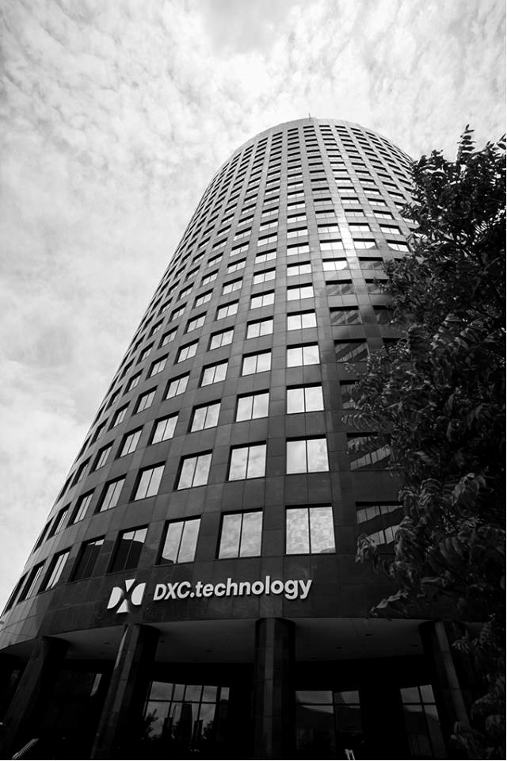


Scope
A DTC is a physical center where we co-develop solutions with clients: designing, prototyping, piloting, and innovating to support their Digital transformations.
DTC changes the client conversation to Digital, highlighting DXC’s unique value proposition to integrate digital capabilities with mainstream technology to scale transformations
DTC converts business solutions into technical feasibility through ideate and explore modes
DTC scales small ideation concepts to large digital projects
DTC works in collaboration with large Transition &Transformation programs to execute digital projects
DTC helps and supports customers in their Transformation/ Digital journey by augmenting digital resources where ever required

