Slide 1
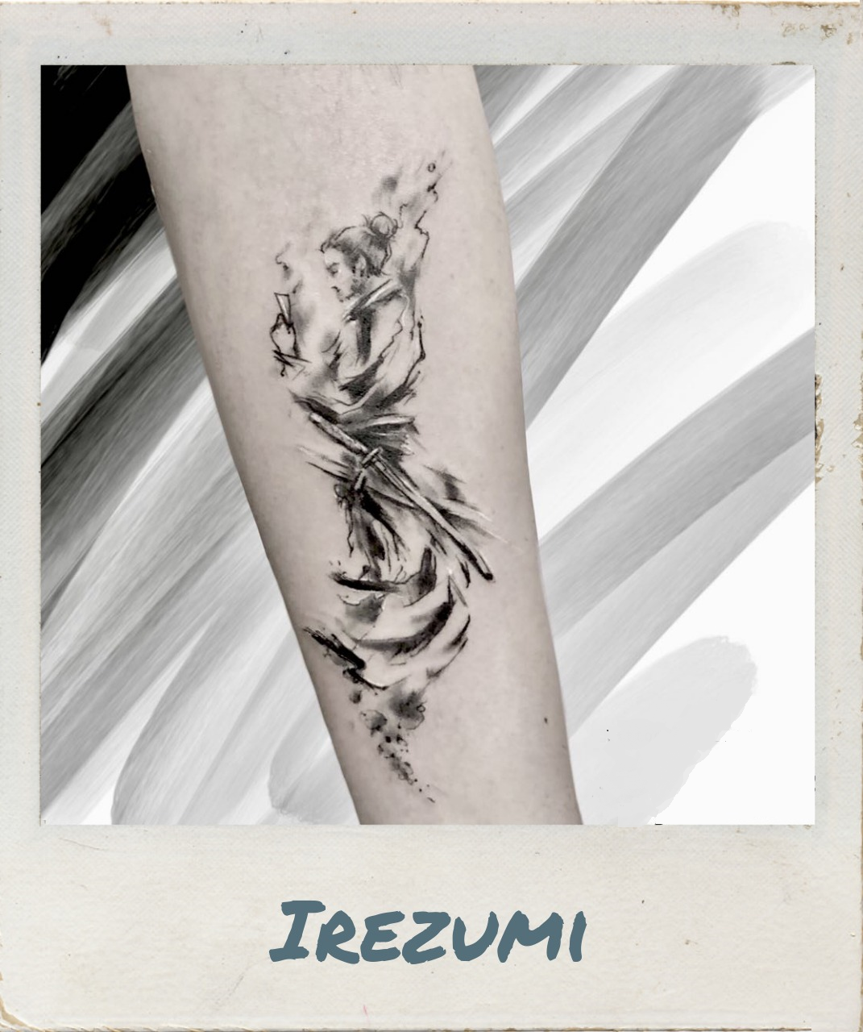

To see other tattoos Alessandra Petrozzi has created have a look at her Portfolio.

