Slide 1
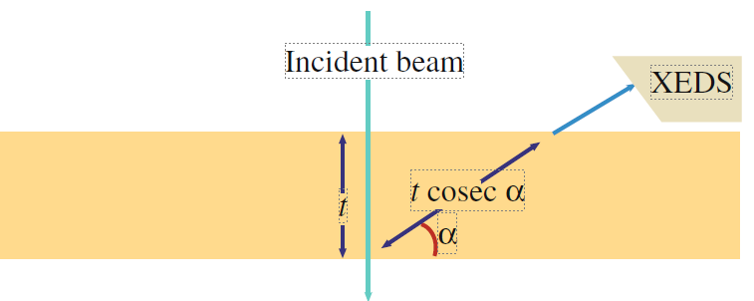
e⁻
EDS
t
sample
path
α

