Slide 1
Introduction to Concepts ‘Genomics of Disease in Wildlife’
GDW 2018
Colorado State University
Slatteryjp@si.edu
Jill.Pecon.Slattery@gmail.com www.cornerstonegenomics.com

Slide 2

Genomics Unites Human Biomedicine and Wildlife Research
Biomedical Advances in Humans
Computer Technology
Whole Genome Annotation
Bioinformatic Tools
Transcriptomics, Proteomics
Next Gen Sequencing
Individualized Medicine
Natural Experiment: Wildlife
Speciation
Biodiversity & Systematics
Population Genetics & Phylogeography
Genome Evolution
Adaptation & Selection

Slide 3
Emergence Of Disease In Wild Species
Why bother?
Zoonotic pathogens are responsible for ~58% human disease
Monitoring wildlife in natural settings rare & expensive
Pathogen outbreak often undetected until noticeable morbidity (rate of incidence) or mortality (death)
Host immune genomics reflects selective filters and/or adaptations of survivors to previous outbreaks of disease
What species?
Are some species more susceptible or more resistant?
Are some species more likely to be reservoir hosts?
Genomic methods identify the molecular basis of the evolutionary arms race between host and pathogen.
Are lessons to be learned from wildlife that can be applied to human disease outbreaks?
Are lessons to be learned from humans that can be applied to wildlife disease outbreaks?

Slide 4
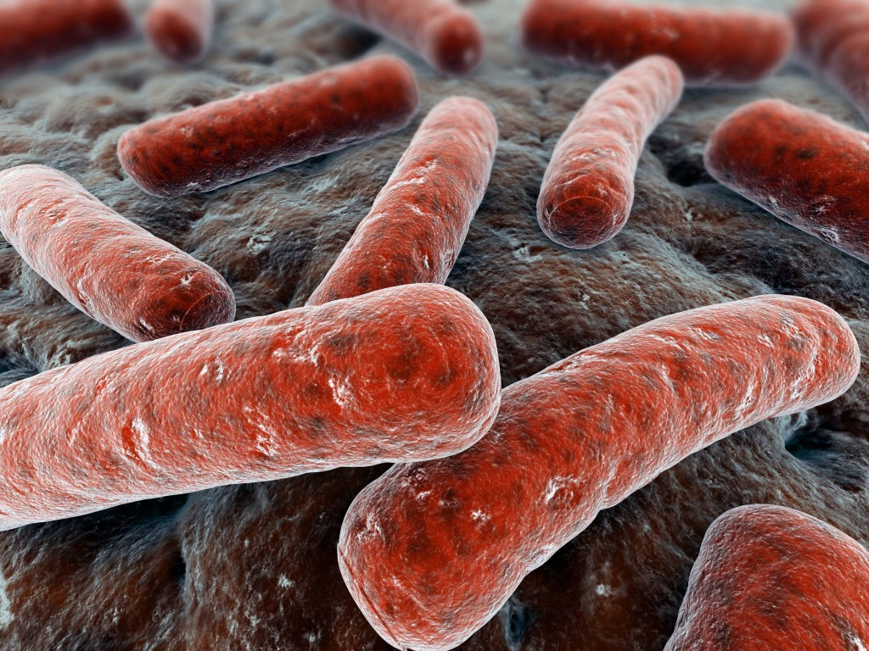
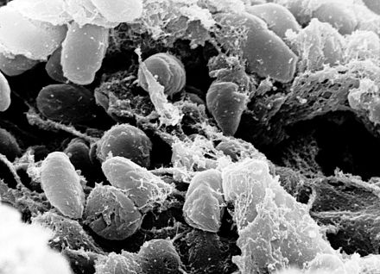
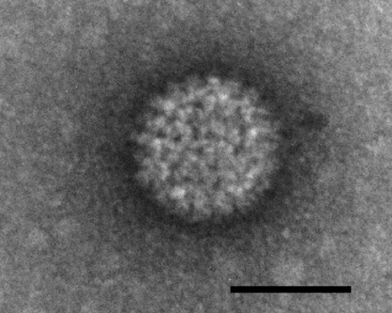
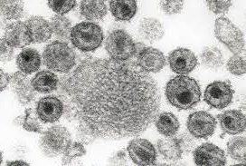
DNA Sequencing of Pathogens
Genome organization, structure and function
Estimation of pattern and rate of mutation within each pathogen gene
Estimation of genetic diversity within the pathogen
Identification of emergent strain
Geographic and evolutionary origin of emergent strain(s)
Patterns of global transmission
Co-evolution and adaptation
Selection
Fitness traits-replication rate, transmissibility, immune recognition
Intra-host diversification and horizontal gene transfer among strains
Vaccine and drug therapy development

Slide 5
DNA Sequencing of Host Species
Evolutionary history of species
Population structure and phylogeography
Historic and ongoing patterns of migration
Genetic diversity
Inbreeding
Endangered or relic species, subspecies and populations
Identification of genes involved in disease resistance and progression
Predictive effects of pathogen emergence in naïve host populations

Slide 6
Design Concepts Incorporating NGS Data
Essential hypothesis-driven design will optimize NGS data
Establish clear objectives
Survey existing genomic resources
Estimate sample size necessary to achieve objectives
Establish a realistic collection strategy:
Disease event, timeline,
Patterns of transmission and dissemination,
Host specificity,
Opportunistic, constant surveillance
Wild or managed populations
Assess availability, quantity, and quality of biological specimens
Identify computational resources to analyze large datasets
Establish a genomic workflow for data assessment, analyses and interpretation
Establish a realistic budget

