Slide 1
Discovery of new fungal pathogen, Coccidioides gediwia, in ancient reindeer in Arctic permafrost
GDW 2019

Slide 2
Parameters:
Unlimited budget
Illumina MiSeq
Fungal etiology
Non-invasive sampling

Slide 3
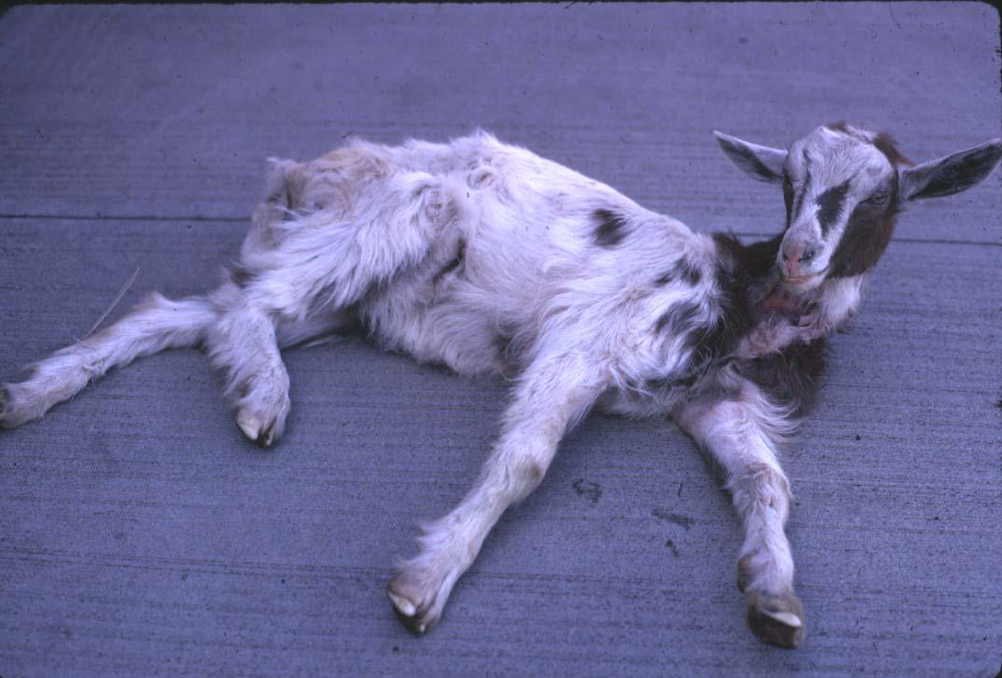
Unexpected death of goat
Clinical history:
Rapid onset respiratory distress,
Lethargy & anorexia,
Recumbency
No tissue available from goat
Notes:
https://noahsarkive.cldavis.org/cgi-bin/show_image_info_detail.cgi?image=F04973

Slide 4
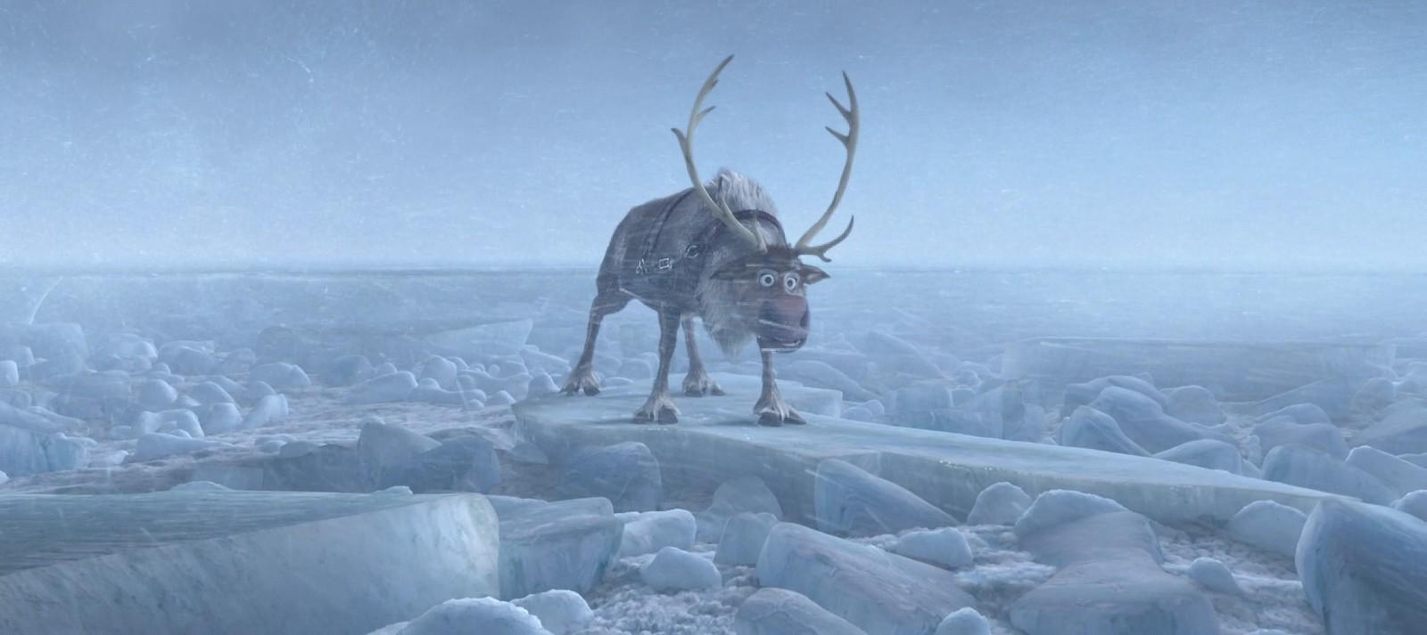
Reindeer Carcass in Permafrost
Notes:
https://medium.com/@jacobosbornecomedy/review-frozen-on-broadway-soars-early-but-profoundly-disappoints-when-sven-the-reindeer-doesnt-bc2cbe3e3d98

Slide 5
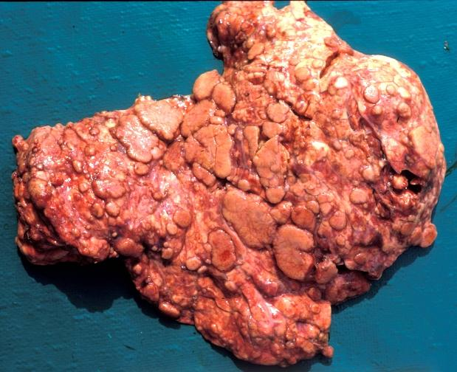
Post-mortem Exam
PPE
Post-mortem examination:
Found a lesion in the lungs
Routine samples for histopathology
Sampling:
Paired frozen and thawed samples
Sampled with clean instruments
Lungs (lesion and not lesion), skin, heart, liver, spleen, kidneys, brain
Swab of nasal sinus and oral cavity
Environmental samples (soil and vegetation) next to the carcass
Record preservation method (cryovials in liquid nitrogen), GPS coordinates of carcass, collection date, label sample type
Notes:
http://www.cfsph.iastate.edu/DiseaseInfo/disease-images.php?name=bovine-tuberculosis&lang=en

Slide 6
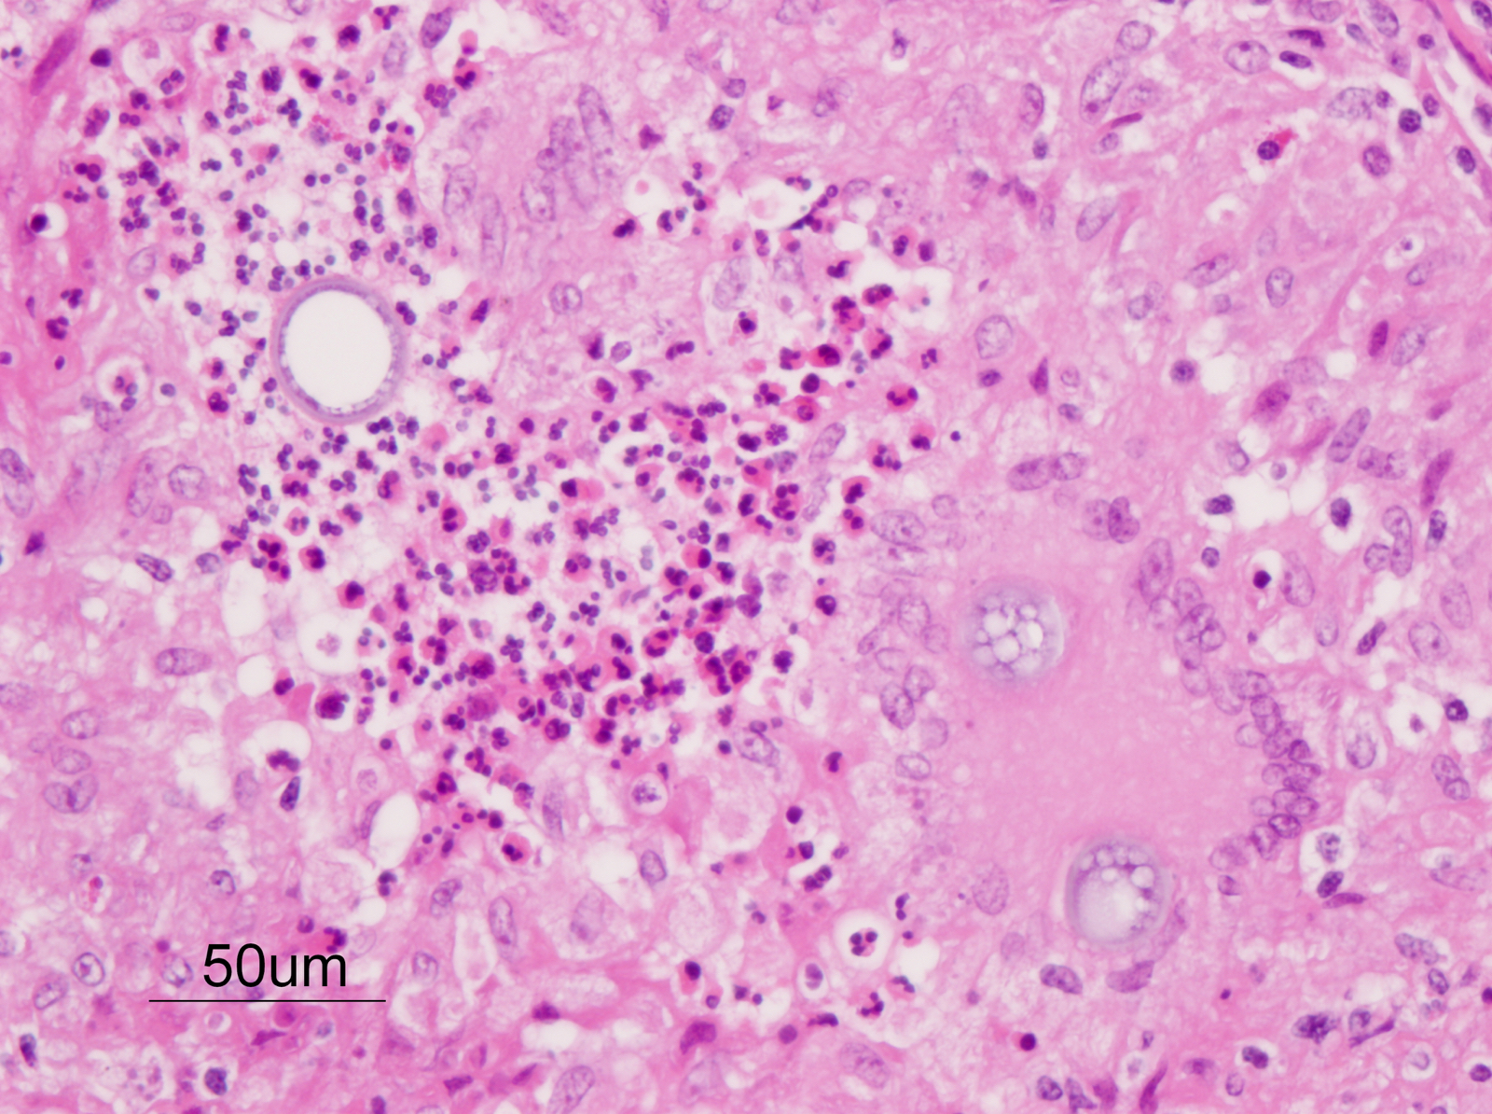
Histopathology
General histopath
ID fungal spherules in pulmonary granuloma
Sequence fungus in lung

Slide 7
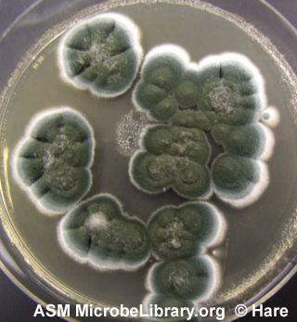
We think it’s a fungus…
Internal transcribed spacer region of rRNA which is approximately 600 bp
Selected locus instead of full genome sequencing because of the likely degradation of genetic material
Meanwhile we are culturing the fungus…
Notes:
https://microbeonline.com/common-fungal-culture-media-uses/

Slide 8
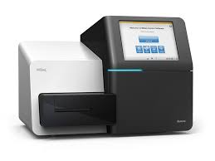
ITS metagenomics with Illumina MiSeq
Sequencing of targeted samples: Lungs, spleen, soil
Utilize ITS1 (forward primer) and ITS4 (reverse primer) to amplify the ITS region
Library preparation
Illumina MiSeq

Slide 9
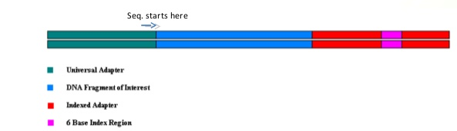
Sequence Processing
Trim off adapters, first and last 20 bp (TRIMMOMATIC)
Evaluate the quality of our sequence data (FastQC)

Slide 10
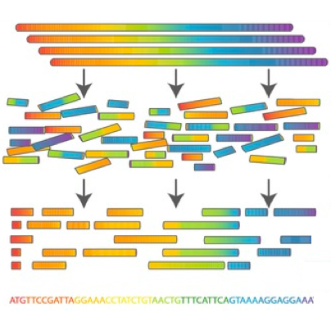
De Novo Assembly
Error Correction (SPADES)
k-mer correction
Assembled contigs
Alignment
Filter out contigs which don’t match our targeted region
Assembled one contig

Slide 11

What is the contig?
BLASTn completely assembled contig against sequences in:
UNITE - fungal specific database
GenBank - limited to fungi
MycoBank – fungal specific database
BLAST gives us a genus of organisms
Confirm that BLAST sequences don’t have adaptor contamination (QC)
We then use a few related species to compare them to our contig in our phylogenetic tree (90% Query Cover)
The same organism is identified in multiple tissues from the reindeer.

Slide 12
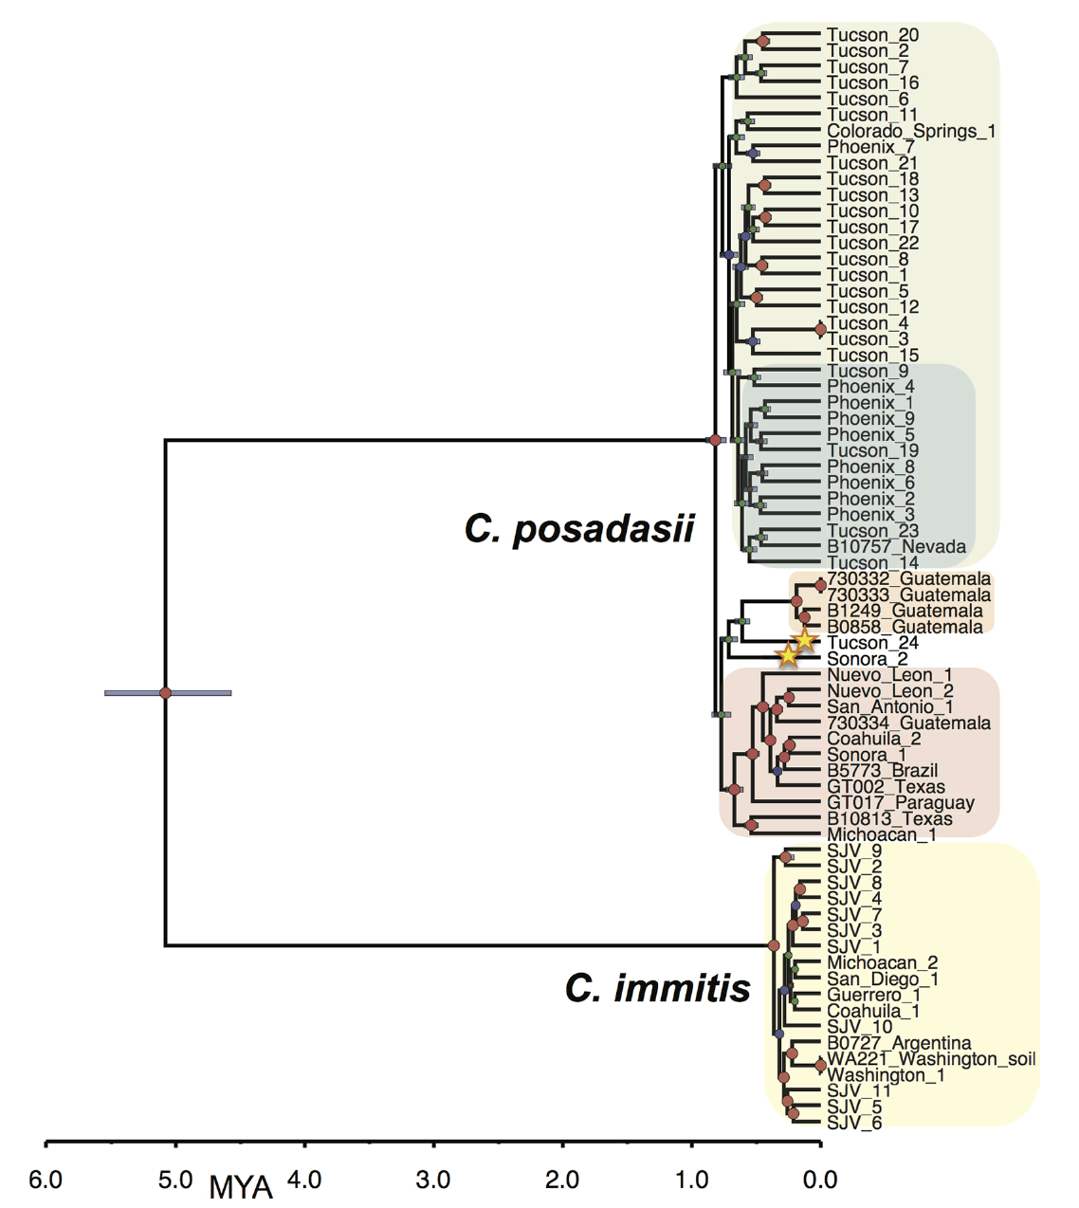
Phylogeny
Use command line coding to pull the genomes of the closest relatives to our pathogen
It looks like a new species!
It’s related to C. immitis! Uh oh!
Maximum Likelihood Tree- Bootstrapping
Visualize tree in Fig Tree
C. gediwia
Engelthaler et al. (2016)

Slide 13
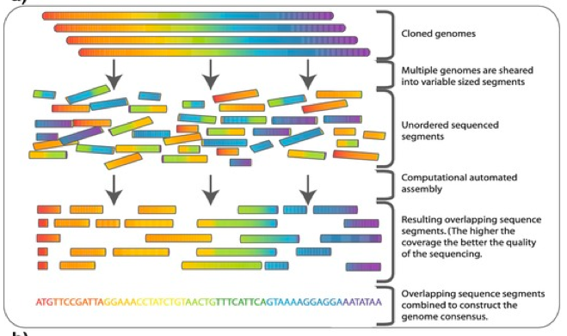
Meanwhile the fungus is growing…
Shotgun sequencing of fungus
Illumina MiSeq (we have unlimited funds after all…)
Trim off adapters, first and last 20 bp (TRIMMOMATIC)
Evaluate the quality of our sequence data (FastQC)
Error Correction (SPADES) with k-mer correction
Map to reference genome (Coccidioides immitis)
Assemble reads to reference genome

Slide 14
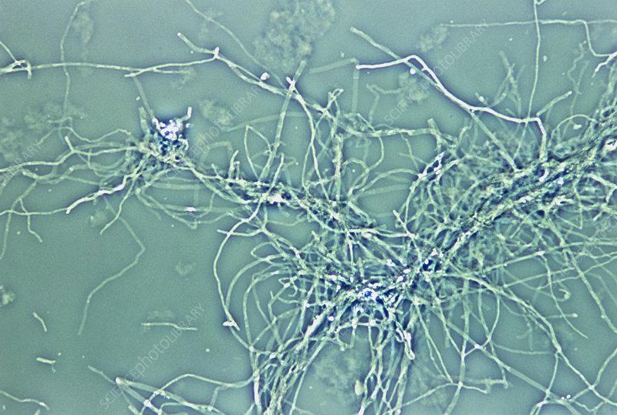
WHAT IS IT?
Coccidioides gediwia!!!!!

Slide 15

Article | Published: 08 June 2019
Discovery of new fungal pathogen, Coccidioides gediwia, in ancient reindeer in Arctic permafrost
Valerie Johnson, Erin Borland, John Neddermayer, Sahana Kuthyar, & Liz Goldsmith
Dissemination of results
Publish in Nature
Public Health Education:
Local residents
Ministry of Health of the Russian Federation
Veterinary public health & local veterinarians
OIE

