Slide 1
Social Lite

Slide 2
Introduction
In Social Lite, an end-user can:
User create a profile and submit his interests.
Browse through various events
RSVP events he/she likes
The application will:
Add important Tags based on event description.
Apply recommending rules on events and users
Send reminder emails to users and link them on google calendar

Slide 3
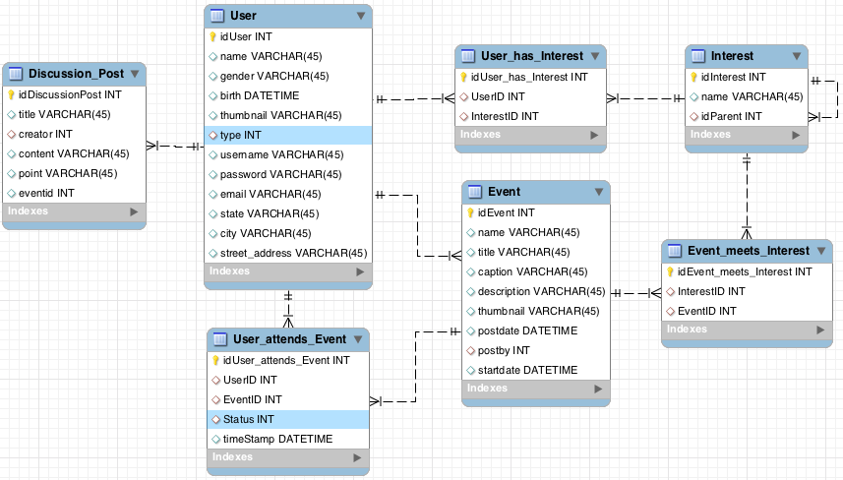
E-R Diagram

Slide 4

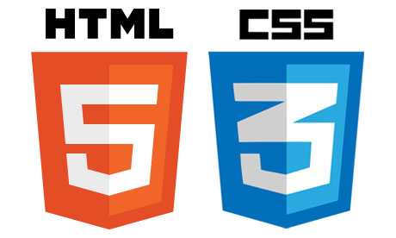



Technologies Involved
Front end
Back end

Slide 5
The Architecture
ng-Controller
Web Service
Method Provider
Database

Slide 6
Team Member
Archit Sood
Bingqing Huang
Gaurav Wadhwani
Weidong Li

