Slide 1
An Improved KNN Text Classification Algorithm Based on Density
7 April, 2017 Kundan Kumar, Shalav Verma

Slide 2
Agenda
Background & Data Instances
About KNN for Text Classification
Problem addressed by chosen research paper.
About Dataset
Project Objective
Data Mining Principle & Methods
Data Preparation
Data Model and algorithm implementation
Evaluation and Validation
Conclusion

Slide 3
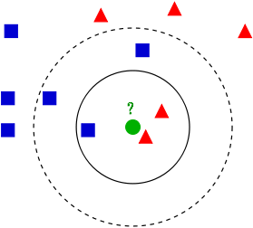
Background
K-Nearest Neighbors (KNN) for classification
Instance based
Non-parametric
Supervised classification algorithm
KNN for Multi-class Text Classification
Represent a document in Vector Space Model(VSM)
Define similarity measure using document pairs.
Tune for selection of ‘k’ and voting scheme( e.g., weighted sum) for scoring
K =5
K =3
KNN Classification [4]

Slide 4
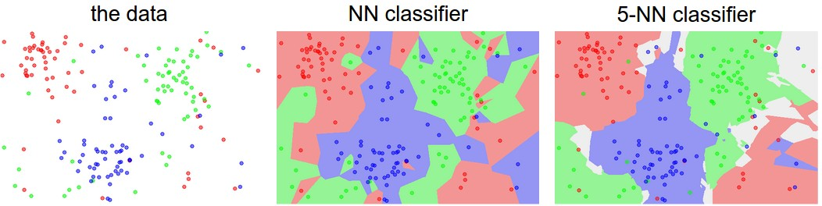
Background
Key Problems of KNN
Computationally Expensive.
Does not have training phase.
All computations are done at test phase.
Sensitive to noise in training data.
Problem Addressed by chosen paper
KNN is sensitive to unbalanced data distribution in training set
Proposes density based decision function to handle it.
KNN Decision Boundaries [5]
Decision Boundary due to noisy data

Slide 5
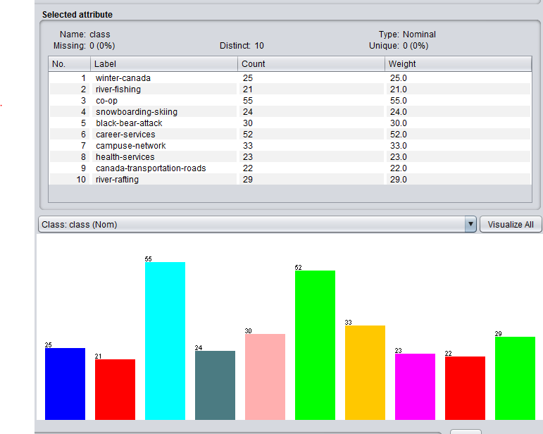
Data Instances
Dataset used by the referenced research paper[2]
Text classification corpus provided by Fudan University, China.
Contains categories of law, education, military and healthcare.
Contains 250 texts for training set and 250 texts for test set.
Publicly not available.
Representative dataset used for this project
Web mining dataset from University of Waterloo[1]
Consists of 314 web pages from university and some Canada websites.
Class Distribution
in Web mining dataset, from University of Waterloo[1]

Slide 6
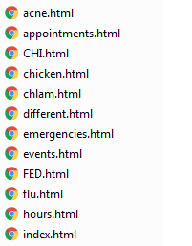
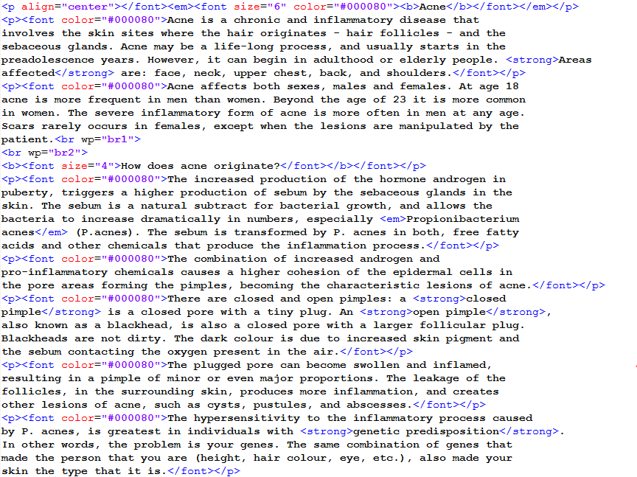
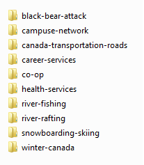
Data Instances
Dataset Description
Each category has its documents in folder with category name
Documents are in HTML format.
Requires parsing HTML to get text for further processing.

Slide 7
Project Objective
Objective 1
Implement KNN algorithm
Objective
To develop a multi-class text classifier using KNN.
To implement TF*IDF*Ci based optimization specified in referenced research paper[3].
To implement density based decision function optimization described in referenced research paper[2].
Objective 2
Verify TF*IDF*Ci based improvement
(Implemented in data modelling phase)
Objective 3
Verify density based decision function
(Implemented in KNN test phase)
TF: Term Frequency IDF: Inverse Document Frequency Ci: Class Bias

Slide 8
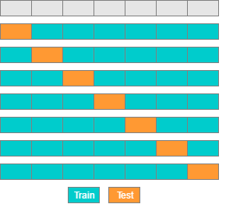
Data Mining Solution: Principle & Method
Feature Extraction
Vector Space Model(VSM) Representation
KNN classification with 10 Fold cross validation
Word | Tf*Idf*Ci Score
grizzlis | 0.97
snowfall | 0.84
Immune | 0.88
Resume | 0.76
Bacteria | 0.56
Document | Class
[0.3,0.2,0,.…1] | Co-op
[0.6,0.3,0,…,2] | Winter-canada
[0.2,0.2,0,…,3] | River-rafting
[0.9,0.3,0,…,4] | Health-service
[0.1,0.1,0,0…,1] | Co-op
Categorized HTML Files
Text Files with labels
Data Collection and Preprocessing
Data Mining Algorithms and Evaluation
Data Labeling and Modelling
TF: Term Frequency IDF: Inverse Document Frequency Ci: Class Bias

Slide 9
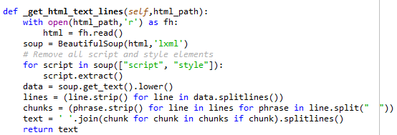
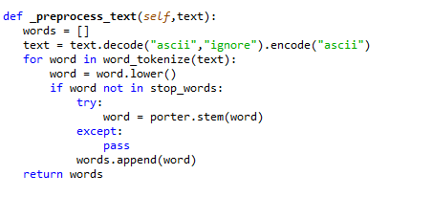
Data Mining Solution: Data Preprocessing
HTML To Text
Implemented a HTML parser in Python
Used BeautifulSoup package
For each HTML returns text without HTML markups.
Pre-processing Text
Removed stop-words
Performed stemming using NLTK
Function to convert HTML to text
Function to pre-processed words from text file
NLTK: Natural Language Toolkit, Python Library

Slide 10

Data Mining Solution: Data Modeling
Feature Selection
Implemented TF*IDF*Ci as specified in the referenced research paper[3].
Ci increases weight for the words which can help in distinguishing categories.
Each document was represented in Vector Space Model Format using identified features
Evaluation against TF*IDF is discussed in the evaluation section in further slides
Equation: 1
N: Total number of texts
n : Number of the texts containing term t
m: Maximum number of documents containing term t in a certain category.
Objective 2
Verify TF*IDF*Ci based improvement
(Implemented in data modelling phase)
TF: Term Frequency IDF: Inverse Document Frequency Ci: Class Bias

Slide 11

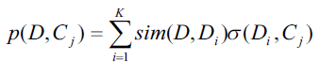


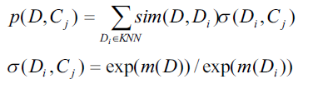
Data Mining Solution: KNN For Classification
Implemented KNN classifier in Python
Use Similarity-Weighted Majority Vote Decision Function
Improvement in KNN as described in referenced research paper [2]
Density Based Decision Function
Increase similarity weight if test data is in has less density space but neighborhood density is lesser.
Reduce similarity weight if test data is in high density space but neighborhood density is higher.
: Similarity score of a test document D for class j
Objective 1
Implement KNN algorithm
Equation: 1
= 1 else 0
Objective 3
Verify density based decision function
(Implemented in KNN test phase)
Equation: 2
Equation: 3
D: Test Document Cj: A class from all classes, m(D): Density of a document in training data space

Slide 12
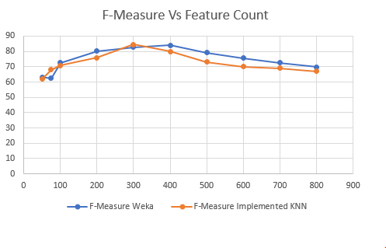
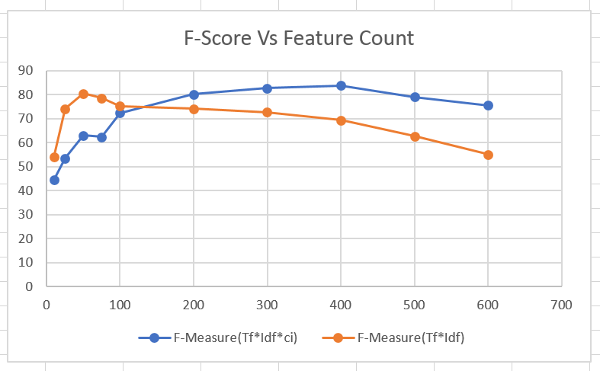
Evaluation And Validation
Objective 1
Implement KNN algorithm
Objective 2
Verify TF*IDF*Ci based improvement
(Implemented in data modelling phase)
Evaluation of implemented KNN against Weka
Evaluation of impact of TF*IDF*Ci on classification using KNN
Evaluation of density based decision function in KNN classifier
This is under implementation.
TF: Term Frequency IDF: Inverse Document Frequency Ci: Class Bias

Slide 13
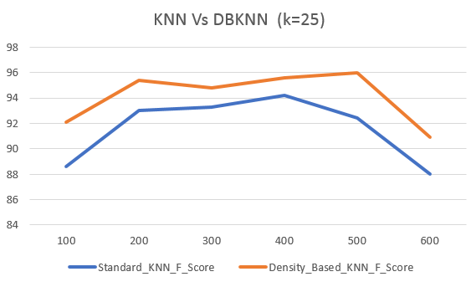
Evaluation And Validation
Objective 3
Evaluation of density based decision function in KNN classifier
TF: Term Frequency IDF: Inverse Document Frequency Ci: Class Bias

Slide 14
Conclusion
KNN performs well for multi-class text classification.
KNN is computationally expensive.
There is no training phase.
All computation happens test phase.
TF*IDF*Ci improves classification accuracy by accounting word frequency in class.

Slide 15
References
[1]"Web Mining Data - UW-CAN-DATASET", Pami.uwaterloo.ca, 2017. [Online]. Available: http://pami.uwaterloo.ca/~hammouda/webdata/. [Accessed: 07- Apr- 2017].
[2]"An improved KNN text classification algorithm based on density - IEEE Xplore Document", Ieeexplore.ieee.org, 2017. [Online]. Available: http://ieeexplore.ieee.org/stamp/stamp.jsp?arnumber=6045043. [Accessed: 07- Apr- 2017].
[3]"Improvement and Application of TF•IDF Method Based on Text Classification - IEEE Xplore Document", Ieeexplore.ieee.org, 2017. [Online]. Available: http://ieeexplore.ieee.org/document/5566113/. [Accessed: 07- Apr- 2017].
[4]"K-nearest neighbors algorithm", En.wikipedia.org, 2017. [Online]. Available: https://en.wikipedia.org/wiki/K-nearest_neighbors_algorithm. [Accessed: 07- Apr- 2017].
[5]"CS231n Convolutional Neural Networks for Visual Recognition", Cs231n.github.io, 2017. [Online]. Available:
http://cs231n.github.io/classification/. [Accessed: 07- Apr- 2017].

Slide 16


Slide 17
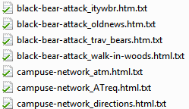
Data Pre-Processing Step
Extract Text from HTML
HTML Documents
Store each HTML in text file having names starting with that of its category
Process each text file by tokenization, stop-words removal and stemming.
Store the processed data in text file for further operation

Slide 18
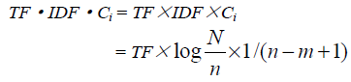
TF-IDF-CI
N is the total number of texts,
n is the number of the texts containing term t,
M is the maximum number of texts containing term t in a category

