Slide 1
Support Vector Machines
Lecturer: Dr. Bo Yuan
E-mail: yuanb@sz.tsinghua.edu.cn

Slide 2
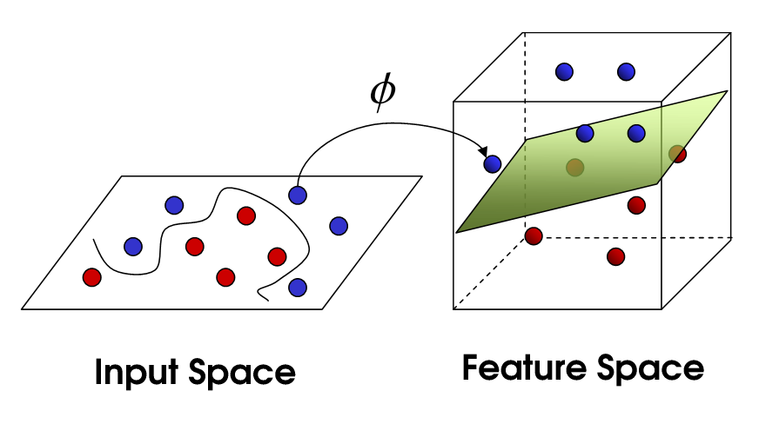
Overview

Slide 3
Linear Classifier
w·x + b =0
w
w·x + b <0
w·x + b >0
Notes:
W方向：与超平面垂直

Slide 4
Distance to Hyperplane
x
x'

Slide 5
Selection of Classifiers
?
Which classifier is the best?
All have the same training error.
How about generalization?

Slide 6
Unknown Samples
B
A
Classifier B divides the space more consistently (unbiased).

Slide 7
Margins
margin
Support Vectors
Support Vectors

Slide 8

Margins
The margin of a linear classifier is defined as the width that the boundary could be increased by before hitting a data point.
Intuitively, it is safer to choose a classifier with a larger margin.
Wider buffer zone for mistakes
The hyperplane is decided by only a few data points.
Support Vectors
Others can be discarded!
Select the classifier with the maximum margin.
Linear Support Vector Machines (LSVM)
How to specify the margin formally?

Slide 9

Margins
“Predict Class = +1” zone
M=Margin Width
x⁺
x⁻
wx+b=1
“Predict Class = -1” zone
wx+b=0
wx+b=-1
Notes:
中间那条线wx+b=0是通过原点的直线，M = 原点到两条分界面 wx+b=1，wx+b=-1的距离之和
由前面基础知识，原点到超平面的距离 = |g(x)|/||w||
而 |g(x)| = 1
所以，M=2/||w||

Slide 10


Slide 11
Objective Function
Correctly classify all data points:
Maximize the margin:
Quadratic Optimization Problem
Minimize
Subject to

Slide 12
Lagrange Multipliers
Dual Problem
Quadratic problem again!

Slide 13

Solutions of w & b
inner product

Slide 14
An Example
x₂
(1, 1, +1)
x₁
(0, 0, -1)

Slide 15
Soft Margin
ε₁
ε₂
wx+b=1
ε₃
wx+b=0
wx+b=-1

Slide 16
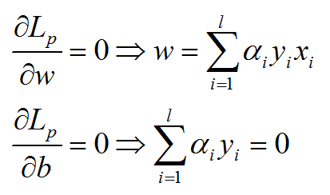
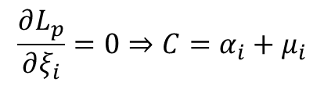
Soft Margin
Same as before
$$\frac{∂L_{p}}{∂ξ_{i}}=0⇒C=α_{i}+μ_{i}$$

Slide 18
Non-linear SVMs
0
x
0
x
x²
x
Notes:
一维不可分，可以将其变换到二维空间中，使其可分

Slide 19

Feature Space
x₂
Φ: x → φ(x)
x₂²
x₁
$${x_{1}}^{2}+{x_{2}}^{2}=r^{2}$$
x₁²

Slide 20
Feature Space
x₂
Φ: x → φ(x)
x₁

Slide 21

Quadratic Basis Functions
Constant Terms
Number of terms
Linear Terms
Pure Quadratic Terms
Quadratic Cross-Terms

Slide 22
Calculation of Φ(x_{i} )·Φ(x_{j} )

Slide 23
It turns out …

Slide 24
Kernel Trick
The linear classifier relies on dot products x_{i}x_{j} between vectors.
If every data point is mapped into a high-dimensional space via some transformation Φ: x → φ(x), the dot product becomes: φ(x_{i})φ(x_{j})
A kernel function is some function that corresponds to an inner product in some expanded feature space: K(x_{i},x_{j}) = φ(x_{i})φ(x_{j})
Example: x=[x₁,x₂]; K(x_{i},x_{j}) = (1+x_{i}x_{j})²

Slide 25
Kernels

Slide 26
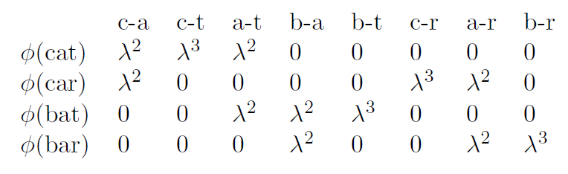
String Kernel
Calculate the similarity between text strings.
The substring ‘c-a-r’ is present in both Car and Custard.
Each substring corresponds to a dimension of the feature space.
Notes:
Lodhi, Huma; Saunders, Craig; Shawe-Taylor, John; Cristianini, Nello; Watkins, Chris (2002). "Text classification using string kernels". Journal of Machine Learning Research: 419–444.

Slide 27
Solutions of w & b

Slide 29
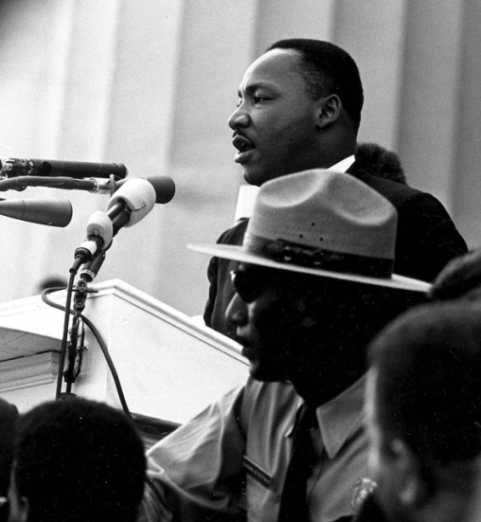

SVM Roadmap
Linear Classifier
Maximum Margin
Linear SVM
Noise
Soft Margin
Nonlinear Problem
a·b → Φ(a)·Φ(b)
High Computational Cost
Kernel Trick K(a,b)=Φ(a)·Φ(b)
“I have a dream ― one day there will be a classifier that can handle nonlinear problems …”

Slide 30
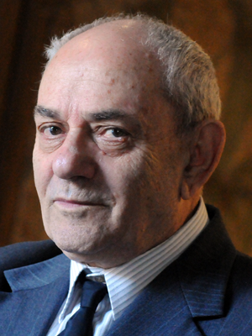
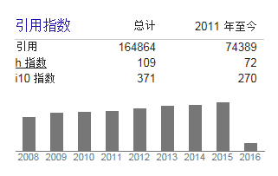
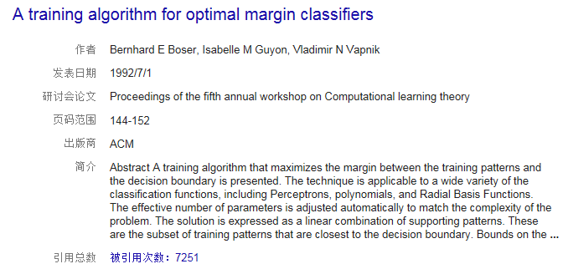
SVM Legend

Slide 31
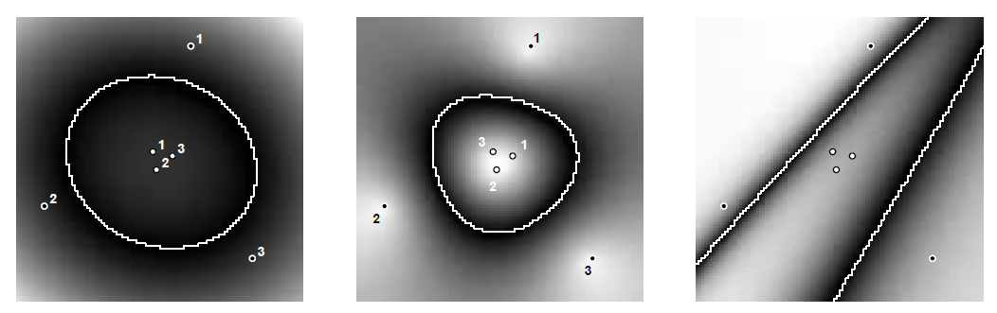
Decision Boundaries
Polynomial
RBF
ANN

Slide 32
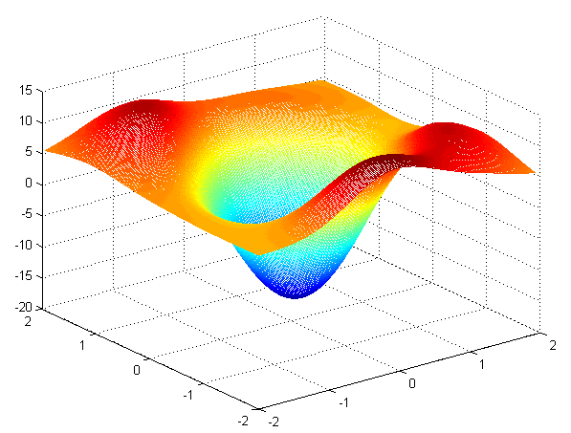
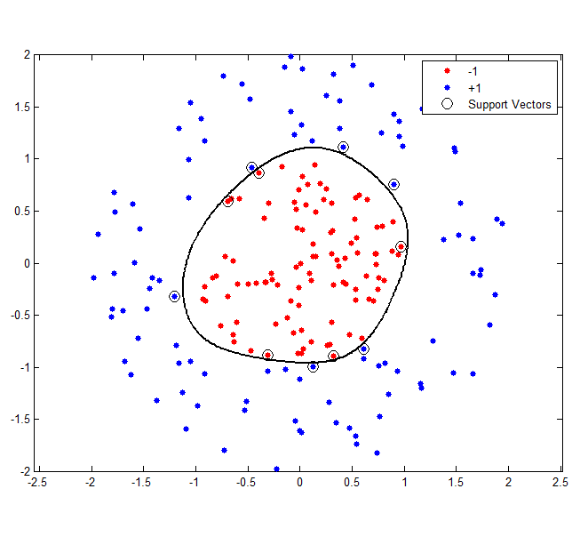
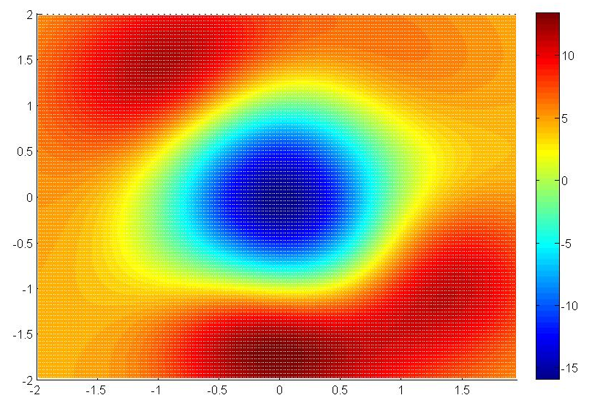
Decision Boundaries

Slide 33


Model Capacity
A straight line can classify (shatter) a certain set of 3 (not 4) points, regardless their labels.

Slide 34
Model Capacity
A rectangle can classify (shatter) a certain set of 4 points, regardless of their labels.

Slide 35
VC Dimension
The VC dimension of a model M is h if there exists a set of (up to) h points that can be shattered by M.
The h value of a hyperplane in R^{n} is n+1.
The h value of DT is roughly the number of internal nodes.
The h value of SVM depends on the kernel function in use.
VC dimension is pessimistic: arbitrary assignment of labels.
Real data sets: points with same labels tend to be close to each other.
N: Number of training samples
Notes:
E_{test}：测试误差
E_{train}：训练误差
模型越复杂，h越大，训练误差 与测试误差之间的差别越大，即风险越大。
所以，训练误差一样的情况下，复杂度高的模型，比复杂度低的模型，测试误差大的风险大 --- 选复杂度低的

Slide 36
Reading Materials
N. Cristianini and J. Shawe-Taylor, An Introduction to Support Vector Machines and Other Kernel-Based Learning Methods. Cambridge University Press, 2000.
C. Burges, “A Tutorial on Support Vector Machines for Pattern Recognition”. Data Mining and Knowledge Discovery, vol. 2, pp. 121-167, 1998.
H. Lodhi et al., “Text Classification Using String Kernels”. The Journal of Machine Learning Research, vol. 2, pp. 419-444, 2002.
Online Resources
http://www.kernel-machines.org/
http://www.support-vector-machines.org/
http://www.tristanfletcher.co.uk/SVM%20Explained.pdf
http://www.csie.ntu.edu.tw/~cjlin/libsvm/

