Slide 1
Neural Networks
Lecturer: Dr. Bo Yuan
E-mail: yuanb@sz.tsinghua.edu.cn

Slide 2

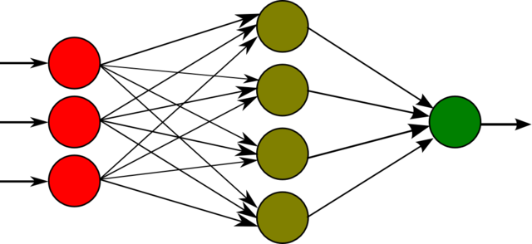
Overview

Slide 3
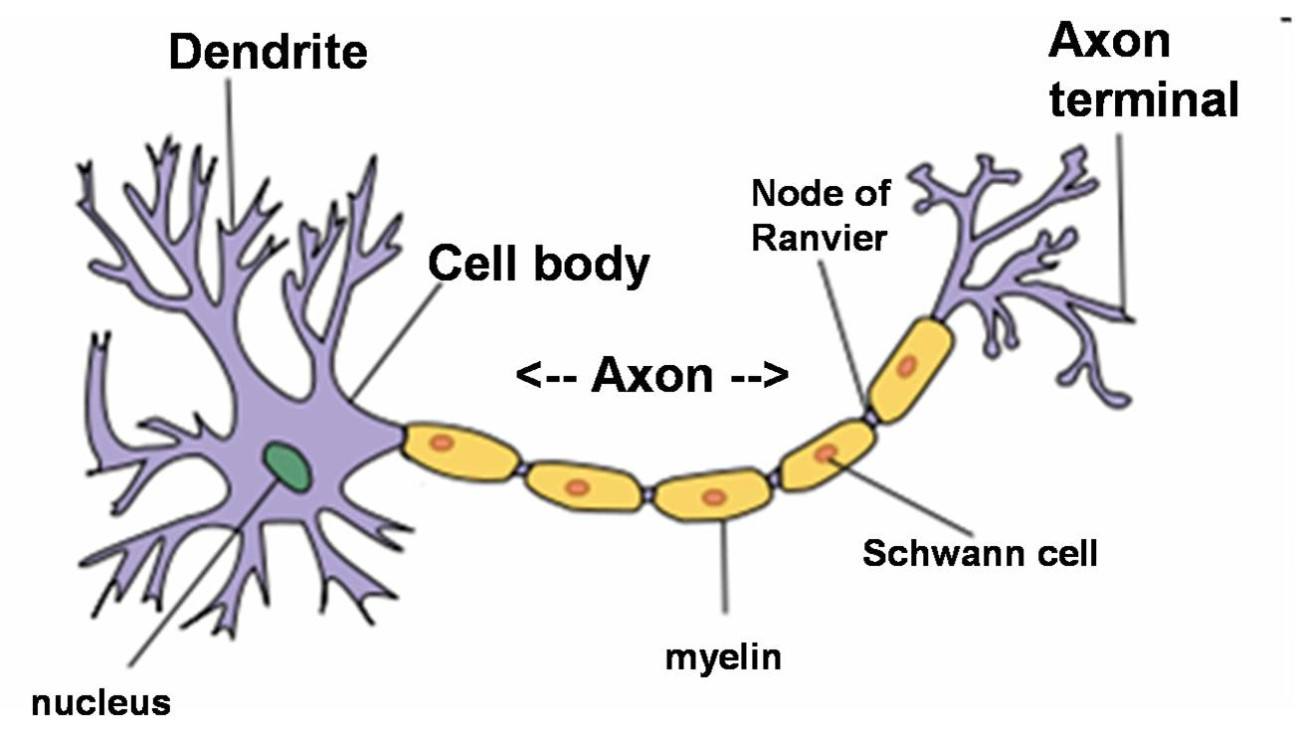
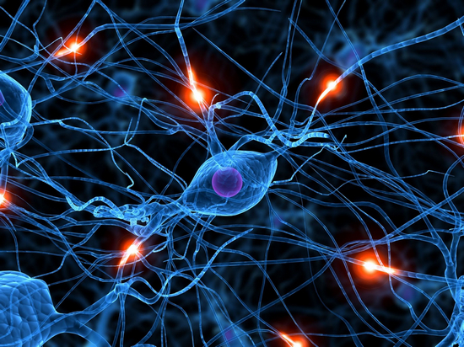
Biological Motivation
10¹¹: The number of neurons in the human brain
10⁴: The average number of connections of each neuron
10⁻³: The fastest switching time of neurons
10⁻¹⁰: The switching speed of computers
10⁻¹: The time required to visually recognize your mother
Notes:
与计算机相比，单个神经元的速度很慢，但是神经整体的识别速度很快，关键在于并行。

Slide 4
Biological Motivation
The power of parallelism
The information processing abilities of biological neural systems follow from highly parallel processes operating on representations that are distributed over many neurons.
The motivation of ANN is to capture this kind of highly parallel computation based on distributed representations.
Group A
Using ANN to study and model biological learning processes.
Group B
Obtaining highly effective machine learning algorithms, regardless of how closely these algorithms mimic biological processes.

Slide 5
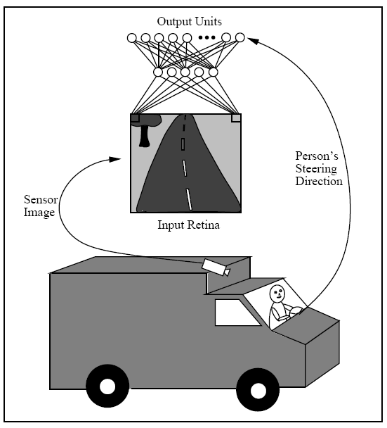
Case Study

Slide 6
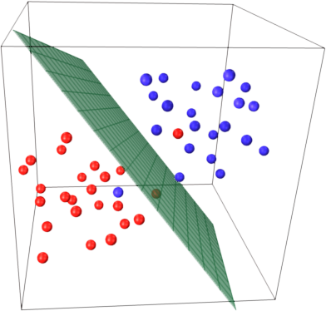
Perceptrons
x₀=1
x₁
w₁
w₀
x₂
w₂
∑
.
.
.
w_{n}
x_{n}
Notes:
特别注意，不要漏了X₀，W₀，否则平面只能经过原点，可能导致不收敛

Slide 7
Power of Perceptrons
-0.8
-0.3
0.5
0.5
0.5
0.5
AND
OR
Input |  | ∑ | Output
0 | 0 | -0.8 | 0
0 | 1 | -0.3 | 0
1 | 0 | -0.3 | 0
1 | 1 | 0.3 | 1
Input |  | ∑ | Output
0 | 0 | -0.3 | 0
0 | 1 | 0.2 | 1
1 | 0 | 0.2 | 1
1 | 1 | 0.7 | 1

Slide 8


Slide 9
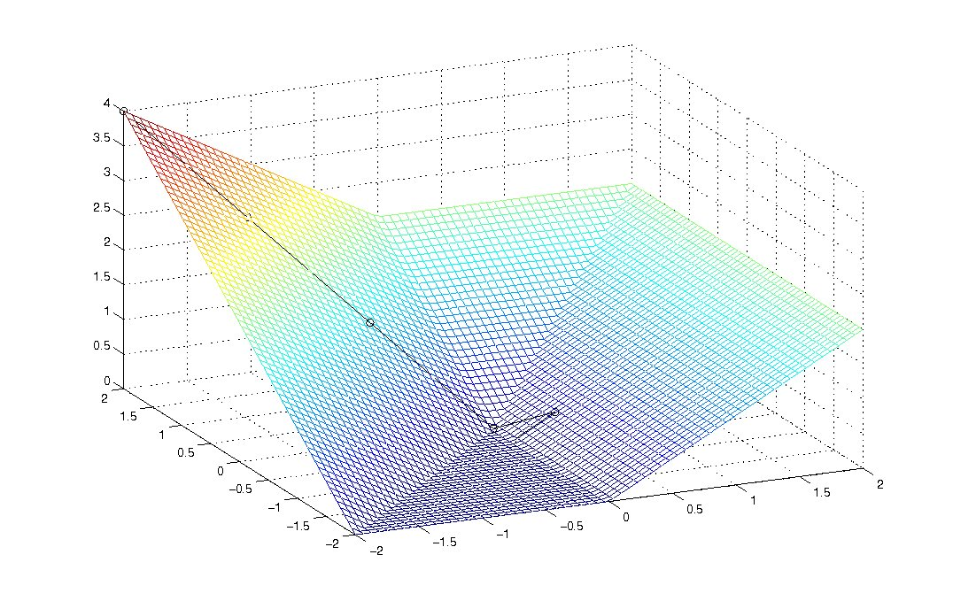
Error Surface
Error
w₁
w₂

Slide 10

Gradient Descent
Batch Learning
Learning Rate
Notes:
t: 目标
o: 实际
D：训练集
如果偏导是整数，则说明随着w的增加，误差增加，而现在是要减少误差，所以取负数

Slide 11
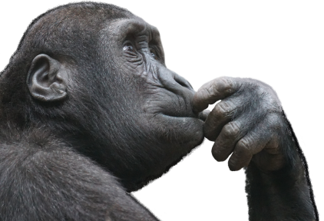
Delta Rule
Notes:
假设：节点是线性的

Slide 12
Batch Learning
GRADIENT_DESCENT (training_examples, η)
Initialize each w_{i} to some small random value.
Until the termination condition is met, Do
Initialize each Δw_{i} to zero.
For each <x, t> in training_examples, Do
Input the instance x to the unit and compute the output o
For each linear unit weight w_{i}, Do
Δw_{i} ← Δw_{i} + η(t-o)x_{i}
For each linear unit weight w_{i}, Do
w_{i} ← w_{i} + Δw_{i}

Slide 13
Stochastic Learning
For example, if x_{i}=0.8, η=0.1, t=1 and o=0
Δw_{i} = η(t-o)x_{i} = 0.1×(1-0) × 0.8 = 0.08
+
+
+
-
+
+
-
-
-
+
-
-

Slide 14
Stochastic Learning: NAND
Input |  |  | Target | Initial Weights |  |  | Output |  |  |  |  | Error | Correction | Final Weights
 |  |  |  |  |  |  | Individual |  |  | Sum | Final Output
x₀ | x₁ | x₂ | t | w₀ | w₁ | w₂ | C₀ | C₁ | C₂ | S | o | E | R | w₀ | w₁ | w₂
 |  |  |  |  |  |  | x₀ · w₀ | x₁ · w₁ | x₂ · w₂ | C₀+C₁+C₂ |  | t-o | LR x E
1 | 0 | 0 | 1 | 0 | 0 | 0 | 0 | 0 | 0 | 0 | 0 | 1 | +0.1 | 0.1 | 0 | 0
1 | 0 | 1 | 1 | 0.1 | 0 | 0 | 0.1 | 0 | 0 | 0.1 | 0 | 1 | +0.1 | 0.2 | 0 | 0.1
1 | 1 | 0 | 1 | 0.2 | 0 | 0.1 | 0.2 | 0 | 0 | 0.2 | 0 | 1 | +0.1 | 0.3 | 0.1 | 0.1
1 | 1 | 1 | 0 | 0.3 | 0.1 | 0.1 | 0.3 | 0.1 | 0.1 | 0.5 | 0 | 0 | 0 | 0.3 | 0.1 | 0.1
1 | 0 | 0 | 1 | 0.3 | 0.1 | 0.1 | 0.3 | 0 | 0 | 0.3 | 0 | 1 | +0.1 | 0.4 | 0.1 | 0.1
1 | 0 | 1 | 1 | 0.4 | 0.1 | 0.1 | 0.4 | 0 | 0.1 | 0.5 | 0 | 1 | +0.1 | 0.5 | 0.1 | 0.2
1 | 1 | 0 | 1 | 0.5 | 0.1 | 0.2 | 0.5 | 0.1 | 0 | 0.6 | 1 | 0 | 0 | 0.5 | 0.1 | 0.2
1 | 1 | 1 | 0 | 0.5 | 0.1 | 0.2 | 0.5 | 0.1 | 0.2 | 0.8 | 1 | -1 | -0.1 | 0.4 | 0 | 0.1
1 | 0 | 0 | 1 | 0.4 | 0 | 0.1 | 0.4 | 0 | 0 | 0.4 | 0 | 1 | +0.1 | 0.5 | 0 | 0.1
. | . | . | . | . | . | . | . | . | . | . | . | . | . | . | . | .
1 | 1 | 0 | 1 | 0.8 | -.2 | -.1 | 0.8 | -.2 | 0 | 0.6 | 1 | 0 | 0 | 0.8 | -.2 | -.1
threshold=0.5 learning rate=0.1
Notes:
注意，这里是Stochastic Learning，不是批量的，所以计算过程是一行一行的迭代。

Slide 16
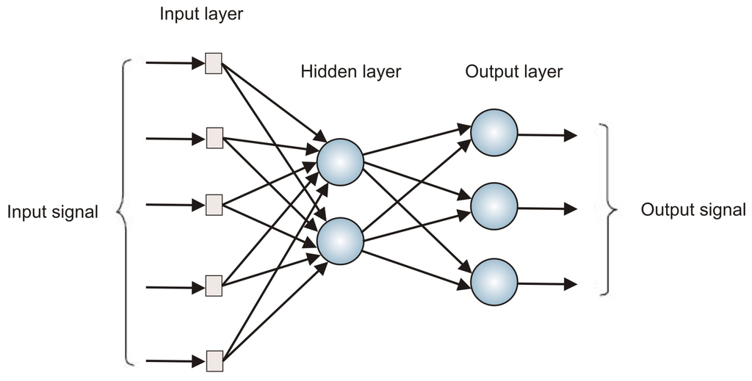
Multilayer Perceptron

Slide 17
XOR
1
0
Input |  | Output
0 | 0 | 0
0 | 1 | 1
1 | 0 | 1
1 | 1 | 0
q
0
1
p
Cannot be separated by a single line.

Slide 18
XOR
AND
1
0
q
OR
NAND
0
1
NAND
p
OR
p
q

Slide 19
Hidden Layer Representations
p | q | OR | NAND | AND
0 | 0 | 0 | 1 | 0
0 | 1 | 1 | 1 | 1
1 | 0 | 1 | 1 | 1
1 | 1 | 1 | 0 | 0
0
1
1
Input
Hidden
Output
NAND
AND
0
OR

Slide 20
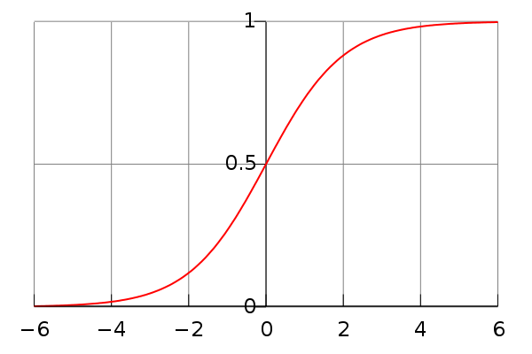
The Sigmoid Threshold Unit
x₀=1
x₁
w₁
w₀
x₂
w₂
∑
.
.
.
w_{n}
x_{n}

Slide 22
Backpropagation Rule
j
x_{ji} = the i ^{th} input to unit j
w_{ji} = the weight associated with the i ^{th} input to unit j
net_{j} = ∑w_{ji}x_{ji} (the weighted sum of inputs for unit j )
o_{j}= the output of unit j
t_{j}= the target output of unit j
σ = the sigmoid function
outputs = the set of units in the final layer
Downstream (j ) = the set of units directly taking the output of unit j as inputs
i

Slide 23
Training Rule for Output Units
Notes:
本slice是计算输出层的反向规则：j节点是输出层的节点之一，w是对应”中间层->输出层”的

Slide 24
Training Rule for Hidden Units
k
j
Notes:
本slice是中间层的规则，其中：j是中间层的节点，w是“输入层->中间层”的

Slide 25
BP Framework
BACKPROPAGATION (training_examples, η, n_{in}, n_{out}, n_{hidden})
Create a network with n_{in} inputs, n_{hidden} hidden units and n_{out} output units.
Initialize all network weights to small random numbers.
Until the termination condition is met, Do
For each <x, t> in training_examples, Do
Input the instance x to the network and computer the output o of every unit.
For each output unit k, calculate its error term δ_{k}
For each hidden unit h, calculate its error term δ_{h}
Update each network weight w_{ji}
Notes:
最后一步，更新w，是所有的，而不仅仅是输入层的。

Slide 26

More about BP Networks …
Convergence and Local Minima
The search space is likely to be highly multimodal.
May easily get stuck at a local solution.
Need multiple trials with different initial weights.
Evolving Neural Networks
Black-box optimization techniques (e.g., Genetic Algorithms)
Usually better accuracy
Can do some advanced training (e.g., structure + parameter).
Xin Yao (1999) “Evolving Artificial Neural Networks”, Proceedings of the IEEE, pp. 1423-1447.
Representational Power
Deep Learning
Notes:
这种算法如果遇上局部最优解，就可能导致整体的性能无法继续下降，这时可以试着取另外一组随机初始值，重新开始计算。
一般BP算法都要试很多次

Slide 27
More about BP Networks …
Overfitting
Tend to occur during later iterations.
Use validation dataset to terminate the training when necessary.
Practical Considerations
Momentum
Adaptive learning rate
Small: slow convergence, easy to get stuck
Large: fast convergence, unstable
Validation
Error
Error
Training
Time
Weight
Notes:
为了克服局部最优解，增加一个冲量，用于越过局部最优解
学习率一般开始时不能太大也不能太小，一般0.05左右，随着过程动态调整。

Slide 29
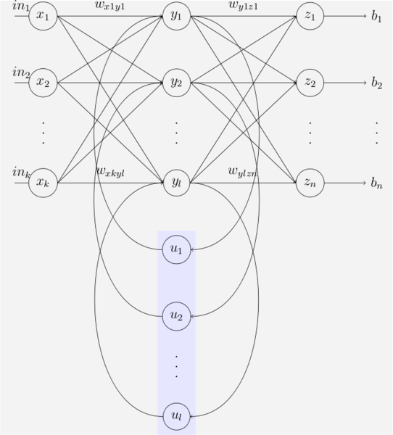
Beyond BP Networks
XOR
0 1 1 0 0 0 1 1 0 1 0 1 …
? 1 ? ? 0 ? ? 0 ? ? 1 ? …
In
Out
Elman Network

Slide 30



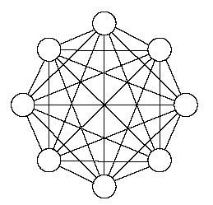
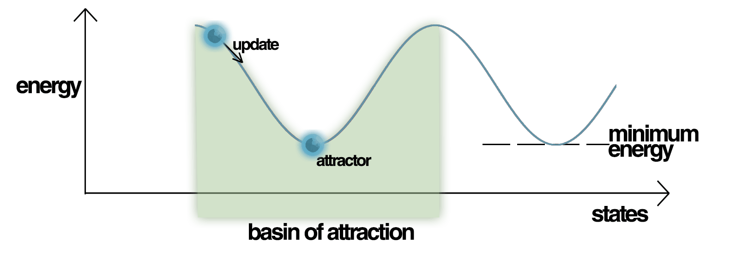
Beyond BP Networks
Hopfield Network
Energy Landscape of Hopfield Network

Slide 31
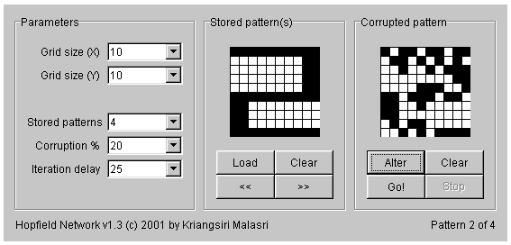
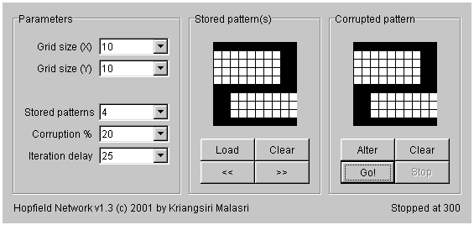
Beyond BP Networks

Slide 32
When does ANN work?
Instances are represented by attribute-value pairs.
Input values can be any real values.
The target output may be discrete-valued, real-valued, or a vector of several real- or discrete-valued attributes.
The training samples may contain errors.
Long training times are acceptable.
Can range from a few seconds to several hours.
Fast evaluation of the learned target function may be required.
The ability to understand the learned function is not important.
Weights are difficult for humans to interpret.
Notes:
ANN
优点：训练好后，用起来比较快；准确度高
缺点：训练时间比较长；可解释性比较差

Slide 33
Reading Materials
Text Book
R. O. Duda et al., Pattern Classification, Chapter 6, John Wiley & Sons Inc.
Tom Mitchell, Machine Learning, Chapter 4, McGraw-Hill.
http://page.mi.fu-berlin.de/rojas/neural/index.html.html
Online Demo
http://neuron.eng.wayne.edu/software.html
http://facstaff.cbu.edu/~pong/ai/hopfield/hopfieldapplet.html
Online Tutorial
http://www.autonlab.org/tutorials/neural13.pdf
http://www.cs.cmu.edu/afs/cs.cmu.edu/user/mitchell/ftp/faces.html

