Slide 1
Clustering
Lecturer: Dr. Bo Yuan
E-mail: yuanb@sz.tsinghua.edu.cn

Slide 2
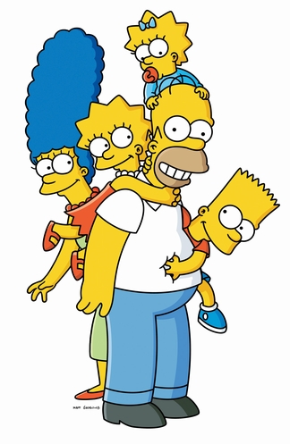
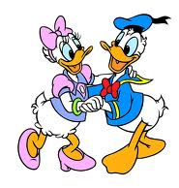
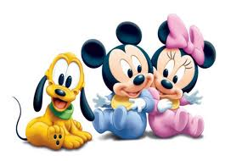
Overview
Partitioning Methods
K-Means
Sequential Leader
Model Based Methods
Density Based Methods
Hierarchical Methods

Slide 3
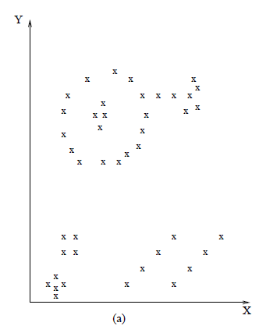
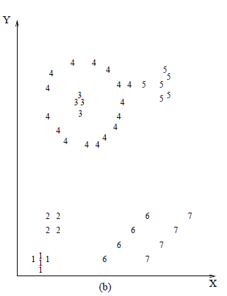
What is cluster analysis?
Finding groups of objects
Objects similar to each other are in the same group.
Objects are different from those in other groups.
Unsupervised Learning
No labels
Data driven

Slide 4
Clusters
Inter-Cluster
Intra-Cluster

Slide 5
Clusters

Slide 6
Applications of Clustering
Marketing
Finding groups of customers with similar behaviours.
Biology
Finding groups of animals or plants with similar features.
Bioinformatics
Clustering microarray data, genes and sequences.
Earthquake Studies
Clustering observed earthquake epicenters to identify dangerous zones.
WWW
Clustering weblog data to discover groups of similar access patterns.
Social Networks
Discovering groups of individuals with close friendships internally.

Slide 7
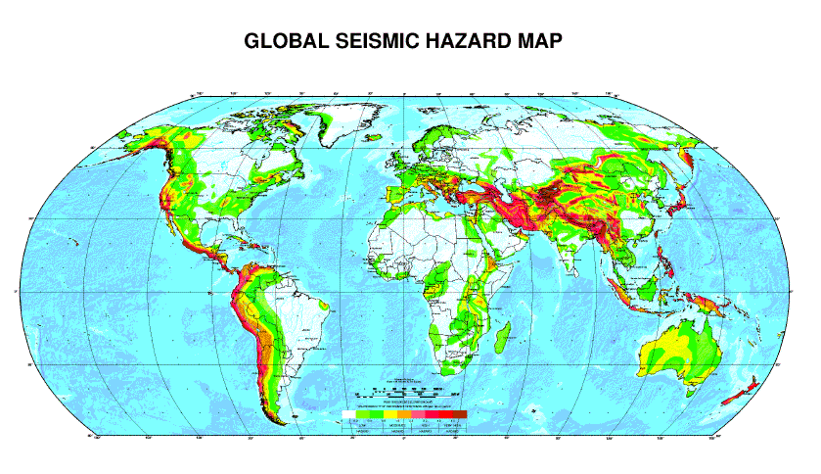
Earthquakes

Slide 8
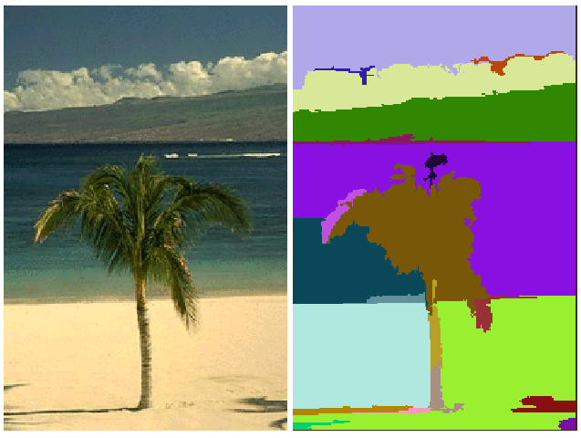
Image Segmentation

Slide 9
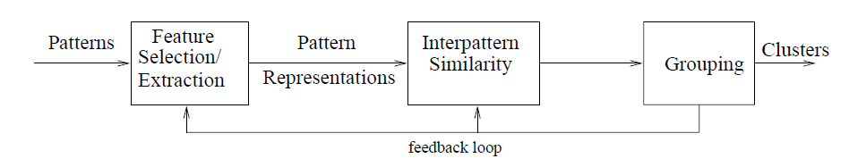
The Big Picture

Slide 10
Requirements
Scalability
Ability to deal with different types of attributes
Ability to discover clusters with arbitrary shape
Minimum requirements for domain knowledge
Ability to deal with noise and outliers
Insensitivity to order of input records
Incorporation of user-defined constraints
Interpretability and usability

Slide 11
Practical Considerations
Scaling matters!
Notes:
坐标变换可能影响到聚类的结果

Slide 12
Normalization or Not?
Notes:
不同的数据预处理方法，可能会直接改变聚类的结果 --- 要小心

Slide 13


Slide 14
Evaluation
VS.

Slide 15
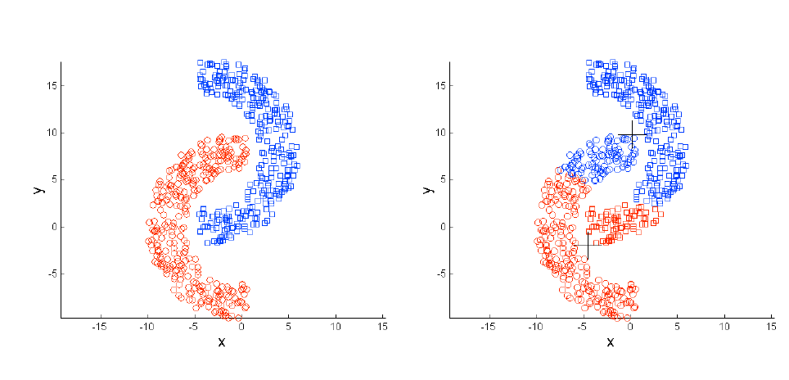
Evaluation

Slide 16
Silhouette
A method of interpretation and validation of clusters of data.
A succinct graphical representation of how well each data point lies within its cluster compared to other clusters.
a(i): average dissimilarity of i with all other points in the same cluster
b(i): the lowest average dissimilarity of i to other clusters

Slide 17
Silhouette
Notes:
上面那一块对应下面比较松散的那一块
下面那一块对应上面比较集中的那一块

Slide 18
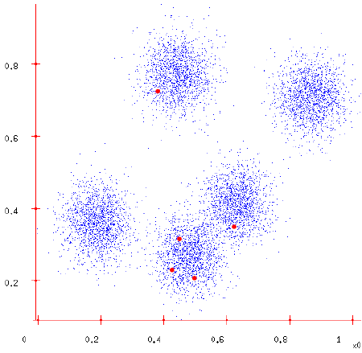
K-Means

Slide 19
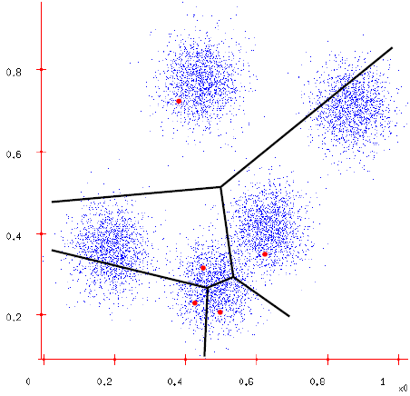
K-Means

Slide 20
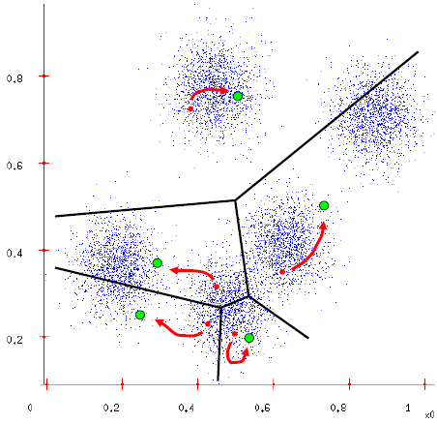
K-Means

Slide 21
K-Means
Determine the value of K.
Choose K cluster centres randomly.
Each data point is assigned to its closest centroid.
Use the mean of each cluster to update each centroid.
Repeat until no more new assignment.
Return the K centroids.
Reference
J. MacQueen (1967): "Some Methods for Classification and Analysis of Multivariate Observations", Proceedings of the 5th Berkeley Symposium on Mathematical Statistics and Probability, vol.1, pp. 281-297.

Slide 22

Comments on K-Means
Pros
Simple and works well for regular disjoint clusters.
Converges relatively fast.
Relatively efficient and scalable O(t·k·n)
t: iteration; k: number of centroids; n: number of data points
Cons
Need to specify the value of K in advance.
Difficult and domain knowledge may help.
May converge to local optima.
In practice, try different initial centroids.
May be sensitive to noisy data and outliers.
Mean of data points …
Not suitable for clusters of
Non-convex shapes

Slide 23
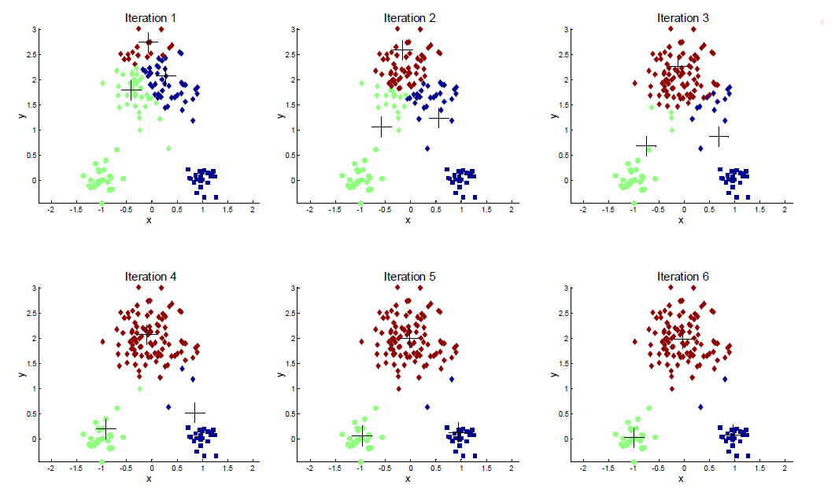
The Influence of Initial Centroids

Slide 24
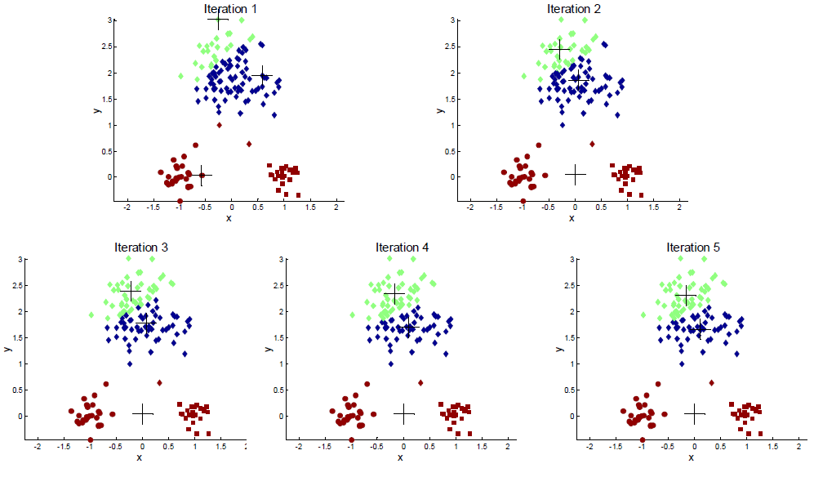
The Influence of Initial Centroids
Notes:
初始点选得不好，可能会影响结果，需要多试几次

Slide 25
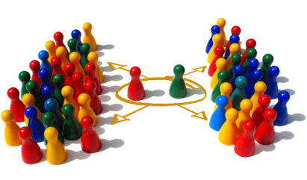
Sequential Leader Clustering
A very efficient clustering algorithm.
No iteration
A single pass of the data
No need to specify K in advance.
Choose a cluster threshold value.
For every new data point:
Compute the distance between the new data point and every cluster's centre.
If the minimum distance is smaller than the chosen threshold, assign the new data point to the corresponding cluster and re-compute cluster centre.
Otherwise, create a new cluster with the new data point as its centre.
Clustering results may be influenced by the sequence of data points.
Notes:
处理流式数据，不迭代

Slide 27
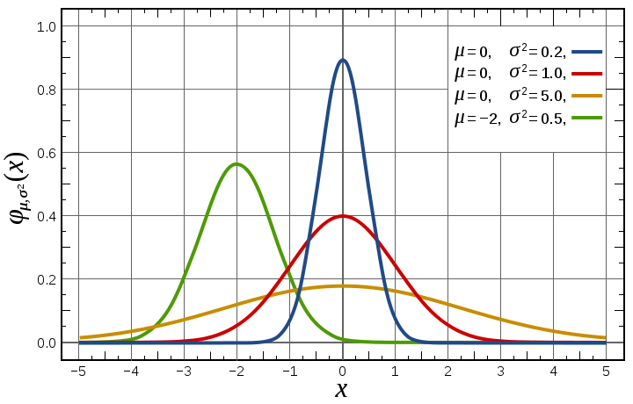
Gaussian Mixture
Notes:
模型逼近

Slide 28
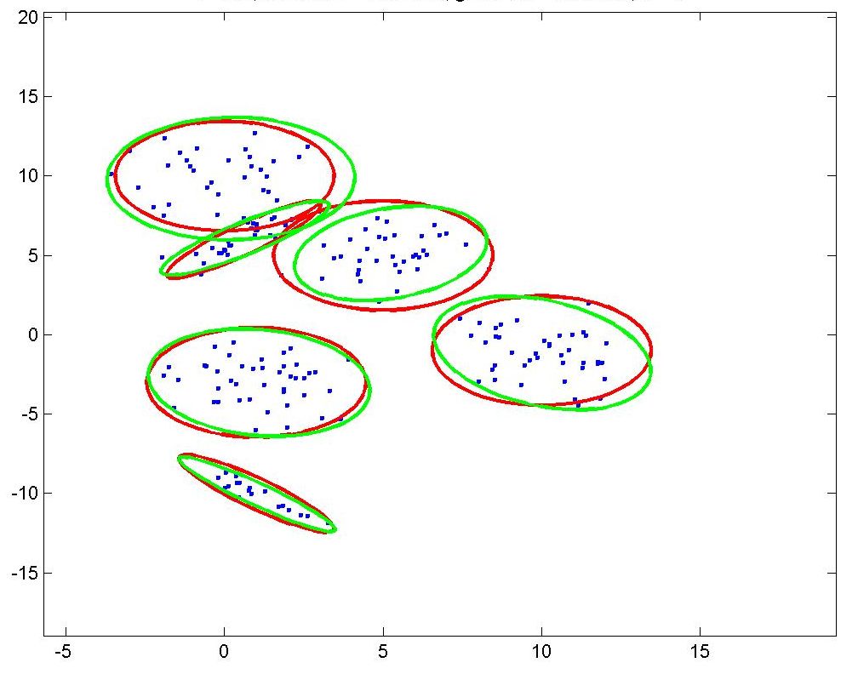
Clustering by Mixture Models

Slide 29
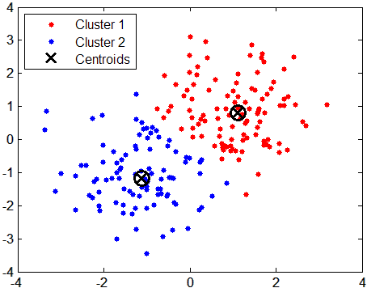


K-Means Revisited
model parameters
$$θ=\{\left(x_{1},y_{1}\right),(x_{2},y_{2})\}$$
$$Z=\{{Cluster}_{1},{ Cluster}_{2}\}$$
latent parameters
Notes:
Z描述的是每个样本点属于那一个cluster
由Z，可以将同一个cluster的点计算均值，就可以得到上面的模型参数

Slide 30
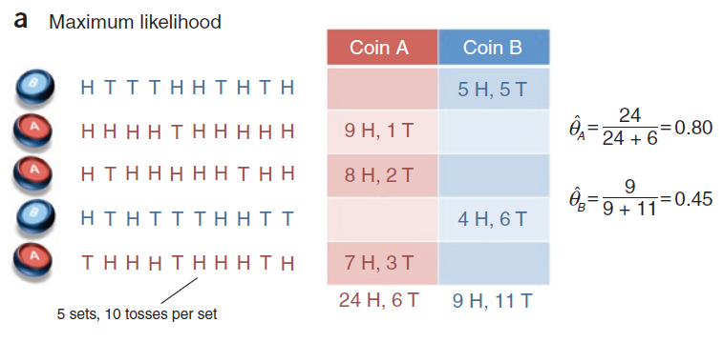
Expectation Maximization
Notes:
http://ai.stanford.edu/~chuongdo/papers/em_tutorial.pdf

Slide 31
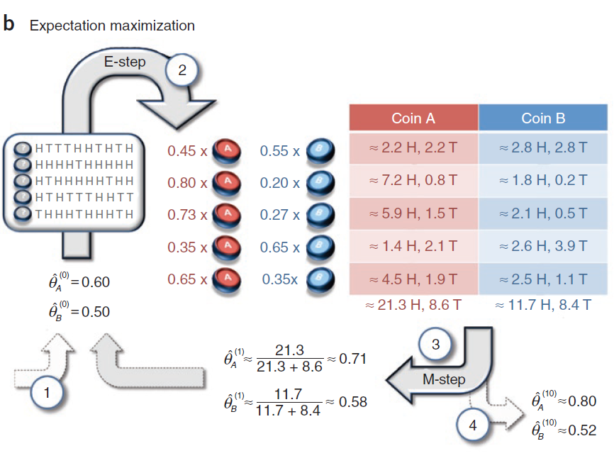
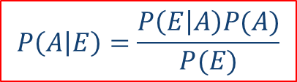
$$P\left(A | E\right)=\frac{P\left(E | A\right)P(A)}{P(E)}$$

Slide 32
EM: Gaussian Mixture
Notes:
Miu：高斯的均值
Alfa：权重
算法开始时，随机生成一些Alfa和miu → 算出每个样本点是由某个高斯生成的概率E（Zij）→ 计算新的Alfa和miu
不断迭代

Slide 34
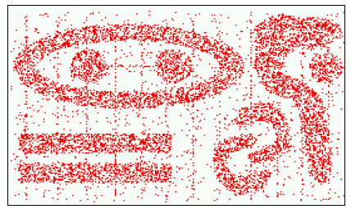
Density Based Methods
Generate clusters of arbitrary shapes.
Robust against noise.
No K value required in advance.
Somewhat similar to human vision.

Slide 35
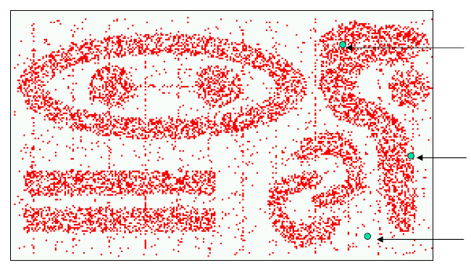
DBSCAN
Density-Based Spatial Clustering of Applications with Noise
Density: number of points within a specified radius
Core Point: points with high density
Border Point: points with low density but in the neighbourhood of a core point
Noise Point: neither a core point nor a border point
Core Point
Border Point
Noise Point

Slide 36
DBSCAN
q
q
p
p
directly density reachable
density reachable
p
q
o
density connected

Slide 37
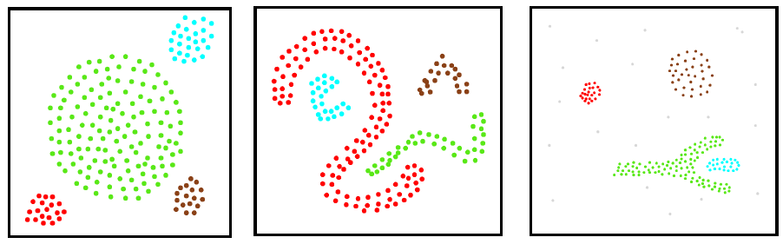
DBSCAN
A cluster is defined as the maximal set of density connected points.
Start from a randomly selected unseen point P.
If P is a core point, build a cluster by gradually adding all points that are density reachable to the current point set.
Noise points are discarded (unlabelled).

Slide 38
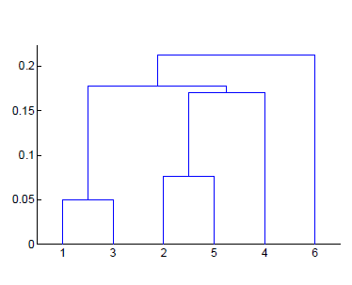
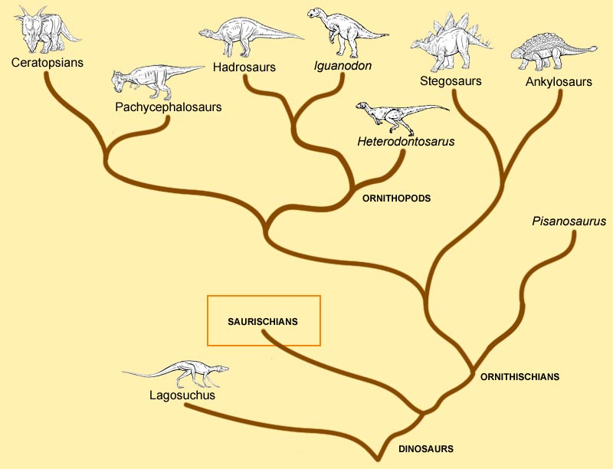
Hierarchical Clustering
Produce a set of nested tree-like clusters.
Can be visualized as a dendrogram.
Clustering is obtained by cutting at desired level.
No need to specify K in advance.
May correspond to meaningful taxonomies.

Slide 39
Agglomerative Methods
Bottom-up Method
Assign each data point to a cluster.
Calculate the proximity matrix.
Merge the pair of closest clusters.
Repeat until only a single cluster remains.
How to calculate the distance between clusters?
Single Link
Minimum distance between points
Complete Link
Maximum distance between points

Slide 40
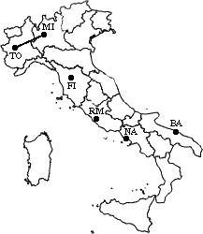
Example
 | BA | FI | MI | NA | RM | TO
BA | 0 | 662 | 877 | 255 | 412 | 996
FI | 662 | 0 | 295 | 468 | 268 | 400
MI | 877 | 295 | 0 | 754 | 564 | 138
NA | 255 | 468 | 754 | 0 | 219 | 869
RM | 412 | 268 | 564 | 219 | 0 | 669
TO | 996 | 400 | 138 | 869 | 669 | 0
Single Link

Slide 41
Example
 | BA | FI | MI/TO | NA | RM
BA | 0 | 662 | 877 | 255 | 412
FI | 662 | 0 | 295 | 468 | 268
MI/TO | 877 | 295 | 0 | 754 | 564
NA | 255 | 468 | 754 | 0 | 219
RM | 412 | 268 | 564 | 219 | 0
 | BA | FI | MI/TO | NA/RM
BA | 0 | 662 | 877 | 255
FI | 662 | 0 | 295 | 268
MI/TO | 877 | 295 | 0 | 564
NA/RM | 255 | 268 | 564 | 0

Slide 42
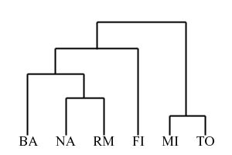
Example
 | BA/NA/RM | FI | MI/TO
BA/NA/RM | 0 | 268 | 564
FI | 268 | 0 | 295
MI/TO | 564 | 295 | 0
 | BA/FI/NA/RM | MI/TO
BA/FI/NA/RM | 0 | 295
MI/TO | 295 | 0

Slide 43
Min vs. Max
E
1
C
MIN
5
2
A
B
3
6
E
4
1
D
B
5
2
A
3
D
6
MAX
C
4

Slide 44
Reading Materials
Text Books
R. O. Duda, P. E. Hart and D. G. Stork, Pattern Classification, Chapter 10, 2nd Edition, John Wiley & Sons.
J. Han and M. Kamber, Data Mining: Concepts and Techniques, Chapter 8, Morgan Kaufmann.
Survey Papers
A. K. Jain, M. N. Murty and P. J. Flynn (1999) “Data Clustering: A Review”, ACM Computing Surveys, Vol. 31(3), pp. 264-323.
R. Xu and D. Wunsch (2005) “Survey of Clustering Algorithms”, IEEE Transactions on Neural Networks, Vol. 16(3), pp. 645-678.
A. K. Jain (2010) “Data Clustering: 50 Years Beyond K-Means”, Pattern Recognition Letters, Vol. 31, pp. 651-666.
Online Tutorials
http://home.dei.polimi.it/matteucc/Clustering/tutorial_html
http://www.autonlab.org/tutorials/kmeans.html
http://users.informatik.uni-halle.de/~hinnebur/ClusterTutorial

