Slide 1

INTELLERA: A Hardware Based Acceleration of Matrix MAC Processor
Team Members:
2020414 Mr. Saad Khan
2020487 Mr. Syed Zaeem Shakir
2020217 Ms. Mahnoor Maleeka
Supervisor: Dr Fahad Bin Muslim
Co-supervisor: Dr Taj Muhammad
Faculty of Computer Sciences and Engineering Ghulam Ishaq Khan Institute of Engineering Sciences and Technology, Pakistan
Notes:
These slides just offer a template. You may change the color scheme and arrangement of items. However, the information contained on each slide should be what is mentioned.
Once the proposal is accepted/modified, students will be asked to submit a detailed proposal/vision document as per requirements.
1

Slide 2
Evaluation Criteria
PLO 3 | Design/Development of Solutions
PLO 4 | Investigation
Rubrics | PLO3 | PLO4 | - | Marks
Requirements Gathering Methodology |  | ✓ |  | 5
Requirements Specifications |  | ✓ |  | 10
Proposed Design | ✓ |  |  | 10
Requirements were mapped to the design adequately | ✓ |  |  | 5
Division of Tasks / Use of Project Management Tools | - | - | ✓ | 10

Slide 3

Recap
Significance: Matrix MAC FPGA Acceleration
Defense: Speed, Efficiency, Breakthroughs
Benefits: Faster, Greener, Game-Changer
Conclusion: Innovation in High-Performance Computing

Slide 4
Introduction / Problem Statement
Introduction: RISC-V FPGA Matrix MAC
Problem: Speeding Up Matrix Operations
Challenge: Efficiency & Performance
Objective: Innovative FPGA Solution

Slide 5
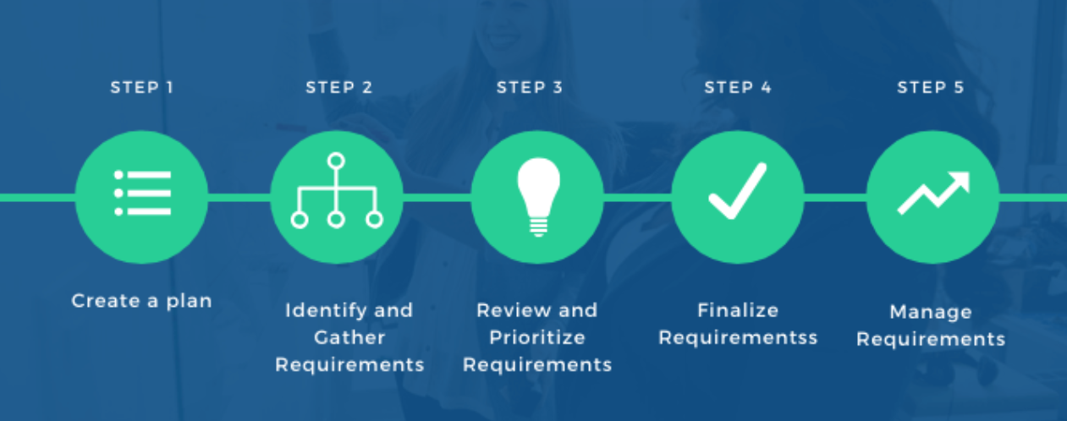
Requirements Gathering Methodology

Slide 6
Requirements Elicitation Technique(s) Followed
Literature Review: Studied past research papers.
Benchmarking Data: Studied past work.
Consultations: consulted Different professors working in the same field
Brainstorming: Detailed discussions on our project.
Notes:
Elaborate with example(s) from your project

Slide 7
Project - Assumptions & Constraints
Assumptions: Clear ISA Understanding
Constraints: FPGA Resource Limitations
Guiding: Design and Implementation

Slide 8
Requirements Specifications

Slide 9
FUNCTIONAL REQUIREMENTS
Custom ISA
Matrix MAC Intr.
Pipelining
Instruction Parallelism
FPGA Implementations

Slide 10
NON-FUNCTIONAL REQUIREMENTS
Power Efficiency
Performance
Scalability
Compatibility

Slide 11
Context Diagram / High Level Block Diagram
FPGA Board
MATRIX
MAC
INPUT
DATA
OUTPUT
DATA
RISC-V
Processor

Slide 12
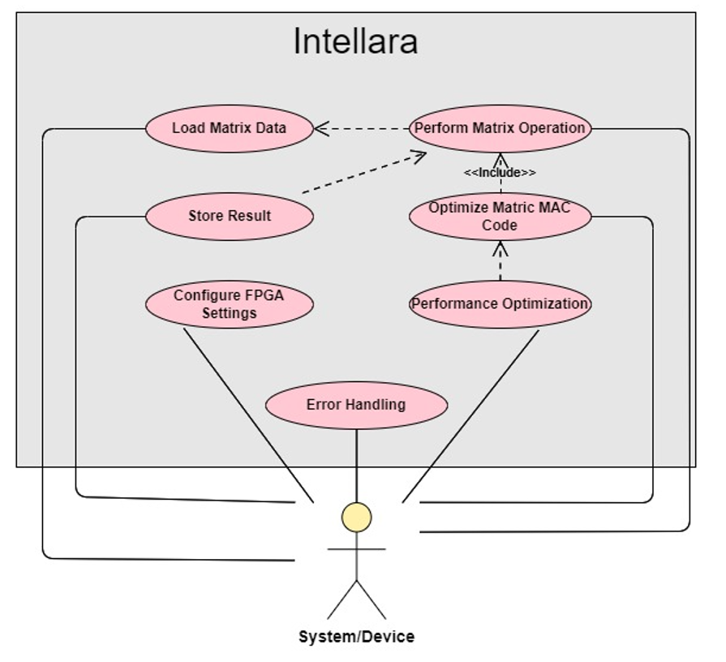
Use Case Diagram

Slide 13
Feature Set Matrix
Feature / Use Case | Priority of Development | Dependencies
Load Matrix Data | High | None
Perform Matrix Operation | High | Load Matrix Data
Store Result | High | Perform Matrix Operation
Configure FPGA Settings | Medium | None
Optimize Matrix MAC Code | Medium | Perform Matrix Operation
Error Handling | Medium | All Features
Performance Optimization | Low | Optimize Matrix MAC Code

Slide 14

Any other external requirements
Regulatory Compliance
Customer/Stakeholder Expectations
Resource Constraints
Interoperability
Environmental Factors
Supplier Dependencies
Intellectual Property
Safety & Compliance
Ethical & Social Considerations
Documentation & Reporting

Slide 15
Project Design
Notes:
Heading slide

Slide 16
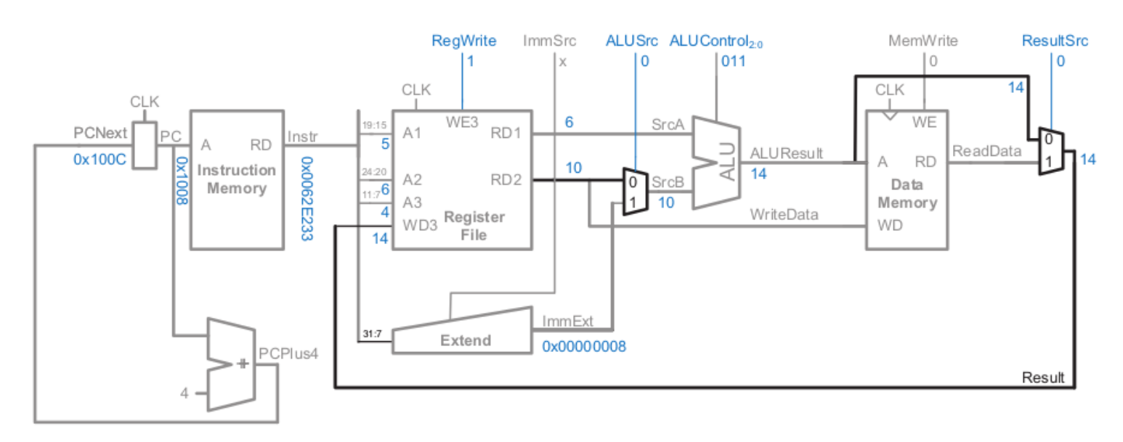
System Architecture
Notes:
Will be elaborated using animation

Slide 17
Different UML Diagrams
Class Diagrams
Sequence Diagrams
Activity Diagrams
State Transition Diagrams
Component Diagrams
ER Schema / Relational Schema
Notes:
Only need to create a component diagram In this

Slide 18
COMPONENT DIAGRAM
Verilog Code Implementation
Inst. Assembly code
Risc-V
Online
Simulator
Vivado
Schematics
FPGA Implementation
Digital US Schematics
Generator
FPGA Board

Slide 19
Project Management

Slide 20
Project Management Tool - JIRA
Benefits:
Issue Tracking
Custom Workflows
Agile Planning
Documentation Management
Integration Capabilities
Reporting and Dashboards
Release Management
Collaboration Features
Customization Options
Key Points:
Streamlined task and issue management.
Customized workflows to match project processes.
Agile planning using Scrum or Kanban boards.
Organized project documentation.
Seamless integration with other tools.
Real-time reporting and visualization.

Slide 21
Project Repository - GITHUB
Link: https://github.com/theuppercaseguy/FYP--Risc-V-32-bit-Matrix-Mac

Slide 22
Division of Tasks
Assigned Responsibilities
Team Members:
Saad Khan
Mahnoor Maleeka
Zaeem Shakir
Saad Khan:
RISC-V Processor Architecture
Matrix MAC Instruction Module
Hazard’s Solution
Project Management (Jira and GitHub)
Mahnoor Maleeka:
RISC-V Processor Architecture
Pipeline Design
Testing and Verification
Documentation
Zaeem Shakir:
RISC-V Processor Architecture
Matrix MAC Instruction Module
FPGA Implementation
Performance Optimization

