Slide 1

INTELLERA: A Hardware Based Acceleration of Matrix MAC Processor
Team Members:
2020414 Saad Khan
2020487 Syed Zaeem Shakir
2020217 Mahnoor Maleeka
Supervisor: Dr Fahad Bin Muslim
Co-supervisor: Dr Taj Muhammad
Faculty of Computer Sciences and Engineering Ghulam Ishaq Khan Institute of Engineering Sciences and Technology, Pakistan
Notes:
1

Slide 2
Evaluation Criteria
PLO 3 | Design/Development of Solutions
PLO 4 | Investigation
Rubrics | PLO3 | PLO4 | - | Marks
Requirements Gathering Methodology |  | ✓ |  | 5
Requirements Specifications |  | ✓ |  | 10
Proposed Design | ✓ |  |  | 10
Requirements were mapped to the design adequately | ✓ |  |  | 5
Division of Tasks / Use of Project Management Tools | - | - | ✓ | 10

Slide 3

Recap
Significance: Matrix MAC FPGA Acceleration
Defense: Speed, Efficiency, Breakthroughs
Benefits: Faster, Greener, Game-Changer
Conclusion: Innovation in High-Performance Computing

Slide 4
Introduction / Problem Statement
Introduction: RISC-V FPGA Matrix MAC
Problem: Speeding Up Matrix Operations
Challenge: Efficiency & Performance
Objective: Innovative FPGA Solution

Slide 5
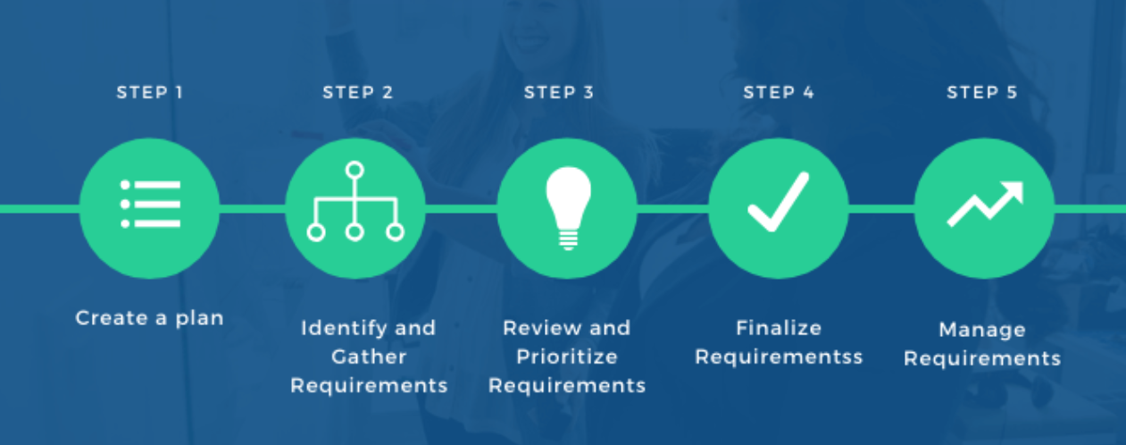
Requirements Gathering Methodology

Slide 6
Requirements Elicitation Technique(s) Followed
Literature Review: Studied past research papers.
Benchmarking Data: Studied past work.
Consultations: consulted Different professors working in the same field
Brainstorming: Detailed discussions on our project.
Notes:
Elaborate with example(s) from your project

Slide 7
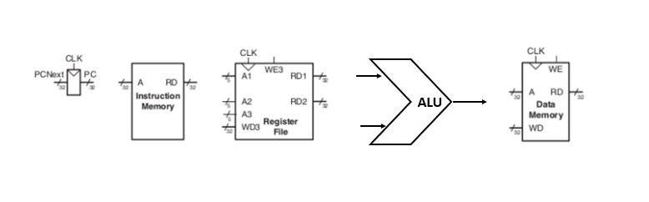
Previous Designs

Slide 8
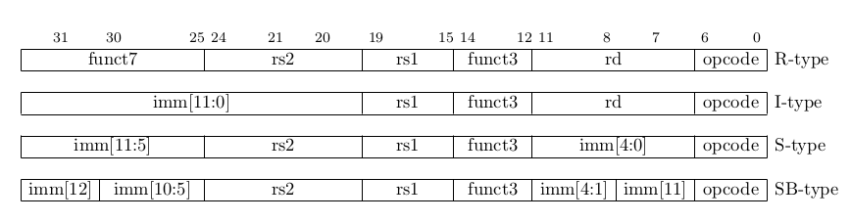
Type of Instructions
R-Type
I-Type
S-Type
B-Type

Slide 9
Project - Assumptions & Constraints
Assumptions: Clear ISA Understanding
Constraints: FPGA Resource Limitations
Guiding: Design and Implementation

Slide 10
Requirements Specifications

Slide 11
FUNCTIONAL REQUIREMENTS
Custom ISA
Matrix MAC Intr.
Pipelining
Instruction Parallelism
FPGA Implementations

Slide 12
NON- FUNCTIONAL REQUIREMENTS
Power Efficiency
Performance
Scalability
Compatibility

Slide 13
Context Diagram / High Level Block Diagram
FPGA Board
Processor
MATRIX
MAC
INPUT
DATA
OUTPUT
DATA
RISC-V
Processor

Slide 14
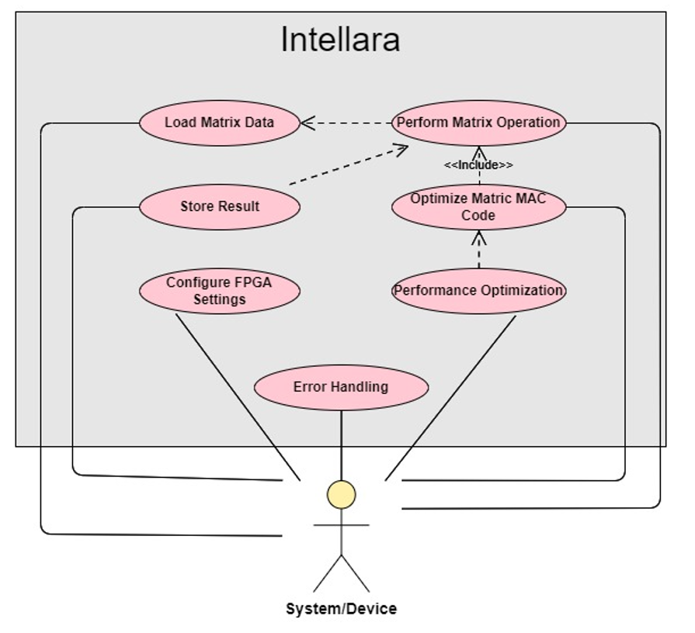
Use Case Diagram

Slide 15
Feature Set Matrix
Feature / Use Case | Priority of Development | Dependencies
Load Matrix Data | High | None
Perform Matrix Operation | High | Load Matrix Data
Store Result | High | Perform Matrix Operation
Configure FPGA Settings | Medium | None
Optimize Matrix MAC Code | Medium | Perform Matrix Operation
Error Handling | Medium | All Features
Performance Optimization | Low | Optimize Matrix MAC Code

Slide 16

Any other external requirements
Regulatory Compliance
Customer/Stakeholder Expectations
Resource Constraints
Environmental Factors
Supplier Dependencies
Intellectual Property
Safety & Compliance
Ethical & Social Considerations
Documentation & Reporting

Slide 17
UML Diagram’s
Notes:
Only need to create a component diagram In this

Slide 18
COMPONENT DIAGRAM
Verilog Code Implementation
Instr. Assembly code
Risc-V
Online
Simulator
Vivado
Schematics
FPGA Implementation
Digital US Schematics
Generator
FPGA Board

Slide 19
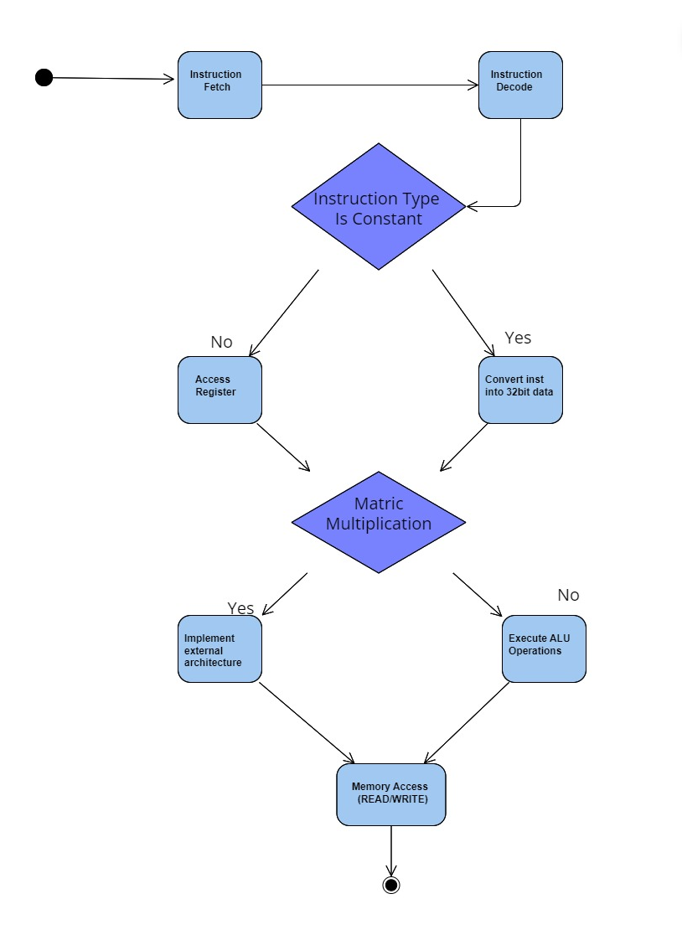
STATE/ACTIVITY DIAGRAM

Slide 20

Project Design

Slide 21
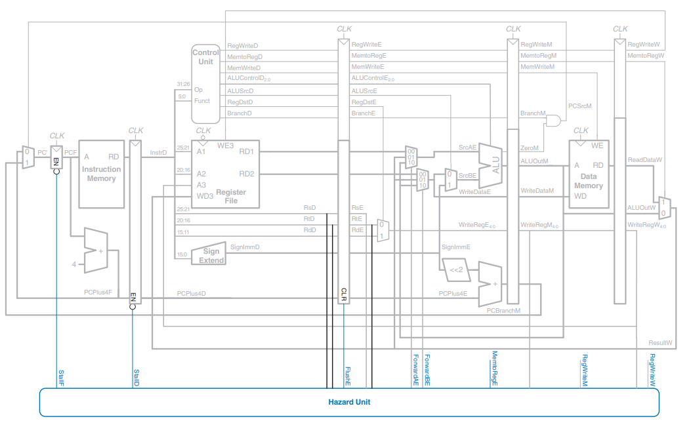
Proposed Design
Matrix
MAC
Notes:
It will be changed and modified a little bit

Slide 22
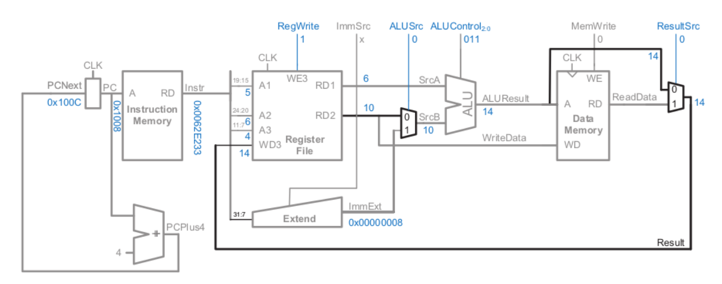
Animation of a single cycle processor
Animated slide of single cycle processor

Slide 23
Project Management

Slide 24
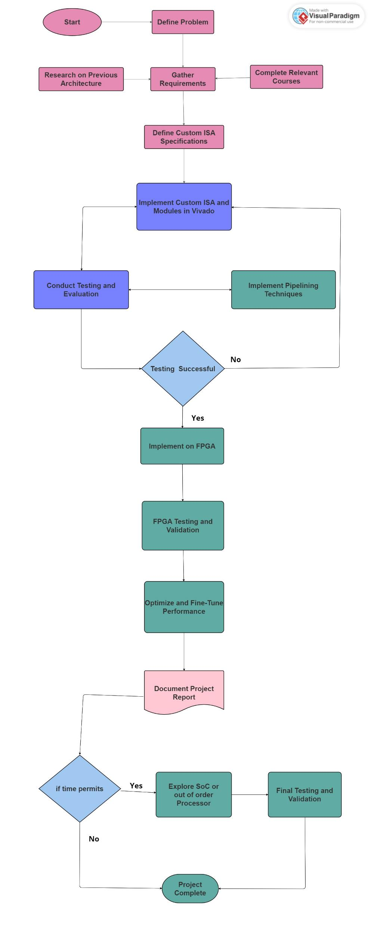
Workflow Chart

Slide 25
Division of Tasks
Assigned Responsibilities
Team Members:
Saad Khan – Team Lead
Mahnoor Maleeka
Zaeem Shakir
Saad Khan:
RISC-V Processor Architecture
Pipeline Implementation
Matrix MAC Instruction Module
Hazard’s Solution
Project Management (Jira and GitHub)
Mahnoor Maleeka:
RISC-V Processor Architecture
Pipeline Design
FPGA Implementation
Testing and Verification
Documentation
Zaeem Shakir:
RISC-V Processor Architecture
Matrix MAC Instruction Module
FPGA Implementation
Performance Optimization
GitHub Management

Slide 26
Project Management Tool - JIRA
Pictures to be added + Link

Slide 27
Project Repository - GITHUB
Link: https://github.com/theuppercaseguy/FYP--Risc-V-32-bit-Matrix-Mac

Slide 28

Thank You

